Slide 1
MAJIS Scientific Performances (update from CDR)
Gianrico Filacchione, Federico Tosi, John Carter, Davide Grassi, Yves Langevin, Francois Poulet, Irene Guerri, Claudia Ruiz de Galarreta, Cydalise Dumesnil, Giuseppe Piccioni

Slide 2
MAJIS Scientific Objectives
MAJIS is designed to perform imaging spectroscopy in the spectral range from 0.50 to 5.54 μm for a comprehensive achievement of the following scientific goals:
-investigation of the nature and location of chemical compounds (especially organic and non-ice constituents) on the surfaces of the Galilean satellites;
-characterization of the Galilean satellites exospheres;
-monitoring of peculiar aspects (Io and Europa torii, Io's volcanic activity);
-study of Jupiter's atmosphere at different levels (including aurorae and magnetic footprints)
-spectral characterization of the whole Jupiter system (including ring system, small inner/outer moons, and targets of opportunity if any).

Slide 3
Characterization and Mapping of Satellite composition
Icy materials
Water ice is the dominant component of the surface of Ganymede, Europa and Callisto. CO2 ice has also been observed on the three icy Galilean satellites, with increasing signature strengths moving outward from Europa to Callisto. The CO2 ice signatures are strongest on the leading hemisphere of Europa (Smythe et al., 1998, McCord et al., 1998a; Hansen and McCord, 2009), in the dark regiones of Ganymede (Hibbits et al., 2009) and in impact features (basins and craters) on Callisto (Hibbits et al., 2002). Several processes may therefore be involved, such as the radiolysis of dark carbonaceous meteoritic deposits. Solid O2 (Spencer et al., 1995) and solid O3 (Noll et al., 1996) are present on the trailing hemisphere of Ganymede, with stronger signatures of O3 at high latitudes (Hendrix et al., 1999), so that exogenic processes such as ionic bombardment of the icy surface are likely to play a major role. SO2 has been observed on Callisto with significant spatial variability at global and local scales (Hibbits et al., 2000). On Europa, SO2 concentration is highest on the trailing hemisphere (Hendrix et al., 1998, 2011). An exogenic formation process was proposed (implantation of sulfur ions from Io’s plasma torus, Lane et al., 1981) but it was not supported by laboratory simulations (Strazzulla et al., 2007).

Slide 4
Characterization and Mapping of Satellite composition
Hydrated compounds, Acids and Organic Matter
Hydrated compounds have been identified on the icy Galilean satellites, with the largest concentrations matching the dark regions (McCord et al., 1998b, 1999). When deriving compositional constraints, one has to take into account the role of grain size and temperature on spectral features of hydrated salt minerals (e.g. Dalton, 2003, Dalton et al., 2005, De Angelis et al., 2017). Hydrated salt minerals enriched in Mg and Ca could have an endogenic origin, in line with the formation models of Europa and Ganymede (McCord et al., 2002, Dalton et al., 2005). Exogenic processes have been proposed for hydrated sulphuric acid (Carlson et al., 1999b). The presence of Mg-bearing chlorinated salts has recently been supported by spectroscopic observations in the near-IR with the VLT (Ligier et al., 2016).
The detection and characterization of organic compounds and related products (carbonates, tholins) is of clear interest for the exobiology objectives of the JUICE mission. Detections have been reported for Ganymede and Callisto (McCord et al., 1997, 1998; Hibbitts et al., 2003) while there is as yet no reliable detection of organic compounds on Europa, a prime candidate for exobiology. The spatial distribution of organic compounds which will be investigated by MAJIS will provide major clues on their endogenic or exogenic origin (e.g. photolysis of O2, Hall et al., 1998, Calvin et al., 1996, Spencer et al., 1995).

Slide 5
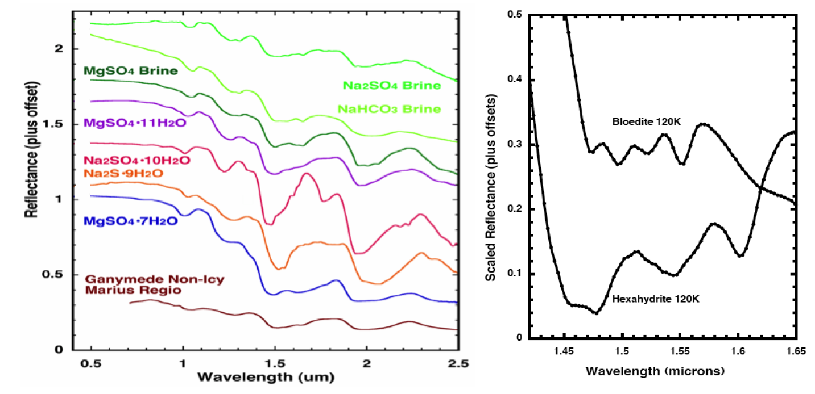
Hydrated Minerals and Brines
Dalton (2003)

Slide 6
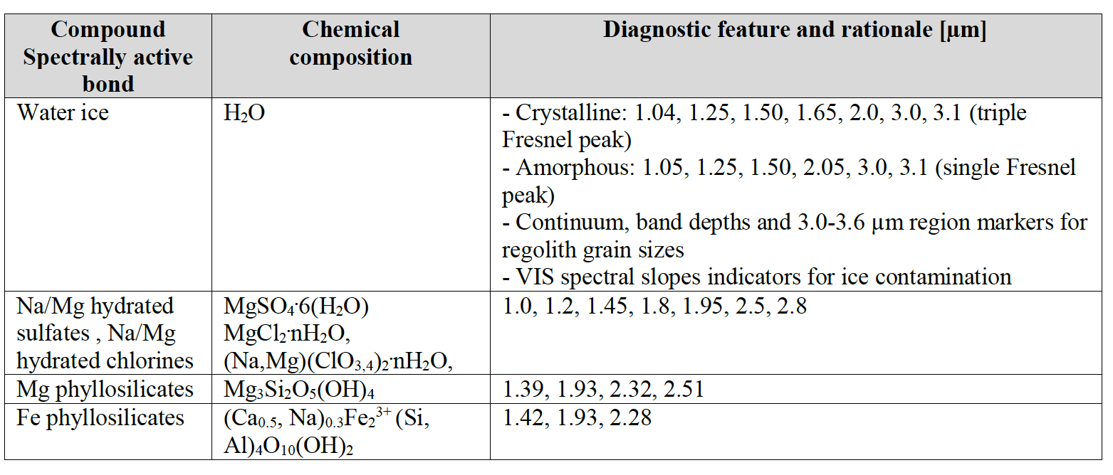
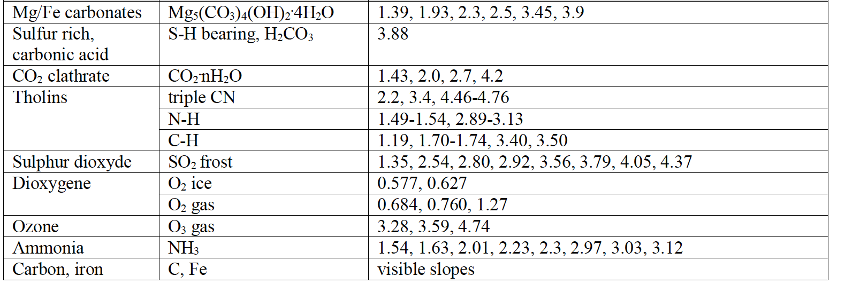

Slide 7
Satellites’ exospheres
The four Galilean satellites are known to have thin atmospheres (McGrath et al., 2004), and their properties are indicative of surface processes and composition. For example, Ganymede has a thin O2 atmosphere and a hydrogen exosphere. At Callisto, NIMS discovered a tenuous carbon dioxide exosphere from the 4.27 µm non-local thermodynamic equilibrium (non-LTE) emission, with an estimated surface pressure of 7.5E-12 bar and a temperature of about 150 K, close to the surface temperature (Carlson et al., 1999a); Callisto is also expected to have a significant O2 atmosphere, which has not been yet detected. The superthermal electron collisions on oxygen molecules are expected to produce observable O2 (a1Δg -> X3Σg-) emissions at 1.27 and 1.58 m. Spectral imaging of Ganymede’s aurorae as well as stellar occultations in the VIS-IR range are also foreseen to complement similar observations carried out in the UV domain.
Recently, HST UV observations of Lyman-α and OI emissions around Europa have been reported and interpreted as tracers of 200 km high plumes of water vapour emanating from its surface (Roth et al., 2014). Subsequent observations at similar latitude and intensity would suggest the process is recurring (Sparks et al., 2016).

Slide 8
Io, rings and small satellites
While close fly-bys of JUICE with Io are not envisaged, remote sensing observations of volcanic active Io carried out from distance are a feasible goal for MAJIS. These observations are suitable to monitor the volcanic activity of Io, its hemispheric thermal emission (currently known with a relatively large uncertainty), and determine the composition of different materials on the surface at regional scale (50-200 km/px) as well as their volatile cycle. Periods close to the two Europa fly-bys will provide the best spatial resolution for these observations.
Jupiter’s ring system is faint and consists mainly of micron-sized dust (Showalter et al., 2008). To characterize the physical and chemical properties of the ring system, VIS-IR mapping of the ring particles’ composition and photometric behaviour of the entire ring system is required in 3D and in a wide range of solar phase angles (including <10° and >170°).
Moreover, infrared remote sensing will contribute to unveil the bulk composition of the small regular satellites revolving between 1.8 and 3.1 RJ (at least the largest objects, Thebe and Amalthea), allowing one to confirm them as sources or sinks of the ring particles.

Slide 9
Jupiter Science: Upper Atmosphere
MAJIS spectral range covers the H3+ emissions around at 3.67 µm that are strongly enhanced in the Jovian aurora (Drossart et al., 1989). MAJIS observations will extend the Juno/JIRAM dataset (Adriani et al., 2008) which has observed the aurora main oval and satellites footprints (Mura et al., 2017) and compared auroral emission on both north and south polar regions (Adriani et al., 2017). The mapping capabilities of MAJIS are ideal to monitor the overall auroral activity and phenomenology of the polar atmosphere and to relate them with in situ measurements by the magnetometer and plasma/neutral packages.
The observations will also be coordinated with those of the UV and visible sensors to investigate the morphological differences between the instantaneous mapping of the incident particle flux (UV, Vis) and the slower atmospheric response of the H3+ emission. MAJIS stellar occultations by Jupiter’s disk will allow one to constrain the mixing ratio of methane in the stratosphere as well as the variability of air temperatures (Nicholson et al., 2006). In addition, observations of the nightside hemisphere will be of particular interest, for possible detections of lightings (Smith et al., 1979) and nightglow emissions.

Slide 10
Jupiter Science: Troposphere Dynamics
Cloud systems will be continuously monitored by synoptic tracking of features on wide regions of the planet. Particular attention will be devoted to the study of dynamical regimes associated with jet streams and associated oval structures (ciclones and anticiclones), like the ones recently observed by JIRAM (Sindoni et al., 2017), plumes and storms occurrence (Sanchez-Lavega et al., 2008).
• Wide spectral coverage of MAJIS will allow to compare the results at different altitudes (approximately between 0.6 and 7 bar, for ideal cloud-free conditions) providing an effective 3D dynamical scenario (West et al., 2004).
• The MAJIS range encompasses also the main diagnostic features of H2O, NH3 (2.73 µm) and NH4SH ices, providing – with the possible evidence of fresh particles – constraints on convective motions (Baines et al., 2002).

Slide 11
Jupiter Science: Aerosols properties
Large data volume and a high number of spectral sampling points in MAJIS data will allow the effective application of statistical analysis methods – such as principal component analysis and various classification schemes – for detection of subtle differences in aerosol properties, with special attention on the nature of chromophores. The extension of the spectral range to wavelengths shortward of 2 m (the Juno/JIRAM lower limit) will allow MAJIS to set better constraints on the composition and size distribution of different cloud decks, by means of comparison of radiances observed in several CH4 spectral windows and observations of the same region at different phase angles (Sromovsky & Fry, 2002). JUICE orbit will enable observations in a variety of zenith angles absent in NIMS or VIMS data, which will eventually better constrain the upper tropospheric and stratospheric hazes, and thus their origin. This information will eventually provide a more robust experimental scenario for condensation and photochemical phenomena originating aerosols. Further constraints on the aerosol properties at higher altitudes will be derived from the modelling of star extinction during occultation measurements.

Slide 12
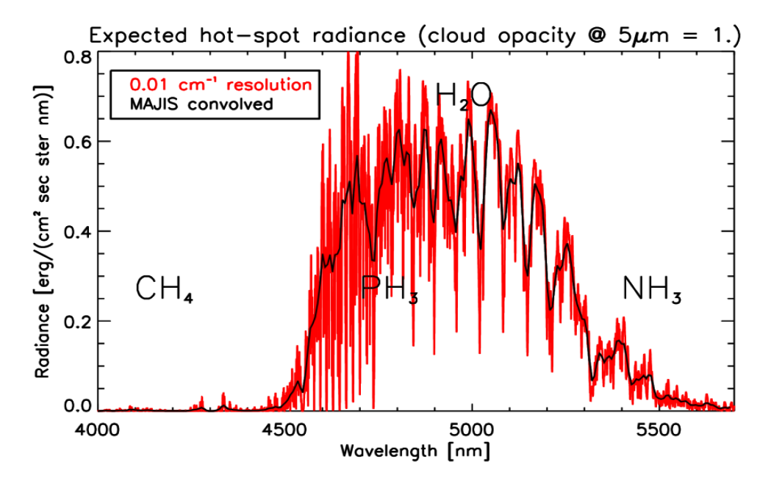
Jupiter Science: Hot Spots
Observations in the 5 m atmospheric window of relatively cloud-free regions provide insights on the bulk composition of Jupiter's atmosphere below the level of the main NH4SH cloud deck , approximately down to the 7-bar level.
JIRAM on JUNO has successfully observed hot spots in the 4-5 μm spectral range and determined the mean mixing ratios of water, ammonia and phosphine at the approximate level of few bars within them (Grassi et al., 2017).

Slide 13
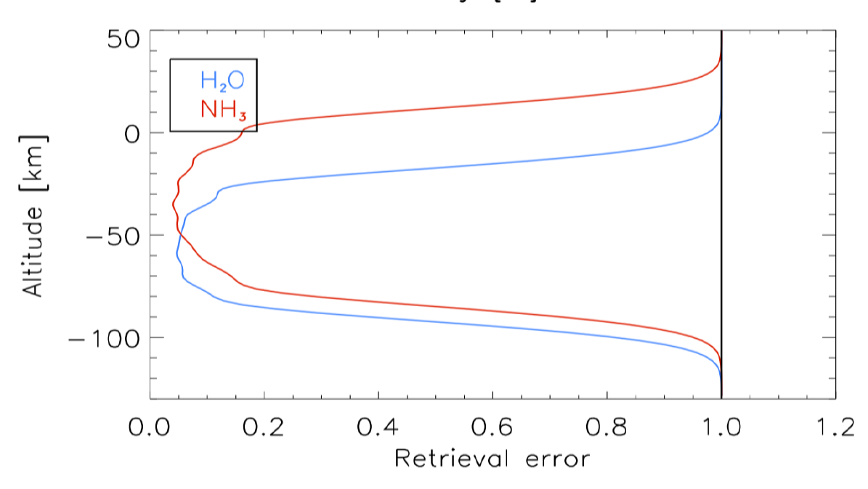
Jupiter Science: NH3-H2O retrieval from Hot Spots
Contents of NH3 and H2O are of particular interest for the constraints they provide on the formation scenarios of giant planets. PH3 – a disequilibrium species – can also be monitored with MAJIS data and used as tracer for the circulation in the Jovian troposphere (Irwin et al., 1998; Fletcher et al., 2009). Thanks to the substantially higher data volume available w.r.t. the NIMS and JIRAM datasets, variability of aerosols and gaseous contents in hot spot regions will be extensively monitored in space as well as on different time scales, providing a statistical assessment of the representativeness of hot spots as samples of general conditions of the deep atmosphere. Very important is
the 5.0-5.54 μm MAJIS spectral range (significantly beyond the 5.0 m JIRAM upper limit), that enables a better coverage of gaseous H2O and NH3 bands, with increased vertical resolution and coverage. Namely, this extension allows one to probe the altitude ranges where NH4SH and NH3 clouds condensation is expected to occur.

Slide 14
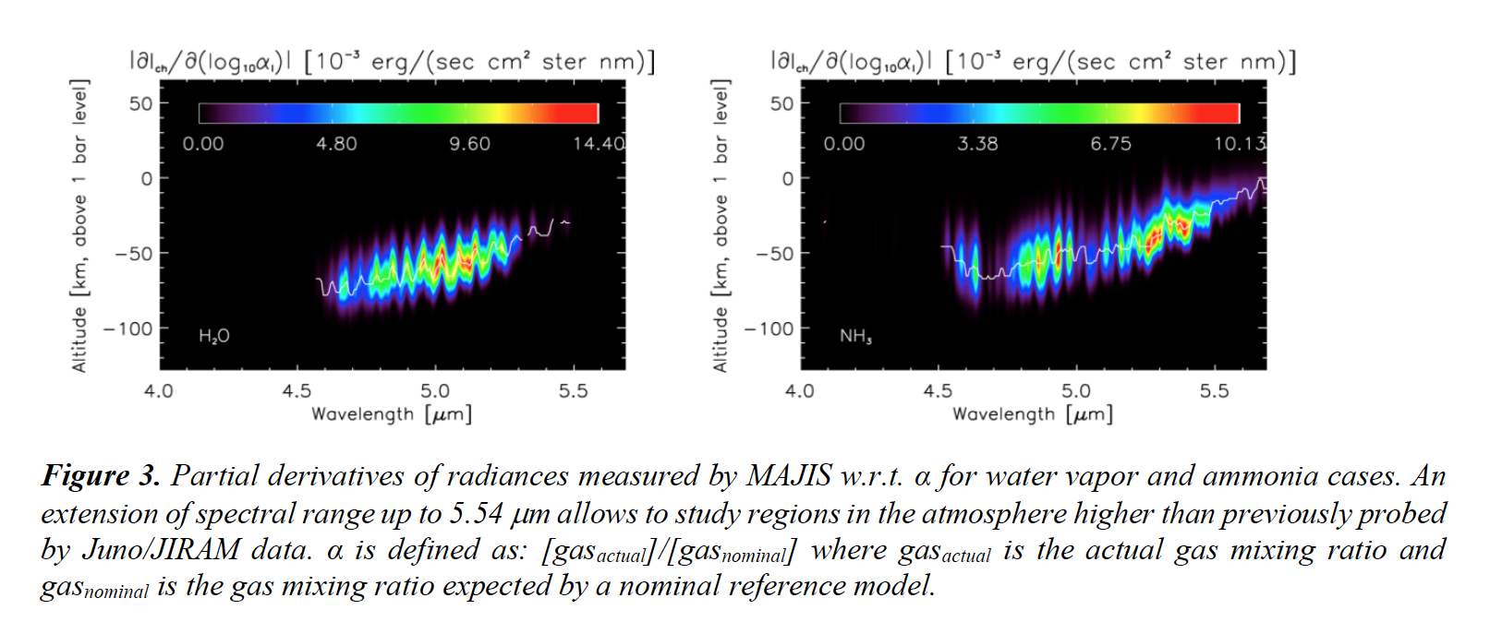
Extension of MAJIS spectral range to 5.54 µm

Slide 15
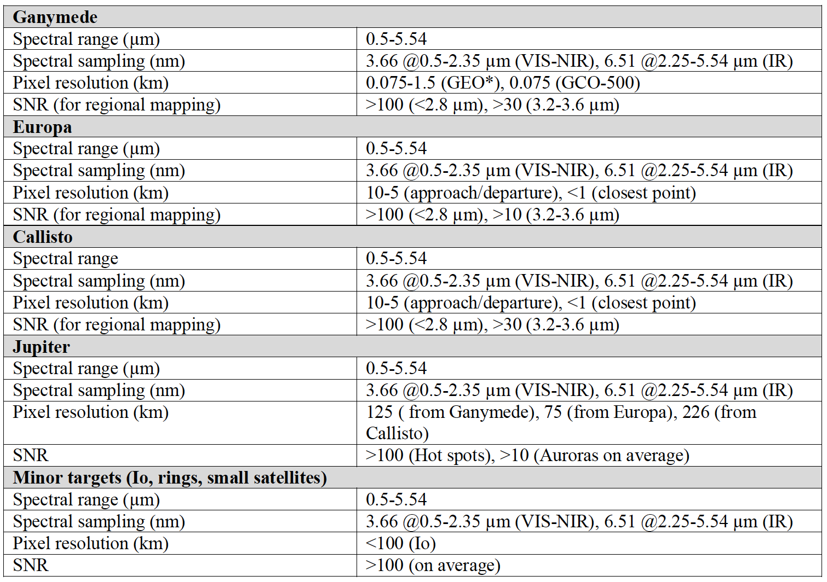
Summary of MAJIS scientific performances requirements

Slide 16
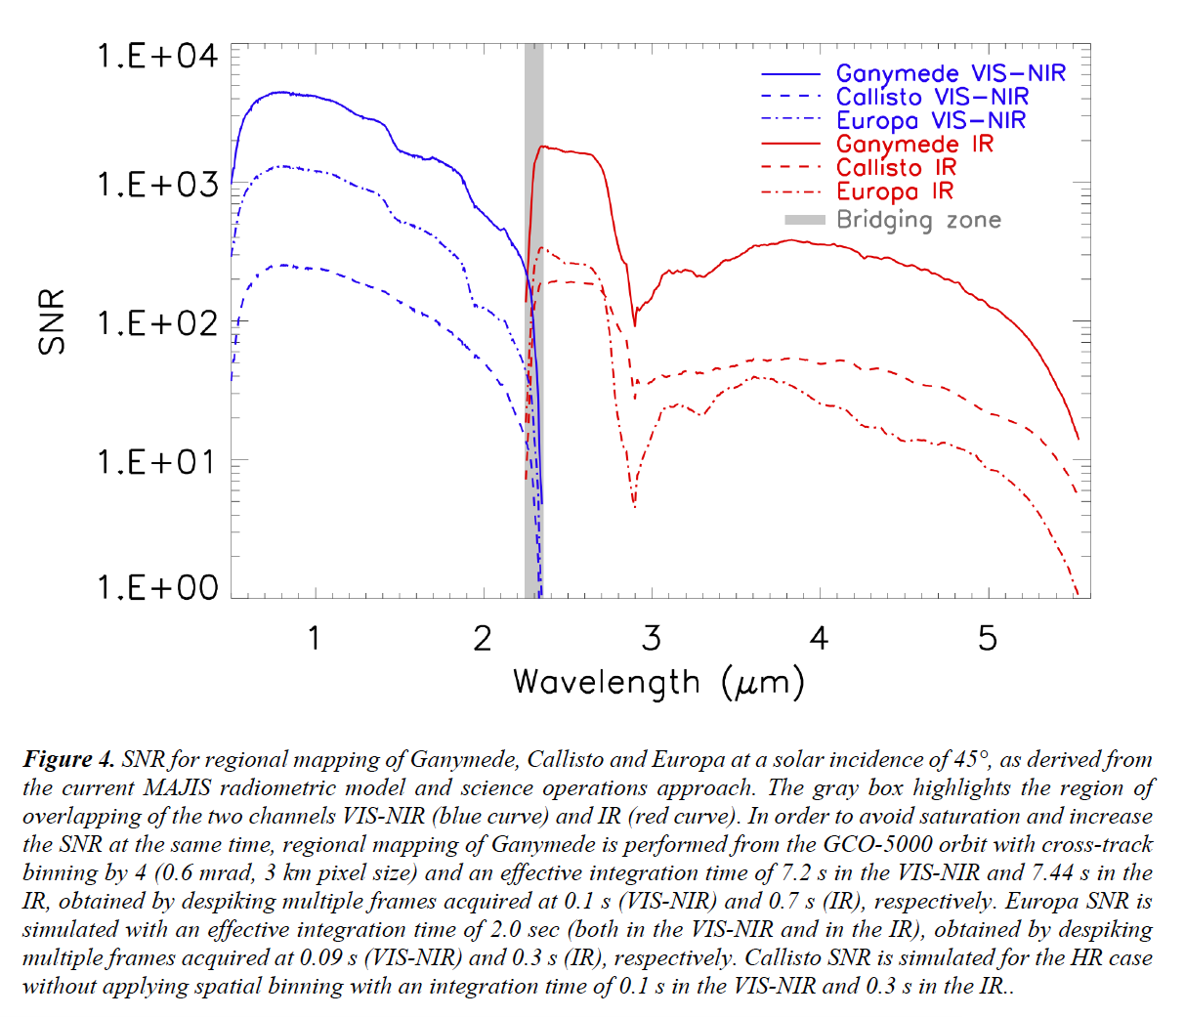
SNR simulations for Satellites

Slide 17
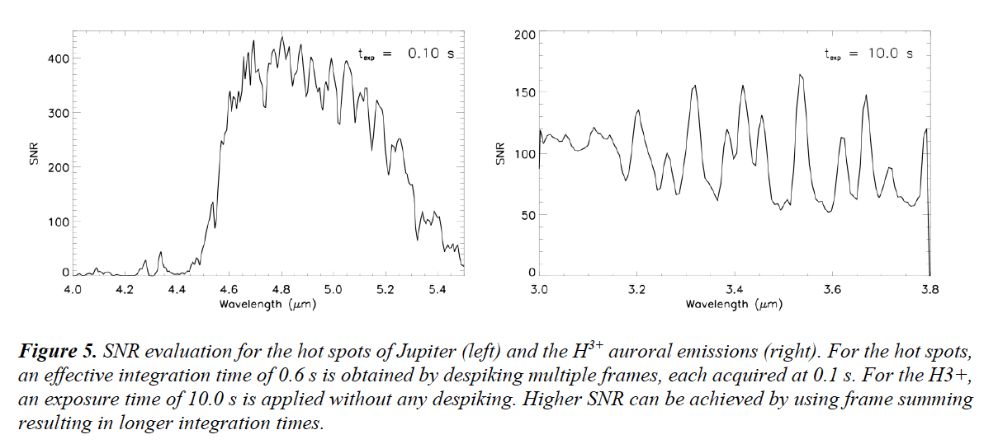
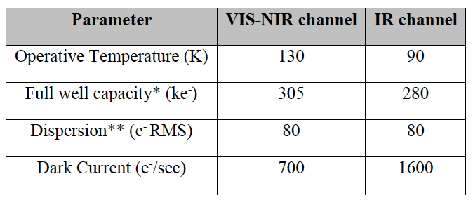
SNR simulations for Jupiter Hot Spot-Aurora
Nominal detectors parameters
for simulations

Slide 18
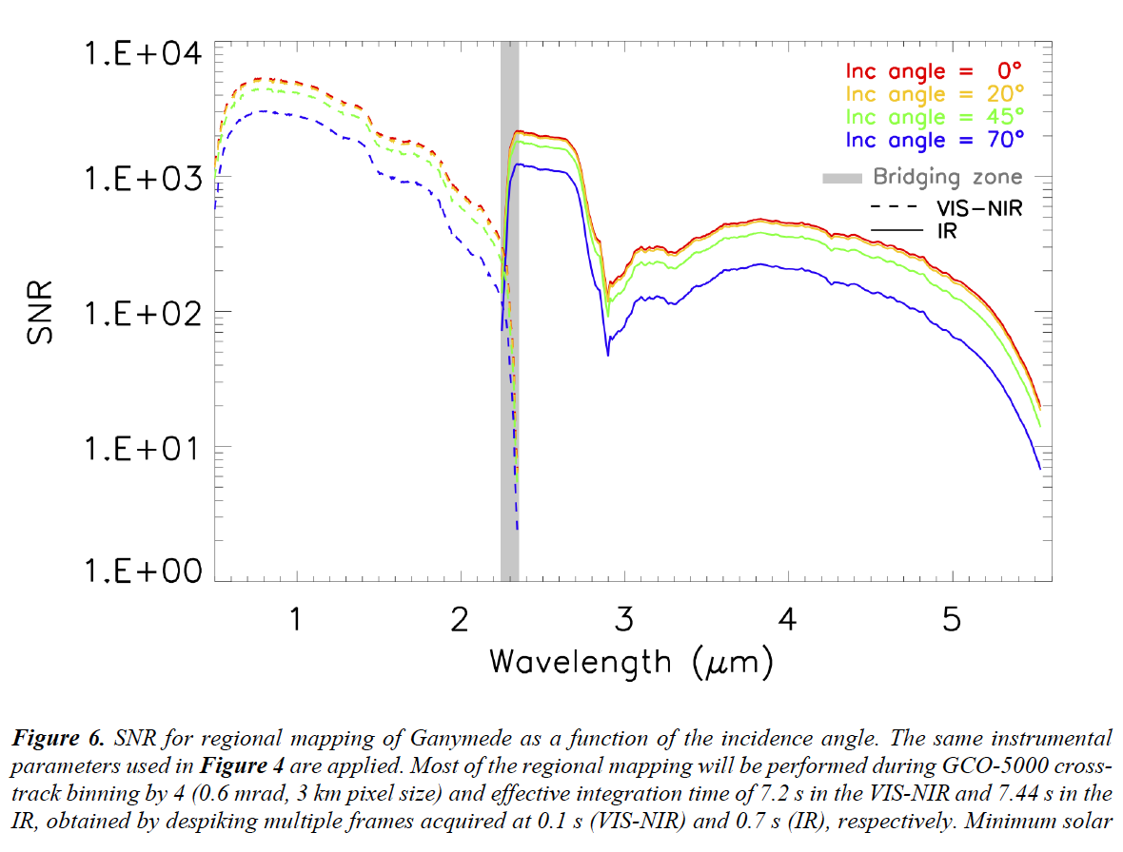
SNR simulations for Ganymede vs. incidence angle

Slide 19
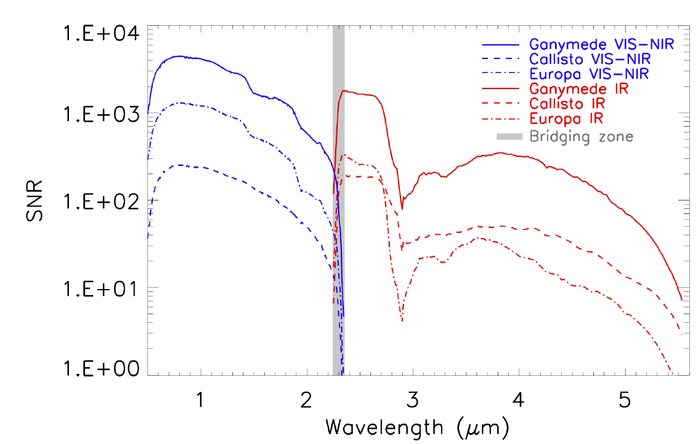
SNR simulations for Satellites vs. MAJIS temperature
Nominal temperature case
VISNIR detector T=130K
IR detector T=90 K
High temperature case
VISNIR detector T=140K
IR detector T=94 K

Slide 20
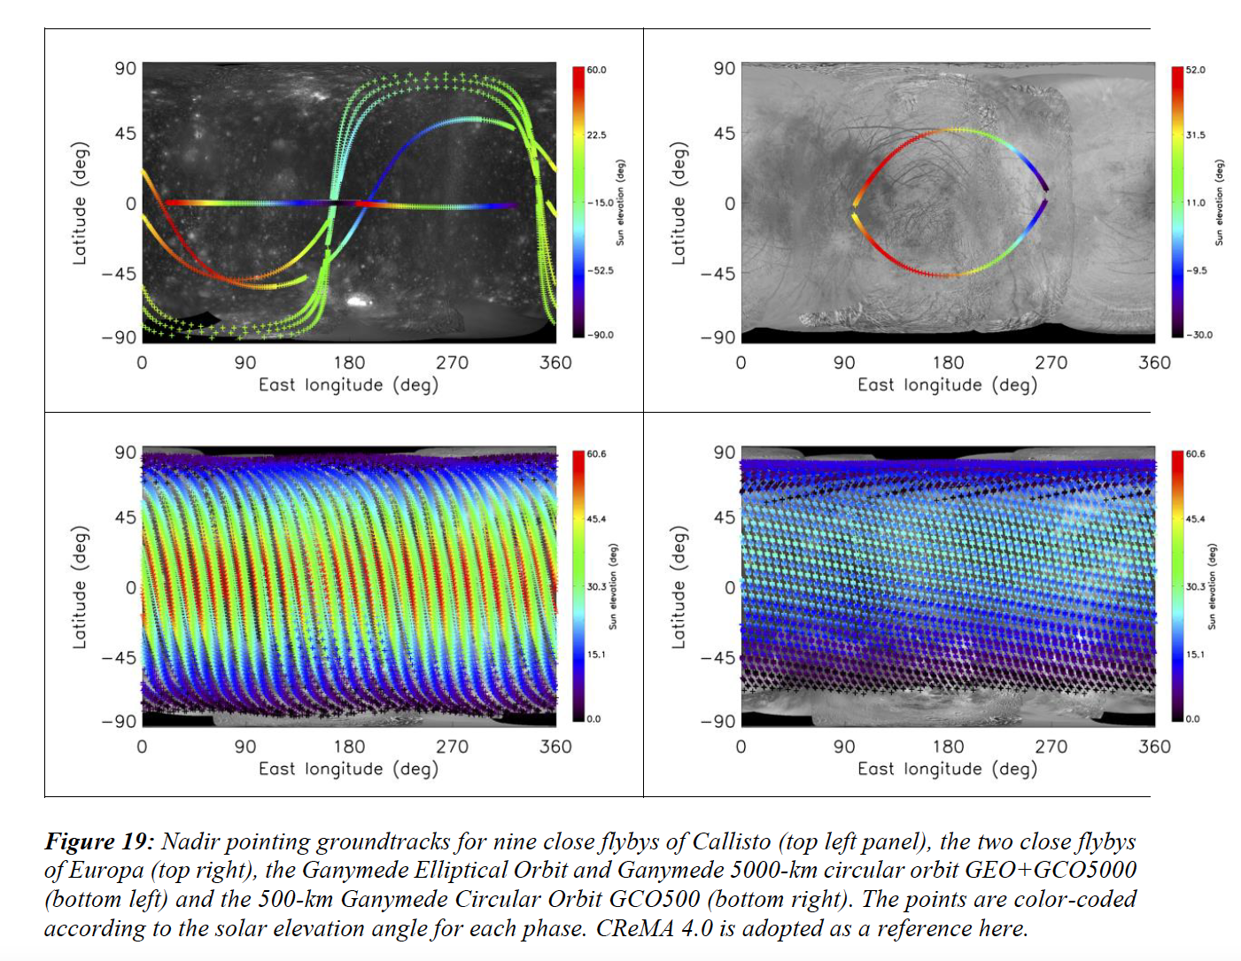
Satellites estimated coverage

Slide 21
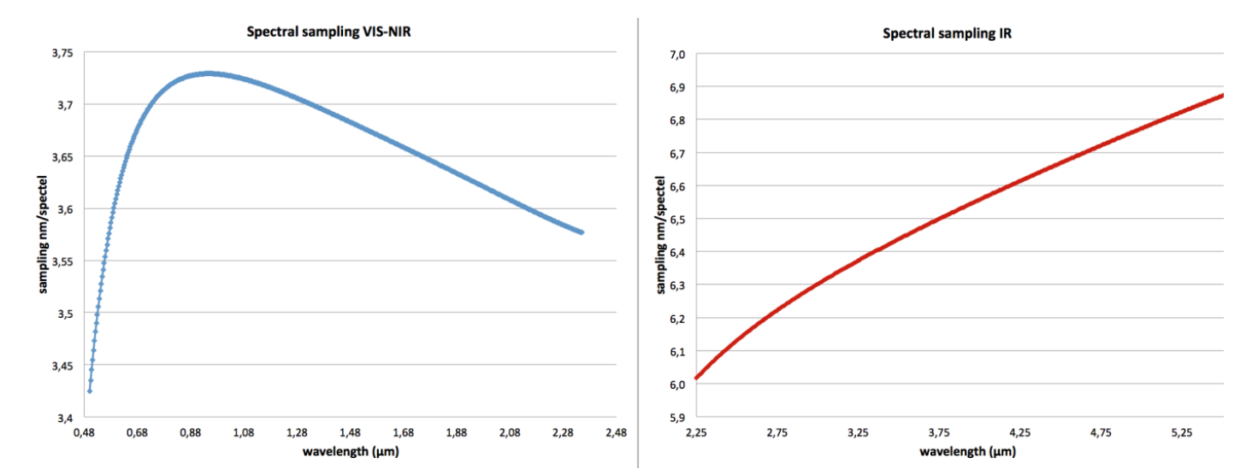
MAJIS Optical Performances: spectral sampling

Slide 22
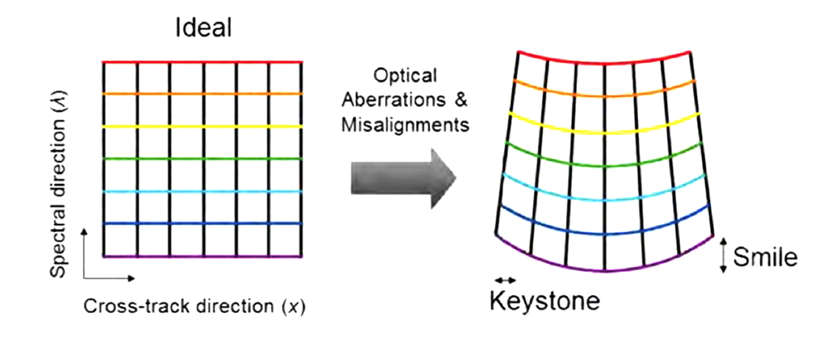
MAJIS Optical Performances: smile

Slide 23
MAJIS Optical Performances: keystone

Slide 24
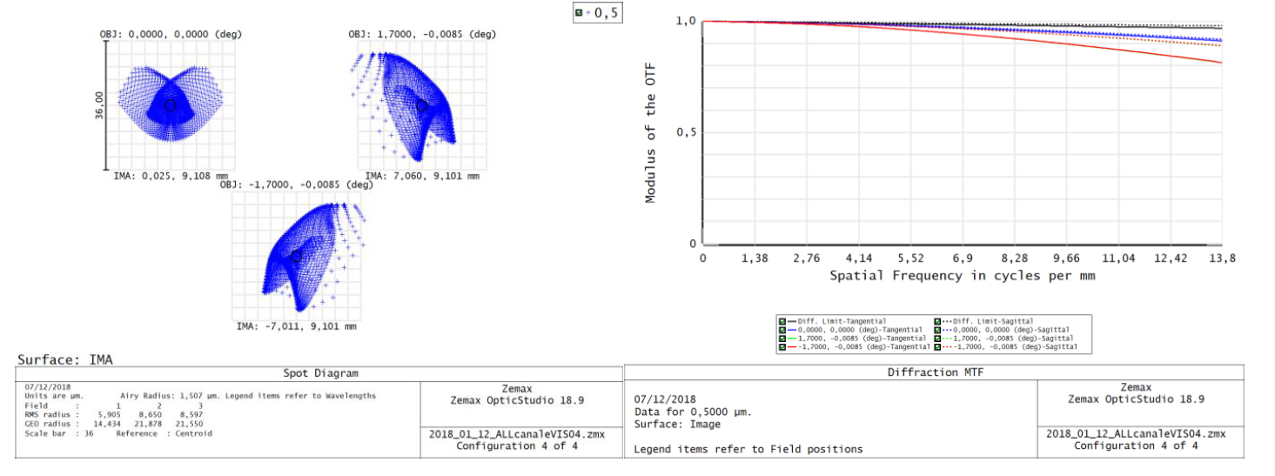
MAJIS-VISNIR Spot diagram and MTF at 0.5 µm

Slide 25
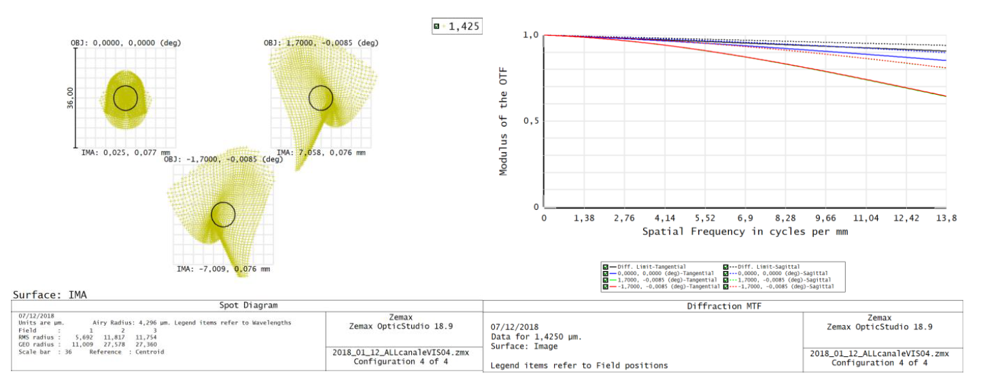
MAJIS-VISNIR Spot diagram and MTF at 1.425 µm

Slide 26
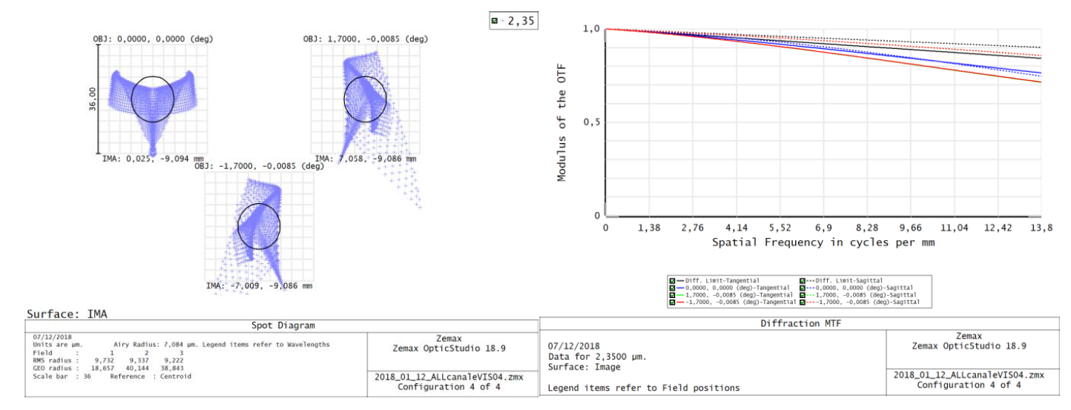
MAJIS-VISNIR Spot diagram and MTF at 2.35 µm

Slide 27
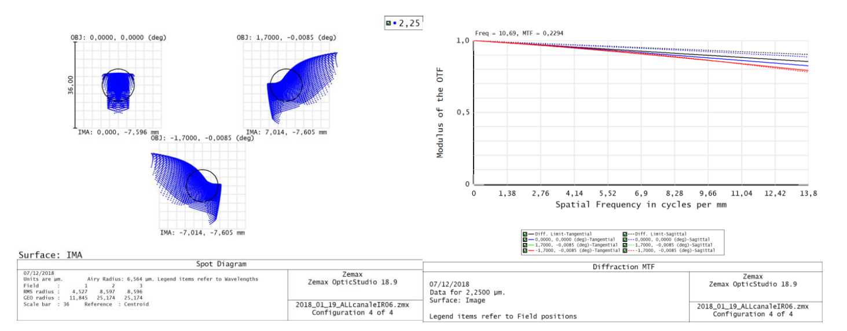
MAJIS-IR Spot diagram and MTF at 2.25 µm

Slide 28
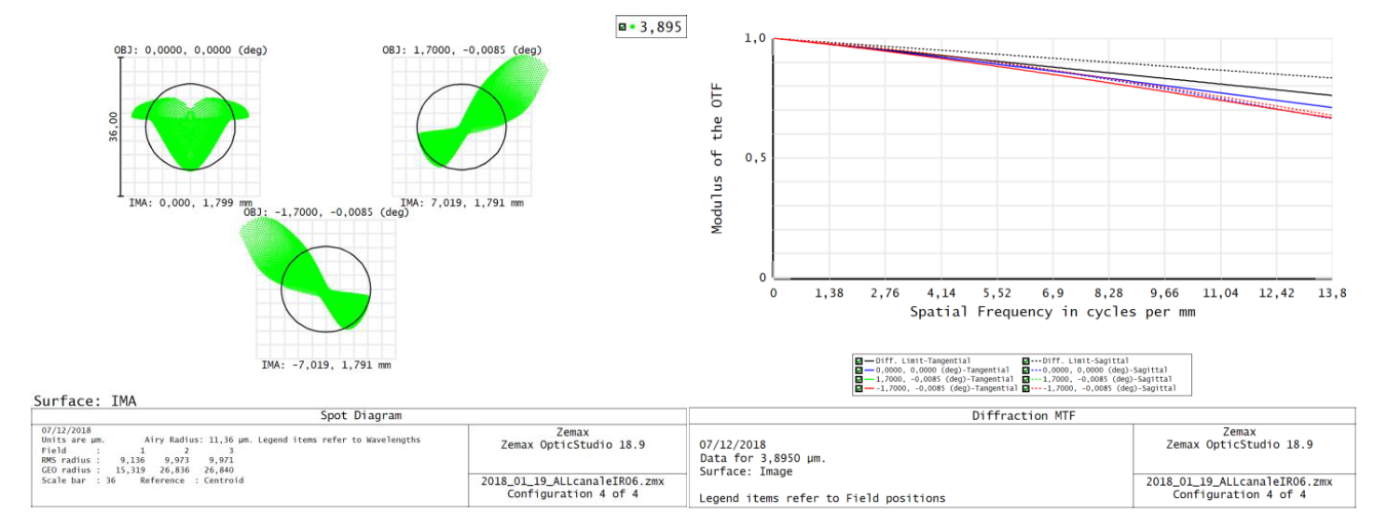
MAJIS-IR Spot diagram and MTF at 3.895 µm

Slide 29
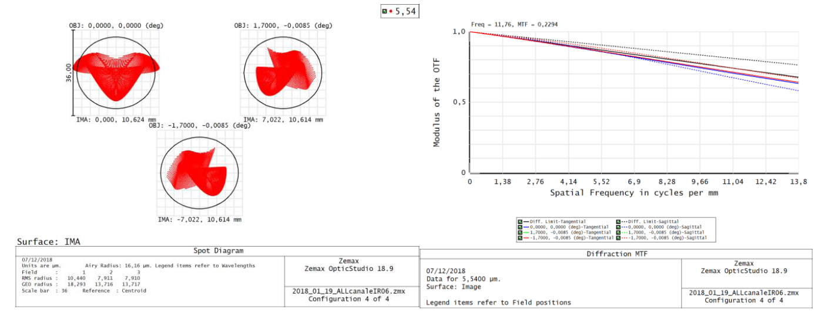
MAJIS-IR Spot diagram and MTF at 5.54 µm

