Slide 1
MAJIS calibration setup: meeting the requirements
P. Guiot, B. Lecomte, M. Vincendon, J. Carter, F. Poulet, C. Dumesnil and the MAJIS technical team

Slide 2
Measurement | Criteria | Comments
Boresight wrt ref cube | < 18 µm
Co-alignement VISNIR-IR | < 18 µm
Scanning mirror accuracy | < 30 µrad
FOV | < 150 µrad
IFOV | < 75 µrad
Spatial PSF | < 30 µrad
Spectral PSF | < 1/5 spectel | Planned on selected λs only
Spectral positions | < 1/5 spectel | All λs
Straylight | Contrast 10⁵ Exploration ± 10°
Linearity | Deviation < 2%
ITF absolute | Absolute errors < 20%
Flat-Field | σ < 1% wrt average FOV
Instrument relative spectral response | σ max (2 – 10 spectels) < 1% | Initial requirement: contiguous spectels only
ME-PE parameters | -
Science verification samples | - | Planned with gas cells, maybe one mineral or icy sample
Polarization response | - | Not planned

Slide 3


Boresight with respect to reference cube: back and forth spot illumination between detectors and cube
Flux requirement: SNR > 10 with 100 W QTH and CI Systems SR-200 32 blackbody through monochromator at zero order
Spatial precision: hexapod performances ~ 10 µm
Spatial coverage: 20 pixels
Spectral coverage: full VISNIR range with QTH source, two blackbody temperatures needed for IR full coverage with sufficient SNR / no saturation
Co-alignment between channels is performed with the same data by extracting channels position differences
Optical path # 1 (OP1)
TVC
Closed optical bench with GN2 flush
Toward MAJIS and hexapod
M3
G1
G2
G3
M1
Blackbody
iHR550
M2
QTH

Slide 4
Measurement | Criteria | Comments
Boresight wrt ref cube | < 18 µm
Co-alignement VISNIR-IR | < 18 µm
Scanning mirror accuracy | < 30 µrad
FOV | < 150 µrad
IFOV | < 75 µrad
Spatial PSF | < 30 µrad
Spectral PSF | < 1/5 spectel | Planned on selected λs only
Spectral positions | < 1/5 spectel | All λs
Straylight | Contrast 10⁵ Exploration ± 10°
Linearity | Deviation < 2%
ITF absolute | Absolute errors < 20%
Flat-Field | σ < 1% wrt average FOV
Instrument relative spectral response | σ max (2 – 10 spectels) < 1% | Initial requirement: contiguous spectels only
ME-PE parameters | -
Science verification samples | - | Planned with gas cells, maybe one mineral or icy sample
Polarization response | - | Not planned

Slide 5
Scanning mirror accuracy: differences between hexapod and scanning mirror movements
Flux requirement: SNR > 10 with 100 W QTH and CI Systems SR-200 32 blackbody through monochromator at zero order
Spatial precision: hexapod performances ~ 10 µrad
Spatial coverage: 20 pixels
Spectral coverage: full VISNIR range with QTH source, two blackbody temperatures needed for IR full coverage with sufficient SNR / no saturation
Optical path # 1 (OP1)
TVC
Closed optical bench with GN2 flush
Toward MAJIS and hexapod
M3
G1
G2
G3
M1
Blackbody
iHR550
M2
QTH

Slide 6
Measurement | Criteria | Comments
Boresight wrt ref cube | < 18 µm
Co-alignement VISNIR-IR | < 18 µm
Scanning mirror accuracy | < 30 µrad
FOV | < 150 µrad
IFOV | < 75 µrad
Spatial PSF | < 30 µrad
Spectral PSF | < 1/5 spectel | Planned on selected λs only
Spectral positions | < 1/5 spectel | All λs
Straylight | Contrast 10⁵ Exploration ± 10°
Linearity | Deviation < 2%
ITF absolute | Absolute errors < 20%
Flat-Field | σ < 1% wrt average FOV
Instrument relative spectral response | σ max (2 – 10 spectels) < 1% | Initial requirement: contiguous spectels only
ME-PE parameters | -
Science verification samples | - | Planned with gas cells, maybe one mineral or icy sample
Polarization response | - | Not planned

Slide 7
Spatial Point Spread Function: sub-pixel source scanning over whole detector
Flux requirement: SNR > 10 with 100 W QTH and CI Systems SR-200 32 blackbody through monochromator at zero order
Spatial precision: motorized diaphragm at monochromator exit to create 120 µm source = 1/5 pixel in spatial direction. Scanning over detectors handled by hexapod.
Spectral coverage: full VISNIR range with QTH source, two blackbody temperatures needed for IR full coverage with sufficient SNR / no saturation
FOV and IFOV measurements deduced from same data since full coverage of both detectors can be achieved in 5 days.
Back-up solution using 20 pixel-wide source edges can be considered.
Optical path # 1 (OP1)
TVC
Closed optical bench with GN2 flush
Toward MAJIS and hexapod
M3
G1
G2
G3
M1
Blackbody
iHR550
M2
QTH

Slide 8
Measurement | Criteria | Comments
Boresight wrt ref cube | < 18 µm
Co-alignement VISNIR-IR | < 18 µm
Scanning mirror accuracy | < 30 µrad
FOV | < 150 µrad
IFOV | < 75 µrad
Spatial PSF | < 30 µrad
Spectral PSF | < 1/5 spectel | Planned on selected λs only
Spectral positions | < 1/5 spectel | All λs
Straylight | Contrast 10⁵ Exploration ± 10°
Linearity | Deviation < 2%
ITF absolute | Absolute errors < 20%
Flat-Field | σ < 1% wrt average FOV
Instrument relative spectral response | σ max (2 – 10 spectels) < 1% | Initial requirement: contiguous spectels only
ME-PE parameters | -
Science verification samples | - | Planned with gas cells, maybe one mineral or icy sample
Polarization response | - | Not planned

Slide 9
Spectral Point Spread Function: 1/5 spectel source scanning over part of detectors
Flux requirement: SNR > 10 with 100 W QTH and CI Systems SR-200 32 blackbody through monochromator at zero order
Spatial coverage: 20 pixels monochromator slit
Spectral precision: 0.7 nm width for VISNIR range and 1 nm width for IR range
At least 2 QTH output powers and 4 blackbody temperatures will be needed to reach sufficient SNR at such narrow spectral widths.
Covering half the dectectors would take 7.5 days, full coverage might be considered to retrieve all spectral positions
Optical path # 1 (OP1)
TVC
Closed optical bench with GN2 flush
Toward MAJIS and hexapod
M3
G1
G2
G3
M1
Blackbody
iHR550
M2
QTH

Slide 10
Measurement | Criteria | Comments
Boresight wrt ref cube | < 18 µm
Co-alignement VISNIR-IR | < 18 µm
Scanning mirror accuracy | < 30 µrad
FOV | < 150 µrad
IFOV | < 75 µrad
Spatial PSF | < 30 µrad
Spectral PSF | < 1/5 spectel | Planned on selected λs only
Spectral positions | < 1/5 spectel | All λs
Straylight | Contrast 10⁵ Exploration ± 10°
Linearity | Deviation < 2%
ITF absolute | Absolute errors < 20%
Flat-Field | σ < 1% wrt average FOV
Instrument relative spectral response | σ max (2 – 10 spectels) < 1% | Initial requirement: contiguous spectels only
ME-PE parameters | -
Science verification samples | - | Planned with gas cells, maybe one mineral or icy sample
Polarization response | - | Not planned

Slide 11
Straylight: high flux small spot outside the field of view
Flux requirement: 10⁵ x smallest dectectable flux with sufficient SNR (10)
Spatial coverage: source diaphragmed at about 10 pixels circle. 4 positions across the slit and 1 along slit. 10° exploration on both sides, for scanning mirror extremal positions at +/- 2°, by 0.5° steps.
Spectral coverage: QTH source for VISNIR and SiC source for IR
Neutral densities and source power adaptation will allow for in-field reference measurements and out-of-field measurements for straylight factors ranging from 10⁻⁵ to 10⁻¹. At 10⁻¹ the detector is saturated at the shortest integration time.
+12°
0.5°

Slide 12
Straylight: high flux small spot outside the field of view
Flux requirement: 10⁵ x smallest dectectable flux with sufficient SNR (10)
Spatial coverage: source diaphragmed at about 10 pixels circle. 4 positions across the slit and 1 along slit. 10° exploration on both sides, for scanning mirror extremal positions at +/- 2°, by 0.5° steps.
Spectral coverage: QTH source for VISNIR and SiC source for IR
Neutral densities and source power adaptation will allow for in-field reference measurements and out-of-field measurements for straylight factors ranging from 10⁻⁵ to 10⁻¹. At 10⁻¹ the detector is saturated at the shortest integration time.
Optical path # 2 (OP2)
TVC
Optical bench with GN2 flush
Towards MAJIS
G1
G2
G3
SiC
Filter wheel
QTH

Slide 13
Measurement | Criteria | Comments
Boresight wrt ref cube | < 18 µm
Co-alignement VISNIR-IR | < 18 µm
Scanning mirror accuracy | < 30 µrad
FOV | < 150 µrad
IFOV | < 75 µrad
Spatial PSF | < 30 µrad
Spectral PSF | < 1/5 spectel | Planned on selected λs only
Spectral positions | < 1/5 spectel | All λs
Straylight | Contrast 10⁵ Exploration ± 10°
Linearity | Deviation < 2%
ITF absolute | Absolute errors < 20%
Flat-Field | σ < 1% wrt average FOV
Instrument relative spectral response | σ max (2 – 10 spectels) < 1% | Initial requirement: contiguous spectels only
ME-PE parameters | -
Science verification samples | - | Planned with gas cells, maybe one mineral or icy sample
Polarization response | - | Not planned

Slide 14
Instrument Transfer Function: highly stable and homogeneous full-field tunable sources
Home-made blackbody: 99% emissivity, 3 cm side active square area, tunable temperature 170 K – 350 K, for IR range
Labsphere Spectralon integrating sphere with 150 W QTH lamp, 10 cm output port, motorized diaphragm for tunable power over 3 orders of magnitude, real-time flux measurement, for VISNIR range
Both sources are collimated by one mirror to cover the whole MAJIS field
ITF absolute and relative specifications are met with this setup, also performing flat-field measurements and linearity check since ITF will be measured at 10 flux levels
Optical path # 3 & 4 (OP3 & 4)
TVC
QTH
Integrating sphere
Blackbody
Cold shields
Optical bench with GN2 flush
Hexapod
MAJIS

Slide 15
Calibration setup summary
TVC
BB
QTH
Integrating sphere
Cold shields
Optical bench with GN2 flush
Hexapod
MAJIS
M3
G1
G2
G3
SiC
Filter wheel
M1
BB
QTH
M2
iHR550
QTH
Reference samples are planned to be illuminated by OP2 (straylight sources) but optical design is still under discussion
No dedicated optical path is planned for polarization but we consider the possibility of adding polarizers to OP2 filter wheel
All the optical configurations presented here have been simulated for their radiometric performances and found to be compliant with the specifications

Slide 16
Calibration campaign preliminary time evaluation
Operation | Instrument temperatures | Integration time | Number of images | Readout modes | Hexapod movements | Flux levels | Wavelengths | Total time (h)
Boresight | 1 | 1 | 3 | 1 | 8 | 2 | 1 | 0.6
Co-alignement |  |  |  |  |  |  |  | With boresight
Scanning mirror | 1 | 1 | 3 | 1 | 20 | 1 | 1 | 0.2
FOV & IFOV |  |  |  |  |  |  |  | With spatial PSF
Spatial PSF | 1 | 1 | 3 | 1 | 2000 | 2 | 1 | 39
Spectral PSF | 1 | 1 | 3 | 1 | 10 | 4 | 1270 | 57.8
Spectral positions |  |  |  |  |  |  |  | With spectral PSF
Straylight | 1 | 1 | 5 | 1 | 240 | 6 | 1 | 5.5
Linearity |  |  |  |  |  |  |  | With ITF
ITF | 4 | 10 | 10 | 2 | 8 | 20 | 1 | 68.2
TOTAL |  |  |  |  |  |  |  | 171
Approximative total time: 22 measurement days TBC
This evaluation does not account for integration and functionnal tests

Slide 17
Next activities
OP1 will be fully integrated in the coming weeks, then validated using two independent reference detectors
The hexapod movements have been tested and validated
OP2, 3 and 4 remain to be integrated
The optical bench GN2 flushing has been tested but still needs to be adapted to all the new light sources
Next months activities will focus on validation of the performances of these solutions and characterisation of the fully integrated calibration bench
The calibration campaign scenario will also be consolidated in the coming months, allowing for robust duration evaluation

Slide 18
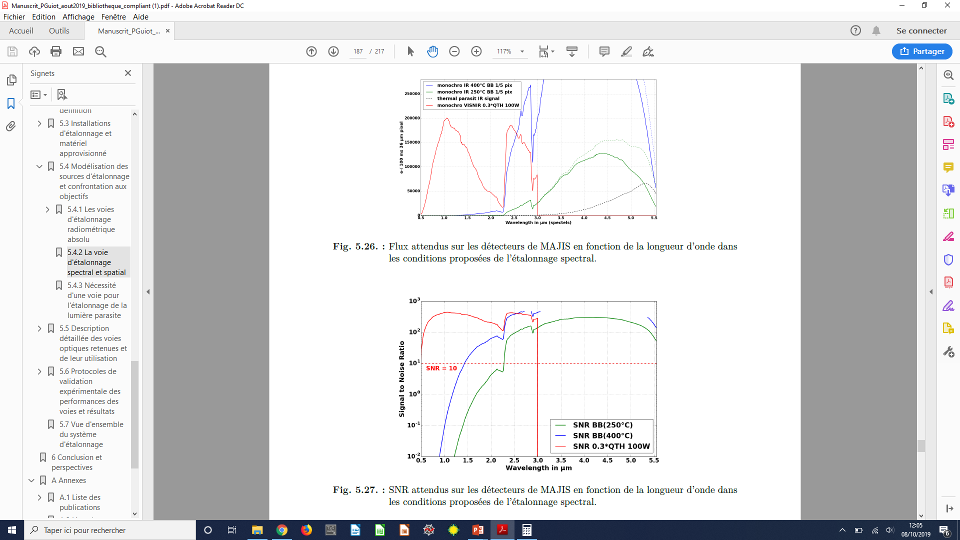
Spectral spatial

Slide 19
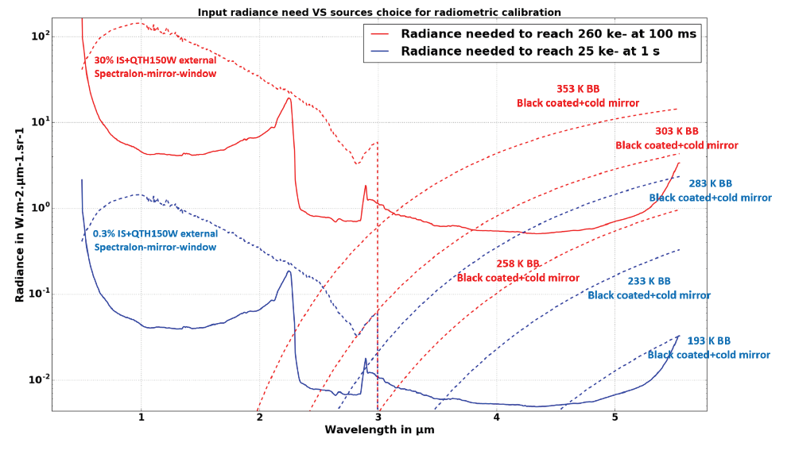
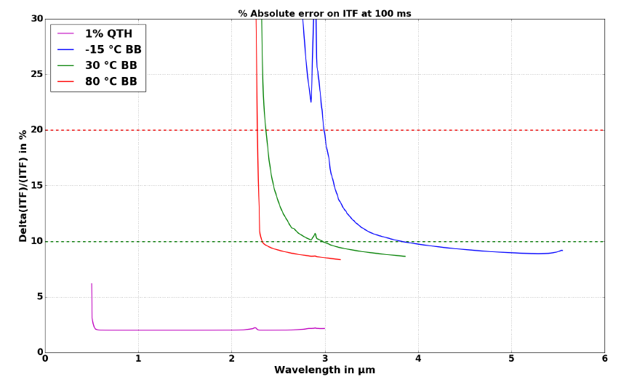
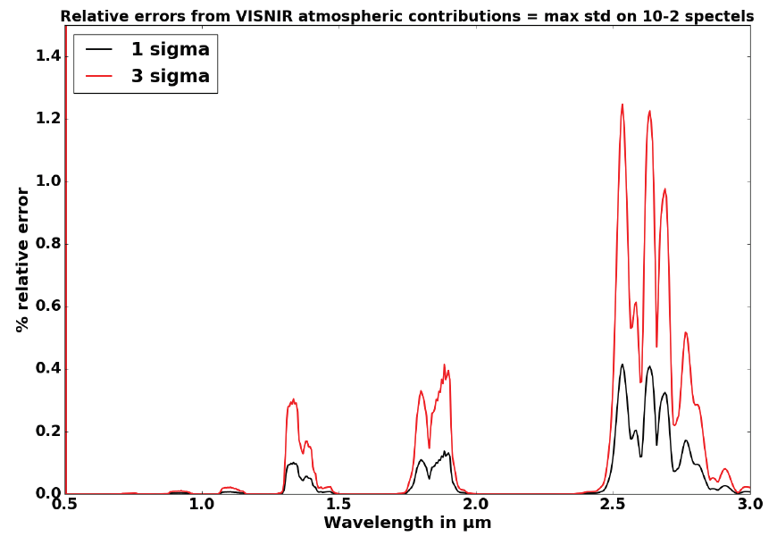
Radiometric

Slide 20
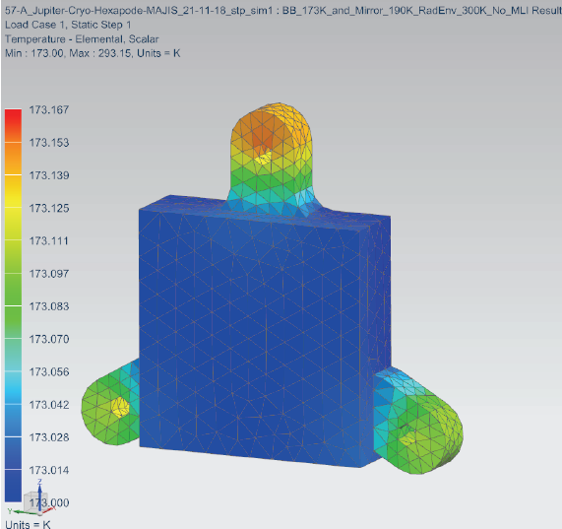
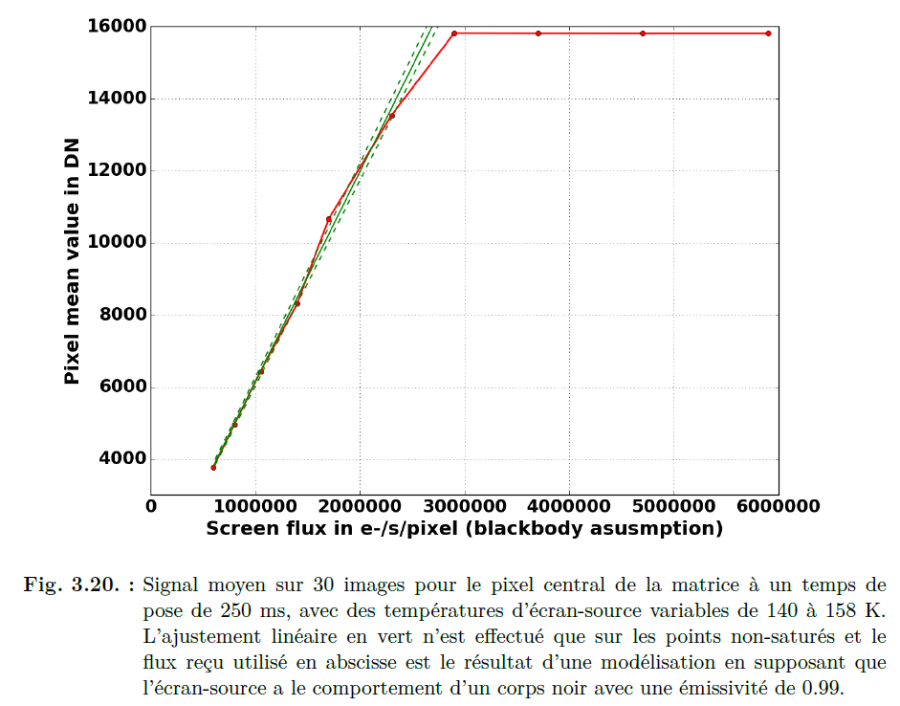
Blackbody feasibility

Slide 21
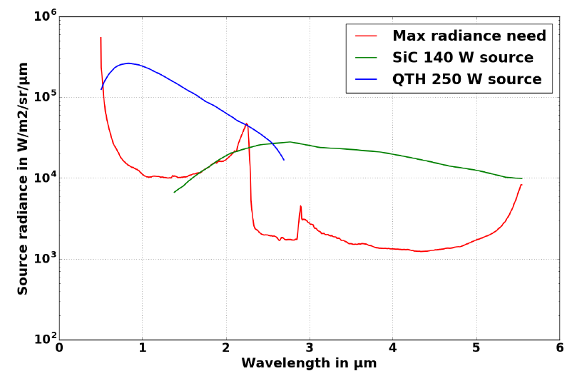
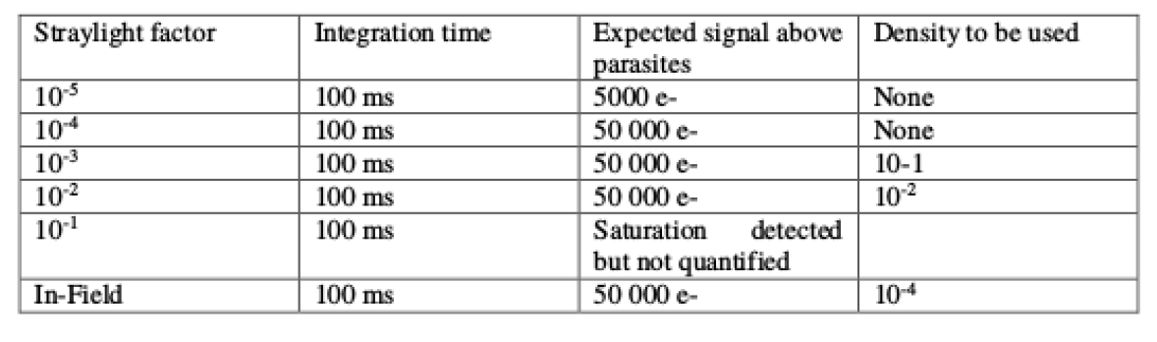
Straylight levels

