Slide 1
MAJIS/JUICE DLR group activities
Gabriele Arnold, David Kappel, Alessandro Maturilli, Ljuba Moroz, Katherina Otto, Katrin Stephan
DLR Institute for Planetary Research
Berlin-Adlershof, Germany
University Potsdam, Germany

Slide 2
Overview about current DLR activities
Water ice size variations on Ganymede and Callisto derived from NIMS data (Katrin Stephan)
Laboratory and modeling support for the spectral investigation of the surfaces of the Galilean moons (Gabriele Arnold, David Kappel, Alessandro Maturilli, Ljuba Moroz, Katherina Otto)
Low temperature bidirectional VIS-R reflectance measurements of analogue materials at DLR’s PSL (minerals).
Laboratory work on organic solids as analogue materials at DLR’s PSL.
Retrieval of physical/compositional surface properties (spectrophotometric modeling).
Studies of dynamic surface processes and laboratory simulations.

Slide 3
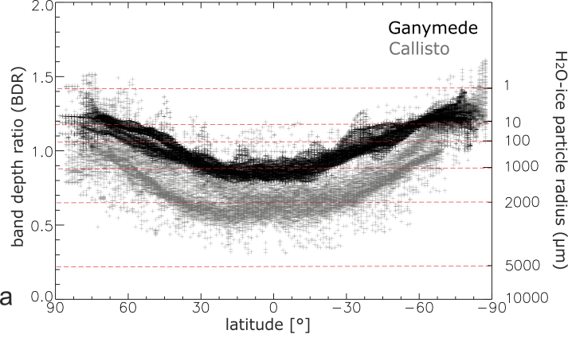
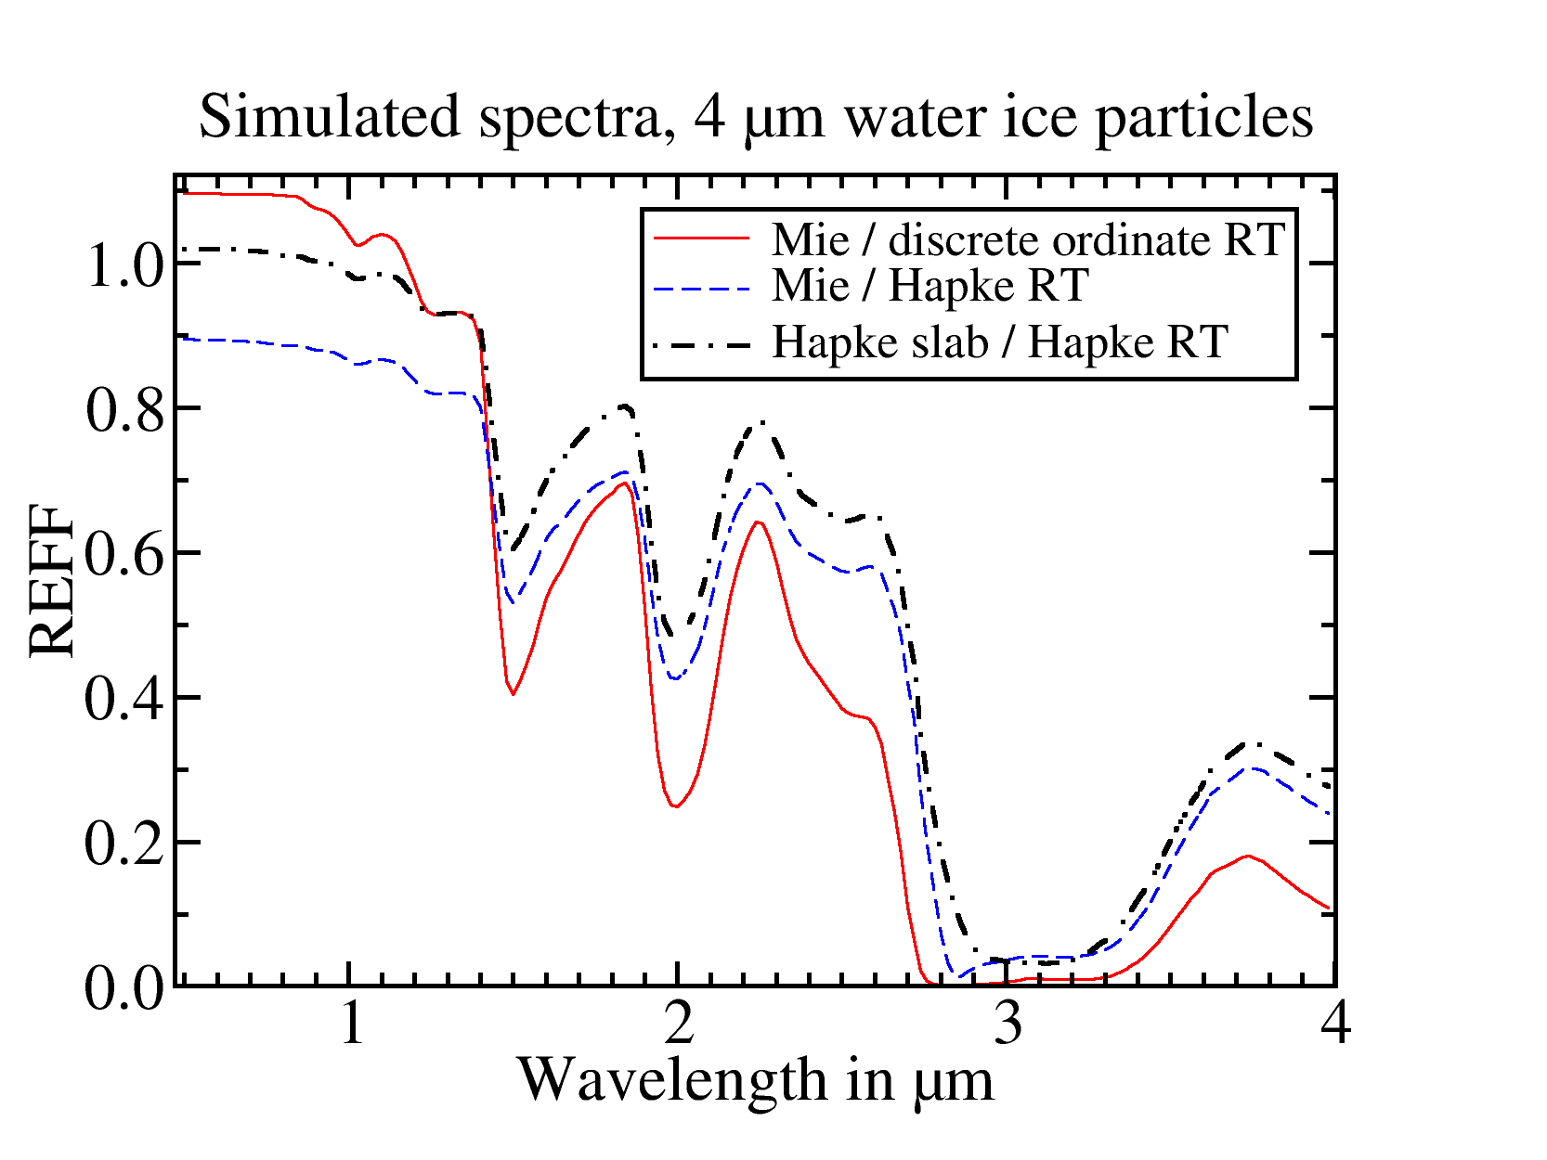
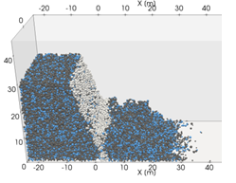
Objectives
Contributions to study the physical and compositional properties of the Galilean satellites
Surface composition (minerals and their mixtures with water ice, solid organics), laboratory studies, spectral modeling, radiolytic alteration.
Physical properties (thermo-physical properties, textural properties: particle sizes, physical structure of particle and material aggregates), multi-spectrum retrieval.
Dynamic surface processes.
Planetologic modeling of relevant surface processes (current state, formation, evolution).

Slide 4
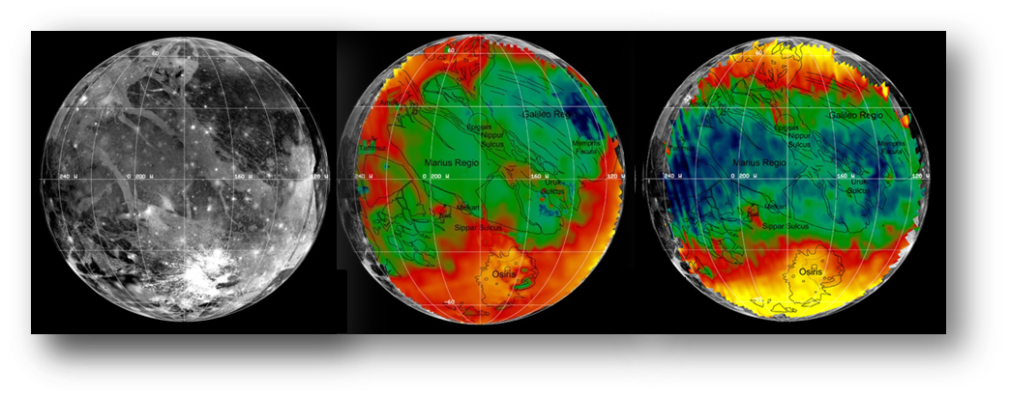
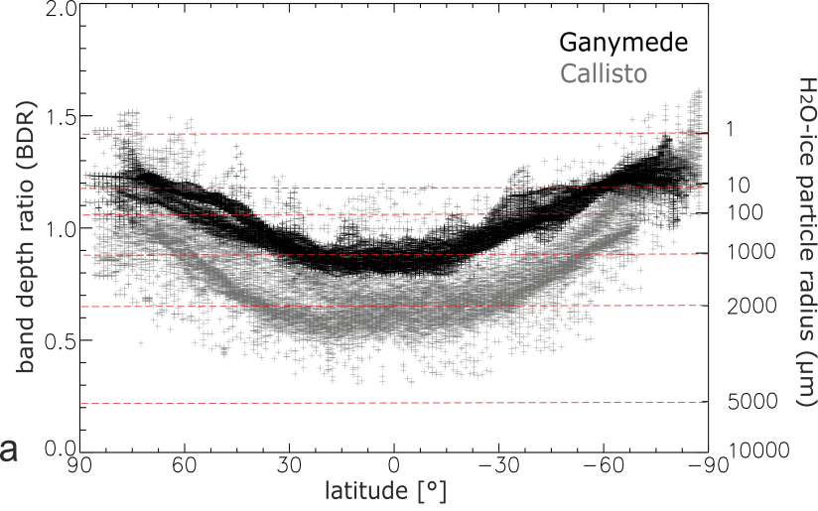
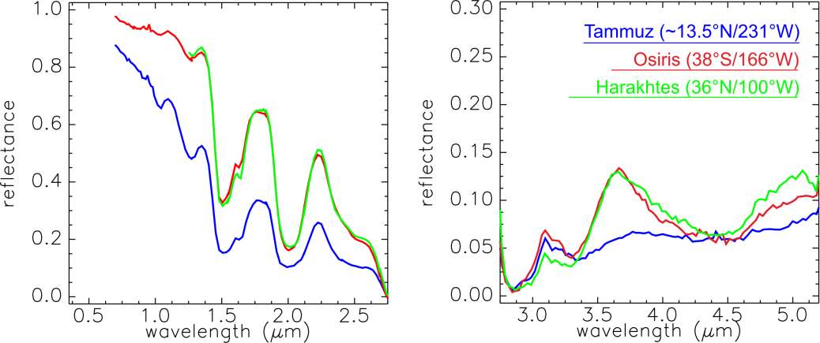
H₂O- ice size variations on Ganymede (and Callisto) derived from NIMS data (Katrin Stephan)
Ganymed – Galileo NIMS
BDRs of H2O-ice absorptions in Ganymede‘s (and Callisto‘s) spectra have shown a direct correlation with H2O-ice particle size differences more or less independent of the dark non-ice material.
BD 1.5µm
BDR BD 2µm/ BD 1.5µm
24%
60%
0.75
1.2
H2O ice abundance
H2O ice particle size
(Stephan et al., 2006, 2013, 2019)

Slide 5
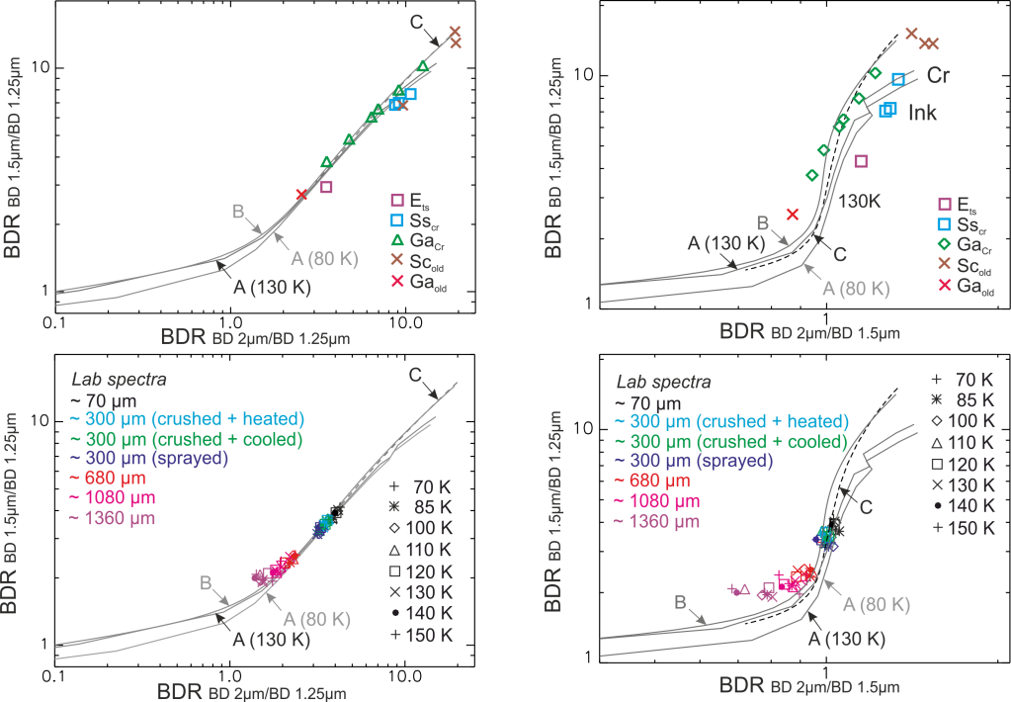
H₂O- ice size variations on Ganymede (and Callisto) derived from NIMS data (Katrin Stephan)
H2O ice samples measured at IPAG/Grenoble (funded by Europlanet) for different particle sizes, particle size mixtures or particle shapes (spherical/irregular) at varying temperatures (70 – 150 K) compared to model spectra.
Ganymede terrains (NIMS) and fresh icy impact craters on Ganymede (NIMS) and icy Saturne satellites (VIMS) compared to model spectra and lab data.
Model A (80 + 130 K): Mie theory Model B (120 K): Shkuratov Model C (120 K): Hapke
BDRs of sample spectra fit to the prepared particle size
BDR variations due to temperature and particle shape negligible for most BDRs
BDRs of large ice grained ice samples with a partly saturated 2-µm absorption differ from the model trend but fit to the BDRs of large H2O ice particles on Ganymede
Individual BDRs mostly fit to Mie values (except for large ice grains with a partly saturated 2-µm absorption)
(Stephan, Ciarniello, Dalle Ore et al., 2019)

Slide 6
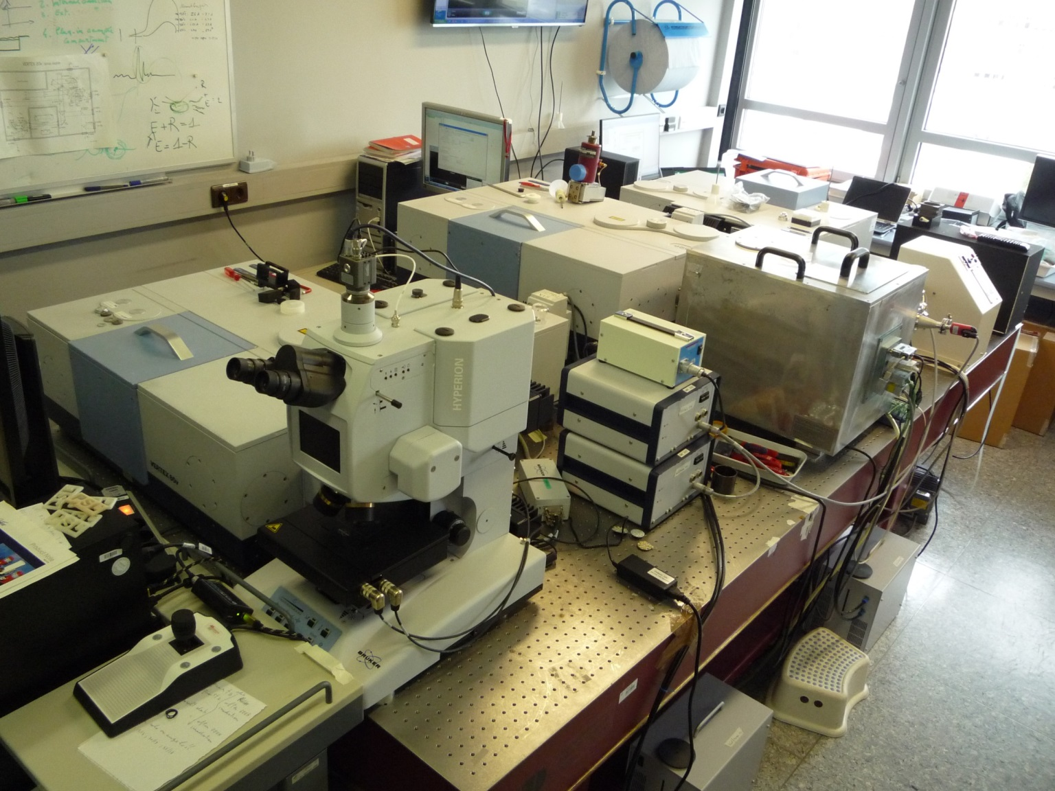
Low temperature bidirectional UV to far IR reflectance measurements at DLR’s PSL (Alessandro Maturilli, Gabriele Arnold)
Planetary Spectroscopy Laboratories
XRD
Reflectance and transmittance:
0.7 to 200 μm
vacuum, ambient temperature
0.25 to 25 μm
vacuum (-100/-196°C to 25°C)
Emissivity:
2 to 50 μm
purged (25 to 180°C)
Emissivity:
0.7 to 200 μm
35 to 700°C
vacuum/nitrogen/air
Micro FTIR - reflectance and transmittance:
0.4 to 20 μm
vacuum (-196°C to 600°C)

Slide 7
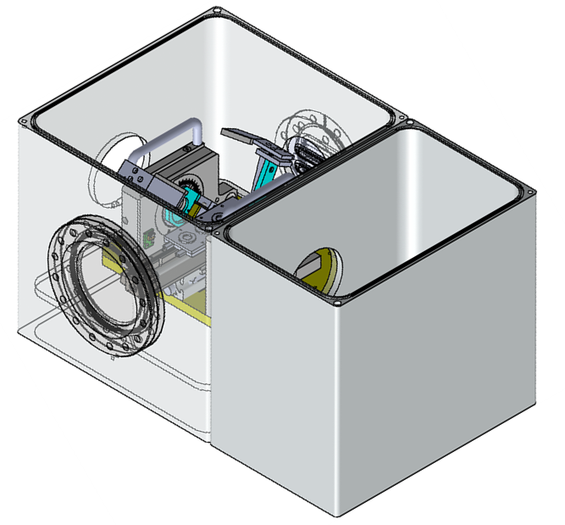
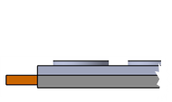
Low temperature bidirectional UV to far IR reflectance measurements at DLR’s PSL (Alessandro Maturilli, Gabriele Arnold)
Low temperature measurements: technical approach
PSL FTIR spectrometer Bruker Vertex 80V has been used
The sample compartment of the Bruker Vertex 80 V used to simulate the low T-chamber
The cooling sample container has been adapted to the reflectance unit
Temperature range: -196° to 100° C (step $≤$ 5°)
Sample holder up to 4 cups
Bi-directional reflectance measurement
Minimum phase angle 13° (before 26°)
Chamber Interior
Reflectance
accessory
Low-T
NEW CHAMBER
Optical
output
Optical enclosure
Sample plate
& Cooling plate
Hi vacuum
Turbo-pump flange
Sample plate
Cooling plate

Slide 8
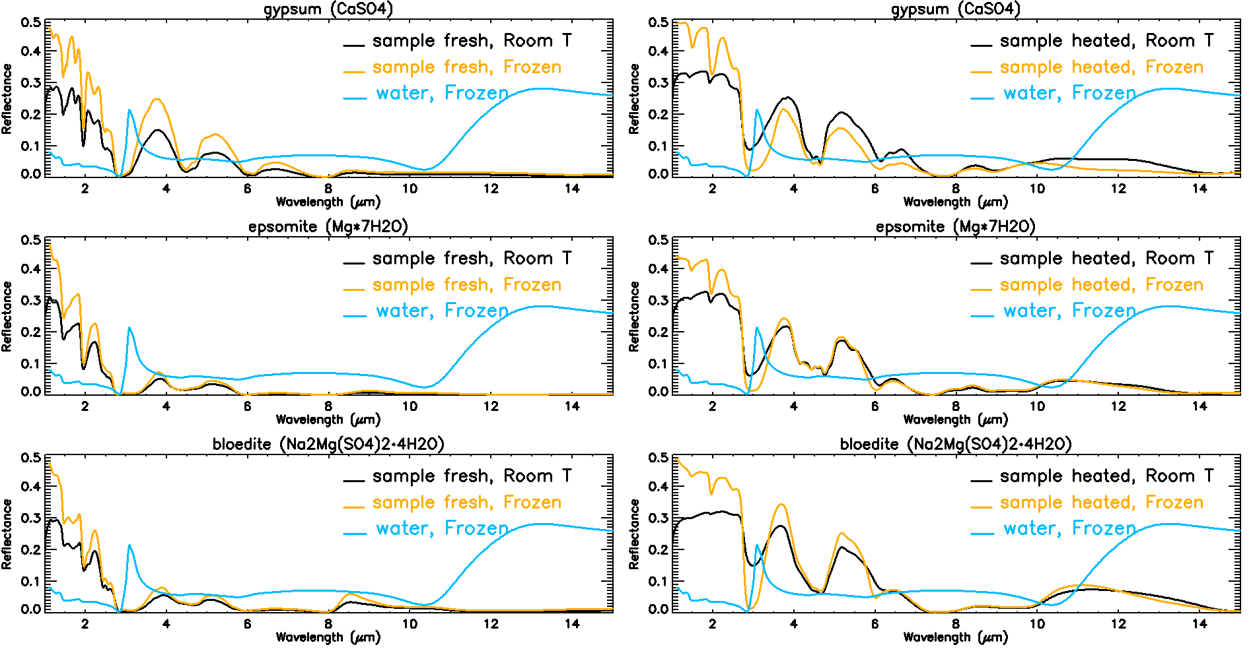
Low temperature bidirectional UV to far IR reflectance measurements at DLR’s PSL (Alessandro Maturilli, Gabriele Arnold)
Reflectance spectra of some sulfates
Thermal decomposition of salts
MgSO₄‚7H₂O epsomite
MgSO₄‚6H₂O hexahydrite
MgSO₄‚5H₂O pentahydrite
MgSO₄‚4H₂O starkeyite
MgSO₄‚3/2H₂O sanderite
MgSO₄‚1.5/1H₂O kieserite
T
Notes:
Epsomite is a hydrous magnesium sulfate mineral with formula MgSO4·7H2O. Absorb water from air, dehydrate in dry air.
Epsomite transforms into hexahydrite (MgSO4‚6H2O) due to loss of extra-polyhedral water at a temperature of 298 K at 50-55% relative humidity (RH), and at lower temperatures when water activity diminishes.
Upon further T increase, phases with 5H2O (pentahydrite), 4H2O (starkeyite), 3H2O, 2H2O (sanderite), 1.5H2O, 1H2O (kieserite) are formed.

Slide 9
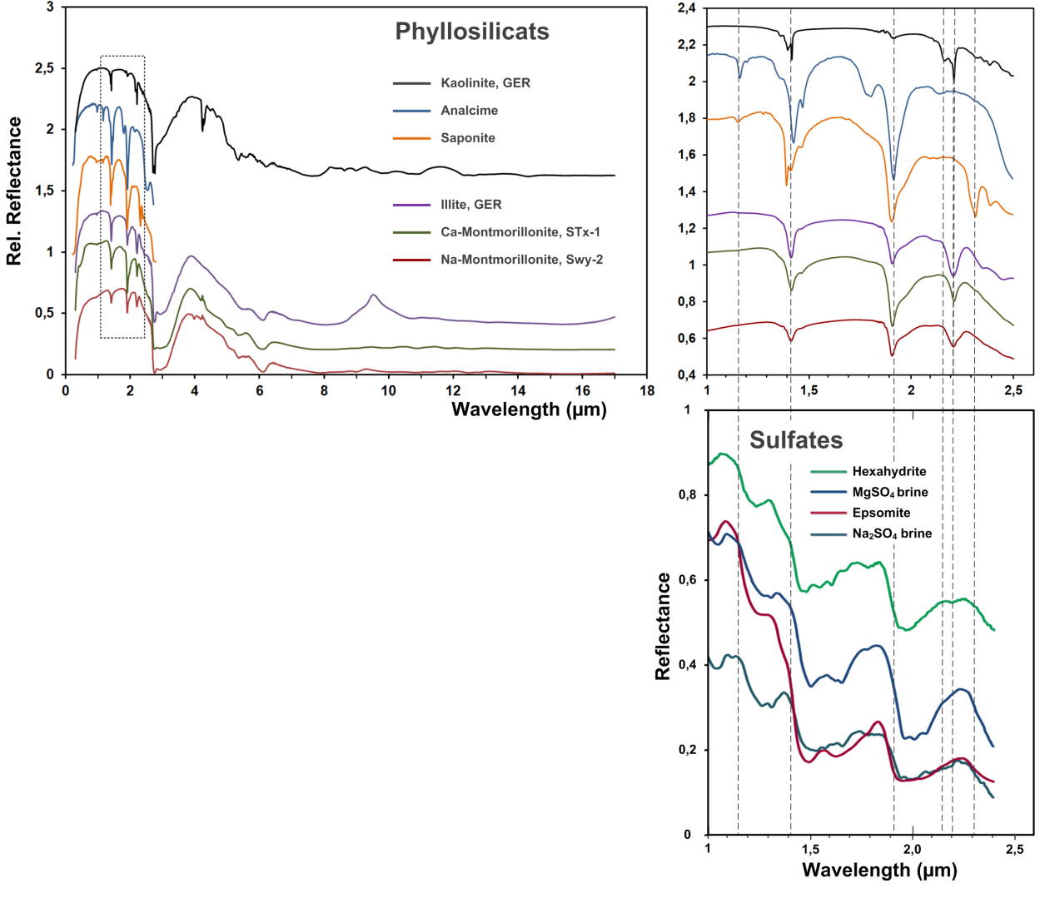
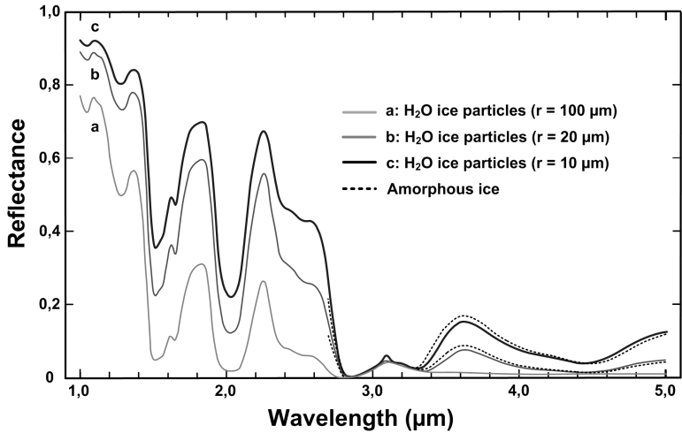
Low temperature bidirectional UV to far IR reflectance measurements at DLR’s PSL (Alessandro Maturilli, Gabriele Arnold)
Outlook
We will re-analyze the low temperature bidirectional reflectance of relevant salts and phyllosilicates (variable grain sizes) with the new chamber interior attachment in the temperature range from -196°C up to room temperature.
It is planned to measure and model the reflectance of relevant mineral mixtures for studies of the non-ice mineral component of the icy Galilea satellites (areal, intimate mixtures).
Future studies: frost and ice additions (areal, intimate, intra mixtures) – disentangle features of ice and hydrated minerals (measurements and spectrophotometric models.
Studies of the thermal decomposition – link to active regions (e.g. plumes and others).
Water ice

Slide 10
Laboratory work on organic solids as analogue materials at DLR’s PSL (Ljuba Moroz, Gabriele Arnold)
Extensive studies of various natural solid bitumens – including their spectral reflectance measurements and the studies of particle size effects (Moroz et al., 1998, and unpublished data).
Temperature effects - reflectance measurements of bitumens at T down to 40 K (Moroz et al., 2004).
Optical constants of bitumens from 1 to 16 µm (IR ellipsometry – work in progress).
Ion-irradiation experiments on asphaltite and kerite accompanied by spectral reflectance measurements after each irradiation step (Moroz et al., 2004).
Ion-irradiation experiments on asphaltite-water ice mixtures accompanied by spectral measurements at T down to 16 K (Strazzullla and Moroz, 2005).
Notes:
Epsomite is a hydrous magnesium sulfate mineral with formula MgSO4·7H2O. Absorb water from air, dehydrate in dry air.
Epsomite transforms into hexahydrite (MgSO4‚6H2O) due to loss of extra-polyhedral water at a temperature of 298 K at 50-55% relative humidity (RH), and at lower temperatures when water activity diminishes.
Upon further T increase, phases with 5H2O (pentahydrite), 4H2O (starkeyite), 3H2O, 2H2O (sanderite), 1.5H2O, 1H2O (kieserite) are formed.

Slide 11
Laboratory work on organic solids as analogue materials at DLR’s PSL (Ljuba Moroz, Gabriele Arnold)
Spectral reflectance measurements of bitumen-montmorillonite mixtures (0.5-16 µm) (unpublished).
Spectral reflectance measurements (0.25-16 µm) of intimate mixtures of kerite with Fe-sulfides as darkening agents (Moroz et al., EPSC 2017; work in progress).
Reflectance spectra (0.25-16 µm) of numerous solid organic acids and their mixtures with a Fe-sulfide (Meißner et al., EPSC 2018; work in progress).
Outlook
To support the development of the MAJIS instrument and the analysis of its future data we will re-analyze the available reflectance data with a focus at the potential relevance to the Jovian satellites’ surface composition.
Dedicated spectral studies of plausible organic materials (tholin, carbon, graphite, solid hydrocarbons and organic acids) at various grain sizes are planned.

Slide 12
Retrieval of physical/compositional surface properties (spectrophotometric modeling) (David Kappel, Gabriele Arnold)
Retrieve physical/compositional surface properties by comparing measured to simulated spectra.
Simulated spectrum depends on given parameter set. Vary parameters to improve fit. Interpret parameters of best fit as physical state of surface that led to measured spectrum.
Estimate reliability of retrieved parameters by investigating sensibility of simulations to parameter perturbations, and degree of reproducibility when retrieving from different measurements.
Improve reliability by retrieving surface properties as parameters that are common to several spectra covering the same target (Bayesian Multi-Spectrum Retrieval, MSR, Kappel 2014).
Helps to discriminate parameter sets that equally likely can explain a measured spectrum, by taking into account information encoded in angular dependence of reflectance spectra.
Takes into account information on measurement noise and a priori information on parameters (mean values, standard deviations) and parameter distributions (correlation lengths, correlation times, parameters constant with space or time).
Successfully applied to derive surface emissivity maps from VIRTIS/Venus Express hyperspectral images of Venus‘ night side, based on atmospheric radiative transfer in Venus‘ lower atmosphere (Kappel et al. 2016; Arnold et al. 2015).

Slide 13
Retrieval of physical/compositional surface properties (spectrophotometric modeling) (David Kappel, Gabriele Arnold)
Spectrophotometric modeling
Simulate spectra by radiative transfer (RT) in top surface layers
- Hapke (2012)
- Discrete ordinate method (Chandrasekhar 1950, Stamnes et al. 1980)
- Or approach by Shkuratov et al. (2011)
Needs single-scattering parameters (single-scattering albedo, single-scattering phase function), derived from given complex refractive index spectrum, particle size distribution (and shape)
- Hapke equivalent slab model for irregular particles, Hapke (2012)
- Mie theory (spherical particles), Wiscombe (1980)
- Or approach by Shkuratov et al. (2011) (particle indicatrix)
- Use illumination/observation angles and shadowing state given by digital shape model
Particulate corrections, roughness, indirect radiation contributions
- Porosity, opposition effects
- Small-scale surface roughness, topographic roughness, repeated reflections within craters
- Solar radiation reflected by Jupiter

Slide 14
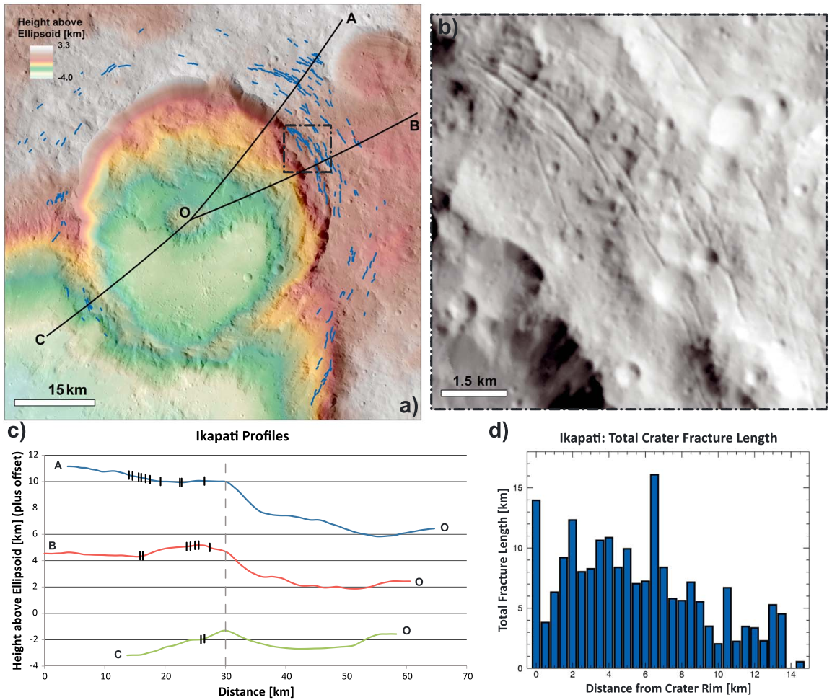
Dynamic surface processes (Katherina Otto)
Alteration of original composition and morphology of material via
Sputtering
Tectonics
Heating (impacts, internal)
But exposure of fresh material from subsurface possible via
Impact cratering
Mass-wasting
Cryovolcanism
$➔$ Identify features of dynamic processes and model formation with DEM for advanced interpretation
Example of a lobate crater with circumferential fractures on Ceres. The fracturing generates weaknesses in the material from which collapse may originate. Similar features are expected on the icy satellites of Jupiter.
Credit: Otto et al., JGR Planets 124, 2019

Slide 15
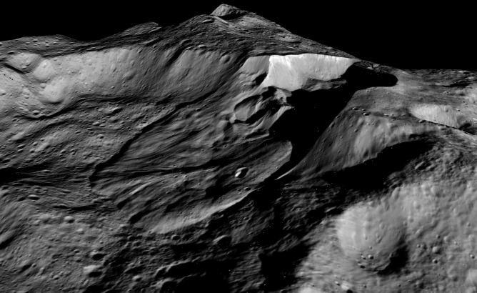
Dynamic surface processes (Katherina Otto)
Alteration of original composition and morphology of material via
Sputtering
Tectonics
Heating (impacts, internal)
But exposure of fresh material from subsurface possible via
Impact cratering
Mass-wasting
Cryovolcanism
$➔$ Identify features of dynamic processes and model formation with DEM for advanced interpretation
10 km
Example of a lobate landslide on Ceres. The deposit and scarps of the feature reveal fresh material previously shielded from surface alteration processes (e.g. sputtering). Similar features have been identified on the icy satellites of Jupiter.
Credit: NASA/JPL-Caltech/UCLA/MPS/DLR/IDA/PSI

Slide 16
Dynamic surface processes (Katherina Otto)
DEM Modelling
Modelling dynamic surface processes with discrete element method (DEM)
Derive mixing of materials within the topography affected by dynamic processes (e.g. after gravitational collapses and cryovolcanic eruptions)
Retrieve material parameters from compositional measurements
$➔$ Combination of DEM and compositional measurements as new approach to investigate material distributions
Example of a cliff collapse/mass wasting on comet 67P simulated with our DEM. Grey represents dust and blue icy particles. The same code can be applied to conditions and materials found on Jupiter’s icy moons.
Credit: Sachse et al., EPSC-DPS #2497, 2019

Slide 17
Additional information
More detailed information for each working package:
See proposal to the team from G. Arnold et al., September 2018.

