Slide 1
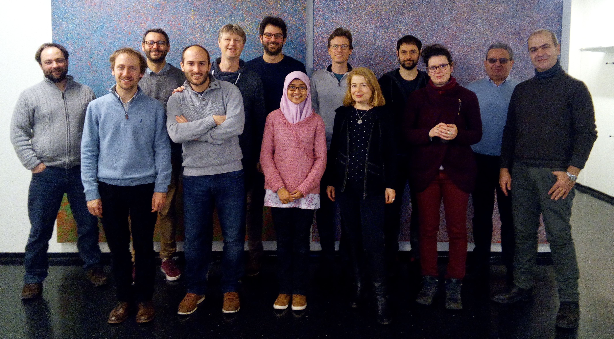
VIS-IR spectroscopy of mixtures of ice, organic matter and opaque mineral in support icy moons remote sensing observations
M. Ciarniello¹, L. V. Moroz², O. Poch³, V. Vinogradoff⁴, P. Beck³, B. Rousseau¹, I. Istiqomah³, R. Sultana³, A. Raponi¹, S. Schroeder², D. Kappel^{5,2}, E. Quirico³, G. Filacchione¹, A. Pommerol⁶, V. Mennella⁷, C. Pilorget⁸
The ISSI international team “Comet 67P/Churyumov-Gerasimenko Surface Composition as a Playground for Radiative Transfer Modeling and Laboratory Measurements”, number 397.
¹IAPS-INAF, Rome, Italy (mauro.ciarniello@inaf.it);
²German Aerospace Center (DLR), Berlin, Germany;
³Institut de Planétologie et d’Astrophysique de Grenoble, Grenoble, France;
⁴PIIM-ASTRO, UMR CNRS 7345, Aix-Marseille University, France;
⁵Institute of Physics and Astronomy, University of Potsdam, Potsdam, Germany;
⁶University of Bern, Bern, Switzerland;
⁷OACN-INAF, Naples, Italy;
⁸IAS Institut d'Astrophysique Spatiale, Orsay Cedex, France
http://www.issibern.ch/teams/churgerasim/

Slide 2
Rationale
Observations from the VIRTIS-Rosetta imaging spectrometer (0.2-5.1 µm, Coradini et al., 2007) of the comet 67P/Churyumov-Gerasimenko (67P/CG) revealed a surface covered of low albedo material (VIS geometric albedo 0.06, Fornasier et al., 2015; Ciarniello et al., 2015) and ubiquitous organics (Capaccioni et al., 2015; Quirico et al., 2016; Raponi et al., submitted).
Water ice on 67P/CG has been detected as intimately mixed with the low albedo regolith, in transient form (De Sanctis et al., 2015; Ciarniello et al. 2016) and as isolated bright spots (Filacchione et al., 2016; Barucci et al., 2016; Raponi et al., 2016).
Starting from these evidences we measured the spectral output of mixtures of water ice, organics and opaque mineral to support the interpretation of remote sensing observations of 67P and minor bodies.
We take advantage of this set of measurements to characterize the capability of the widely used Hapke model for spectral un-mixing (Hapke, 2012) to correctly identify and quantify the real abundances of the different end-members.
These results are in general applicable also to remote sensing observations of the icy moons:
  by providing support for comparison with laboratory measurements in assessing the effect of darkening phases mixed with water ice
  by constraining the accuracy of the spectral un-mixing when applied to ice-contaminant mixtures.

Slide 3
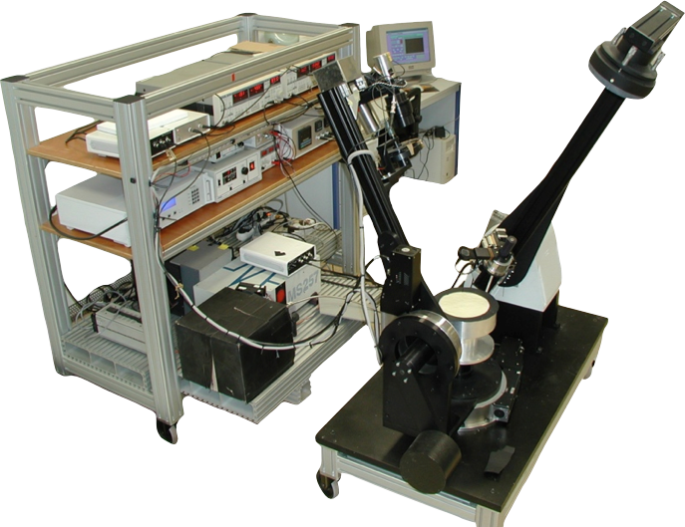
Cold Surface Spectroscopy (CSS) facility at IPAG-Grenoble
SHINE
Reflectance spectra have been measured at IPAG-Grenoble at the CSS lab (Europlanet 2020 Research-Infrastructure programme, grant agreement No. 654208, “SAMPIK” project)
Ice-bearing mixtures have measured with the SHINE spectro-gonio-radio-meter coupled to the environmental chamber CARBON-IR:
  Temperature of 173 k
  N₂ atmosphere under primary vacuum P=1.5 mbar
  Synchronous detection system
  Spectral sampling: 50 nm in the VIS (0.5-1 µm); 20 nm in the IR (1-4.2 µm)
  Observation geometry: i=0°, e=30°, α=30°
CARBON-IR

Slide 4
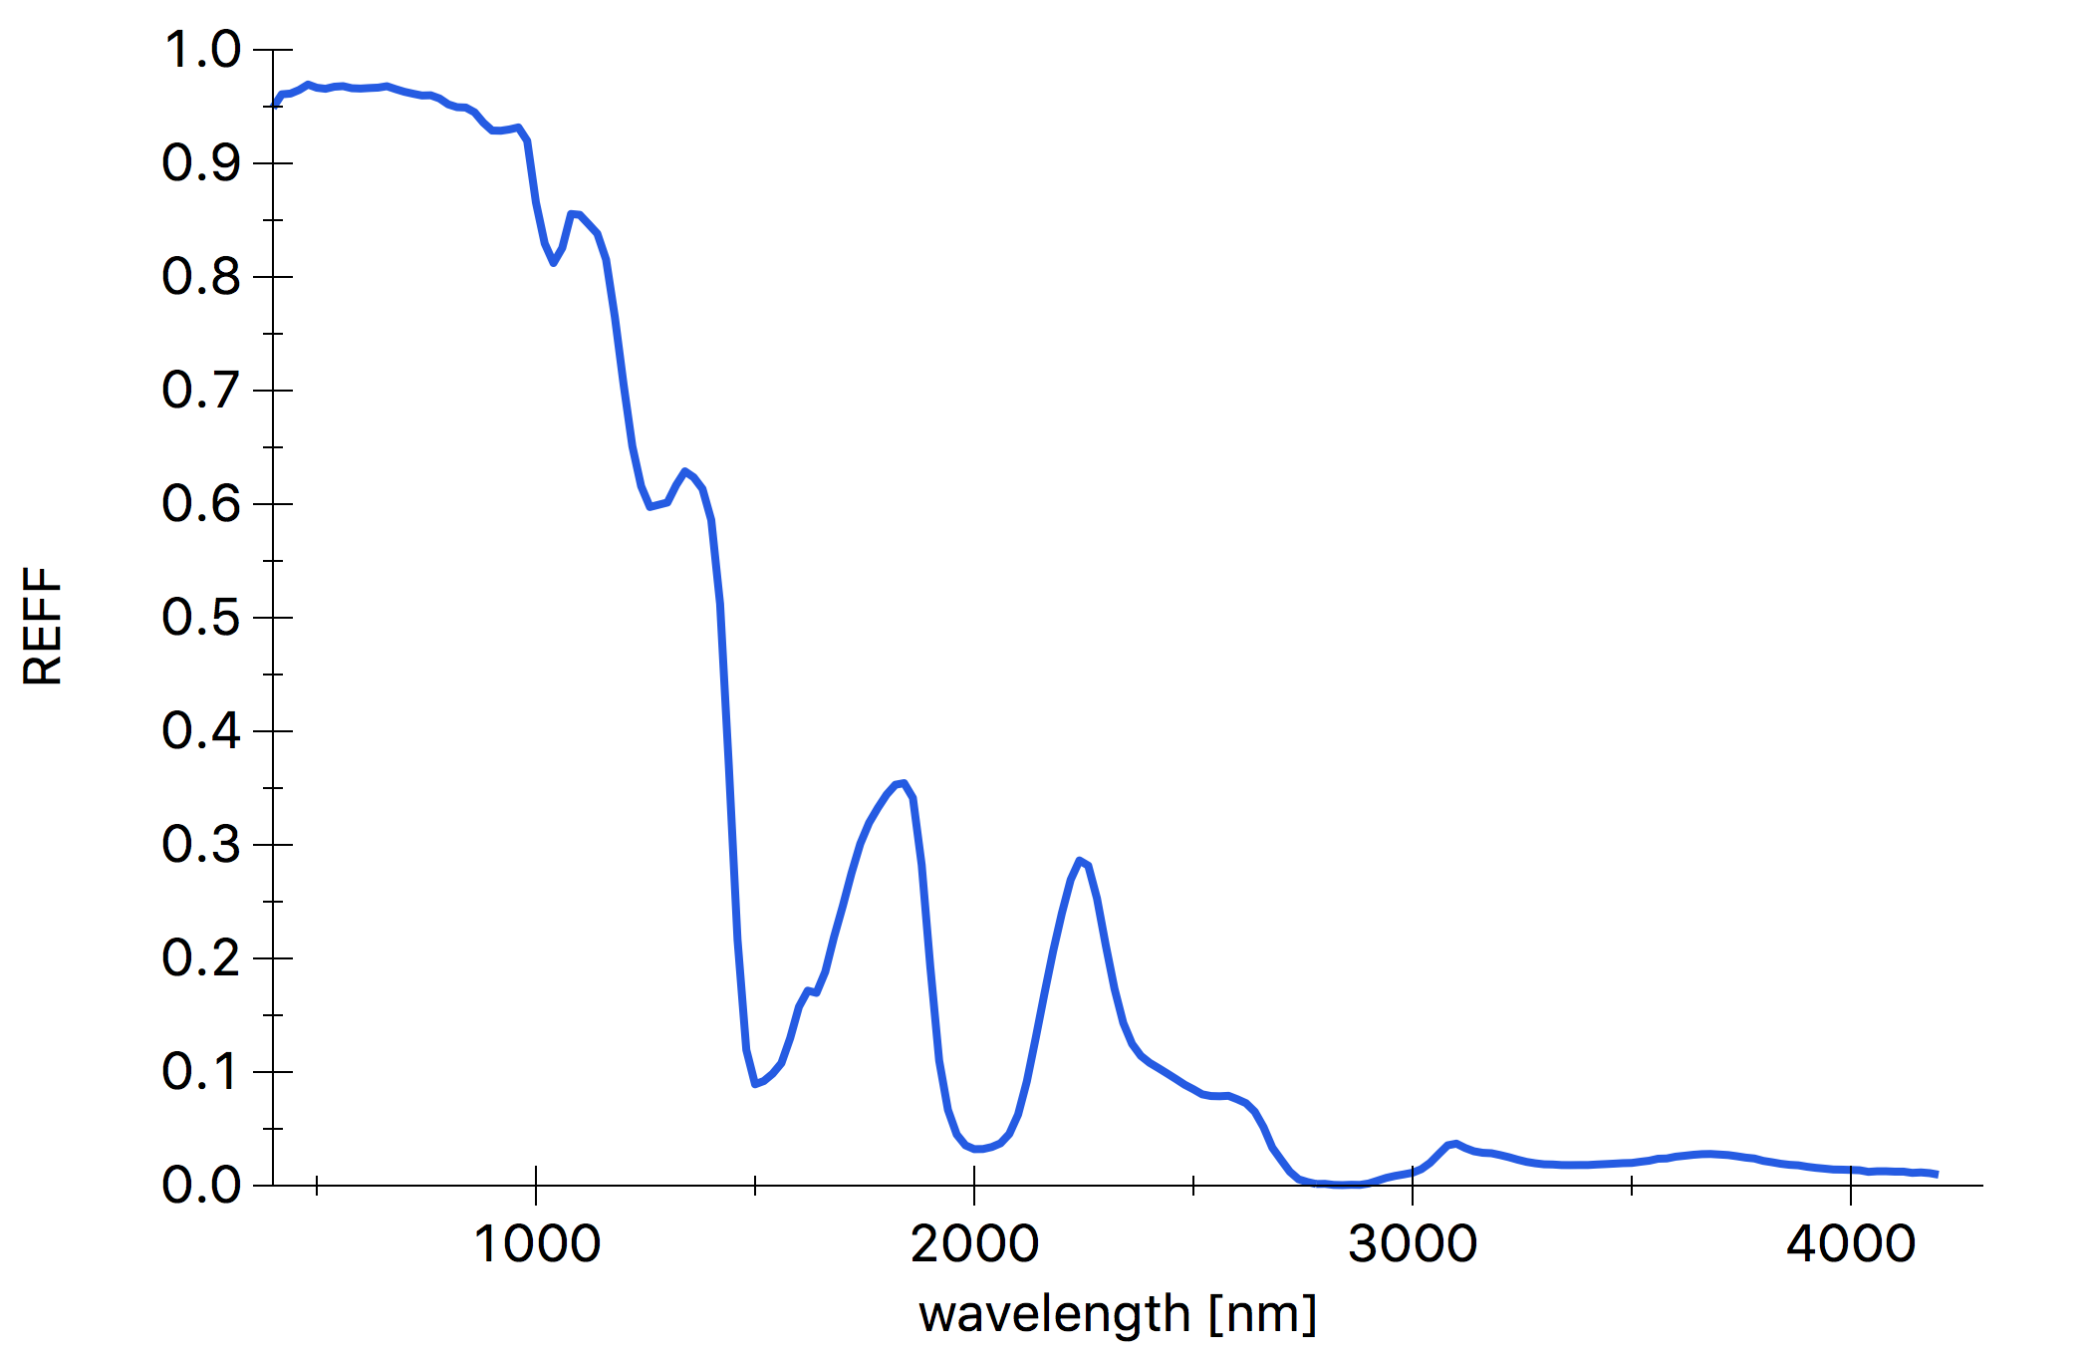
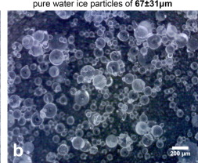
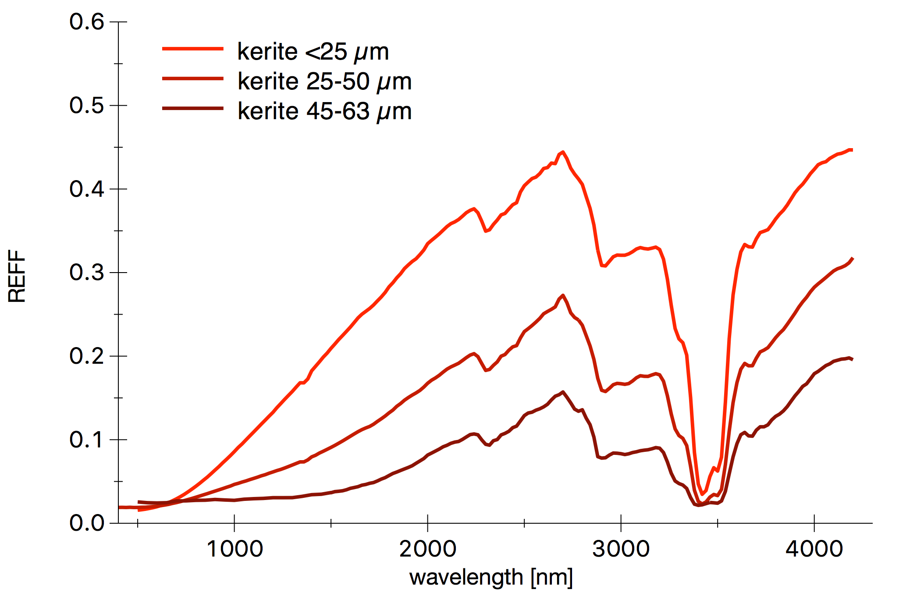
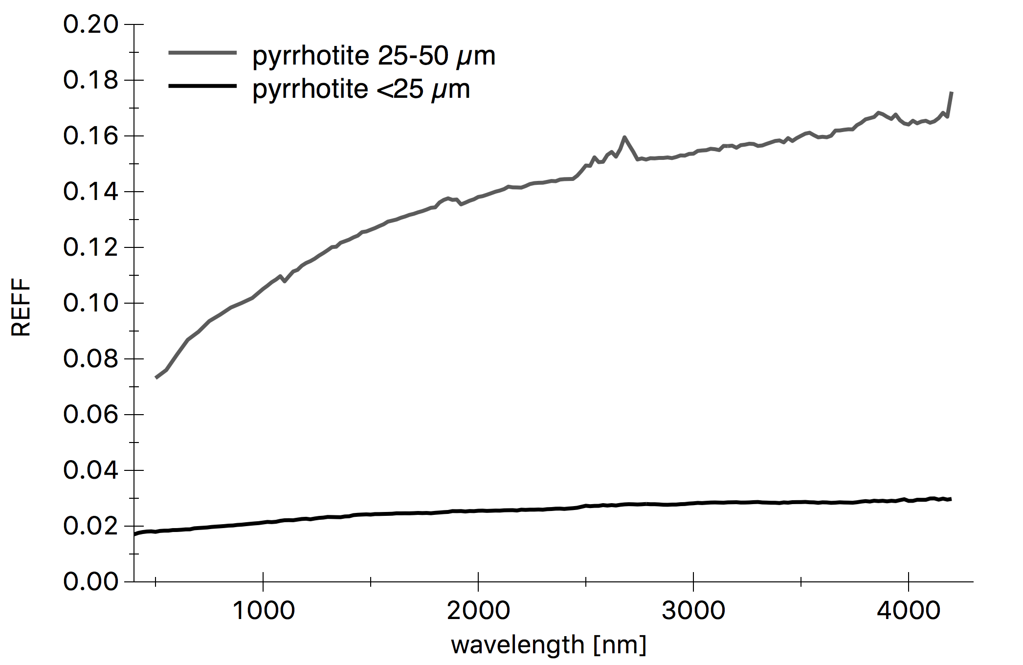
End-members
Water ice grains of controlled grain size d=67±31 µm produced by means of the SPIPA-B setup obtained from freezing of water droplet in N₂ (Yoldi, et al., 2015; Poch et al., 2016)
Kerite (solid oil bitumen) powder as analogue of organic compounds for different different sizes by hand grinding (#8450 from Moroz et al., 1998):
  Coarse: 45-63 µm; 25-50 µm (by wet sieving)
  Fine grained: <25 µm (by sieving)
Pyrrhotite grains as analogue of opaque phases:
  Coarse: 25-50 µm (by hand grinding and wet sieving)
  Fine grained: <25 µm (by colloidal grinding)
Water ice
Poch et al., 2016
CH₂, CH₃
CH arom.
Kerite
x
OH
CH₂, CH₃
Coarse
Water vapour in the optical path
Pyrrhotite
Fine grained

Slide 5
List of measurements
Ice-kerite mixtures.
Mixtures have been prepared in order to explore different configurations in terms of mixing modalities (intimate and intra-particle) and grain size of the end-members (coarse vs fine-grained)
The explored mixing ratios are meant to maximize spectral variability within the mixtures
*kerite 45-63 µm; **kerite <25µm
Ice-pyrrhotite mixtures.
*Pure pyrrhotite 25-50 µm; **water ice with pyrrhotite <25µm inclusions
***kerite 25-50 µm , pyrrhotite <25 µm

Slide 6
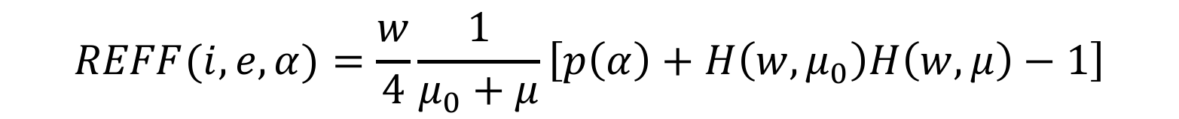
Hapke model (Hapke, 2012)
We compare the spectral output of the different mixtures with Hapke’s model simulations to test its ability in deriving reliable end-member abundances in remote sensing applications
$$REFF(i,e,α)=\frac{w}{4}\frac{1}{μ_{0}+μ}\left[p\left(α\right)+H\left(w,μ_{0}\right)H\left(w,μ\right)−1\right]$$
𝑤: single scattering albedo (SSA)
𝑝(𝛼): single particle phase function (SPPF)
𝜇₀, 𝜇: cos(i), cos(e)
𝐻(𝑤,𝑥): Chandrasekhar‘s function, accounting for multiple scattering
At this stage we neglect opposition effect contribution, porosity and roughness effects

Slide 7
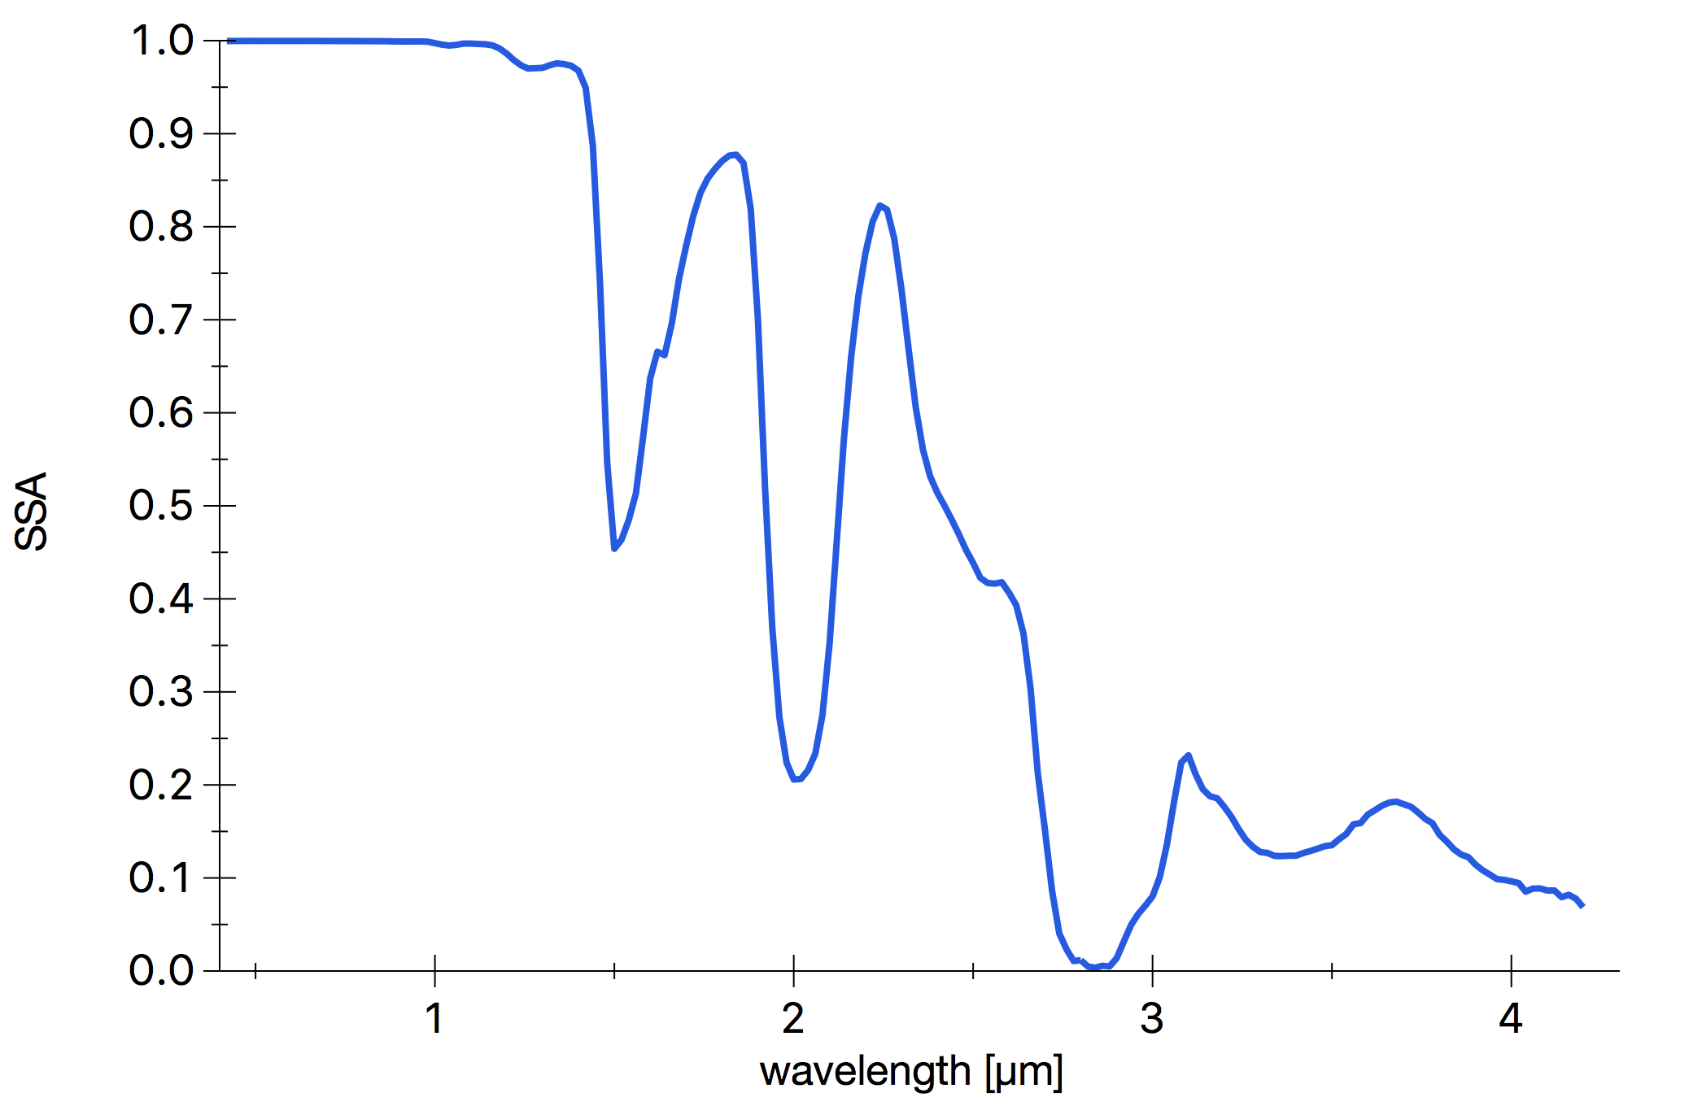
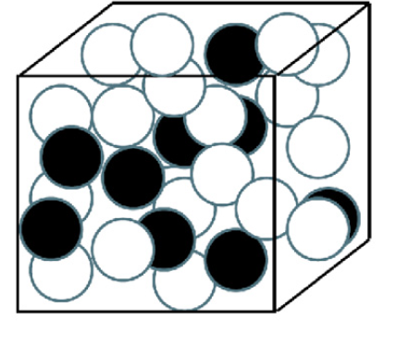
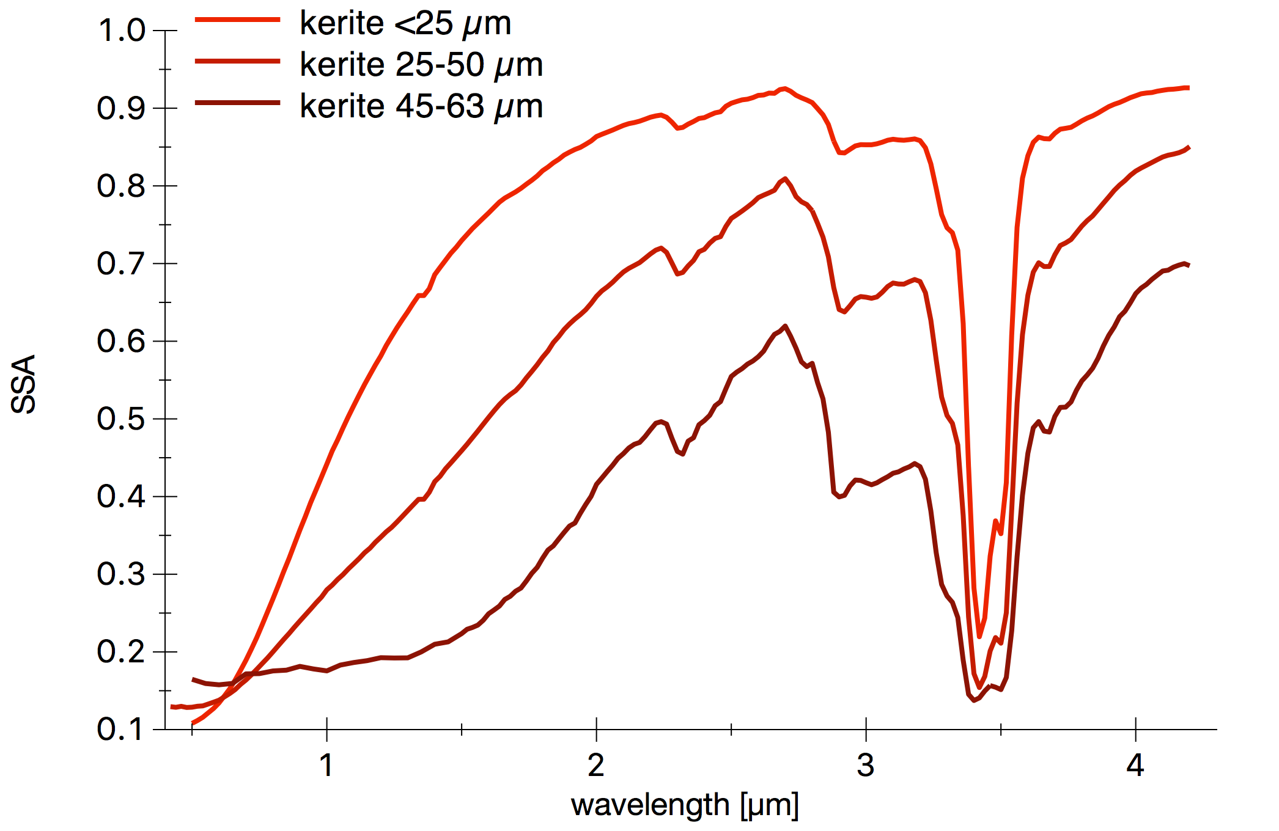
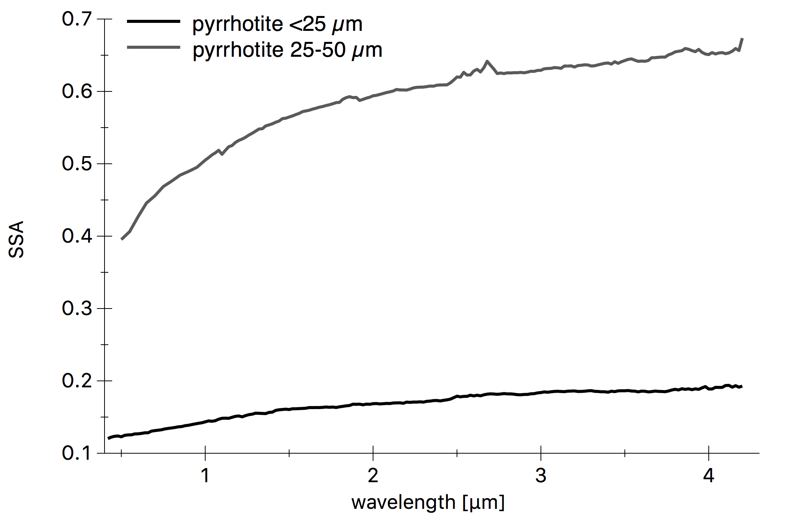
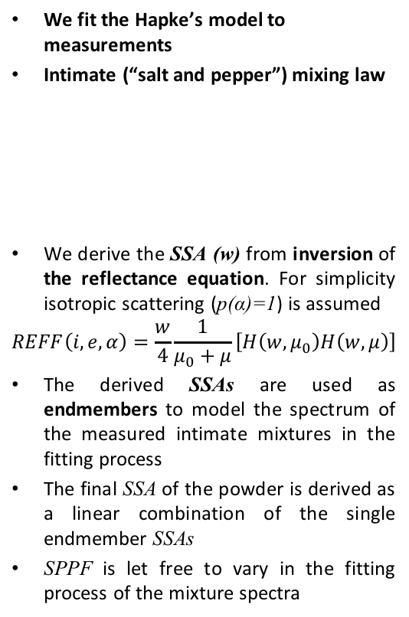

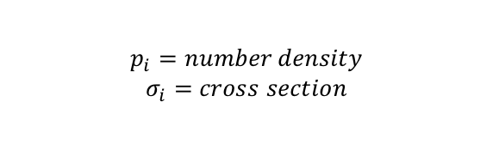
Method
We fit the Hapke’s model to measurements
Intimate (“salt and pepper”) mixing law
We derive the SSA (w) from inversion of the reflectance equation. For simplicity isotropic scattering (p(α)=1) is assumed
$$REFF\left(i,e,α\right)=\frac{w}{4}\frac{1}{μ_{0}+μ}\left[H\left(w,μ_{0}\right)H\left(w,μ\right)\right]$$
The derived SSAs are used as endmembers to model the spectrum of the measured intimate mixtures in the fitting process
The final SSA of the powder is derived as a linear combination of the single endmember SSAs
SPPF is let free to vary in the fitting process of the mixture spectra
From REFF to SSA
$$w=\frac{\sum_{i}{p_{i}}σ_{i}w_{i}}{\sum_{i}{p_{i}}σ_{i}}$$
$$p_{i}=number density$$
$$σ_{i}=cross section$$
Notes:
The SSA of a single endmeber can be derived as a function of grain size and optical constants of the corresponding material
The lack of optical constants for kerite prevent us to derive the SSA systematically for all the investigated mixtures

Slide 8

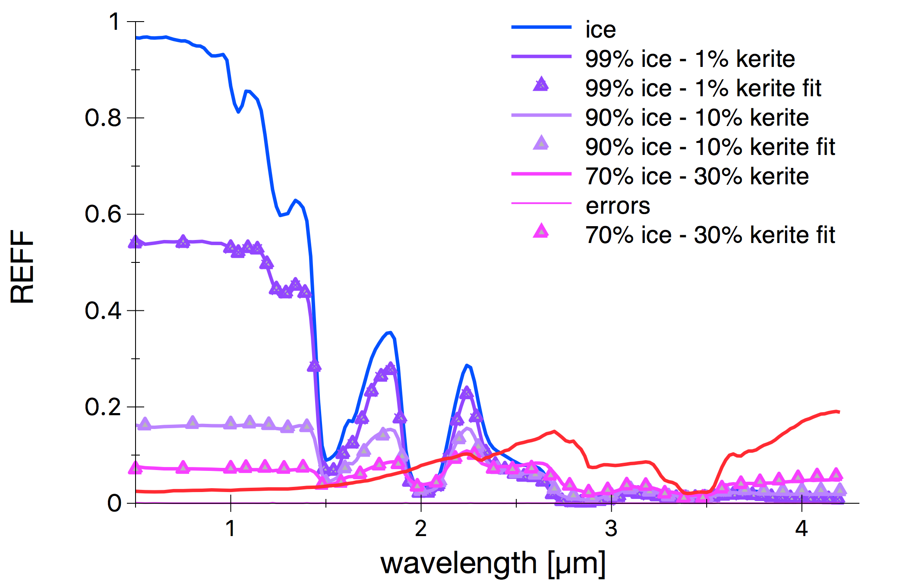
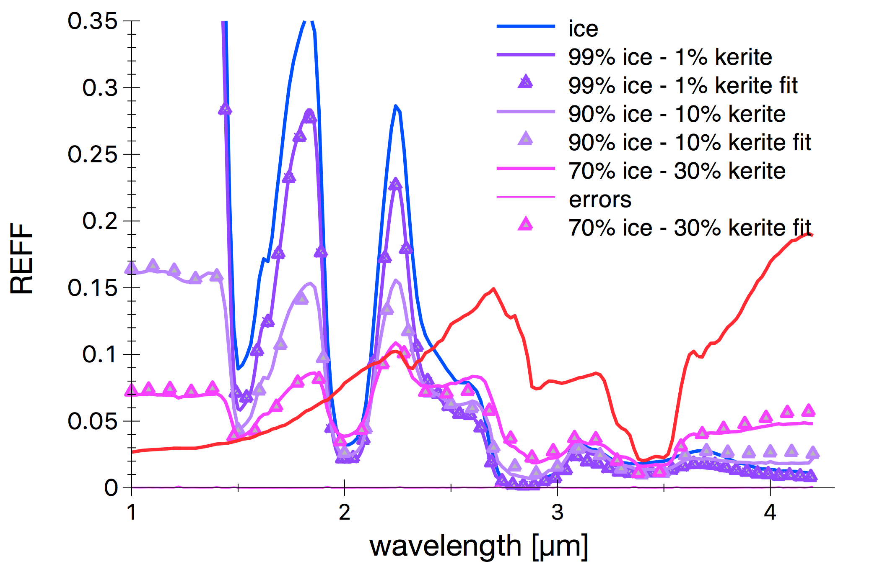
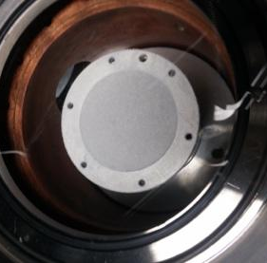
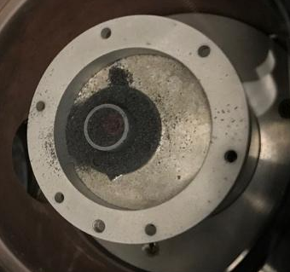
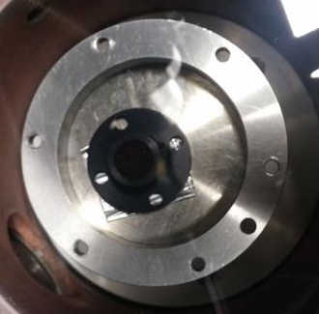
Ice-kerite intimate mixtures (1/2)
100% ice
99% ice – 1% kerite
90 % ice -10 % kerite
70% ice -30 % kerite
100% kerite
measured
-Δ-Δ- fit with Hapke’s model
ZOOM
100% ice
99% ice – 1% kerite
90 % ice -10 % kerite
70% ice -30 % kerite
100% kerite
measured
-Δ-Δ- fit with Hapke’s model
99% ice - 1% kerite
90% ice - 10% kerite
Ice(67±31 µm)-kerite (45-63 µm) abundance [wt%]
99-1 (98-2)
90-10 (81-19)
70-30 (57-43)
The models reproduce fairly well the laboratory spectra and the derived abundances are in reasonable agreement with the measured values
Small amounts of kerite mixed with ice produces a significant albedo reduction
70% ice - 30% kerite
Values in parentheses are derived from Hapke model fitting. Kerite grain size = 54 µm

Slide 9
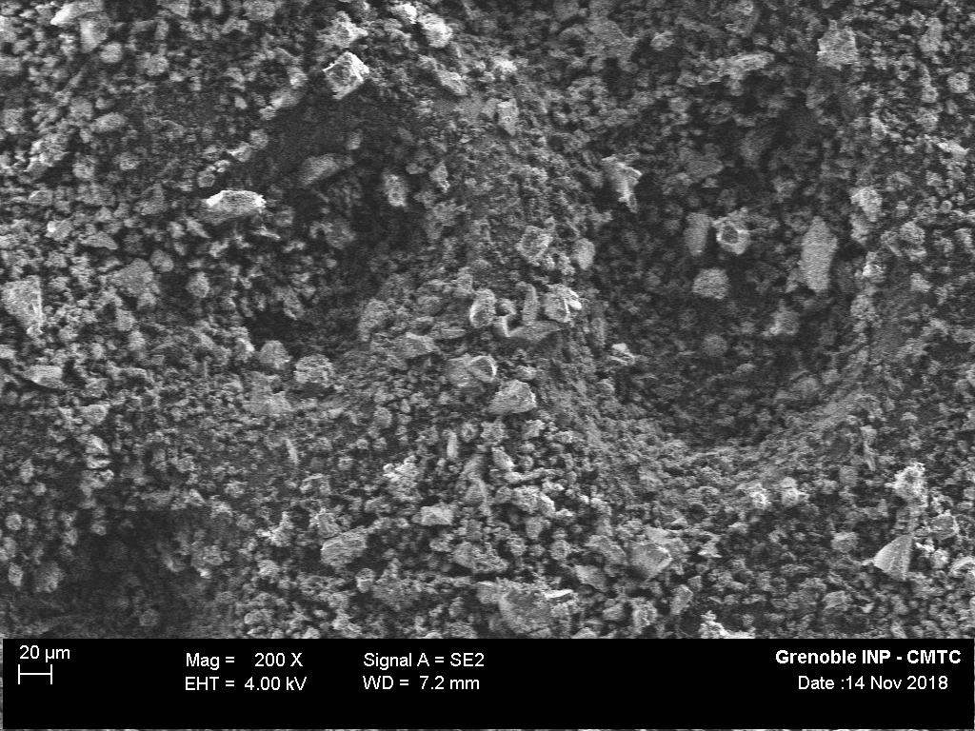
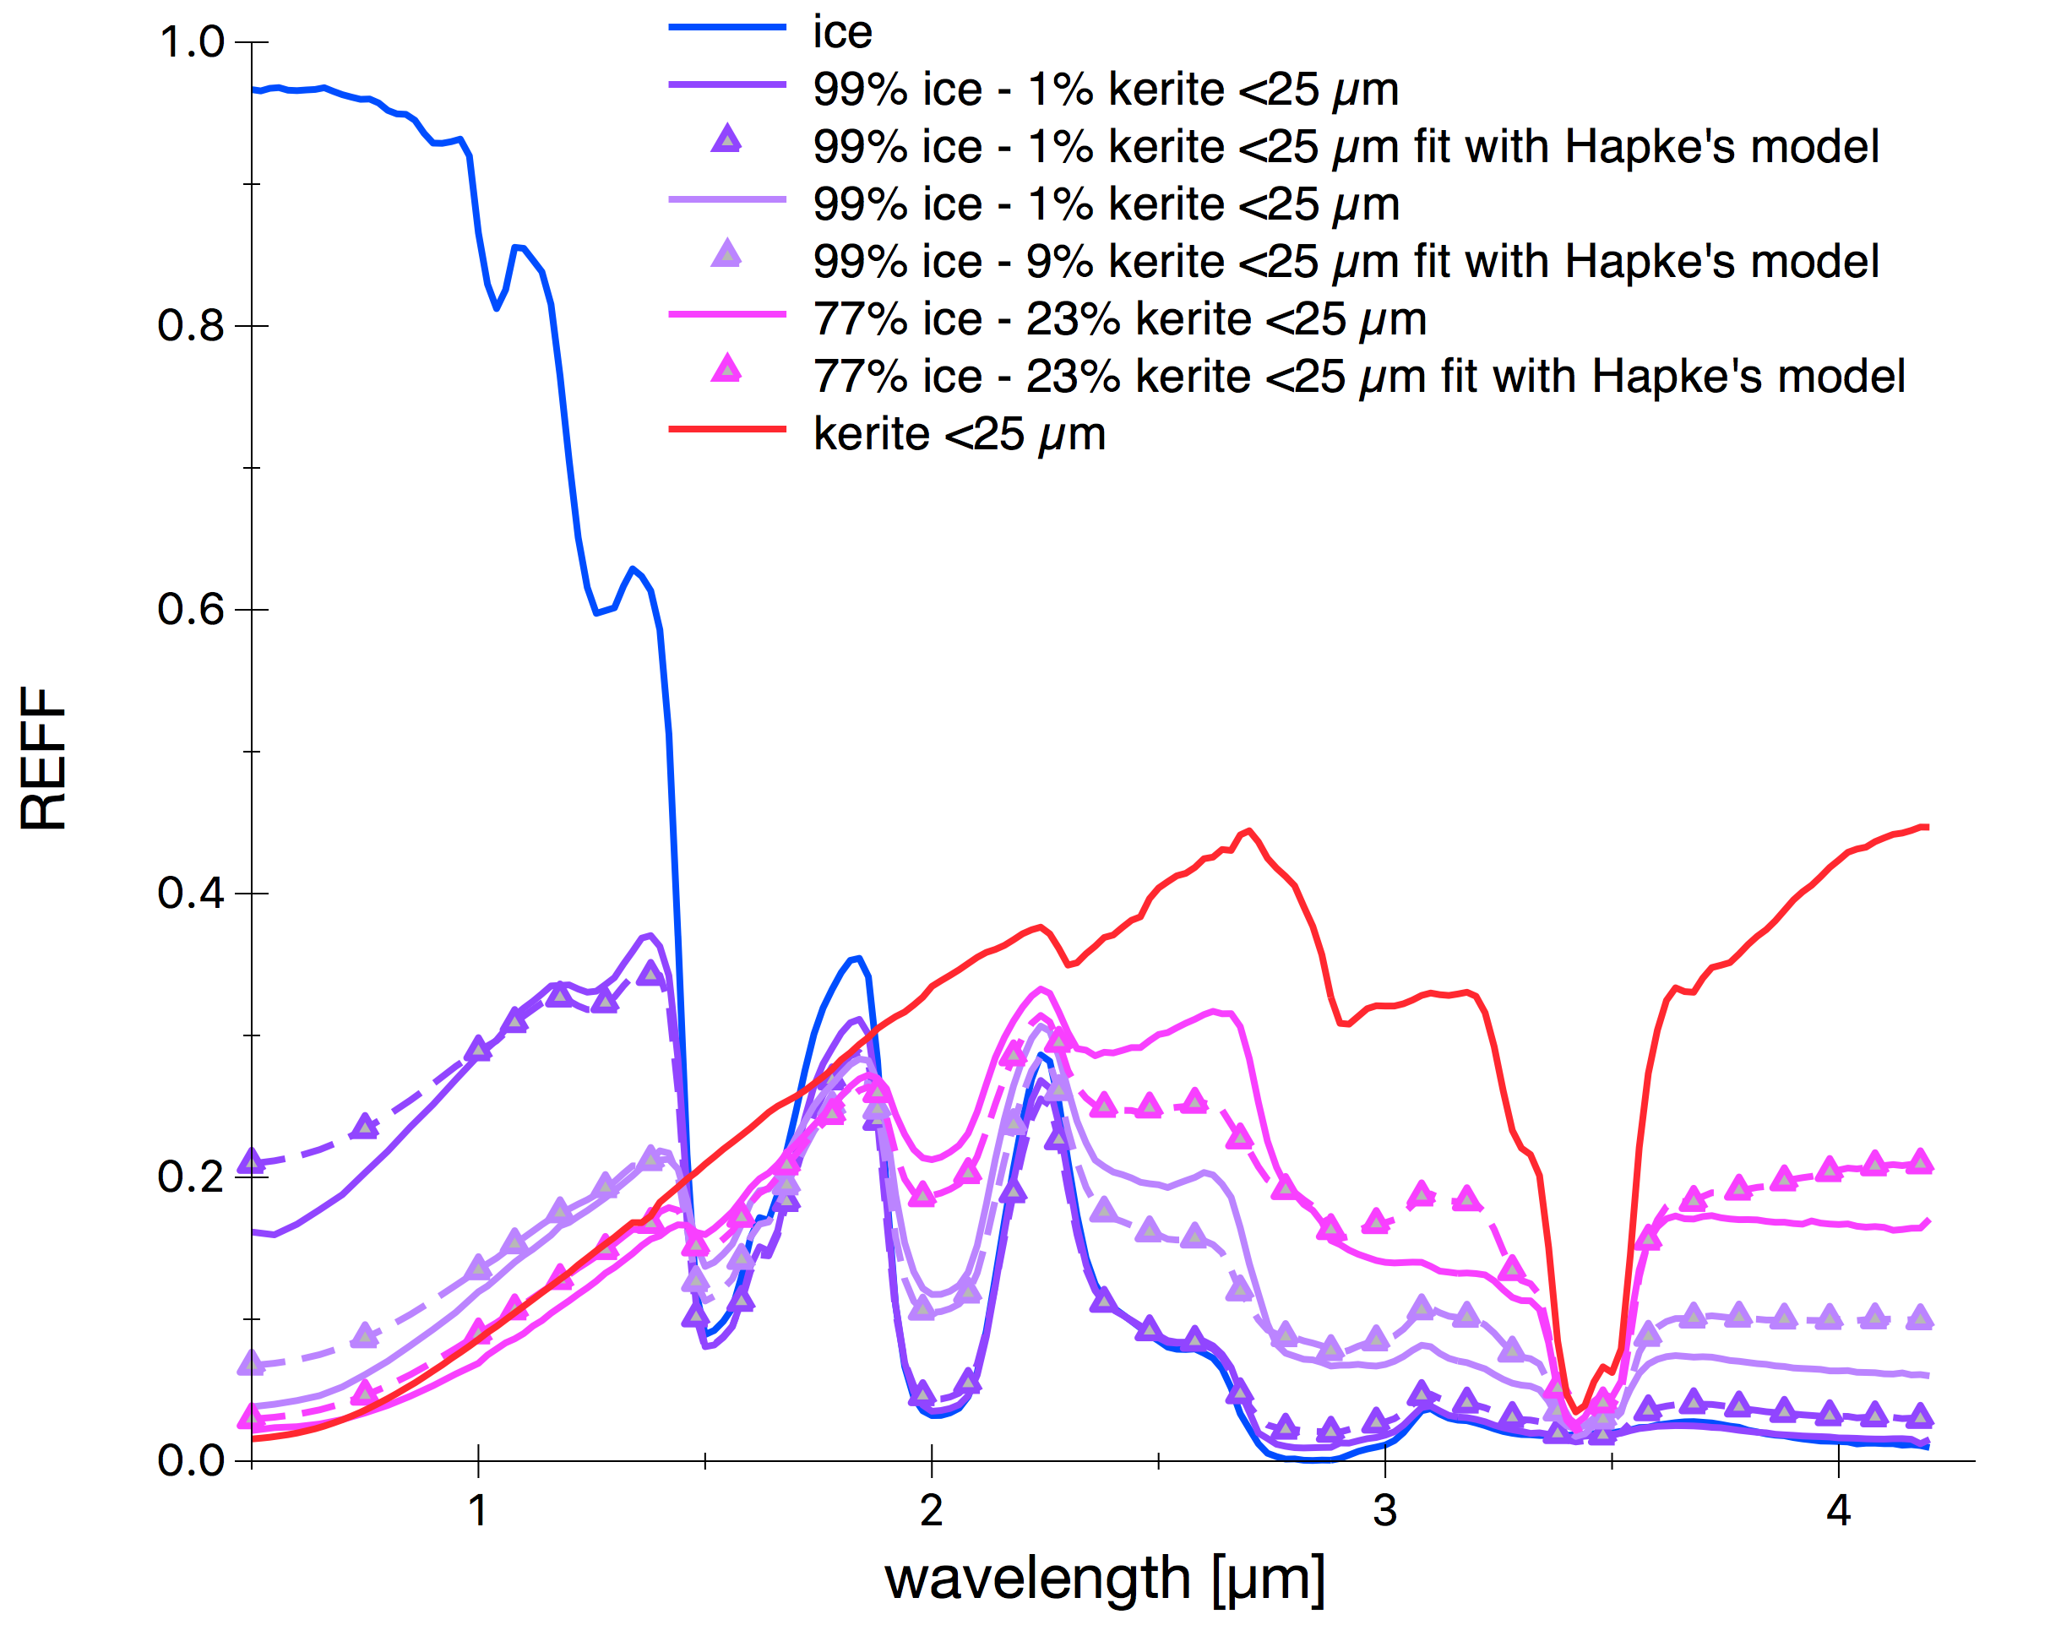
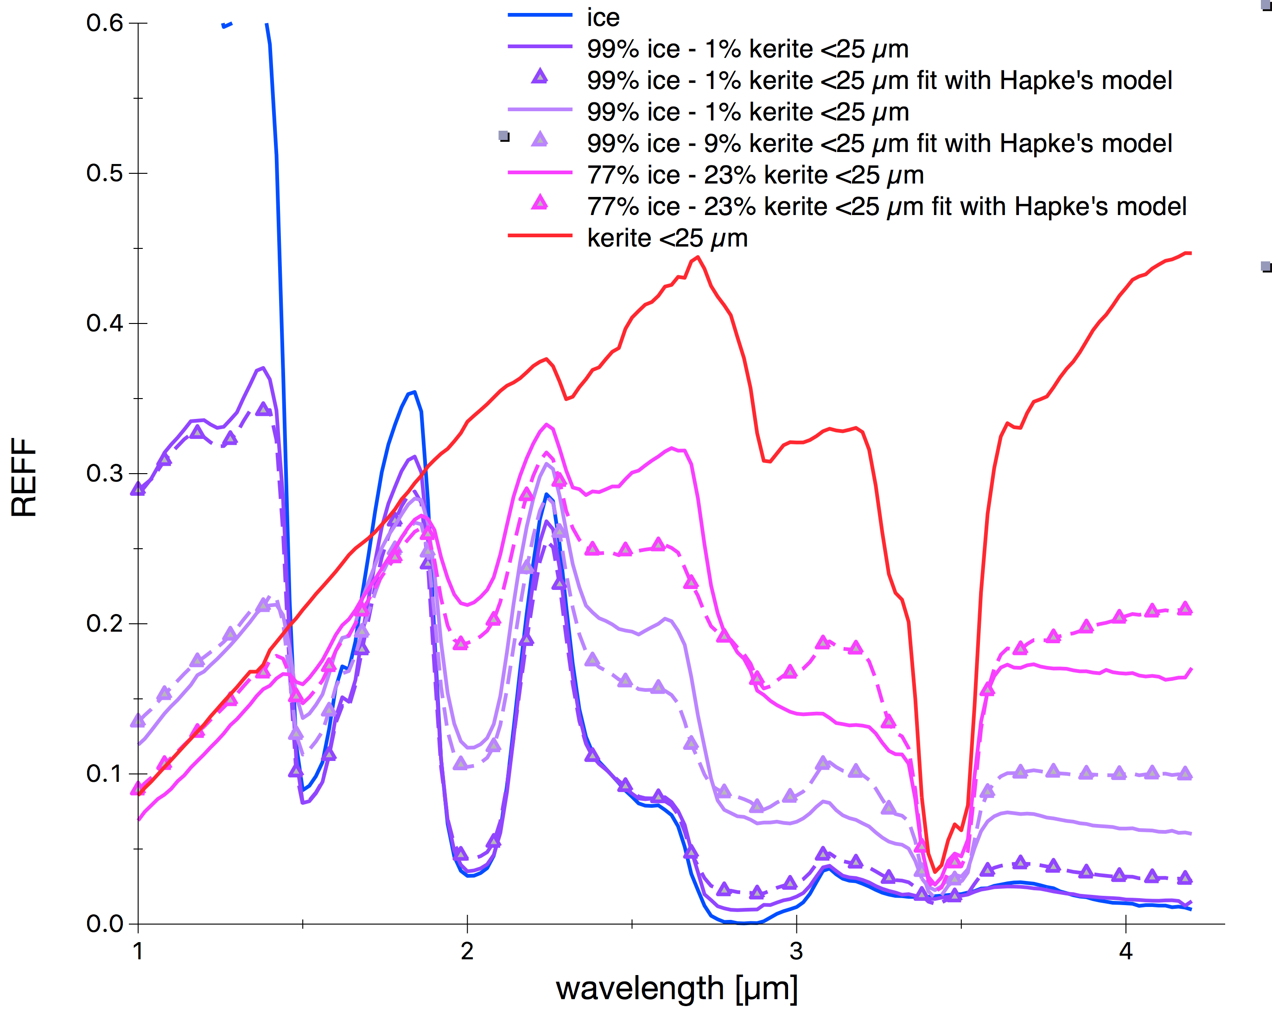
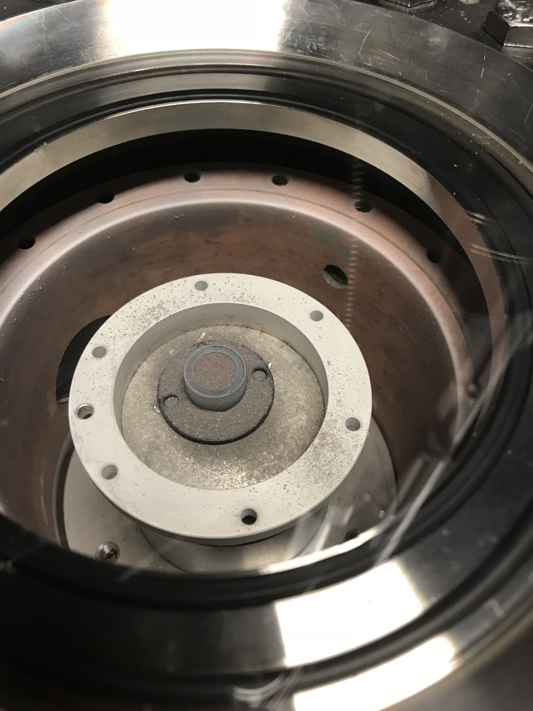
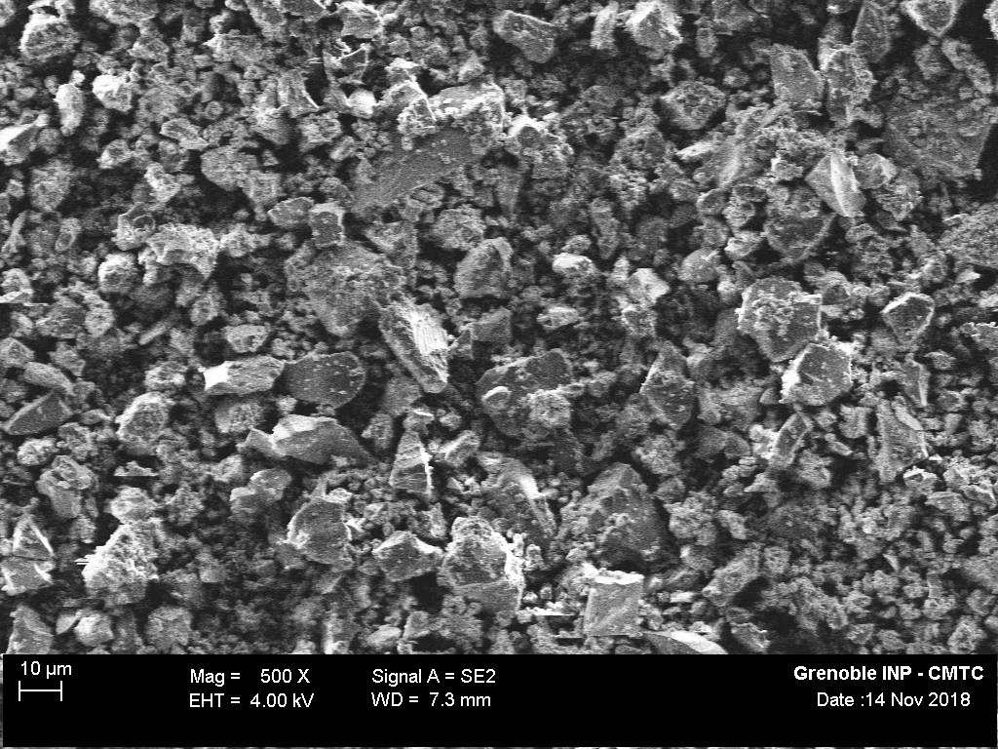
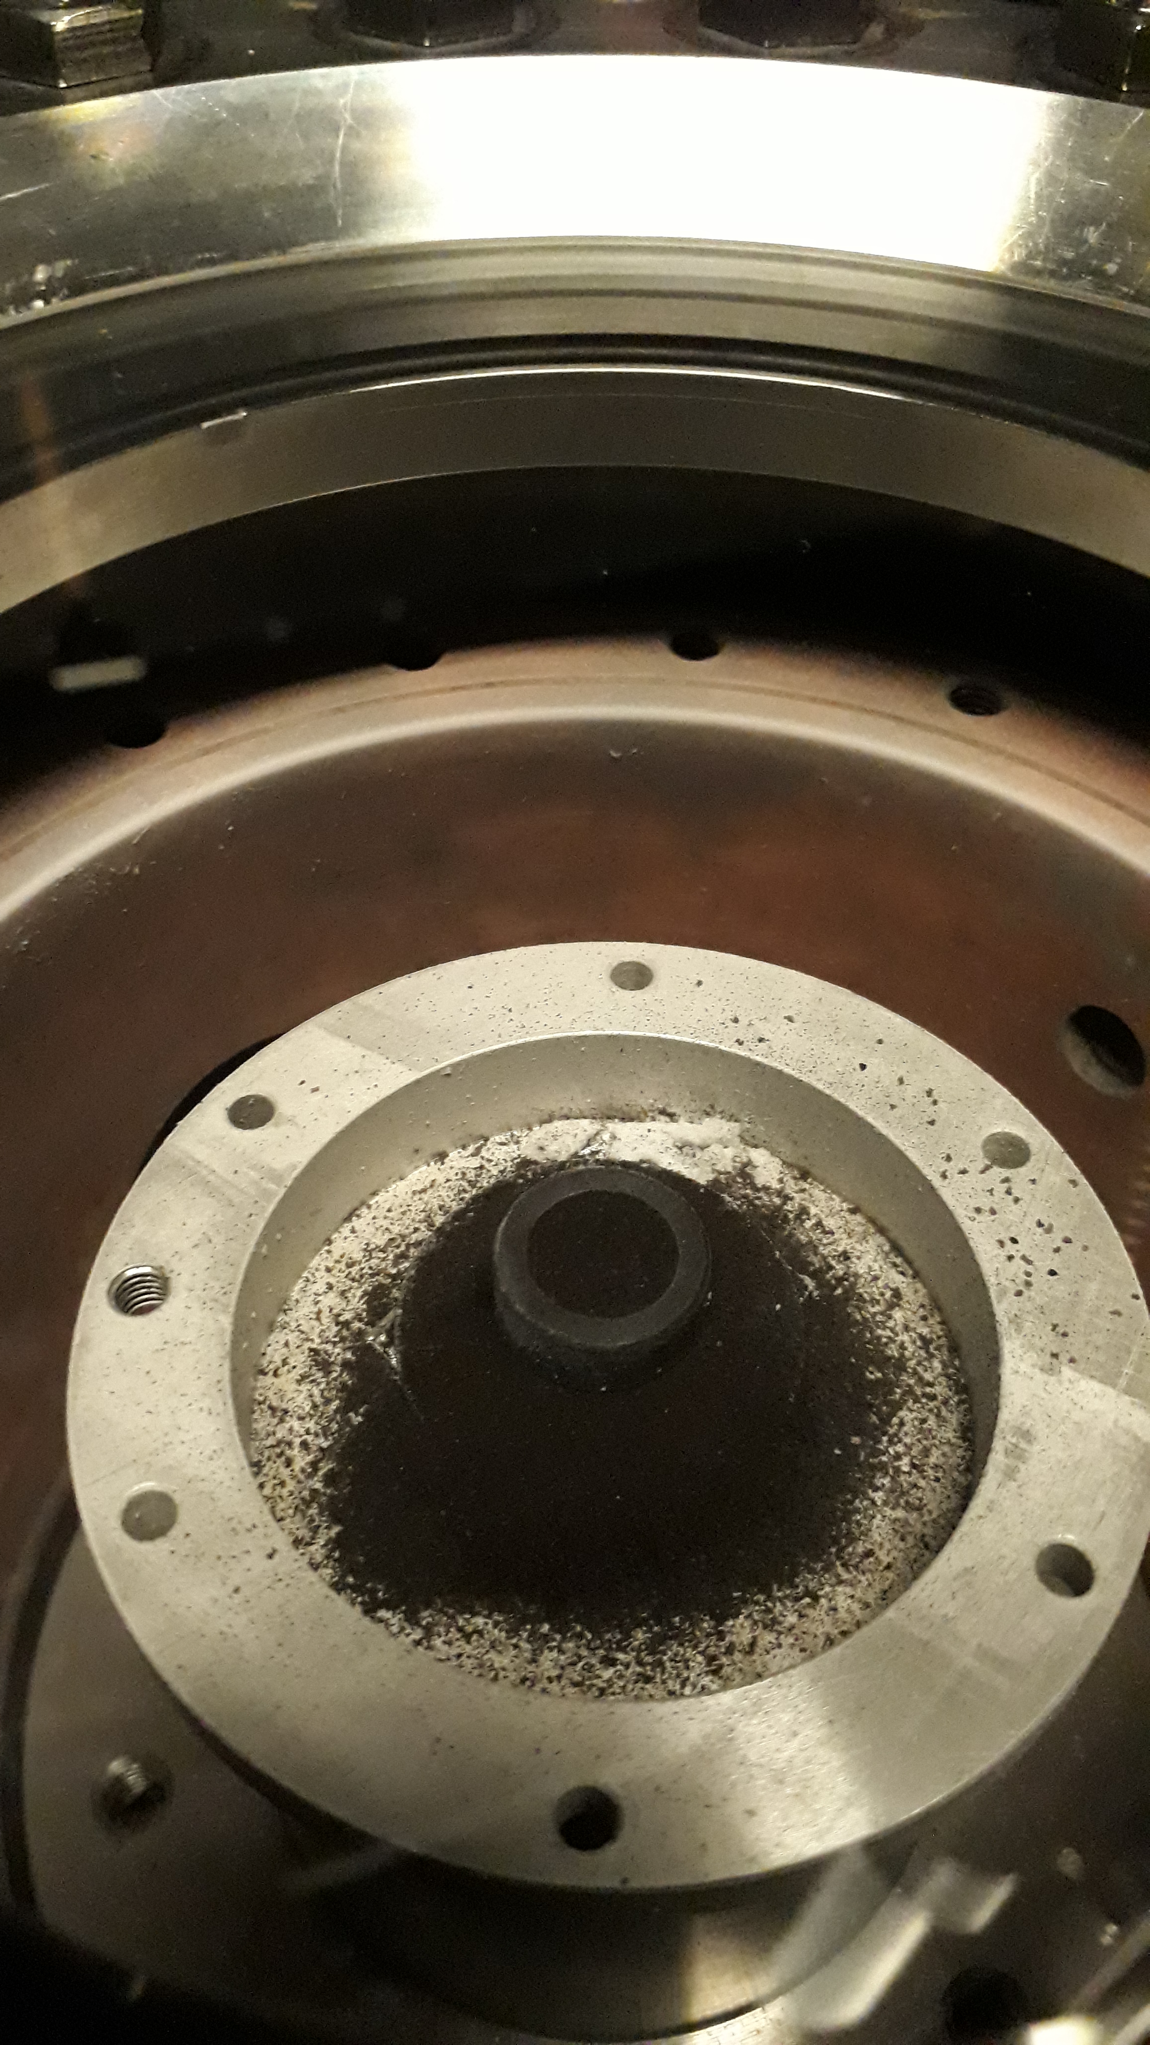
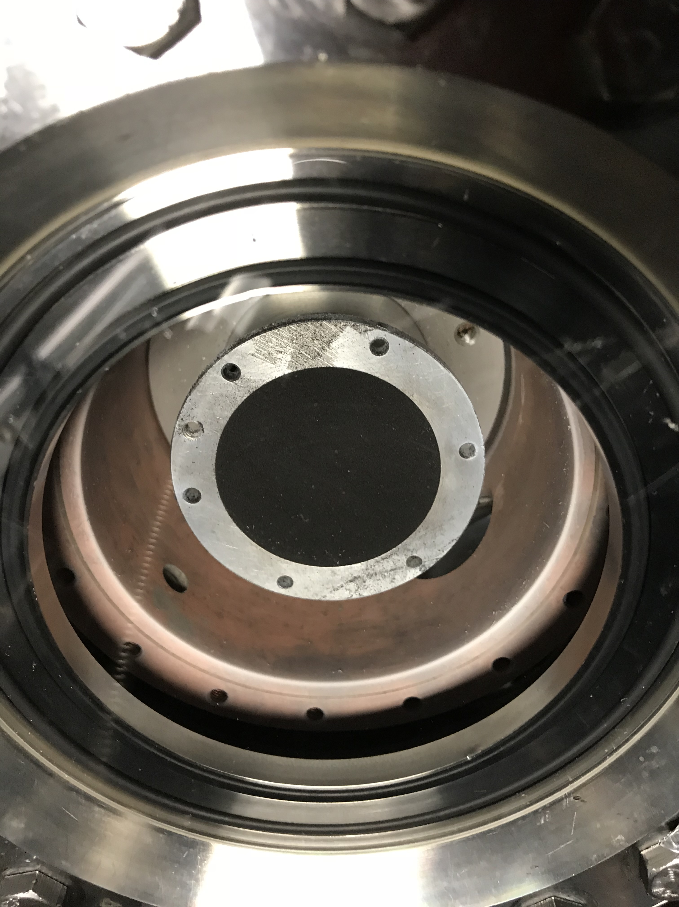
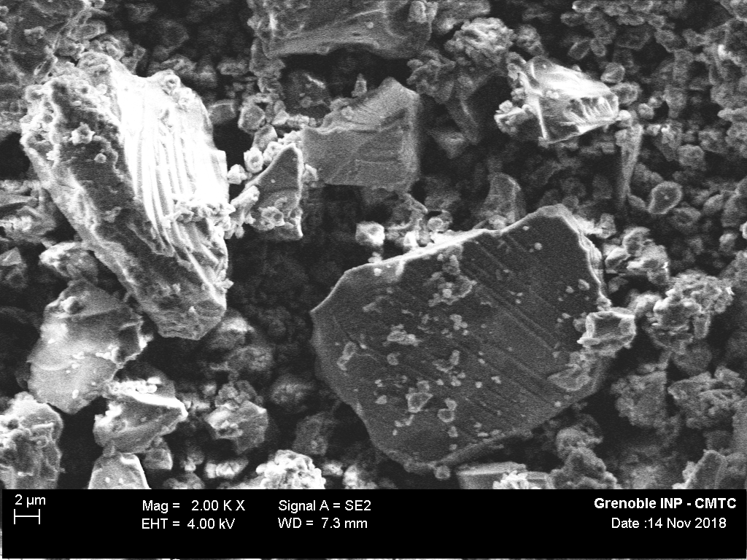
Ice-kerite (fine grained) intimate mixtures (2/2)
SEM images of fine kerite
100% ice
99% ice – 1% kerite
91 % ice -9 % kerite
77% ice - 23 % kerite
100% kerite
measured
-Δ-Δ- fit with Hapke’s model
ZOOM
99% ice - 1% kerite
20 µm
ZOOM
91% ice - 9% kerite
Ice(67±31 µm)-kerite (<25µm) abundance [wt%]
99-1 (99-1)
91-9 (93-7)
77-23 (81-19)
The modelled spectra reproduce fairly well the measured ones: some discrepancies in the Fresnel peak region
The derived abundances are in good agreement with the measured ones
Minor amounts of kerite mixed with ice are easily detected by marked spectral reddening
10 µm
77% ice - 23% kerite
Values in parentheses are derived from Hapke model fitting
Kerite grain size is estimated from SEM images to be of the order of 5 µm
2 µm

Slide 10

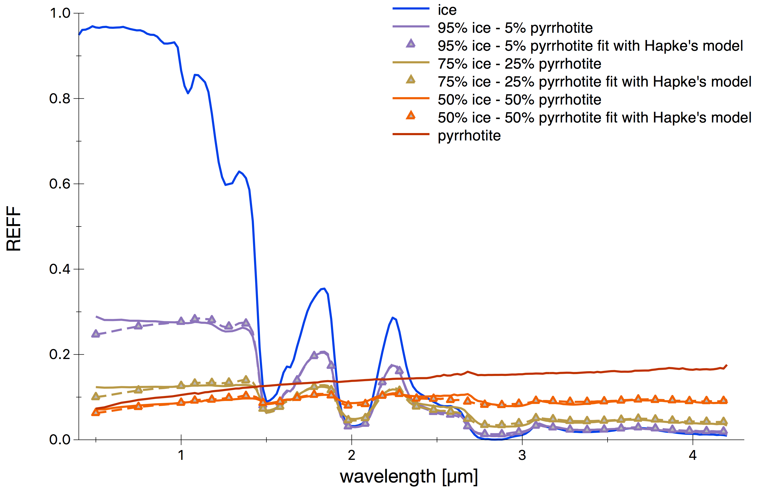
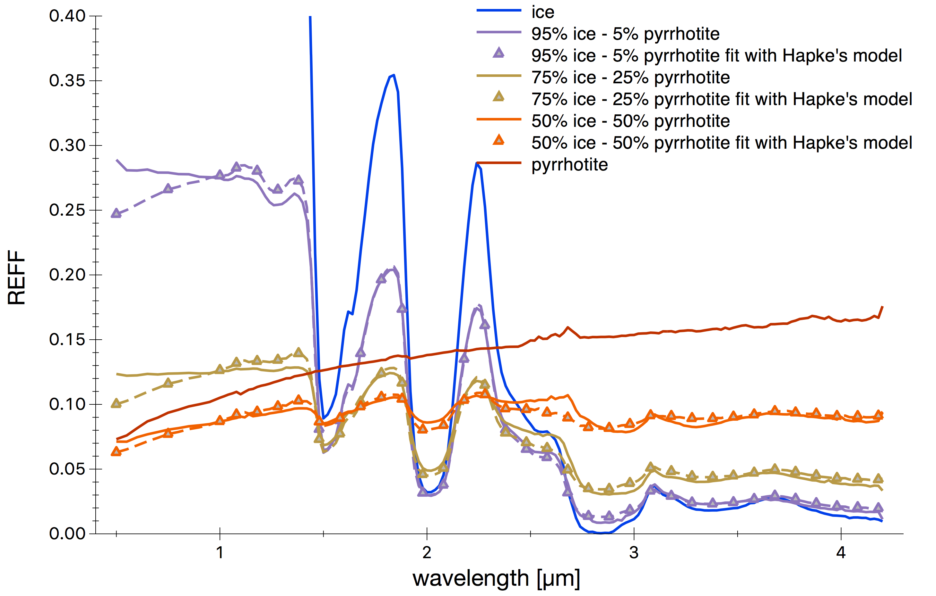
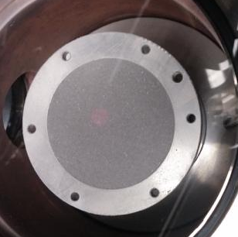
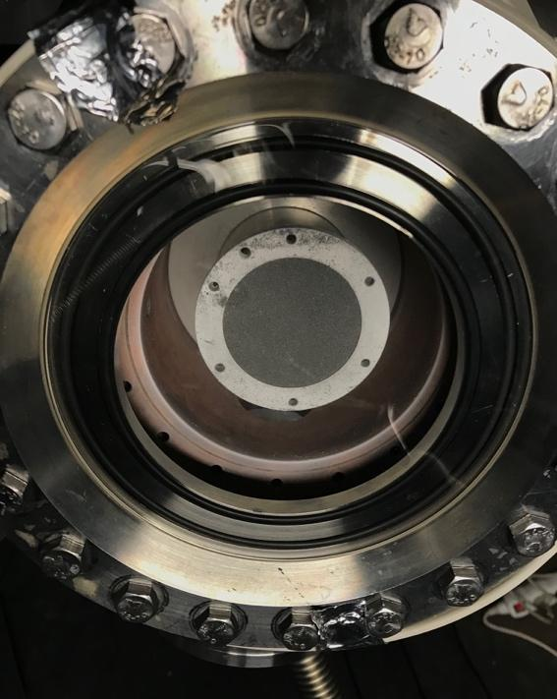
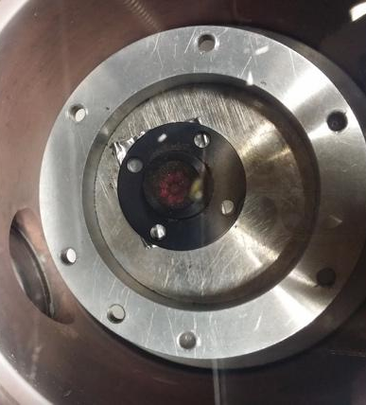
Ice-pyrrhotite intimate mixtures
100% ice
95% ice – 5% pyrrhotite
75 % ice -25% pyrrhotite
50% ice - 50 % pyrrhotite
100% pyrrhotite
measured
-Δ-Δ- fit with Hapke’s model
ZOOM
100% ice
95% ice – 5% pyrrhotite
75 % ice -25% pyrrhotite
50% ice - 50 % pyrrhotite
100% pyrrhotite
measured
-Δ-Δ- fit with Hapke’s model
95% ice - 5% pyrrhotite
75% ice - 25% pyrrhotite
Ice(67±31 µm)-pyrrhotite (25-50 µm) abundance [wt%]
95-5 (54-46)
75-25 (22-78)
50-50 (6-94)
The modelled spectra reproduce reasonably well the measured ones: issues with spectral slope in the VIS for ice-rich mixtures
Pyrrhotite amount is largely overestimated
50% ice - 50% pyrrhotite
Values in parentheses are derived from Hapke model fitting
Pyrrhotite grain size = 37.5 µm

Slide 11

Ice-pyrrhotite intimate mixtures: effects of the grain shape on abundance estimation
Ice(67±31 µm)-pyrrhotite (25-50 µm) abundance [wt%]
95-5 (54-46)
75-25 (22-78)
50-50 (6-94)
95% ice - 5% pyrrhotite
-By assuming pyrrhotite grain size of 37.5 µm.
100 µm
20 µm
-Values in parentheses are derived from Hapke model fitting.
75% ice - 25% pyrrhotite
In SEM images, pyrrhotite grains appear as irregular and flattened.
The assumption of sphericity in the model leads to large overestimation of pyrrhotite abundance.
Abundance estimations of opaque end-members can be severely affected by shape effects in the case of irregular grains. The spectral output is sensitive to the particle cross-section (Hiroi et al., 1992; Yoldi et al., 2015).
50% ice - 50% pyrrhotite
$$w=\frac{\sum_{i}{p_{i}}σ_{i}w_{i}}{\sum_{i}{p_{i}}σ_{i}}$$

Slide 12
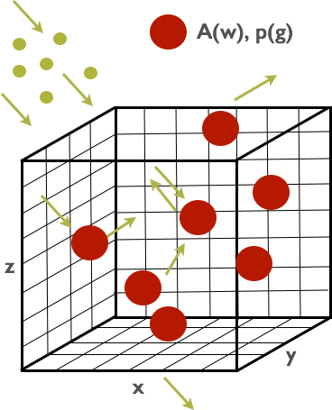
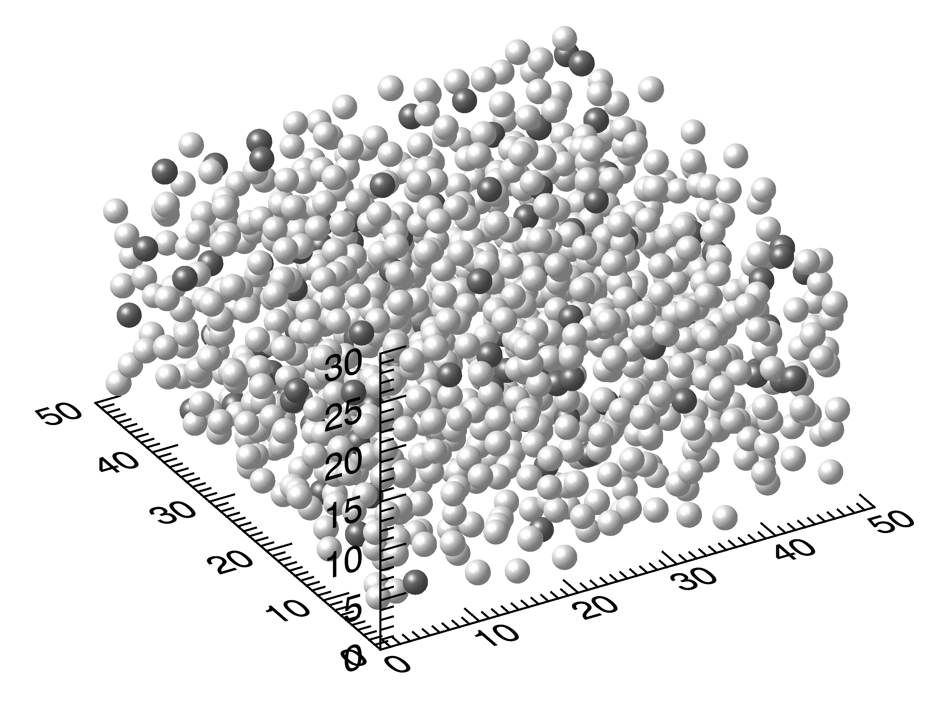
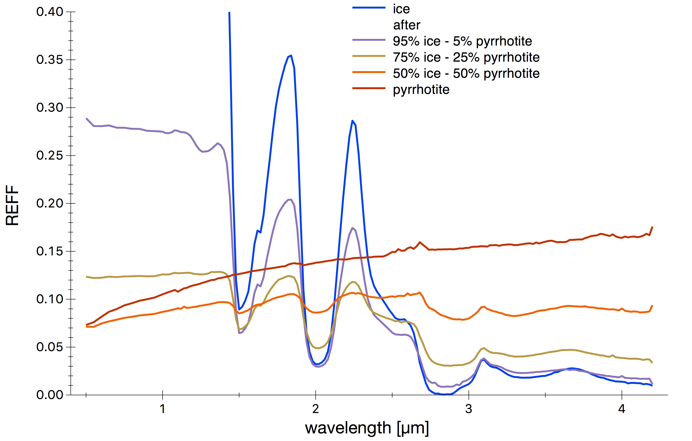
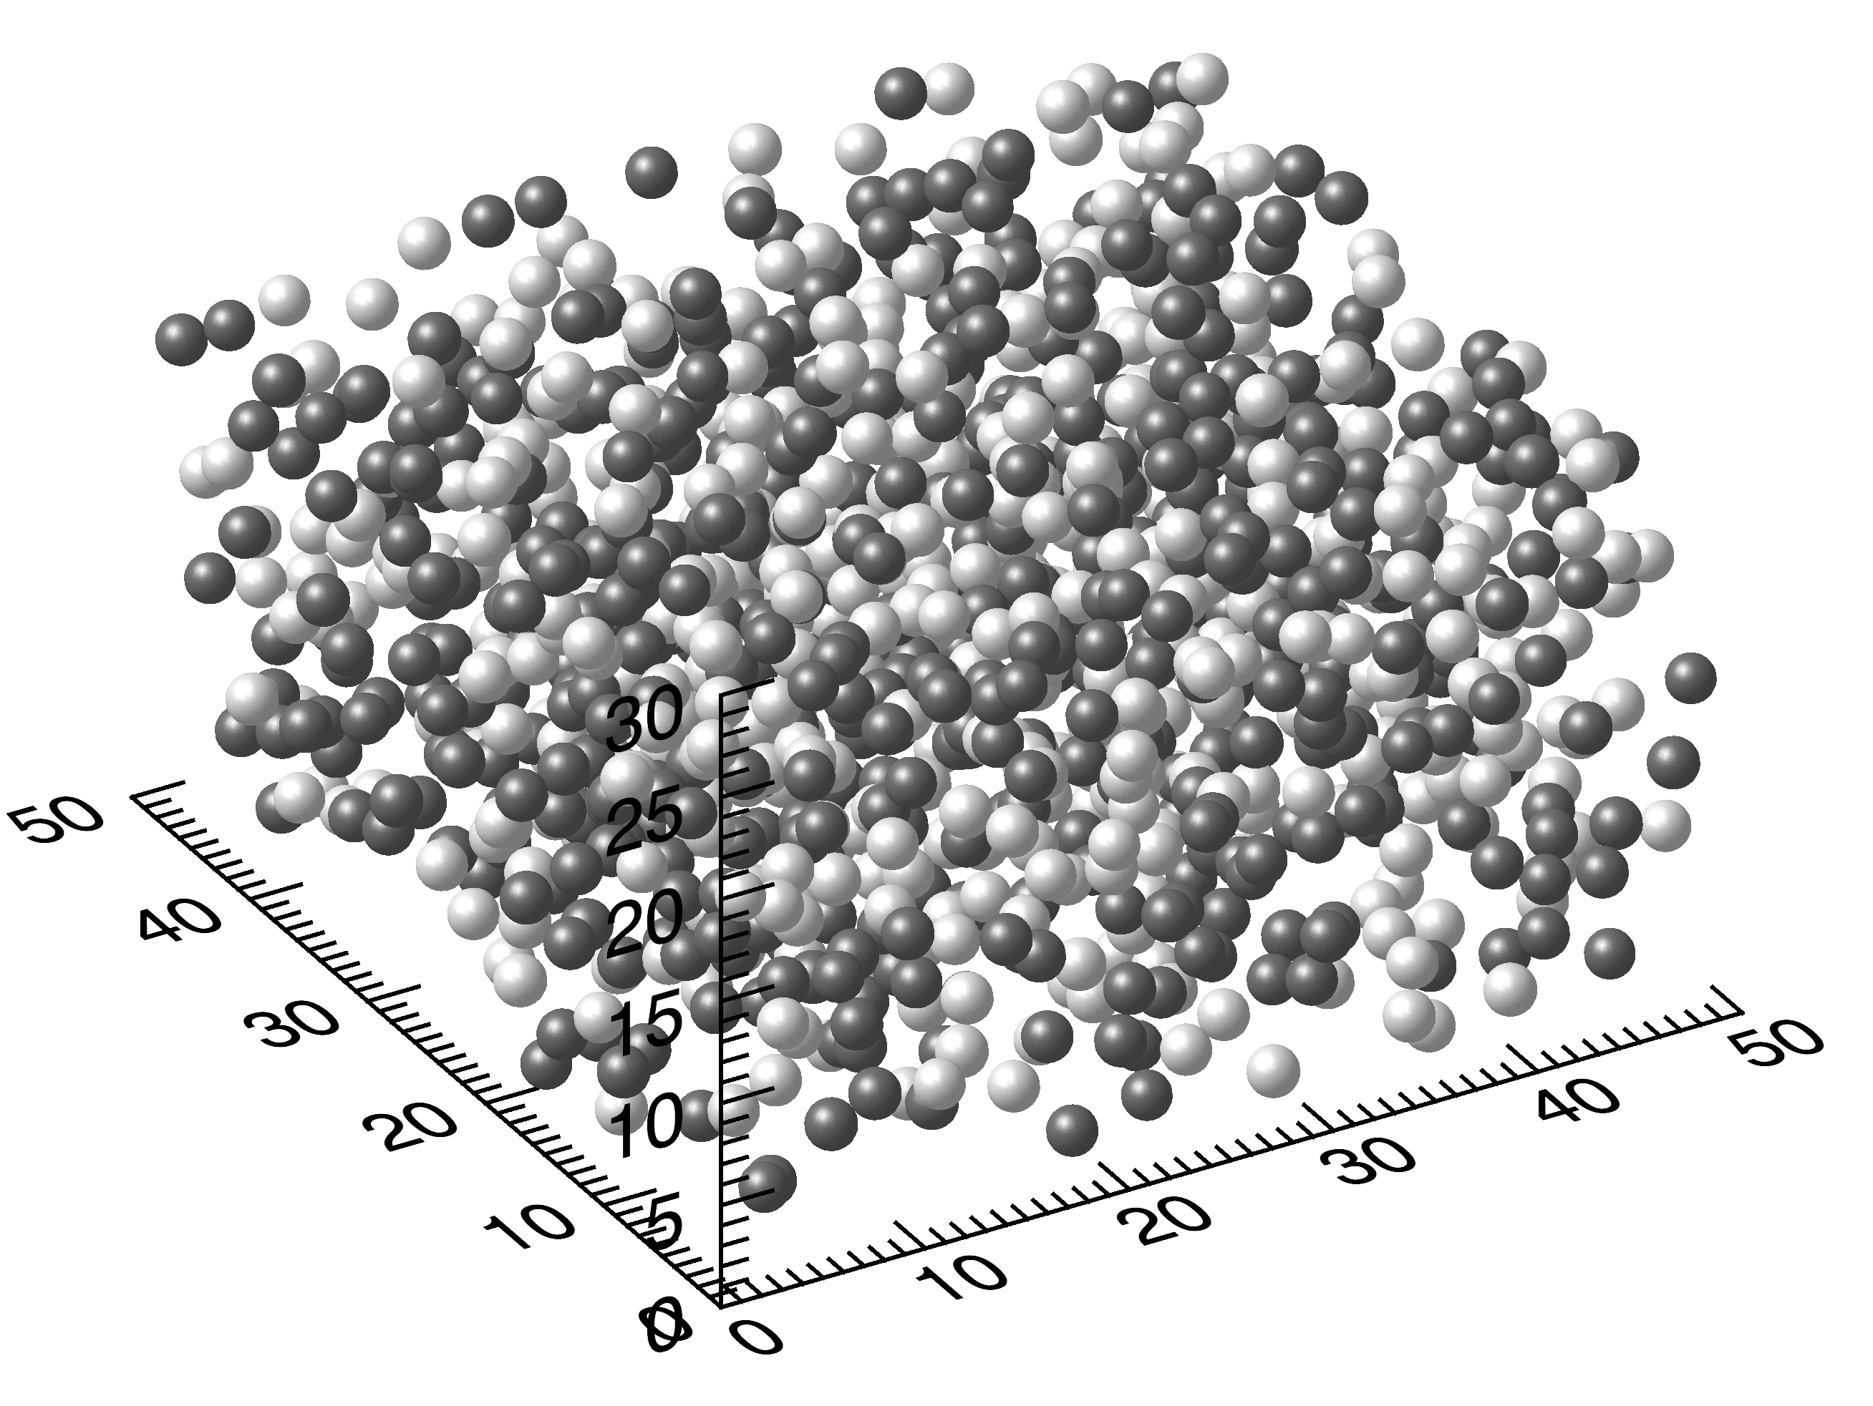
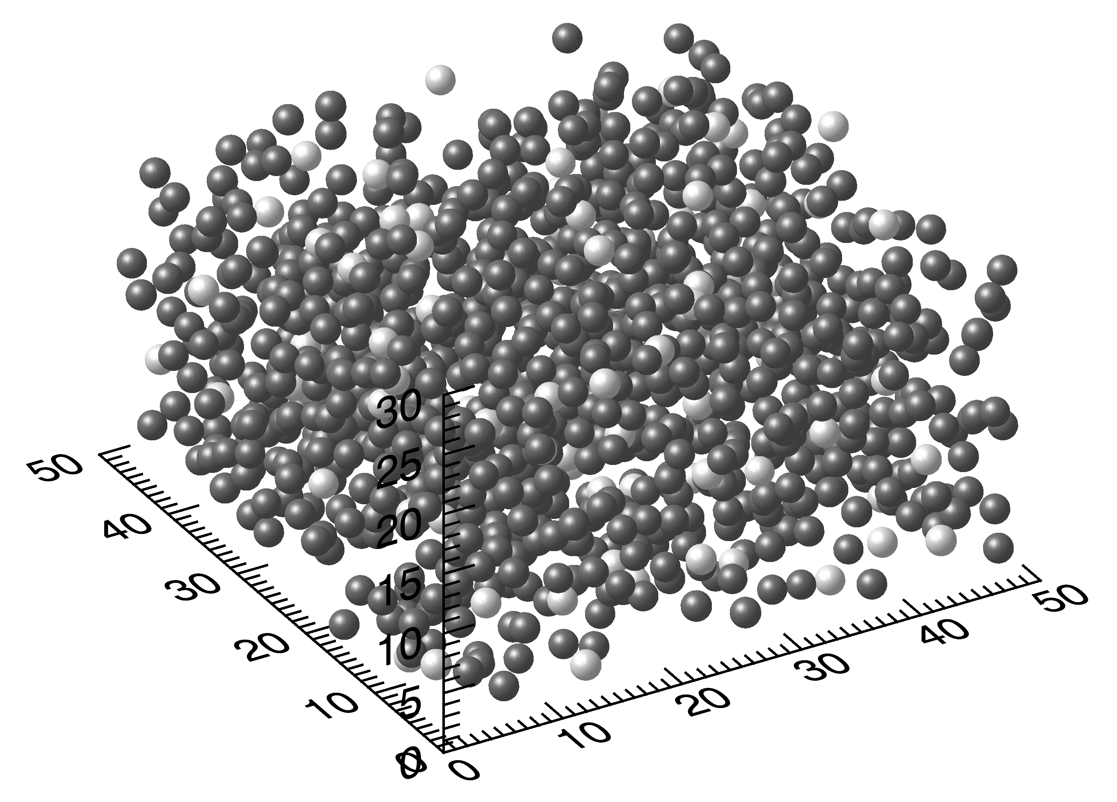
Ice-pyrrhotite intimate mixtures: albedo variation
Mixtures with minor amount of ice appear darker than pure pyrrhotite (minor effect also in kerite-ice mixtures): effect of forward scattering from transparent icy grains?
Monte Carlo ray-tracing simulations
90%-10% mixture
SSA, p(α)
ZOOM
100% ice
95% ice – 5% pyrrhotite
75 % ice -25% pyrrhotite
50% ice - 50 % pyrrhotite
100% pyrrhotite
50%-50% mixture
With MC ray-tracing we simulate the scattering process in an intimate mixture of particles characterized by different optical properties in terms of SSA and p(α)
10%-90% mixture

Slide 13
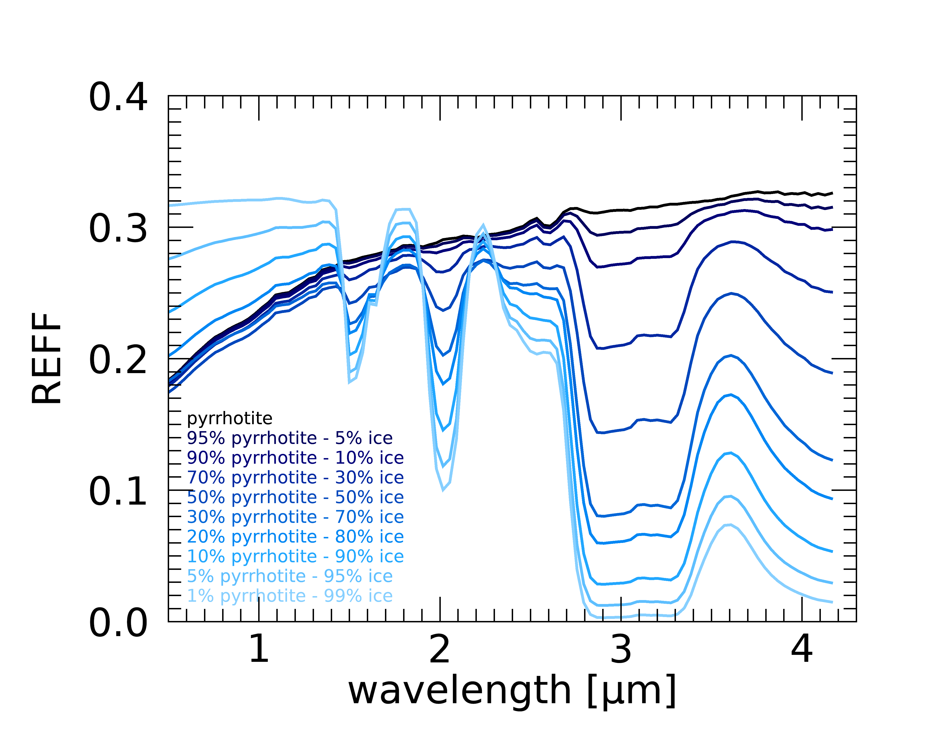
Ice-pyrrhotite intimate mixtures: albedo variation
MC ray-tracing simulations (Ciarniello, et al., 2014)
Back-scattering pyrrhotite-like grains + Forward-scattering ice-like grains
ZOOM
100% ice
95% ice – 5% pyrrhotite
75 % ice -25% pyrrhotite
50% ice - 50 % pyrrhotite
100% pyrrhotite
Transparent (forward-scattering) water ice particles push light deeper into the medium.
This may provide a reduction of the overall reflectance with increasing amount of water ice
This trend eventually reverses for larger amount of ice in the mixture
VIS albedo is not necessarily a good proxy for water ice abundance estimation

Slide 14

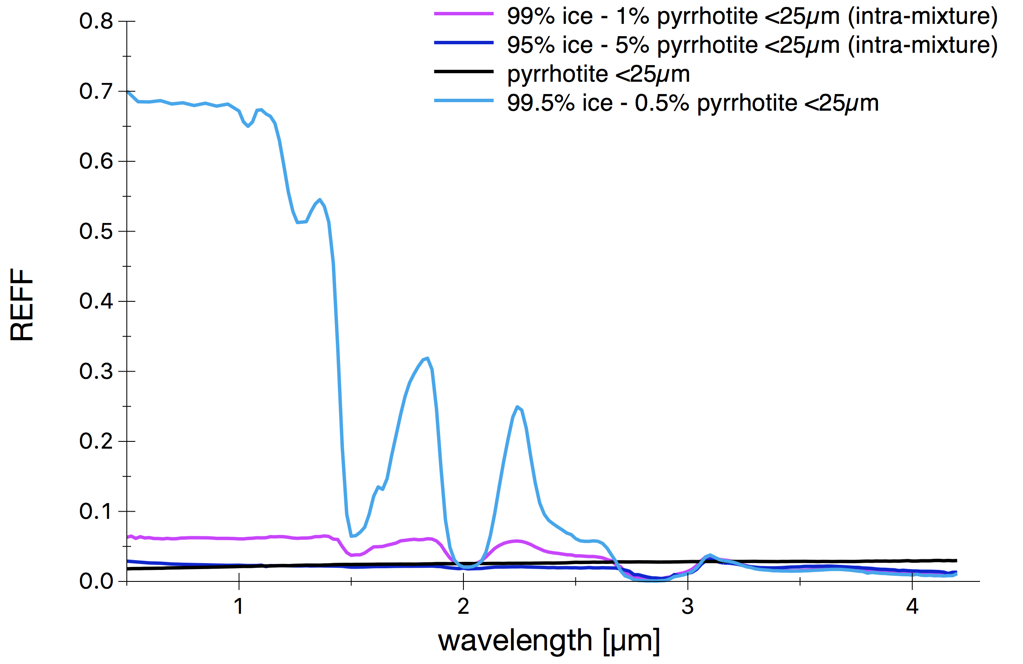
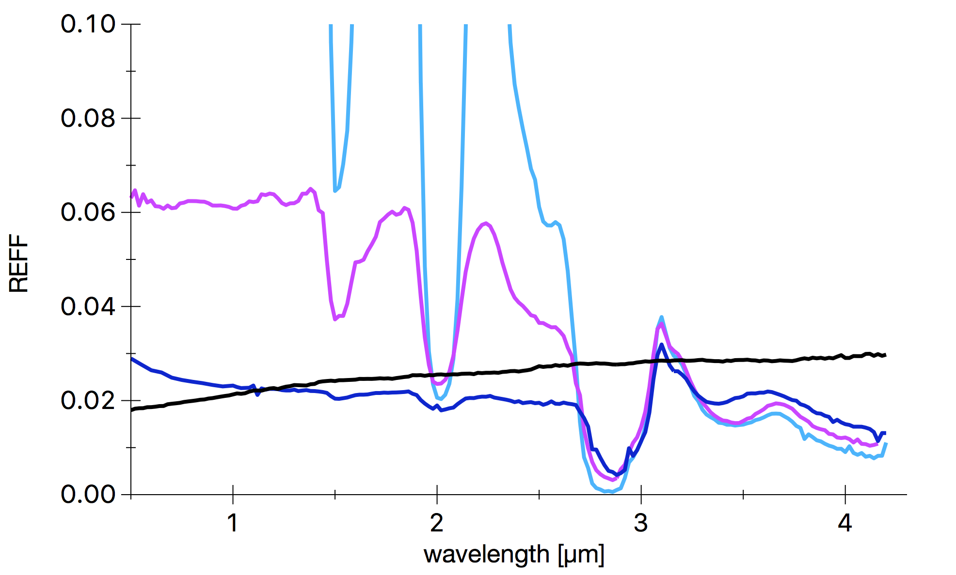
Intra-particle mixtures
99.5% ice – 0.5% pyrrhotite (intra-part.)
99 % ice -1% pyrrhotite (intra-part.)
95% ice - 5 % pyrrhotite (intra-part.)
100% fine grained pyrrhotite
ZOOM
Fine pyrrhotite grains are mixed with water. Water-pyrrhotite droplets are frozen in liquid N₂
Extremely effective darkening: 1% pyrrhotite reduces water ice reflectance at VIS wavelengths by a factor ~15
Fresnel peak is nearly not affected by the presence of pyrrhotite

Slide 15


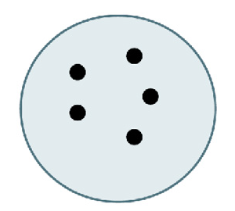
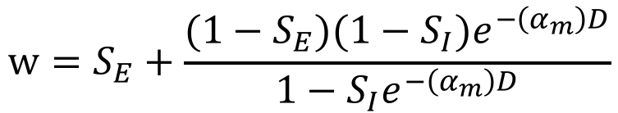
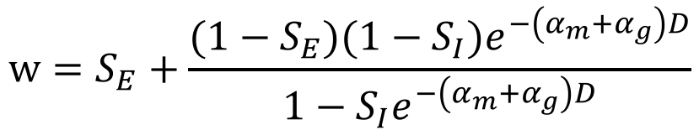
Intraparticle mixtures: models
In Hapke theory the SSA (w) is a function of the optical constants and grain size
$$w=S_{E}+\frac{(1−S_{E})({1−S}_{I})e^{−\left(α_{m}\right)D}}{1−S_{I}e^{−\left(α_{m}\right)D}}$$
S_{E}: External scattering, function optical constants (n,k)
S_{I}: Internal scattering, function of optical constants (n,k)
α_{m}: absorption in the particle (function of k)
D: grain size
(Hapke, 2012)
Homogenous particle with inclusions of finite size: add absorption of inclusions from Mie theory (Lucey & Riner 2011, LR11)
Heterogeneous particle at scale <<λ: homogenous grain with effective optical constants
$$w=S_{E}+\frac{(1−S_{E})({1−S}_{I})e^{−\left(α_{m}{+α}_{g}\right)D}}{1−S_{I}e^{−\left(α_{m}{+α}_{g}\right)D}}$$
+ =
Maxwell-Garnett (MG) equation (Maxwell & Garnett 1904)
Absorption efficiency from Mie theory
Size of inclusions

Slide 16
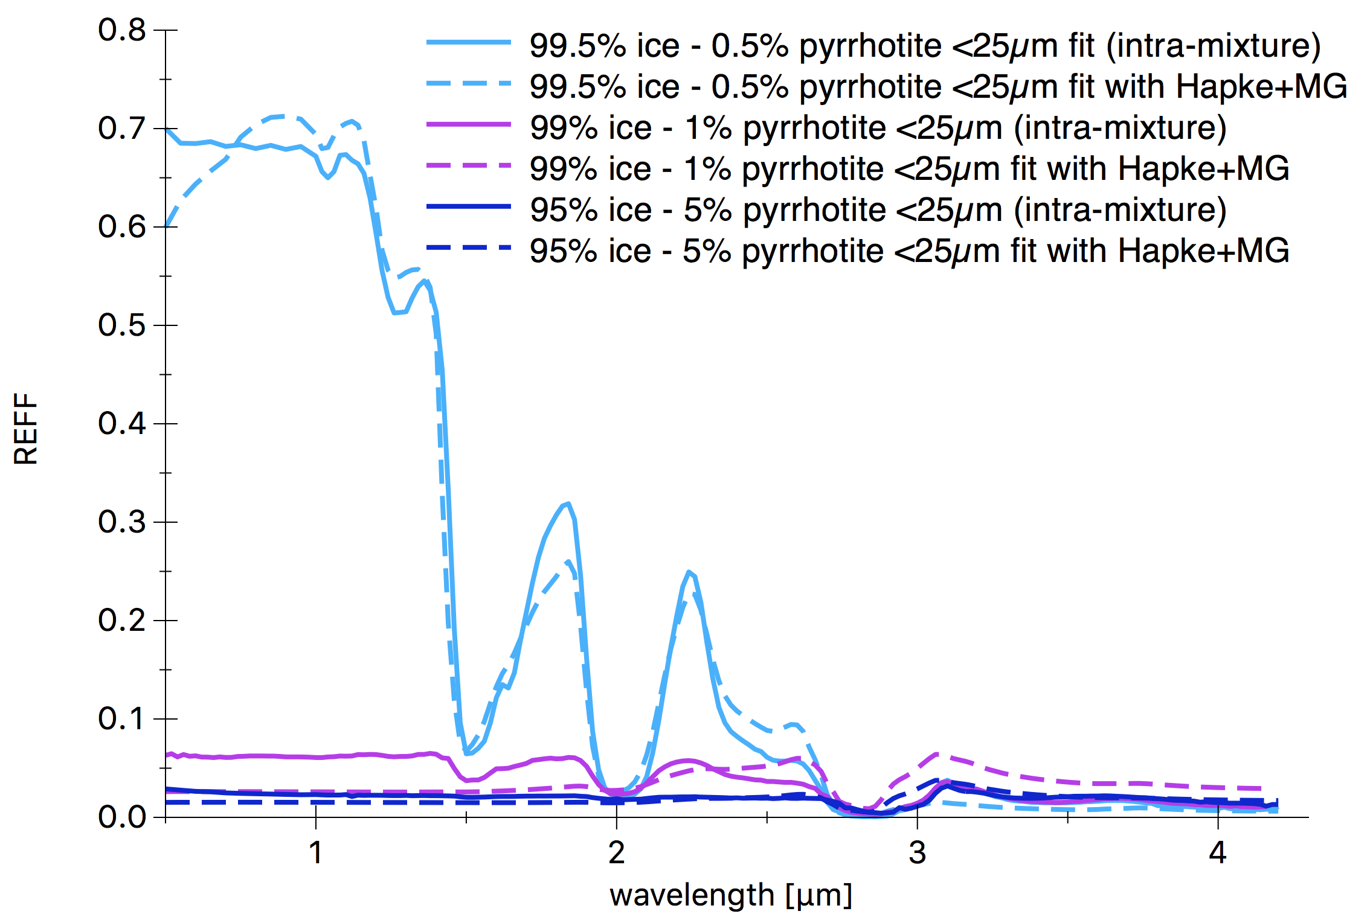
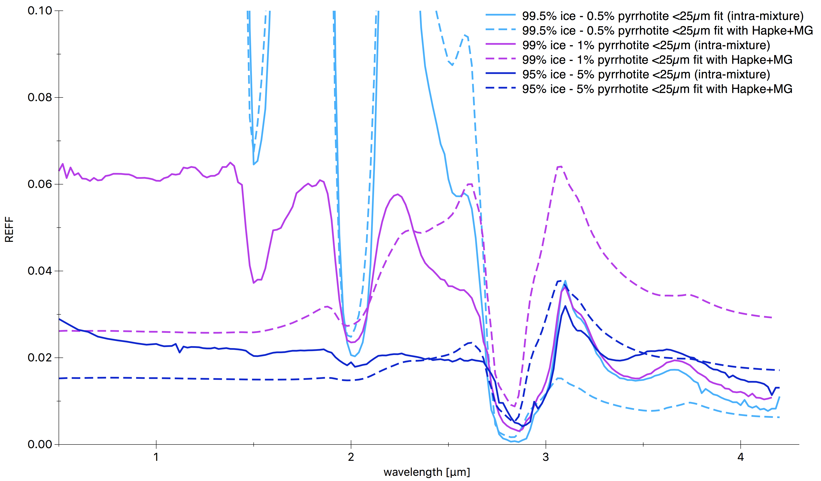
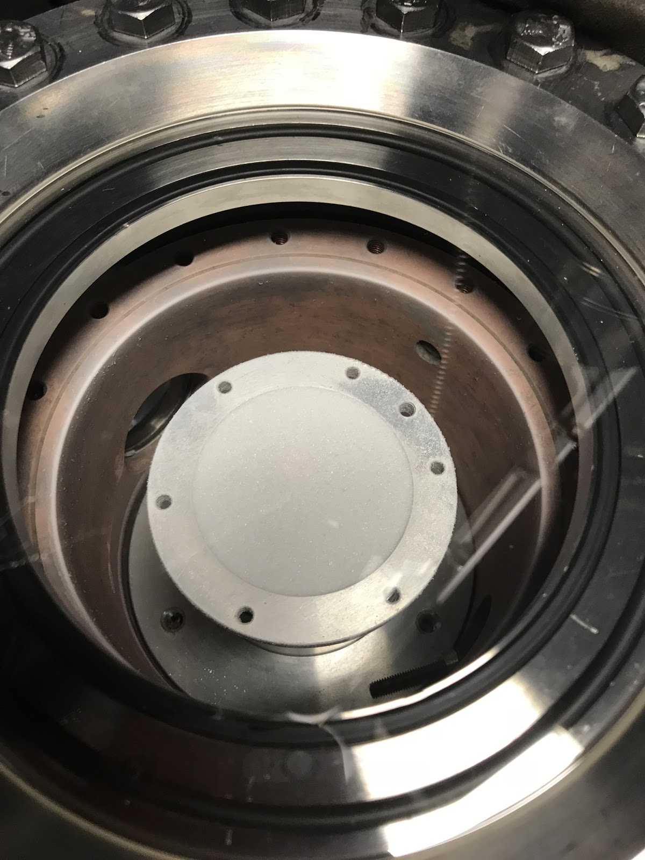
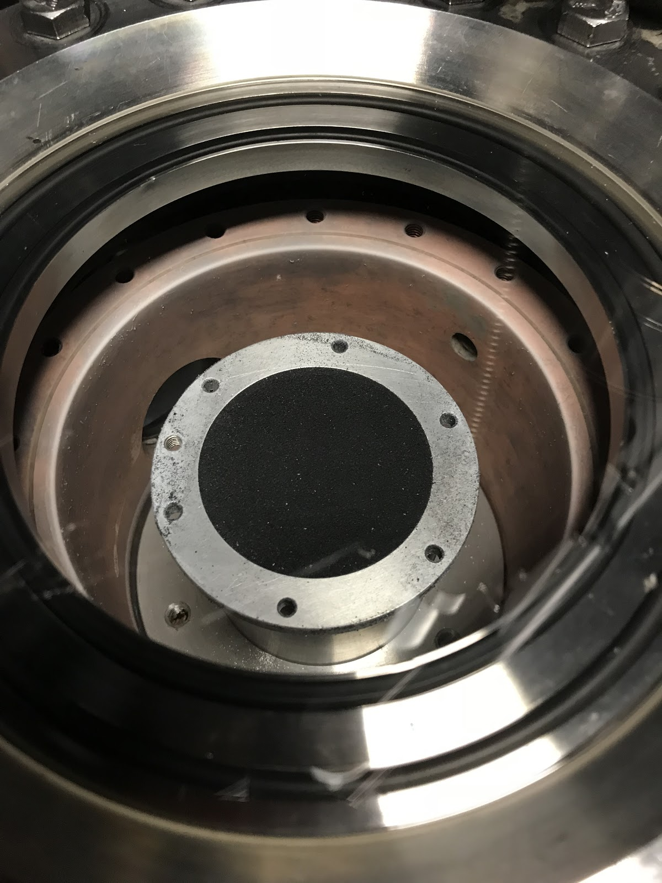
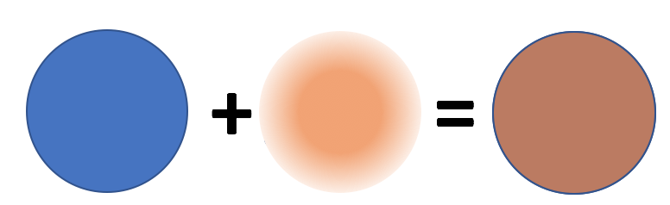
Ice-pyrrhotite Intraparticle mixtures: fit with Hapke model + MG
99% ice – 0.5% pyrrhotite
Figure. 13. Appearance of the ice-pyrrhotite intra-mixtures. Left: 99.5% ice -0.5% pyrrhotite. Right 95% ice – 5% pyrrhotite.
95% ice - 5% pyrrhotite
Optical constants of ice from Clark et al., (2012) and
Pyrrhotite optical constants were measured at ISAS Berlin and kindly provided by U. Schade.
Fine grained pyrrhotite in intraparticle mixing dramatically reduces water ice albedo
The Maxwell-Garnett (MG) theory is not able to properly account for the effect of the pyrrhotite inclusion
Pyrrhotite grains are likely characterized by a finite size and the ice-pyrrhotite grains cannot be considered as homogeneous at the scale of the wavelength

Slide 17
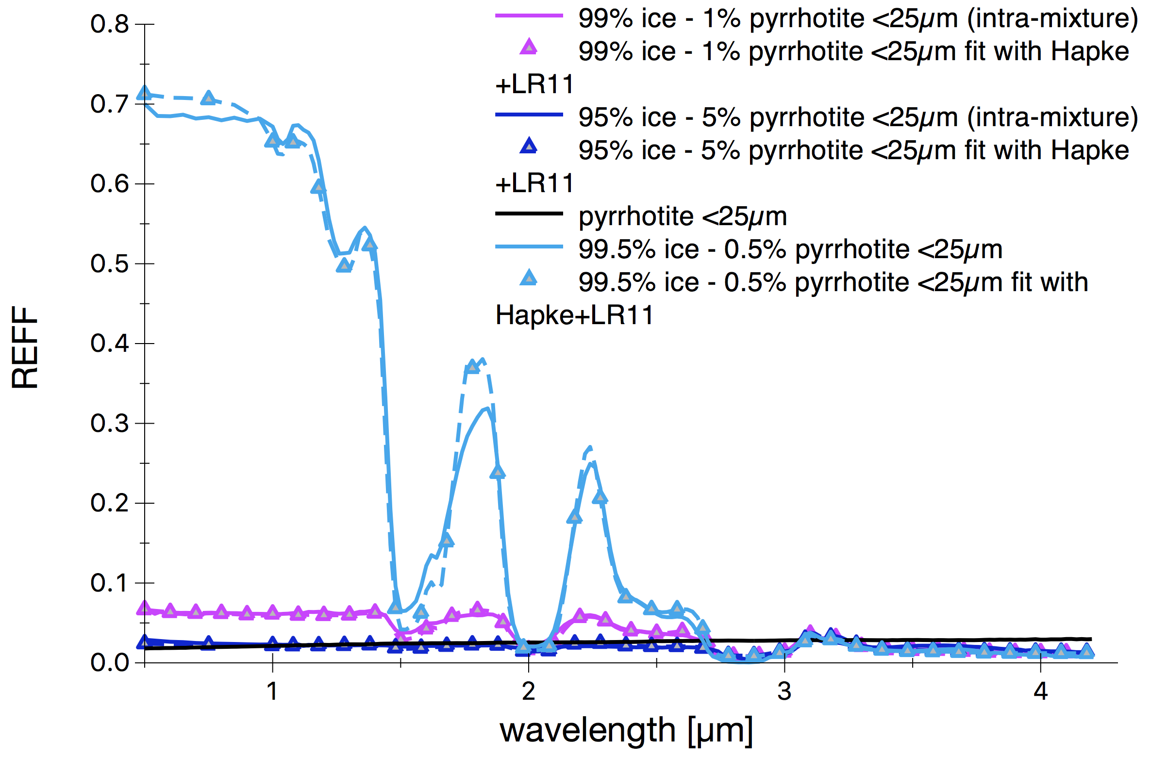
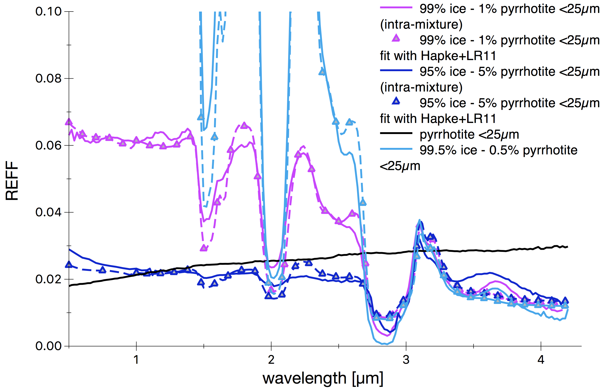

Ice-pyrrhotite Intraparticle mixtures: fit with Hapke model + LR11
Optical constants of ice from Clark et al., (2012)
Pyrrhotite optical constants were measured at ISAS Berlin and kindly provided by U. Schade.
99.5% ice – 0.5% pyrrhotite (intra-part.)
99 % ice -1% pyrrhotite (intra-part.)
95% ice - 5 % pyrrhotite (intra-part.)
100% fine grained pyrrhotite
measured
-Δ-Δ- fit with Hapke’s model+LR11
99.5% ice – 0.5% pyrrhotite (intra-part.)
99 % ice -1
% pyrrhotite (intra-part.)
95% ice
99% ice – 0.5% pyrrhotite
ZOOM
Light interacting on the grain surface
Scattering from
inclusions
95% ice - 5% pyrrhotite
$α_{g}$= $α_{Mie}=\frac{3q_{a}M_{g}ρ_{m}}{d_{g}ρ_{g}}$
The model reproduces qualitatively the observed behaviour.
Bluening at small wavelengths is suggestive of scattering from fine grained pyrrhotite inclusions
The 1.5, 2 and 3-µm bands are clearly visible, although strongly reduced in intensity
The prominent, almost constant, Fresnel peak is explained by light interacting on the surface of the water ice grain, encountering minor amounts of pyrrhotite inclusions
Ice-pyrrhotite (intra-mix) [wt%] | Inclusions size [µm] | Ice-pyrrhotite grain size [µm]
99.5-0.5 (99.975-0.025) | (1.9) | 67±31 (220)
99-1 (assumed) | (0.7) | 67±31 (156)
95-5 (assumed) | (1.0) | 67±31 (122)
Values in parentheses are derived from Hapke model fitting.

Slide 18
Summary and conclusions
Reflectance spectra of mixtures of ice-kerite-pyrrhotite have been measured in the 0.5-4.2 µm spectral range at the CCS facility at IPAG (Grenoble, France)
Hapke modeling of ice-kerite mixtures suggests it can provide reasonable abundance estimation in mixtures of ice and organics (semi-transparent)
The assumption of spherical grains in the description of irregular (not equant) particles may lead to large overestimation of neutral opaque phases.
Ice-pyrrhotite mixtures can be darker than pure pyrrhotite: light is pushed deeper in the medium by forward-scattering transparent icy grains.
  VIS albedo appears not to be a good proxy for constraining water ice abundance in mixtures with opaque phases.
Intra-particle mixing is an extremely effective modality to darken water ice and can be qualitatively modelled by the description of Lucey&Riner (2011).
  Intra-particle mixture of ice and opaque contaminants should exhibit a prominent Fresnel peak
Ongoing & Future activity:
  comparison with Shkuratov model
  Spectral modeling of pure water ice (O. Poch)

Slide 19
Intra-particle mixtures: model
In Hapke’s theory SSA (w) can be computed as function of optical constants and grain size:
$$w=S_{E}+\frac{(1−S_{E})({1−S}_{I})e^{−\left(α_{m}\right)D}}{1−S_{I}e^{−\left(α_{m}\right)D}}$$
S_{E}: External scattering, function optical constants (n,k)
S_{I}: Internal scattering, function of optical constants (n,k)
α_{m}: absorption in the particle (function of k)
D: grain size
(Hapke, 2012)
Homogenous particle with inclusions of finite size: additional absorption of inclusions as derived from Mie theory (Lucey & Riner 2011, LR11)
99.5% ice – 0.5% pyrrhotite (intra-part.)
99 % ice -1% pyrrhotite (intra-part.)
95% ice - 5 % pyrrhotite (intra-part.)
100% fine grained pyrrhotite
$$w=S_{E}+\frac{(1−S_{E})({1−S}_{I})e^{−\left(α_{m}{+α}_{g}\right)D}}{1−S_{I}e^{−\left(α_{m}{+α}_{g}\right)D}}$$
Mass fraction of inclusions
Absorption efficiency from Mie theory
Size of inclusions

Slide 20
Intimate mixture water ice-kerite (fine) (2/2)
100% ice
99% ice – 1% kerite
91 % ice -9 % kerite
77% ice - 23 % kerite
100% kerite
measured
-Δ-Δ- fit with Hapke’s model
ZOOM
SEM images of fine kerite
99% ice - 1% kerite
20 µm
ZOOM
91% ice - 9% kerite
Ice(67±31 µm)-kerite (<25µm) abundance [wt%]
99-1 (99-1)
91-9 (93-7)
77-23 (81-19)
Typical grain size of kerite is estimated from SEM images to be of the order of 5 µm
The modeled spectra reproduce fairly well the measured ones: some discrepancies in the Fresnel peak region
The derived abundances are in good agreement with the measured ones
Minor amounts of kerite mixed with ice are easily detected by marked spectral reddening
10 µm
77% ice - 23% kerite
Values in parentheses are derived from Hapke model fitting
2 µm

Slide 21
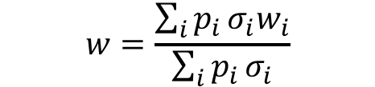
Intimate mixtures water-ice pyrrhotite: effects of the shape on abundance estimation
Ice(67±31 µm)-pyrrhotite (25-50 µm) abundance [wt%]
95-5 (54-46)
75-25 (22-78)
50-50 (6-94)
By keeping as fixed the mixing ratio in the fitting routine we can derive what is the compatible pyrrhotite grain size under the assumption of spherical grains
Pyrrhotite effective grain size
2.3 µm
3.5 µm
2.4 µm
95% ice - 5% pyrrhotite
-By assuming pyrrhotite grain size of 37.5 µm.
75% ice - 25% pyrrhotite
-Values in parentheses are derived from Hapke model fitting.
$$w=\frac{\sum_{i}{p_{i}}σ_{i}w_{i}}{\sum_{i}{p_{i}}σ_{i}}$$
50% ice - 50% pyrrhotite
100 µm
20 µm
The small effective grain size is likely related to the combined effect of:
small residual grain sizes surviving the wet sieving
flattened shape of the pyrrhotite grains: the derived effective grain size should approximate the grains thickness (Hiroi et al., 1992; Yoldi et al., 2015). Mass estimations of opaque end-members can be severely affected by shape effects since the spectral output is only sensitive to the optical abundance

Slide 22
Intraparticle mixtures: models
In Hapke theory is a function of optical constants
$$w=S_{E}+\frac{(1−S_{E})({1−S}_{I})e^{−\left(α_{m}\right)D}}{1−S_{I}e^{−\left(α_{m}\right)D}}$$
S_{E}: External scattering, function optical constants (n,k)
S_{I}: Internal scattering, function of optical constants (n,k)
α_{m}: absorption in the particle (function of k)
D: grain size
(Hapke, 2012)
Homogenous particle with inclusions of finite size: add absorption of inclusions from Mie theory (Lucey & Riner (2011))
Heterogeneous particle at scale <<λ: homogenous grain with effective optical constants
$$w=S_{E}+\frac{(1−S_{E})({1−S}_{I})e^{−\left(α_{m}{+α}_{g}\right)D}}{1−S_{I}e^{−\left(α_{m}{+α}_{g}\right)D}}$$
+ =
Maxwell-Garnett (MG) equation (Maxwell & Garnett 1904)
Absorption efficiency from Mie theory
Size of inclusions

Slide 23
Ice-pyrrhotite Intraparticle mixtures: fit with Hapke model + MG
99% ice – 0.5% pyrrhotite
Figure. 13. Appearance of the ice-pyrrhotite intra-mixtures. Left: 99.5% ice -0.5% pyrrhotite. Right 95% ice – 5% pyrrhotite.
95% ice - 5% pyrrhotite
Optical constants of ice from Clark et al., (2012) and
Pyrrhotite optical constants were measured at ISAS Berlin and kindly provided by U. Schade.
Fine grained pyrrhotite in intraparticle mixing dramatically reduces water ice albedo
The Maxwell-Garnett (MG) theory is not able to properly account for the effect of the pyrrhotite inclusion
Pyrrhotite grains are likely characaterized by a finite size and the ice-pyrrhotite grains cannot be considered as homogeneous at the scale of the wavelength

Slide 24



Ice-pyrrhotite Intraparticle mixtures: fit with Hapke model + LR11 modified
99% ice – 0.5% pyrrhotite
Figure. 13. Appearance of the ice-pyrrhotite intra-mixtures. Left: 99.5% ice -0.5% pyrrhotite. Right 95% ice – 5% pyrrhotite.
95% ice - 5% pyrrhotite
$α_{g}$= $α_{Mie}=\frac{3q_{ext}M_{g}ρ_{m}}{d_{g}ρ_{g}}$
Ice-pyrrhotite (intra-mix) [wt%] | Inclusions size [µm] | Ice-pyrrhotite grain size [µm]
99.5-0.5 (99.99-0.02) | (3.1) | 67±31 (218)
99-1 (assumed) | (1.05) | 67±31 (105)
95-5 (assumed) | (1.4) | 67±31 (63)
The model reproduces qualitatively the observed behavior with a prominent Fresnel peak.
Bluening at small wavelengths is suggestive of Reyleigh scattering from fine grained pyrrhotite inclusions
The 1.5, 2 and 3-µm bands are clearly visible, although strongly reduced in intensity
The prominent, almost constant, Fresnel peak is explained by light interacting on the surface of the water ice grain, encountering minor amounts of pyrrhotite inclusions
Values in parentheses are derived from Hapke model fitting.

Slide 25




Ice-pyrrhotite (intra-mix) mixed with coarse pyrrhotite
The model reproduces qualitatively the observed behavior with a prominent Fresnel peak.
Bluening at small wavelengths is suggestive of Reyleigh scattering from fine grained pyrrhotite inclusions
The 1.5, 2 and 3-µm bands are clearly visible, although strongly reduced in intensity
The inclusion of pure pyrrhotite is clearly noticed by the increase in spectral reddening
Albedo in the VIS is not increased by the addition of pyrrhotite
99% ice –pyrrhotite (1% intra)
+ 1% pyrrhotite
95% ice –pyrrhotite (1% intra)
+ 5% pyrrhotite
Reference pyrrhotite grain size is 37.5 µm
Ice-pyrrhotite (intra-mix) [wt%] | Inclusions size [µm] | Ice-pyrrhotite grain size [µm] | Ice-pyrrhotite +pyrrhotite (25-50 µm) [wt%] | Pure pyrrhotite effective size [µm]
99-1 (assumed) | (0.86) | 67±31 (60) | 95-5 (assumed) | (3.2)
95-5 (assumed) | (1.0) | 67±31 (87) | 80-20 (assumed) | (5.2)
Values in parentheses are derived from Hapke model fitting.

Slide 26




Kerite-fine grained pyrrhotite mixtures
SEM images of fine grained pyrrhotite
kerite-pyrrhotite (<25µm)[wt%]
33-66 (0.4-0.6)
50-50 (0.43-0.57)
According to SEM images we associate an effective grain size of 1µm to the fine grained pyrrhotite particles
The fit with Hapke’s model provide a fairly good match with measurements
Fitted abundances are in reasonable agreement with the measured ones.
Values in parentheses are derived from Hapke model fitting.
Pyrrhotite grain size assumed to be 1 µm

Slide 27

Ternary mixtures
ice | kerite | pyrrhotite(<25µm)
40 (24) | 20 (15) | 40 (60)
20 (13-28) | 40 (48-50) | 40 (38-22)
Values in parenthesis are fits from Hapke’s model

