Slide 1
Low Temperature IR spectroscopy of Na-sulfates and Mg-chlorides as analogues for Europa
S. De Angelis¹, F. Tosi¹, C. Carli¹, P. Beck², O. Brissaud²,
B. Schmitt², S. Potin², G. Piccioni¹
¹ INAF-Istituto di Astrofisica e Planetologia Spaziali, Rome, Italy
² Institut de Planétologie et d'Astrophysique de Grenoble, France

Slide 2
Outline
Scientific context
Experimental setup & methods
Lab measurements
Results: spectral analyses
Conclusions

Slide 3
Scientific context
Europa surface composition:
dichotomy b/w leading and trailing hemisphere
Composition dominated by
brighter pure icy regions (leading)
Darker / reddish “non-ice” regions (trailing) [McCord et al., 1998, 1999]
Overal components: H₂O, Na, Cl, K, S, SO₂, O₂, CO₂, H₂O₂, hydrated phase [Carlson et al., 2009]
Bright icy region: >99% H₂O-ice
Reddish “non-ice” regions: a heavily hydrated component

Slide 4
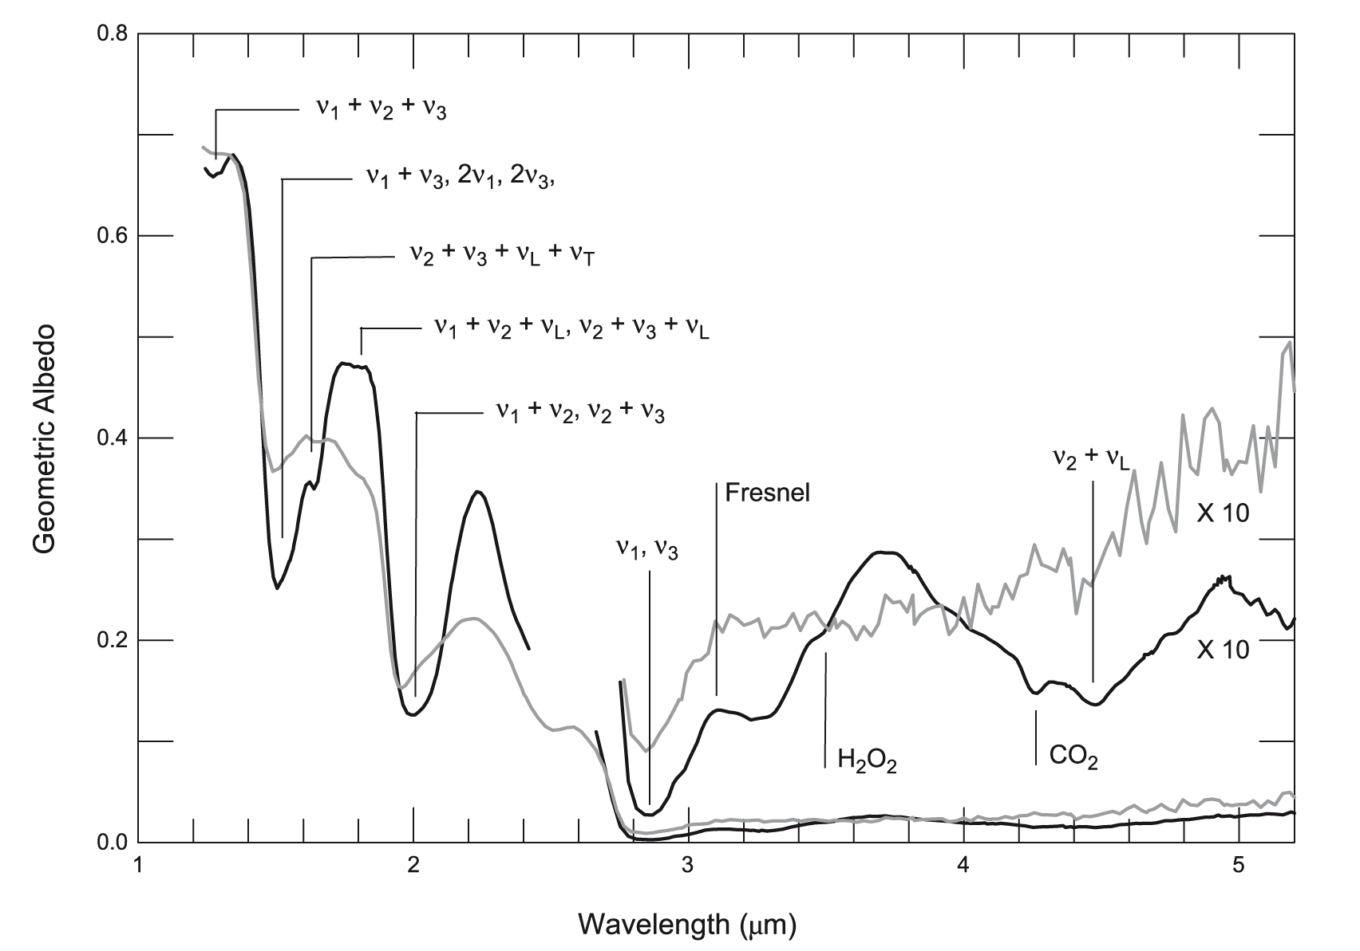
Scientific context
Europa surface composition:
Reddish “non-ice” regions:
Non-ice = gray line
spectra characterized by:
hydration bands at ≈1.5 and ≈2.0 μm
Distorted, asymmetric and shifted (shortward) with respect to H₂O ice
Europa NIR spectra (Galileo NIMS – Carlson et al., 2009)

Slide 5
Scientific context
Europa surface composition:
Reddish “non-ice” regions: Various phases proposed and studied:
Mono and poly-hydrated Mg-sulfates (Dalton et al., 2003, 2005, 2007, 2012)
Hydrated Na-carbonates (McCord et al., 1998, 1999)
Hydrated H₂SO₄ (Carlson et al., 2009)
Mix: H₂O-ice + hydrated H₂SO₄ + chlorides and perchlorates (Ligier et al., 2016)
Hydrated Mg-sulfates & Na-carbonates studied at low Temp (De Angelis et al., 2016, 2018)

Slide 6
Scientific context
Materials of “non-ice” regions:
Hydrated salts:
emplaced on surface as brines from the subsurface ocean
Endogenic source
Hydrated sulfuric acid: radiolysis product of S-bearing material + H₂O
S-bearing material: exogenic (implantation from Io) or endogenic source
Central question:
What are the non-ice components
Where the hydrated material comes from

Slide 7
2. Experimental setup & methods
Institut de Planétologie et d'Astrophysique de Grenoble – IPAG
Cold Surfaces Spectroscopy Facility
Spectro-gonio-radiometer + monochromator source
Spectral range: 0.5-4.8 μm
Detectors: Si-photodiode (<1μm) + InSb (>1μm)
Sampling: 20 nm
Resolution: 5-40 nm [Na-sulfates] & 3-25 nm [Mg-chlorides]
Temperatures: 80, 90, 100, 110, 125, 140, 160, 180, 205, 230, 255, 275, 298K

Slide 8
2. Experimental setup & methods
Two types of samples analyzed:
Na-sulfates
Thenardite: Na₂SO₄
Mirabilite (deca-hydrated):
Na₂SO₄ ·10 H₂O
3 grain size: 36-50, 75-100, 125-150 μm
EuroPlanet TNA 3rd Call proposal 2017
Mg-chlorides
Anhydrous: MgCl₂
Bischofite (Hexa-hydrated):
MgCl₂ ·6 H₂O
3 grain size:
* anhydrous: 36-50, 75-100, 125-150 μm
* hydrated: <250, 250-500, 500-800 μm
EuroPlanet TNA 5th Call proposal ’18

Slide 9
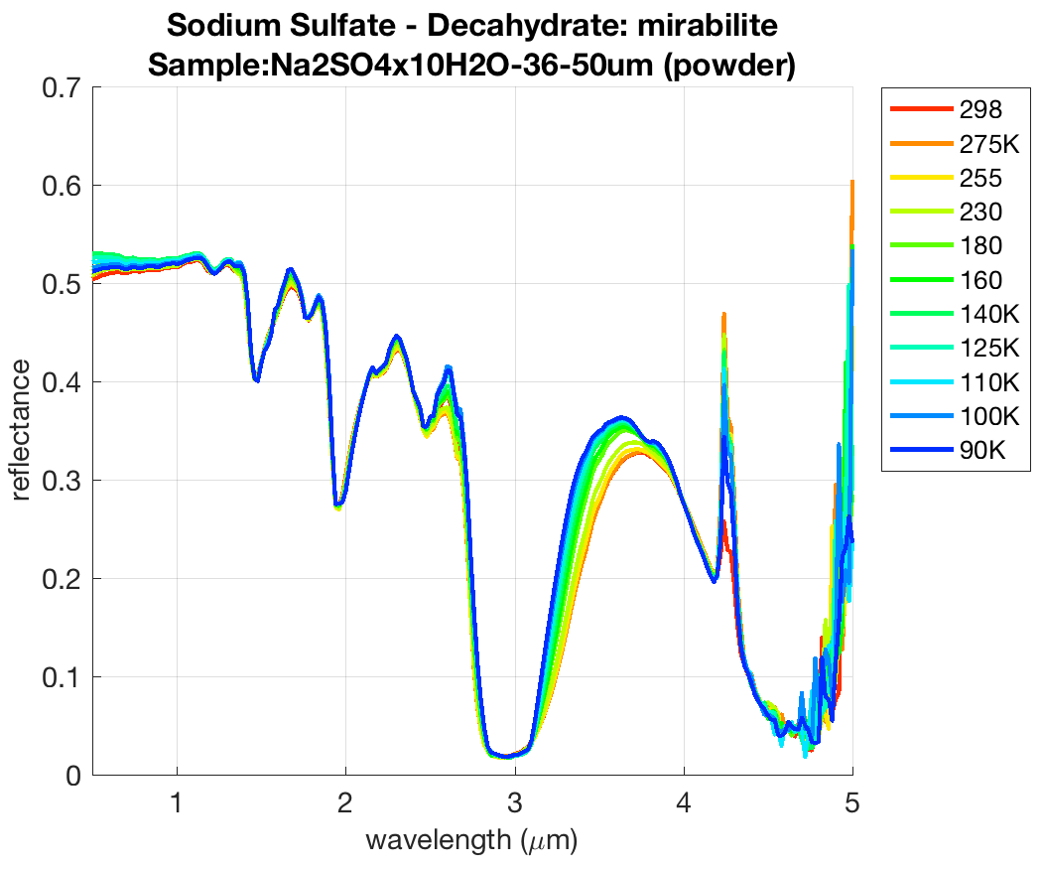
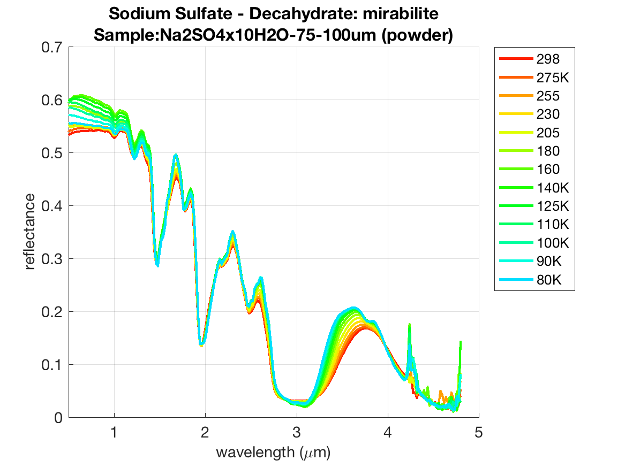
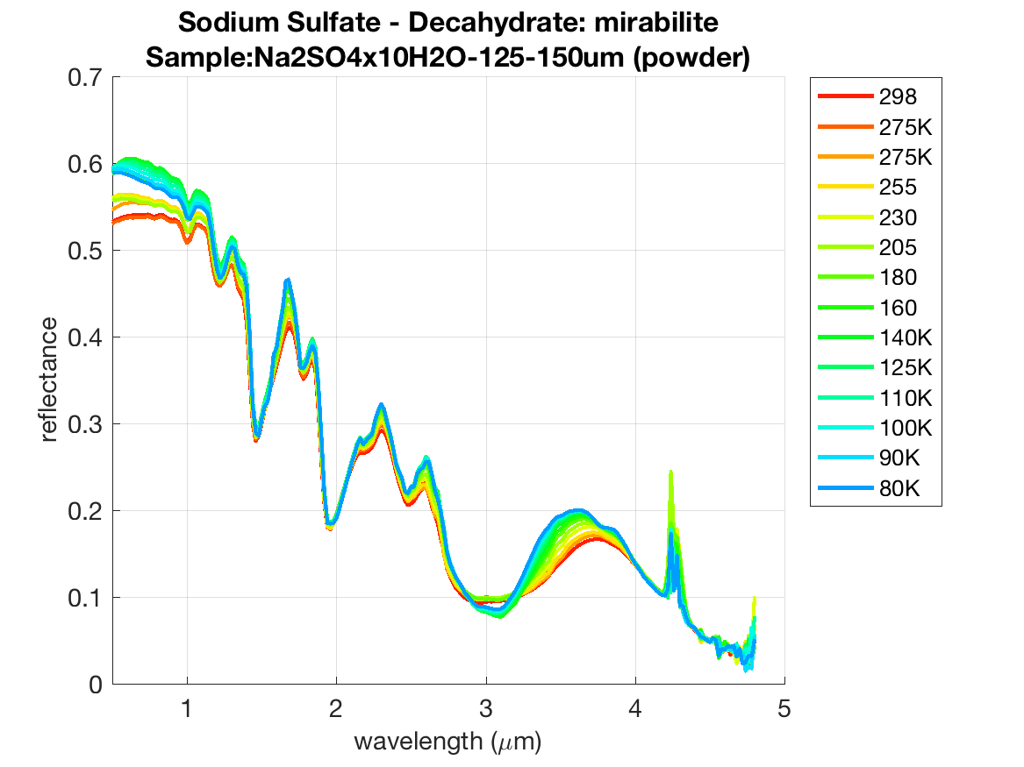
3. Lab measurements (i)
Na-sulfate deca-hydrate
Na₂SO₄ ·10 H₂O
H₂O
CO₂
H₂O–
SO₄²⁻ (?)
SO₄²⁻
Slope (blueing):
changes with T
Δ_slope increases with g.s.
Max slope @T~140K
New bands:
A feature appears near 3.8 μm

Slide 10
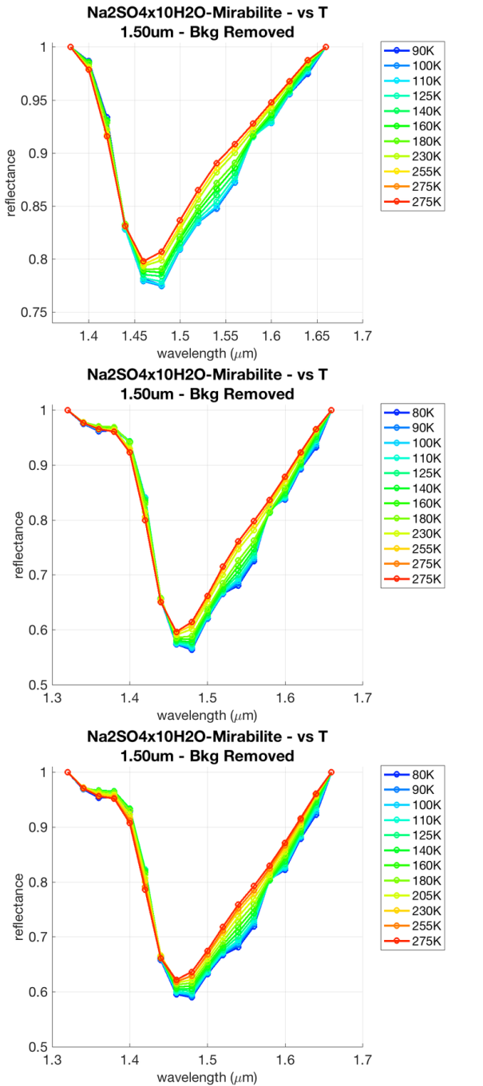
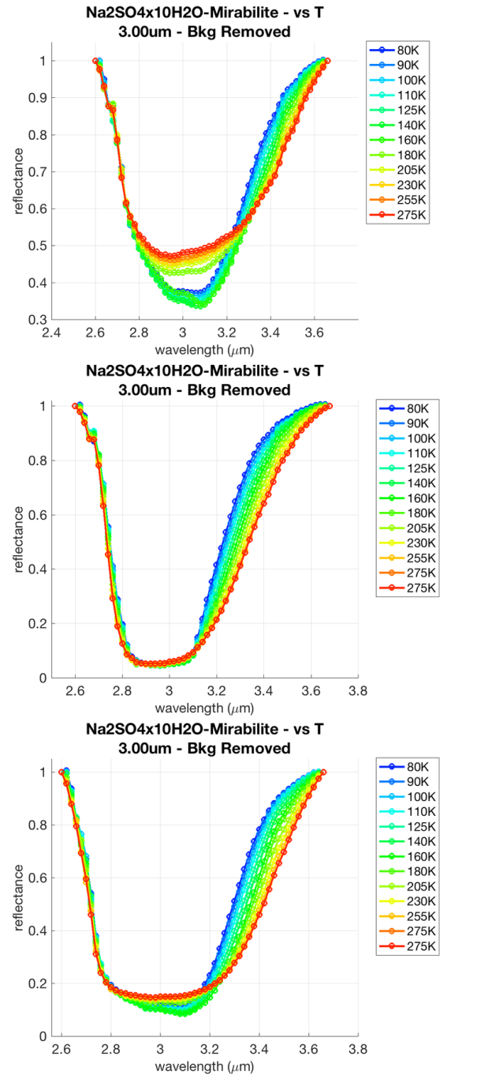
Na-sulfate deca-hydrate
Na₂SO₄ ·10 H₂O
fine
medium
coarse
1.5-μm band
3.0-μm band

Slide 11
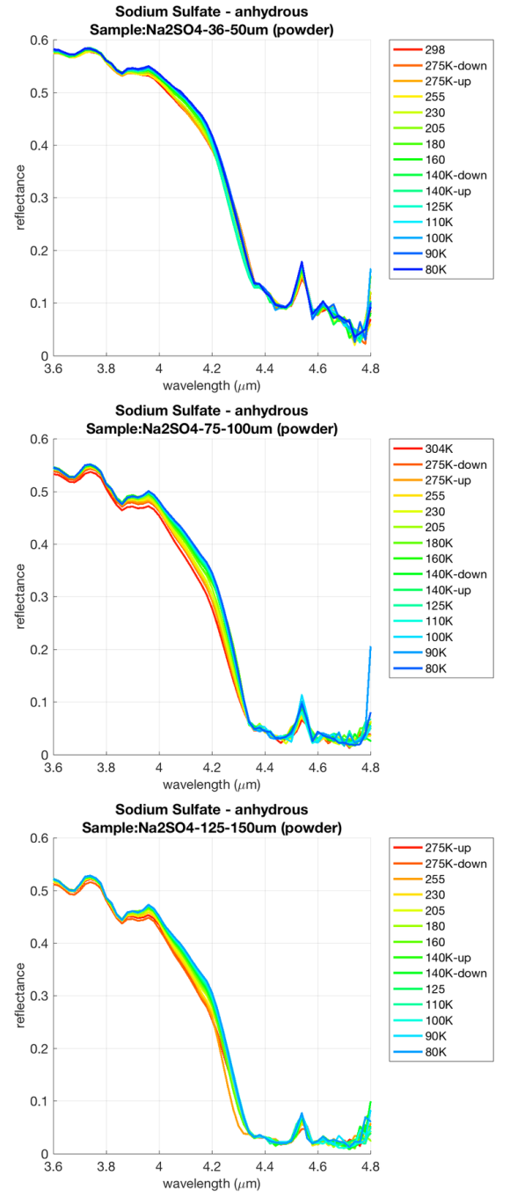
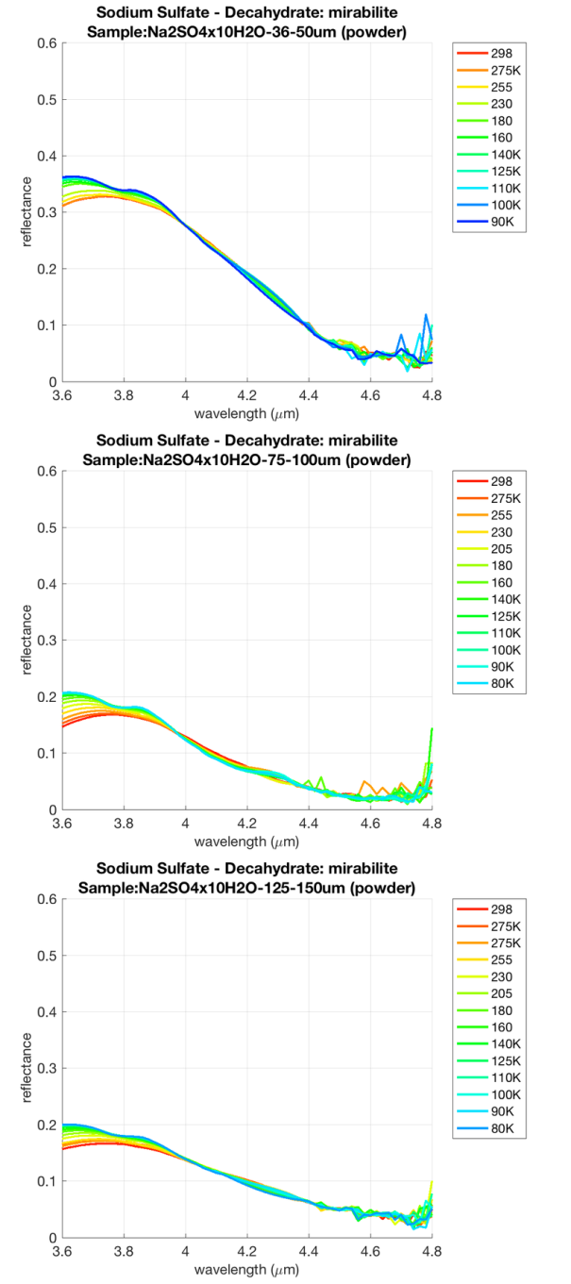
Na-sulfate deca-hydrate
Na₂SO₄ ·10 H₂O
4.6 μm SO₄²⁻ band (1st overtone)
Difference b/w anhydrous and hydrated compound
4.5 μm peak only in anhydrous
The peak reduces with grain size and T (but very noisy…)
fine
medium
coarse
anhydrous deca-hydrated

Slide 12
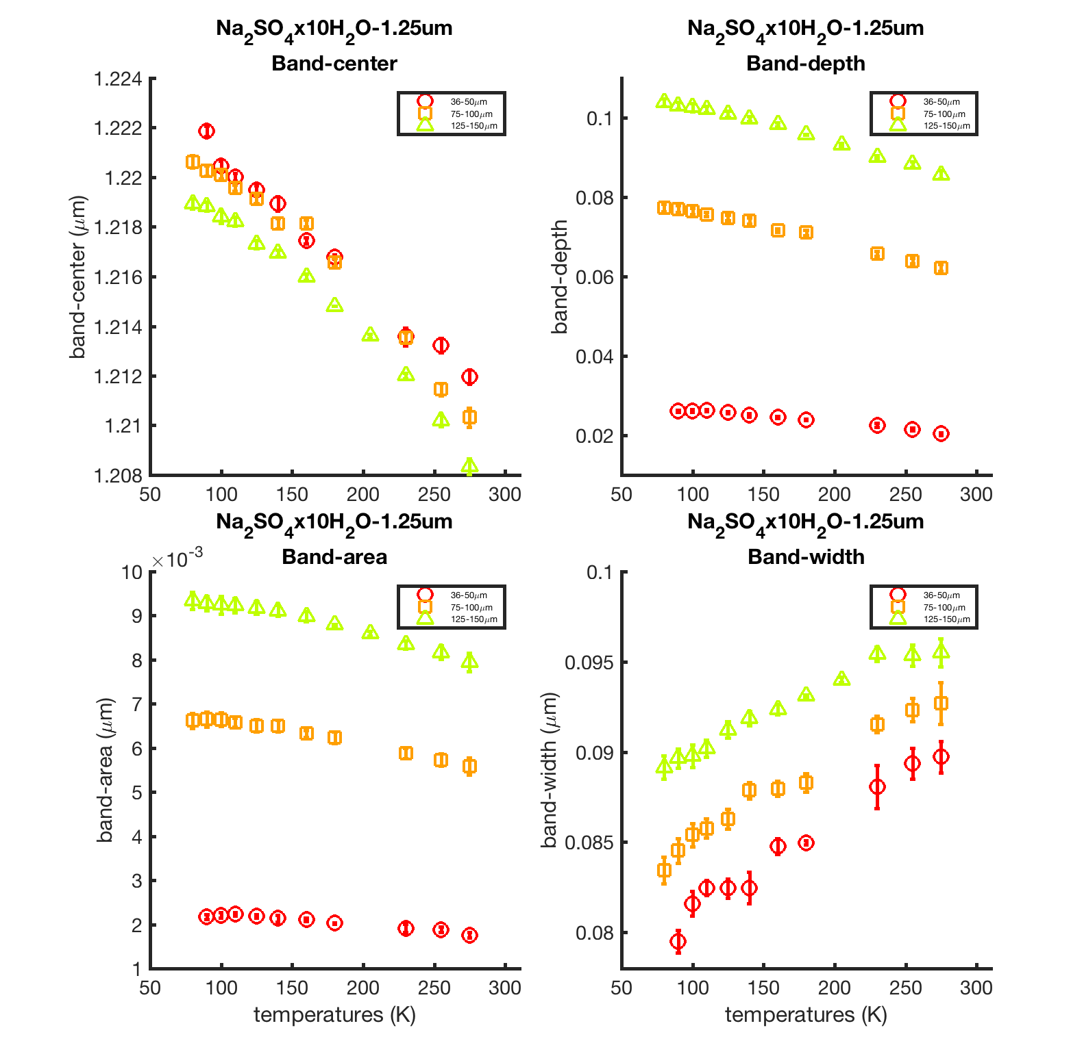
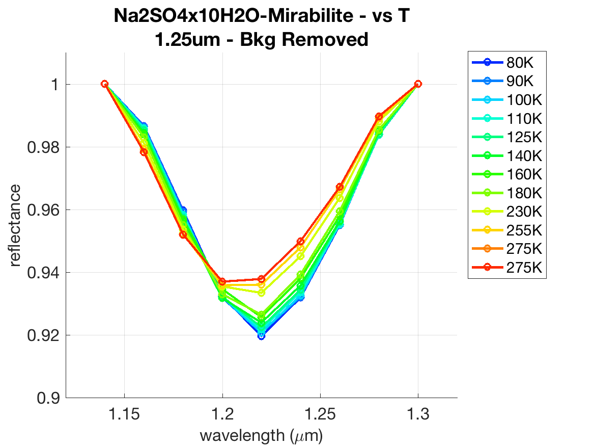
4. Results: spectral analyses (i)
Na-sulfate deca-hydrate
Na₂SO₄ ·10 H₂O
H₂O related: longward shift with decreasing T

Slide 13
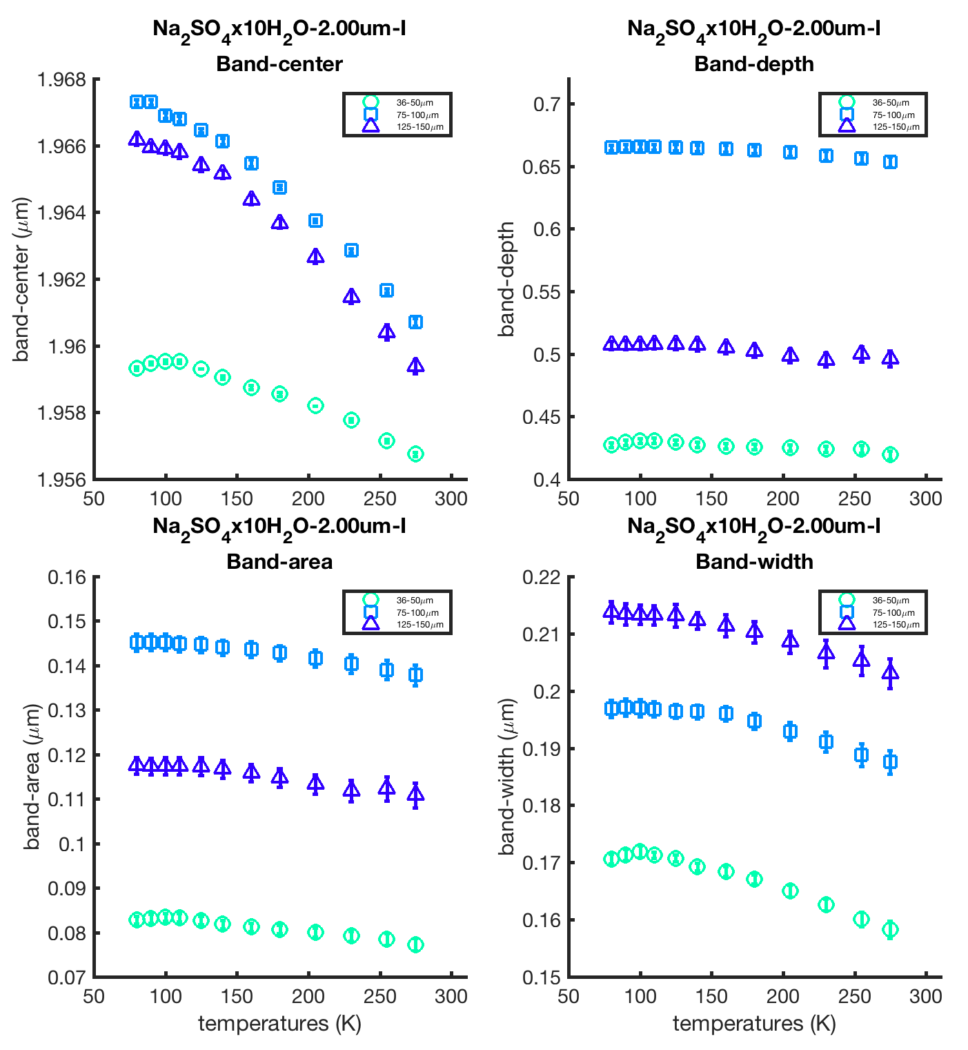
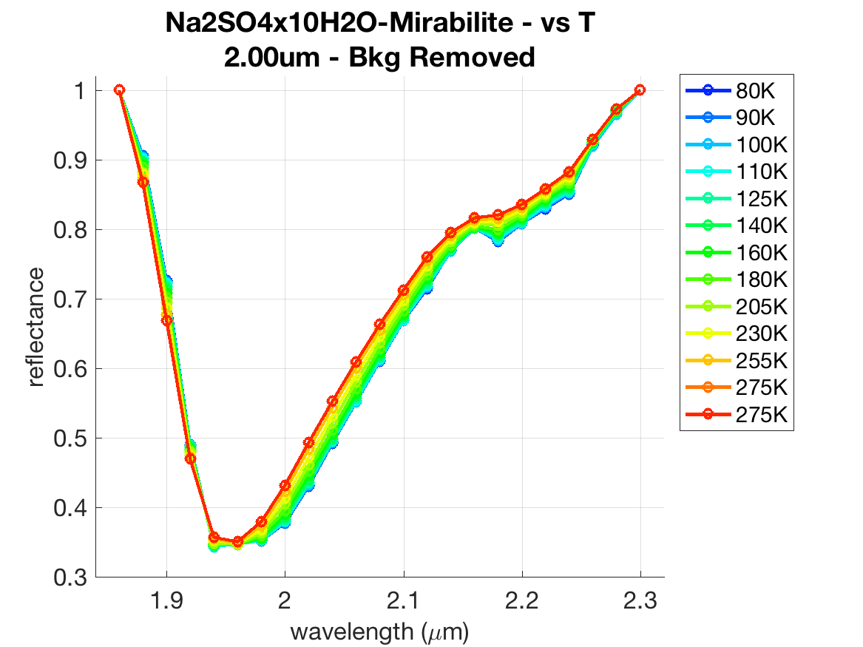
4. Results: spectral analyses (i)
Na-sulfate deca-hydrate
Na₂SO₄ ·10 H₂O
H₂O related: longward shift with decreasing T

Slide 14
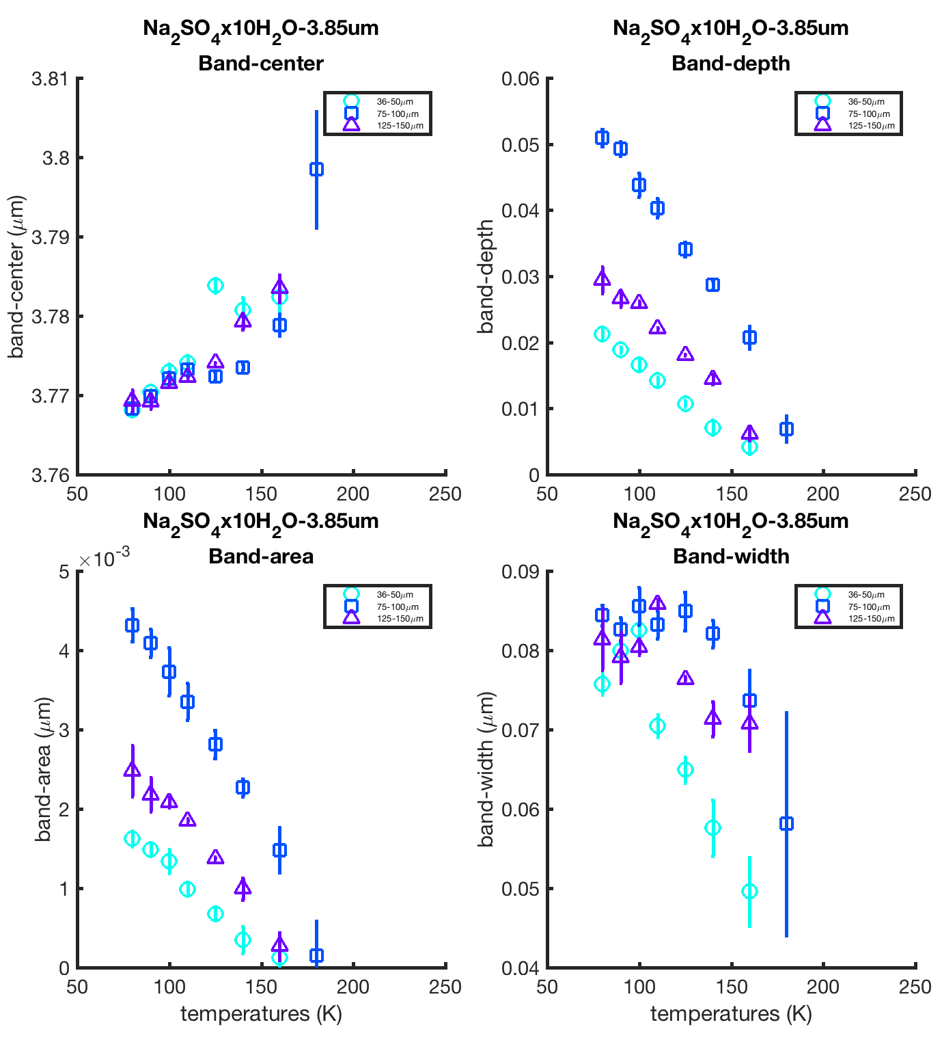
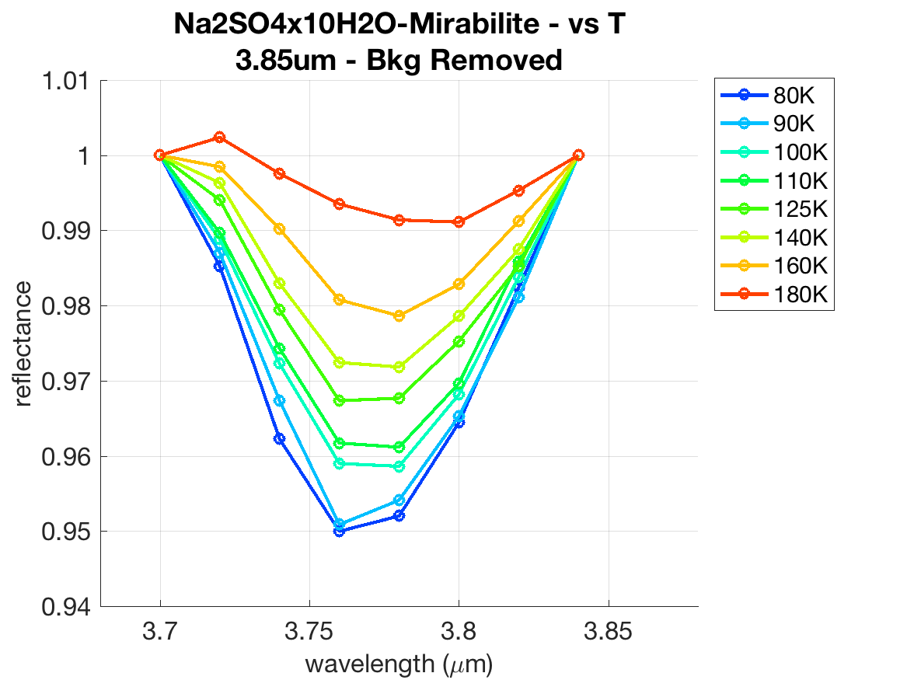
4. Results: spectral analyses (i)
Na-sulfate deca-hydrate
Na₂SO₄ ·10 H₂O
Non H₂O related: shortward shift with decreasing T
Maybe overtone/combination of SO₄²⁻ fundamentals?

Slide 15
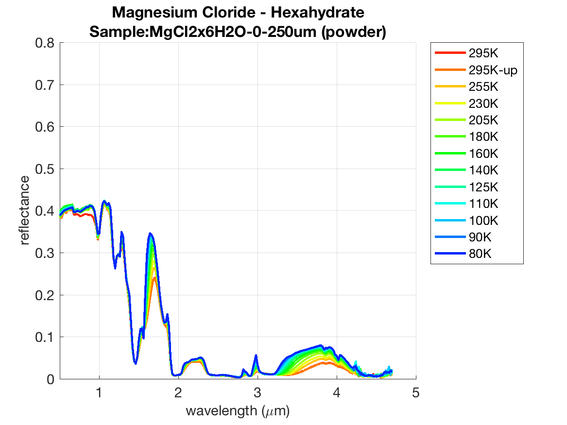
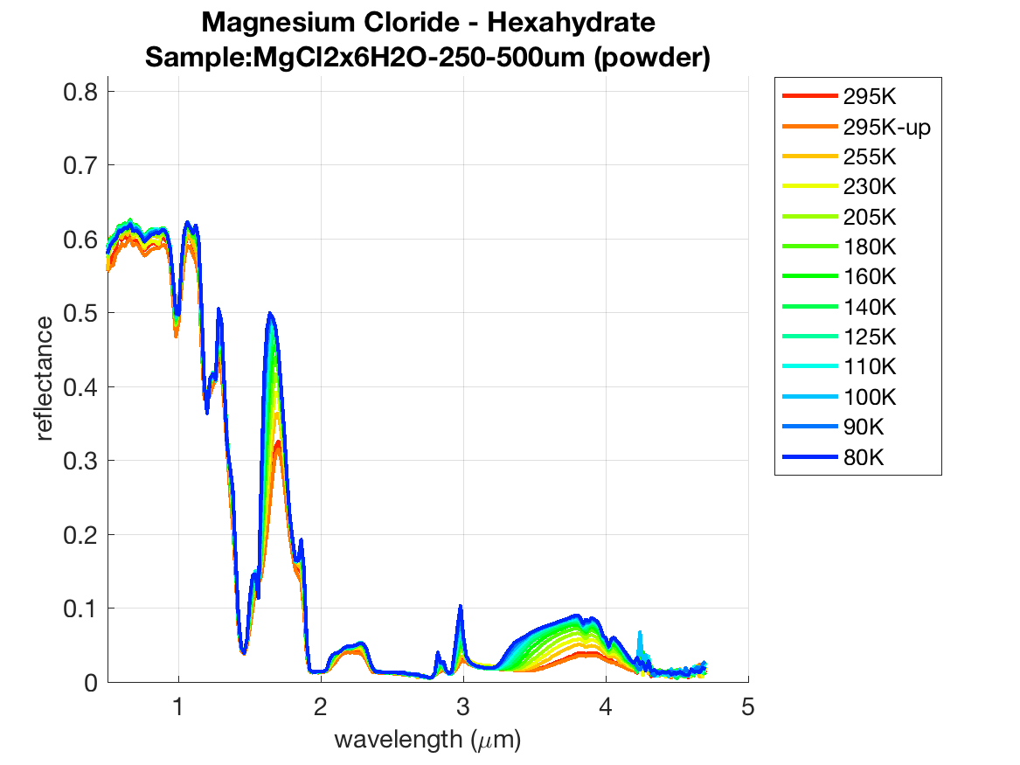
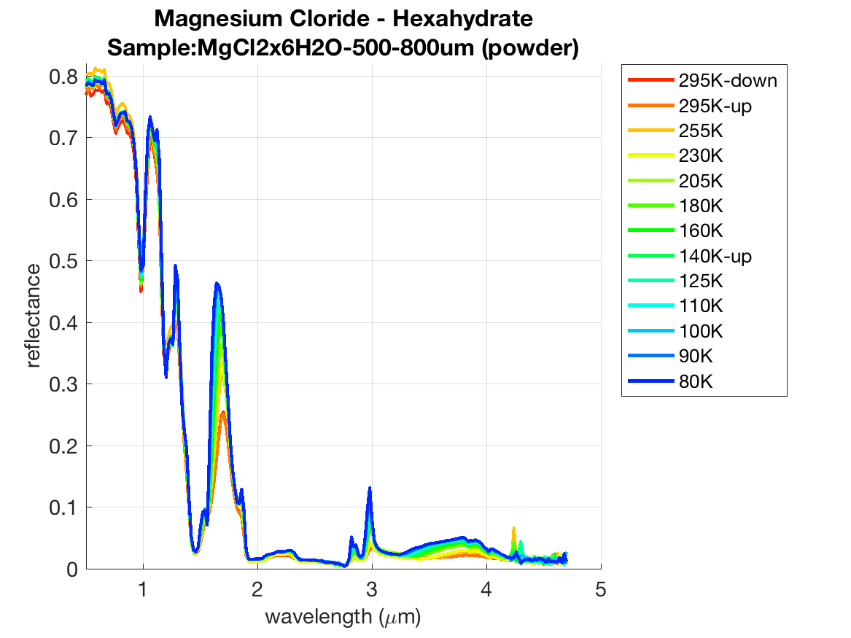
3. Lab measurements (ii)
Mg-chloride hexa-hydrate
MgCl₂ ·6 H₂O
H₂O
H₂O–
MgCl₂ (?)
VIS Reflectance:
Maximum for coarser g.s.
0.75 μm band:
Apparently not strongly depending on T

Slide 16
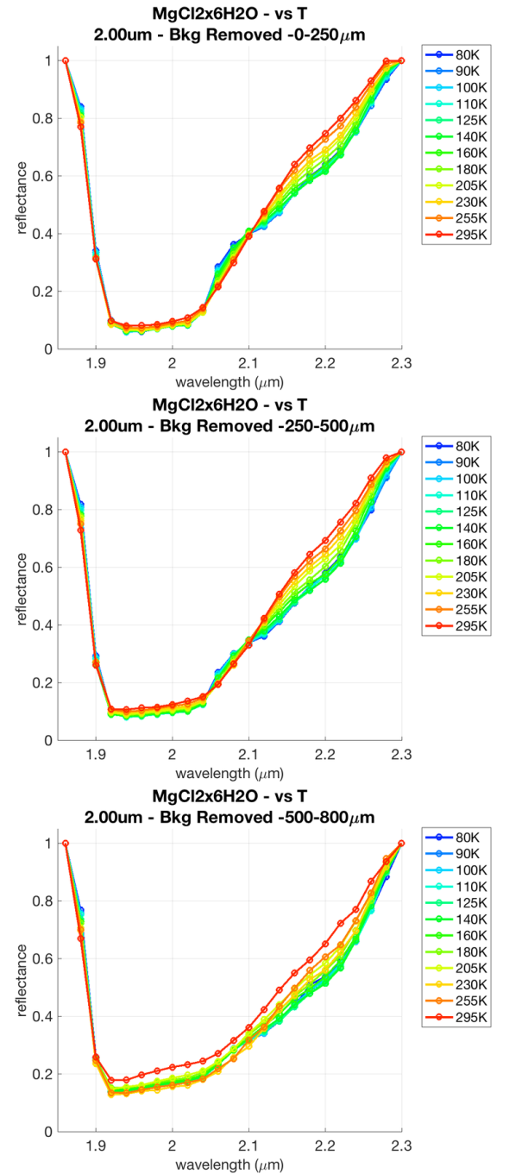
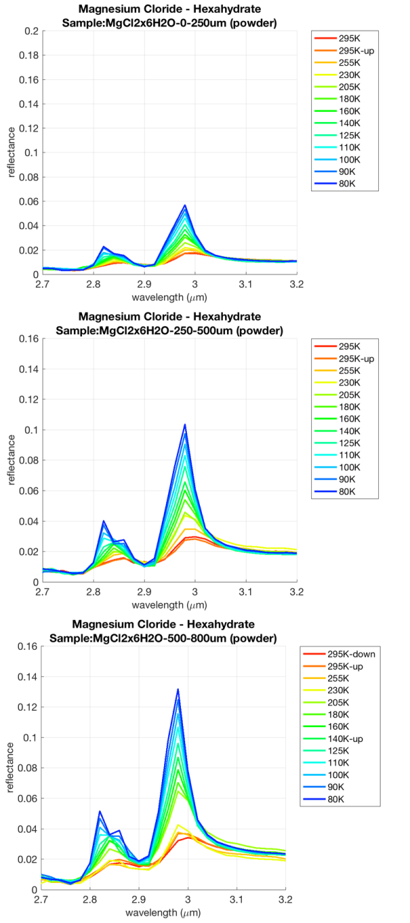
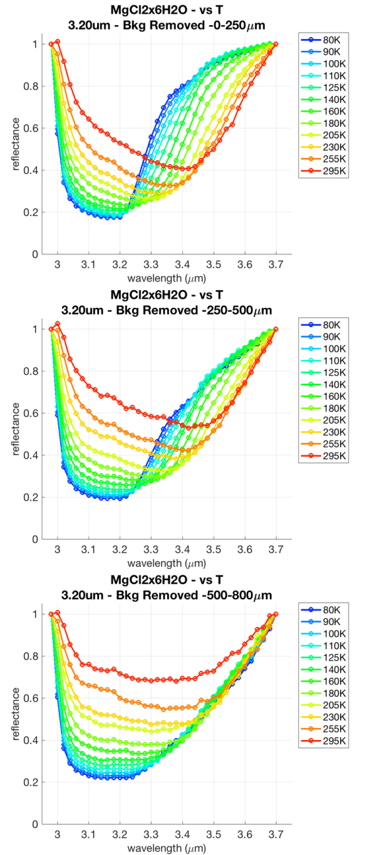
fine
medium
coarse
2.0-μm band
3.0-μm peak
3.2-μm band

Slide 17
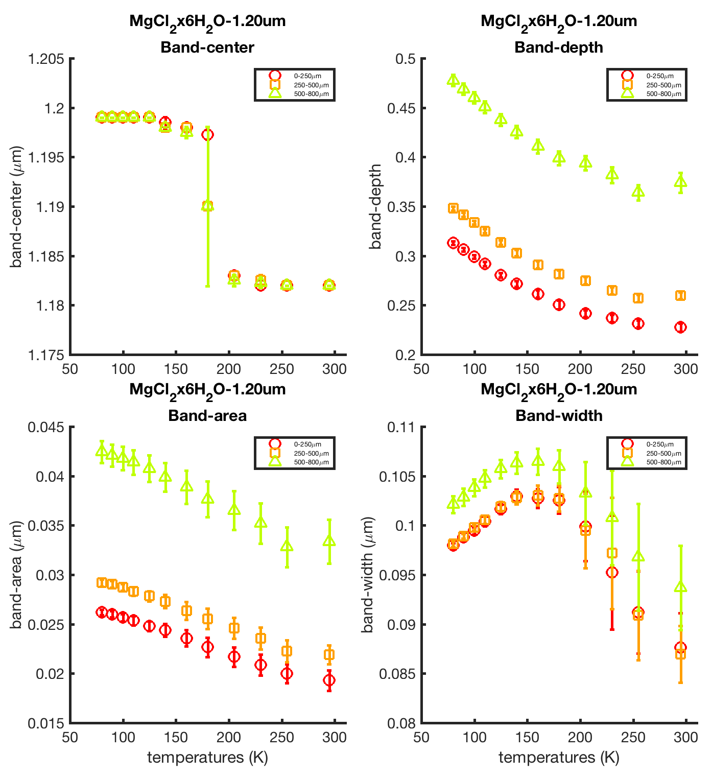
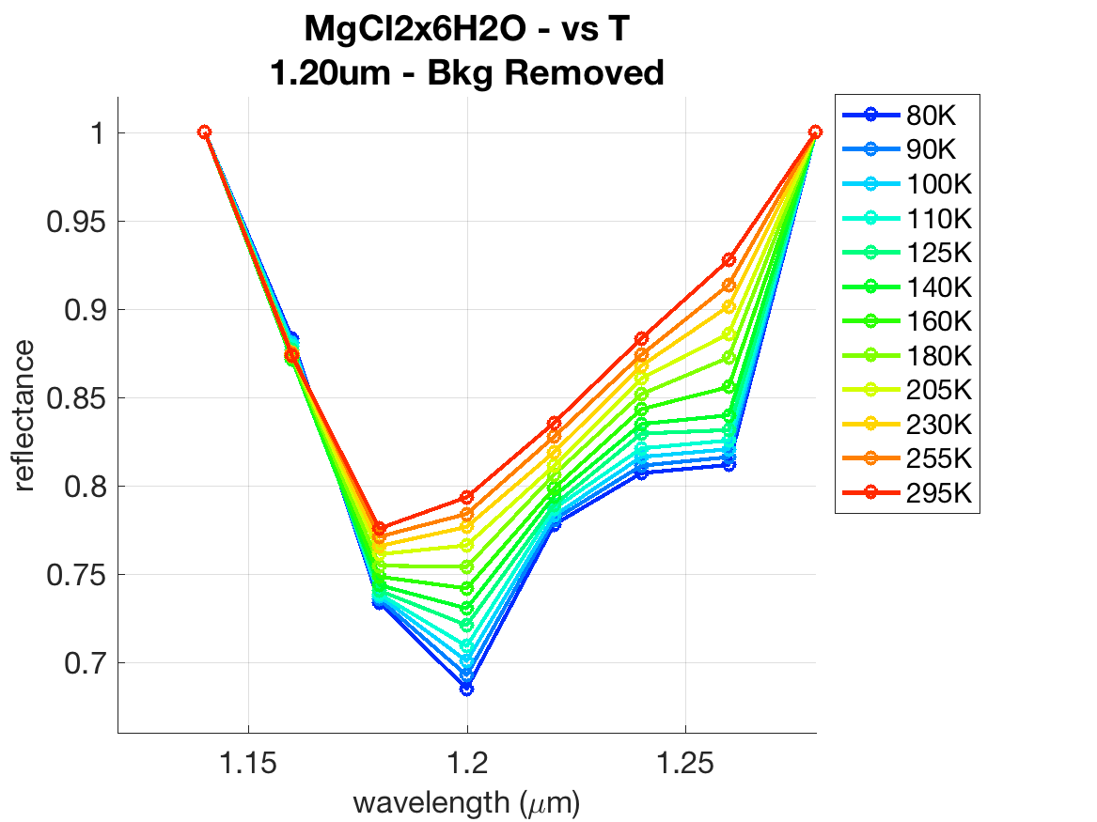
4. Results: spectral analyses (ii)
Mg-chloride hexa-hydrate
MgCl₂ ·6 H₂O
H₂O related: longward shift with decreasing T
Shift ~ sampling (~20 nm)
Few points around the minimum

Slide 18
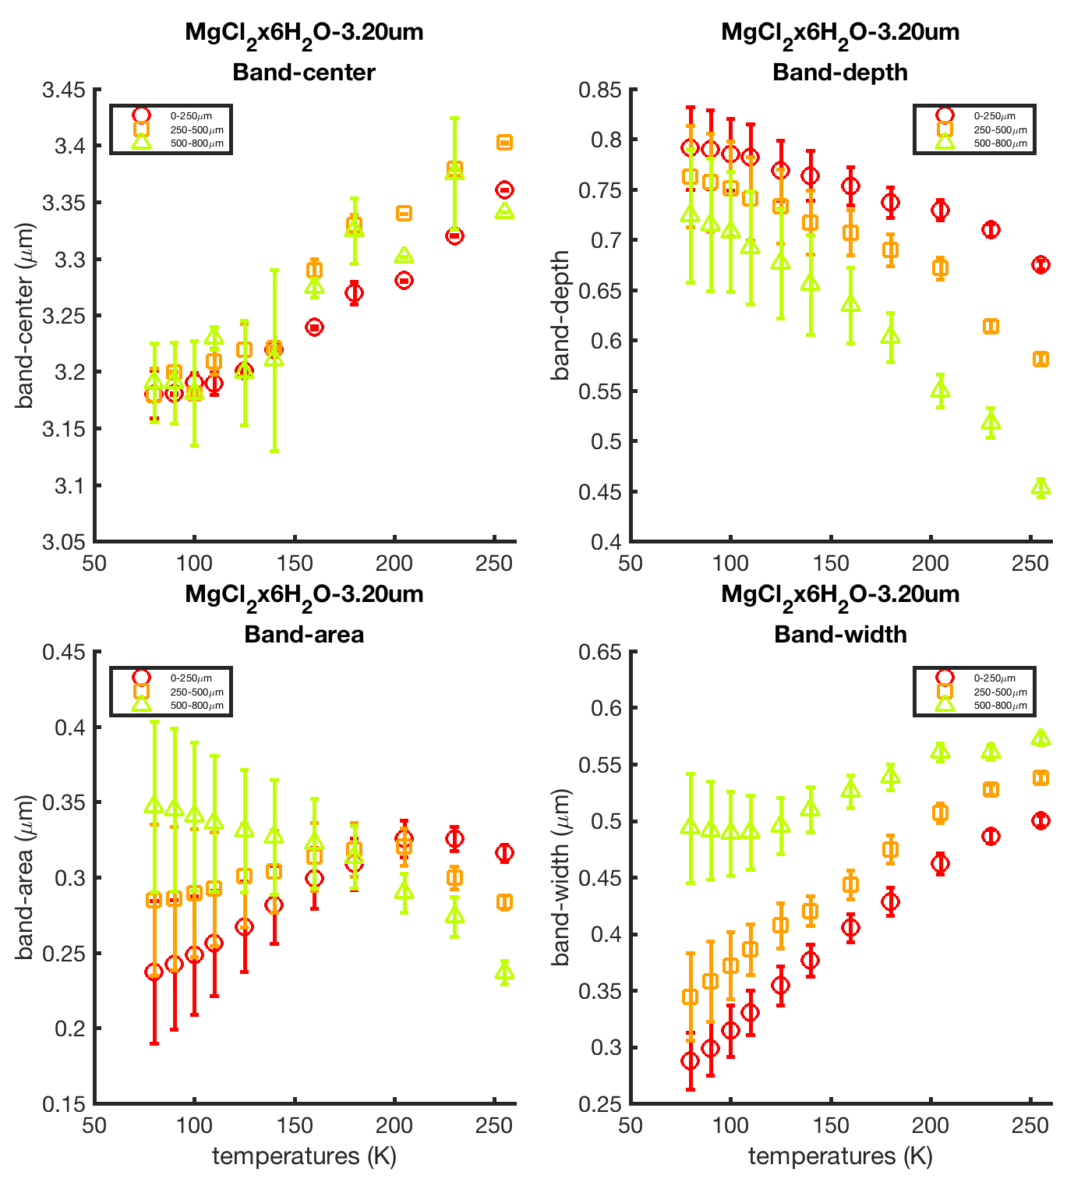
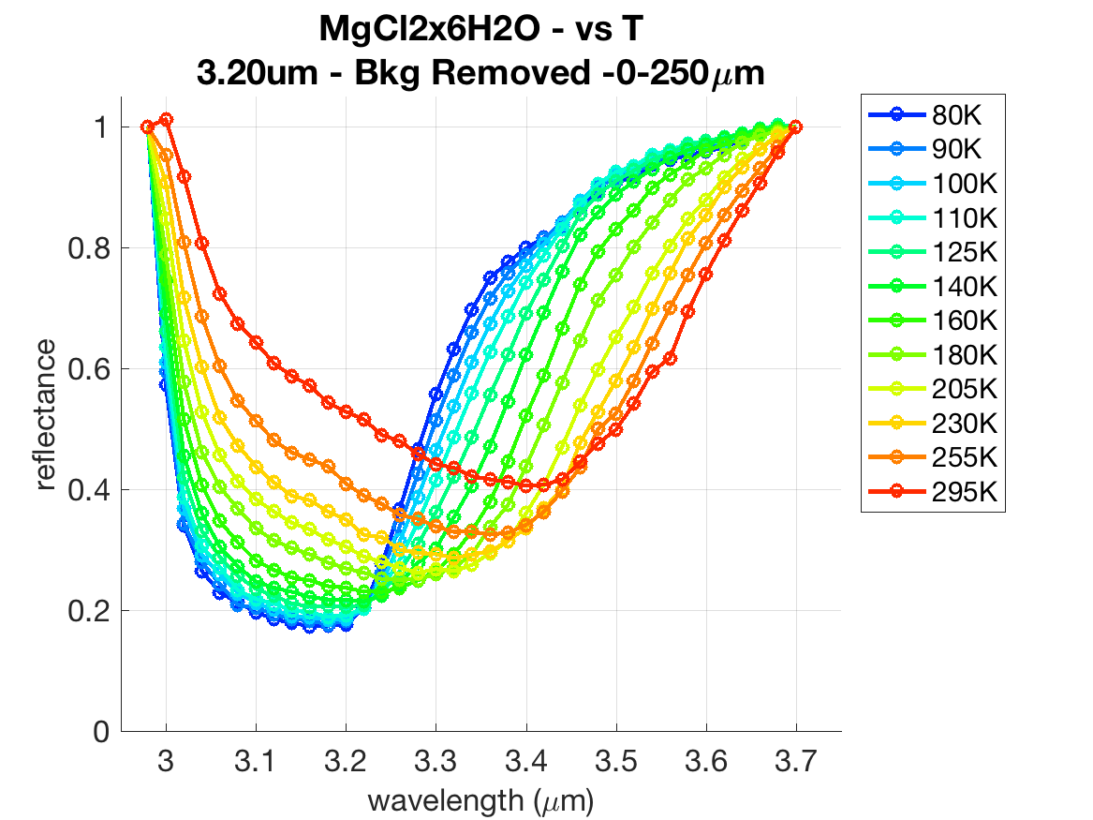
4. Results: spectral analyses (ii)
Mg-chloride hexa-hydrate
MgCl₂ ·6 H₂O
Should be H₂O related:
But shortward shift with decreasing T

Slide 19
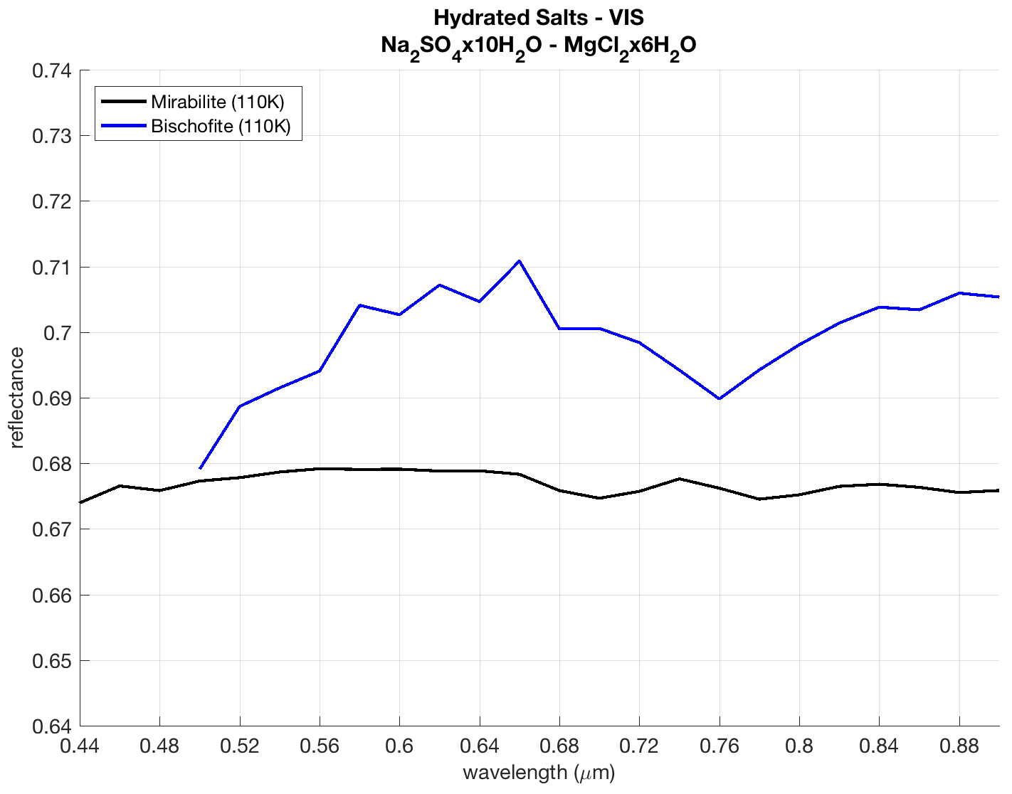
760 nm
Bischofite (MgCl₂ ·6H₂O) @110K
Mirabilite (Na₂SO₄ ·10H₂O) @110K
700 nm
780 nm
On Europa: a weak NaCl band @450 nm (F-center) is observed in HST spectra (Trumbo et al., Sci. Adv. 2019)
No 750 nm feature is observed (M-center): in lab spectra this is caused by a very high radiation flux (Hand&Carlson, 2015), more than on Europa

Slide 20
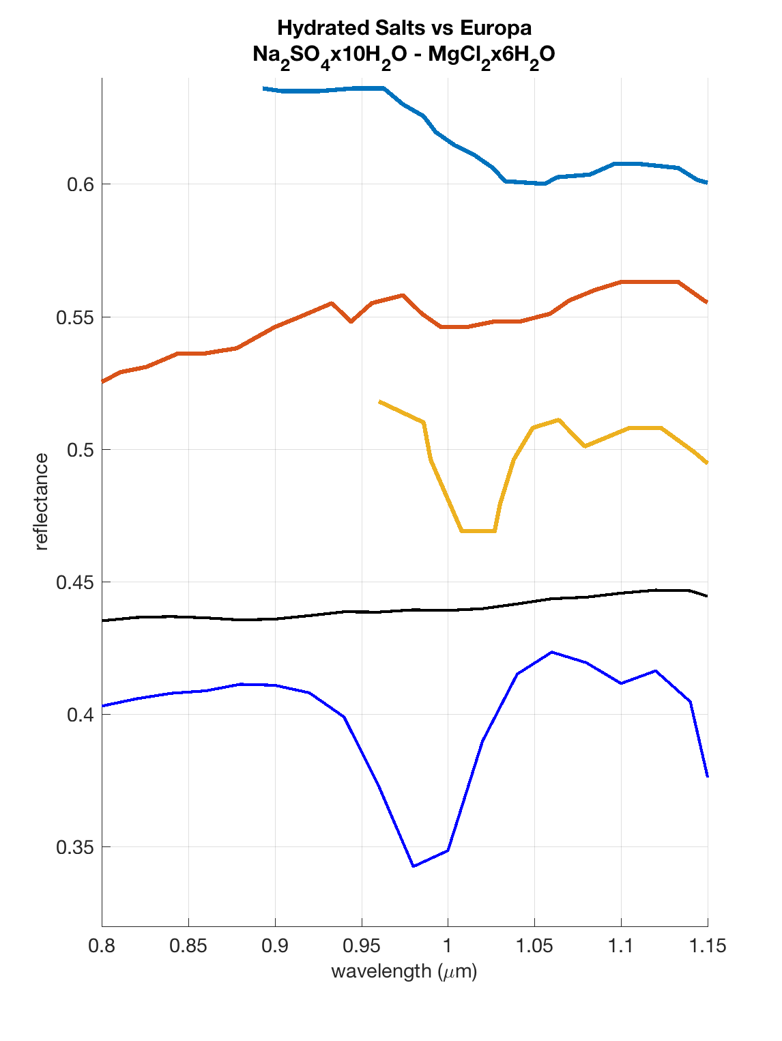
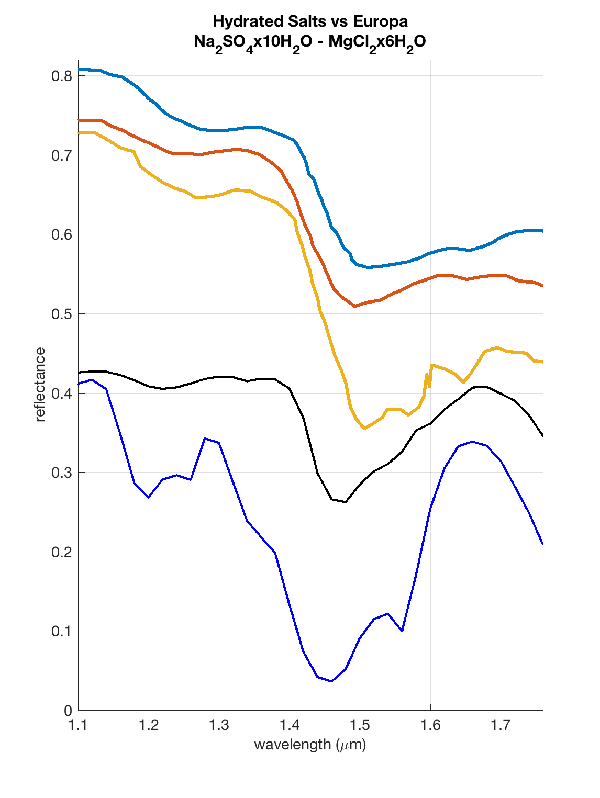
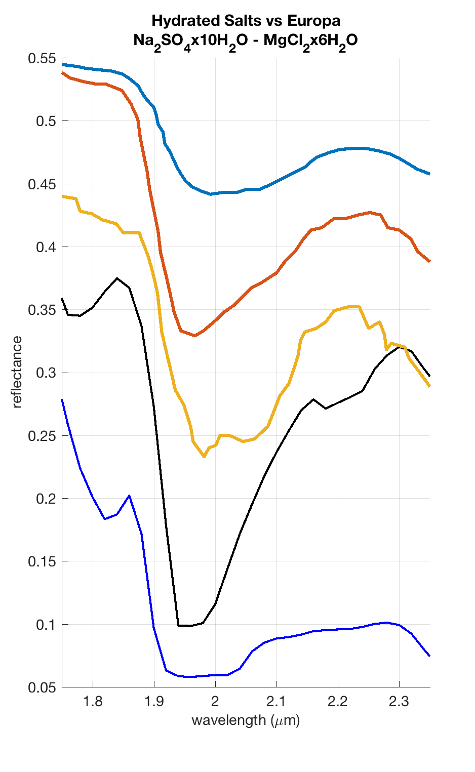
Europa-A
Europa-D
Europa-E
Mirabilite (110K)
Bischofite (110K)
1 μm
1.5 μm-complex
2 μm-complex
The bands @1.01 and 1.09 μm (Europa-E) could be due to MgCl₂ ·6 H₂O, although somewhat displaced

Slide 21
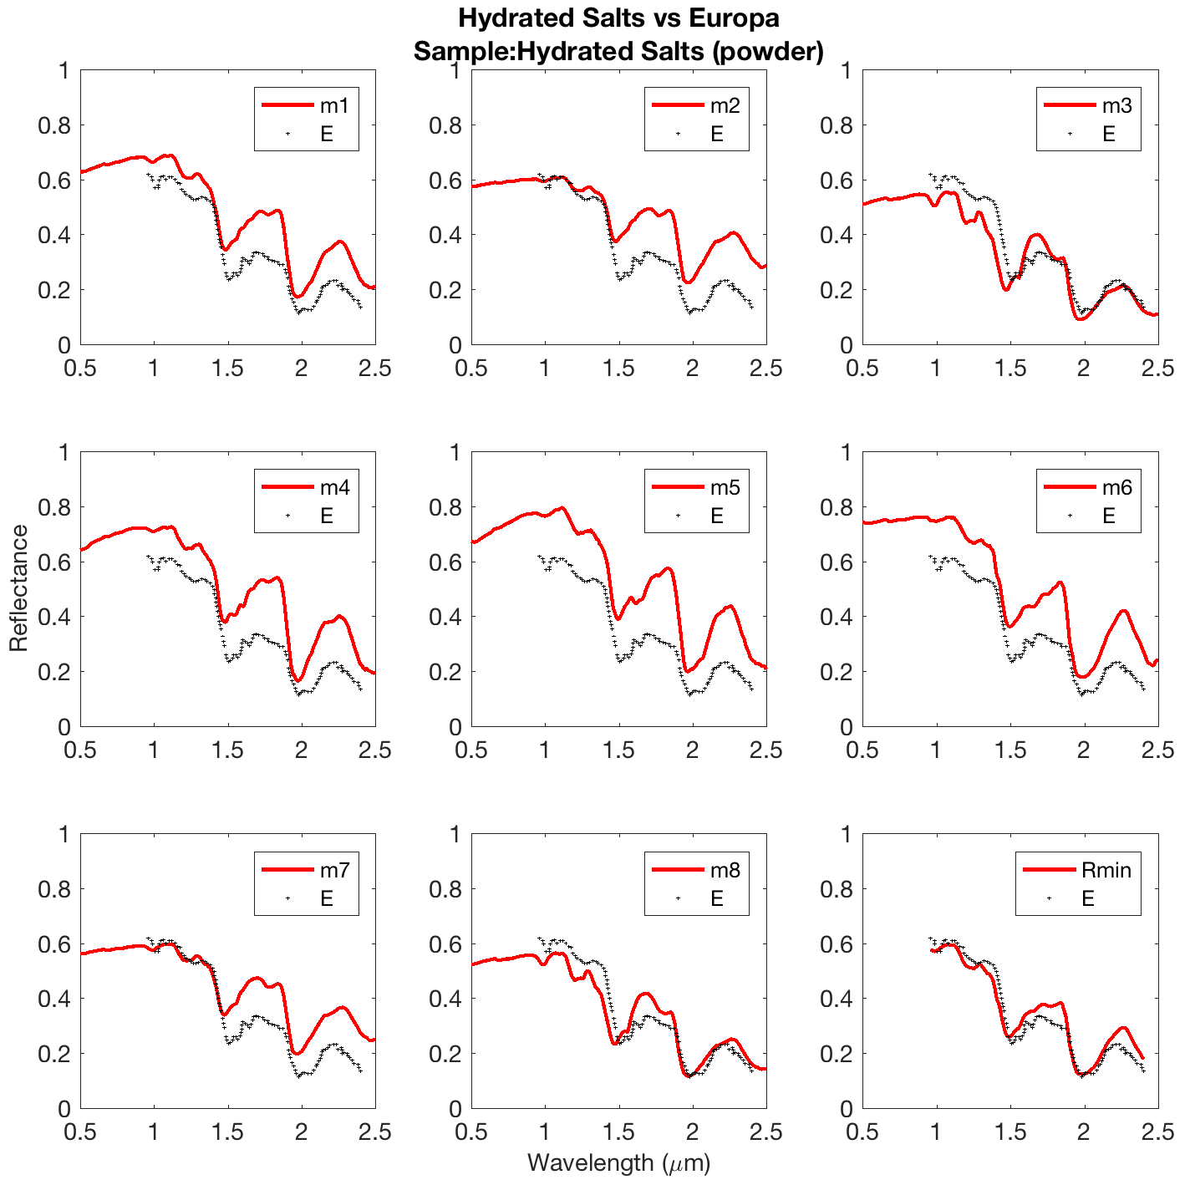
Europa spectrum Area “E” – from Mc Cord et al., 2010
Numerical linear mixtures containing 5 endmembers:
Na₂SO₄ ·10 H₂O
MgCl₂ ·6 H₂O
MgSO₄ ·6 H₂O
MgSO₄ ·7 H₂O
Na₂CO₃ ·10 H₂O
measured at 110-113K
Best Fit:
m9: (a) 10%, (b) 30%, (c) 10%, (d) 10%, (e) 30%
But not included:
Hydrated H₂SO₄
H₂O-ice

Slide 22
5. Conclusions
Na-sulfates (anhydrous + ·10 H₂O (mirabilite)) and Mg-chlorides (anhydrous + ·6 H₂O (bischofite)) analyzed at temps 80÷290 K
Compounds are discernible on the basis of several features:
0.76 μm band in MgCl₂·6 H₂O vs 0.70-0.78 μm bands in Na₂SO₄·10H₂O
Sulfates: intense SO₄²⁻ overtone band @4.2-4.8 μm (center ≈4.6 μm)
Chlorides: two reflection peaks at 2.8 and 3 μm
* Strong band at 3.2 μm shifts at shorter
wavelengths with decreasing T
* Weak bands in Europa spectra @1.01 and 1.09 μm also appear in bischofite, but shifted by ≈2 nm
Our work confirm Europa “non-ice” spectrum is likely due to a mixture of several hydrated salts
Anhydrous: peak @4.5 μm
Hydrated: no peak
Peak higher with decreasing T
Peak higher for larger grains

