Slide 1
Detector update, impact of despiking on performances
Yves Langevin

Slide 2
Checking the assumptions of the ICDR Science Performance Report
● interpixel variability and its impact on compression
MAJIS compression scheme: 3-D reversible compression after right shift
target for nominal data sets: 5 bits/data
interpixel variability: high frequency contribution to entropy
factor of 2: + 1 bit for the first frame, 5% more data volume for 4 frames
● Noise model for 18 µm pixels
100 kHz readout: 20 e- readout noise → 40 e- after 2x2 binning
1 MHz readout: 40 e- readout noise → 80 e- after 2x2 binning
● de-spiking: split of t_{int} into sub-integrations, selection of lowest values
gaussian distribution of successive read-outs
→ no sample beyond 3σ except positive outliers resulting from spikes
● 04/2019 - 07/2019: Tests with an EM FPA+FPE, Teledyne interface (SAM card)
● 07/2019 - 09/2019: Tests with an EM FPA+FPE, MAJIS EM PE, EM harness

Slide 3
Checking performances of IAS microcodes wrt Teledyne provided microcodes
● Correlated Double Sampling (100 kHz readout / 1 MHz readout):
Teledyne: 2 t_{int} - 1 t_{int} t_{int}: integration time
preamp reset before each frame
IAS: t_{int} - “reset-read” reset-read: readout of each line immediately after reset
full well available for the acquired signal
(saturation t_{int} increased by a factor of 2)
preamp reset once per CDS (reduces column effects)
● windowing:
Teledyne: always 1024 lines (full frame); t_{int} 740 ms for 100 kHz readout
IAS: spatial windowing capability anywhere on the detector
nominal FOV: 800 lines, centered
VISNIR and IR windows can be offset for aligning the FOVs along slit
32 lines (star occultations, exospheres): t_{int} down to 33 ms with 100 kHz readout
● dark subtraction (on-line with the MAJIS PE)
- replaces the Teledyne “column correction” (impact reduced by the single preamp reset)
- improves cosmetics

Slide 4
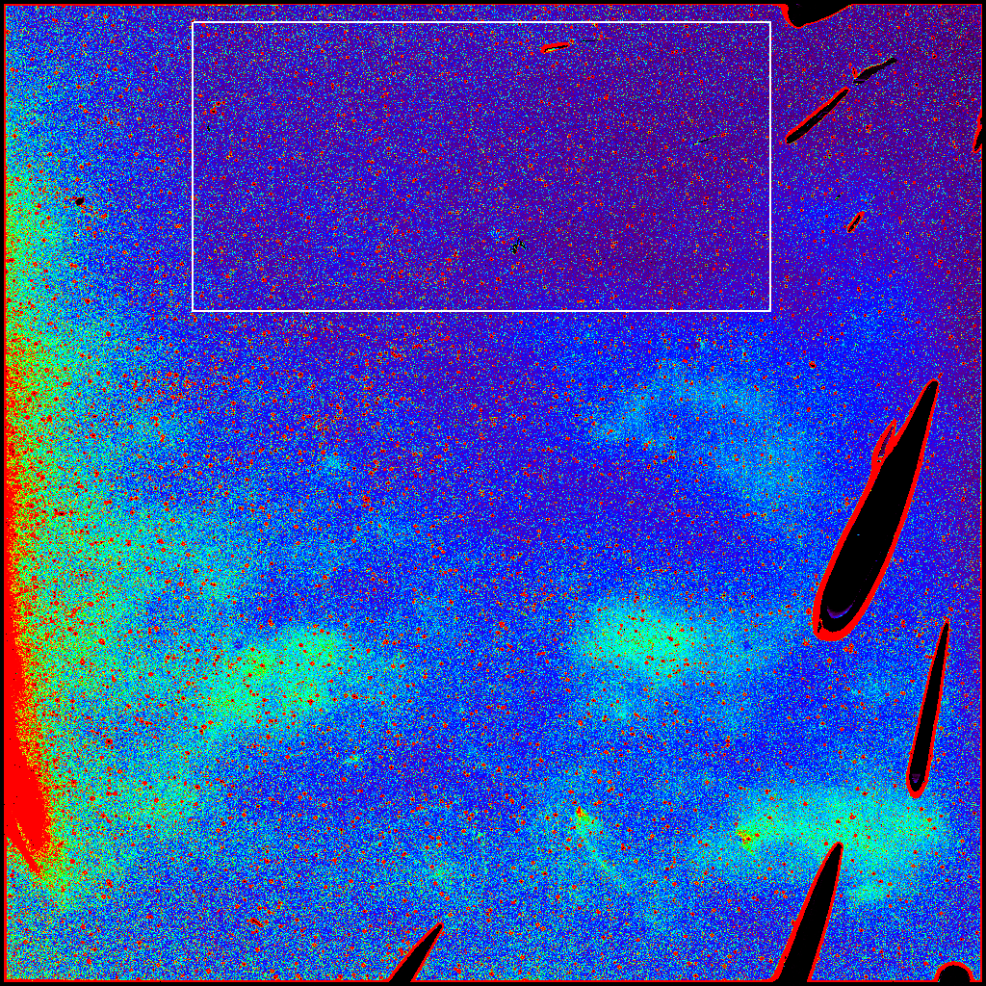
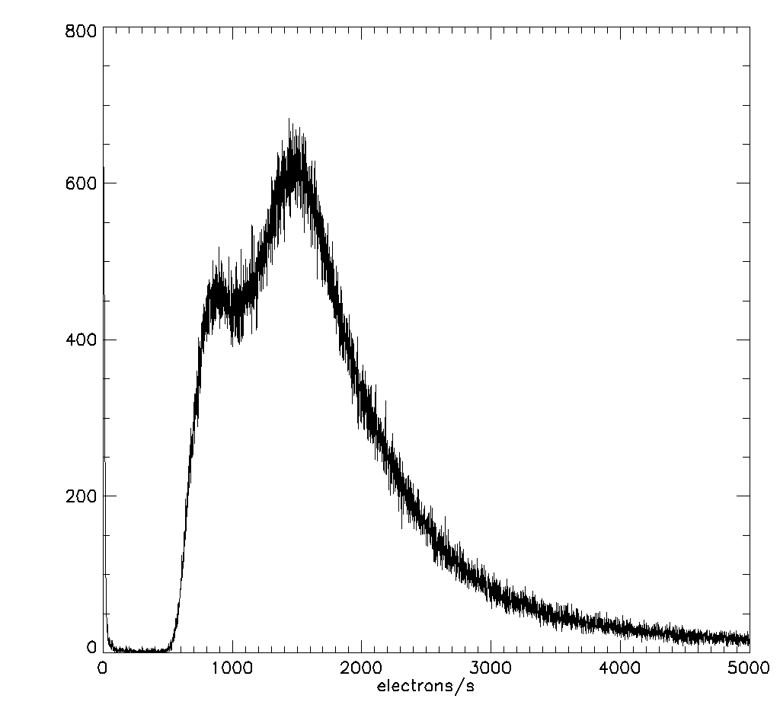
20313 (EM-IR) selected for tests
- Most critical channel for SNR, dark current
- large unconnected areas
- Upper part not that far from FM, FS candidates
(dark, hot pixels: FM x 2)
Dark current histogram
(18 µm pixels, 100 kHz readout)
IAS
Test chamber,
microcode

Slide 5
Test procedures
- EM FPE + FPA + connecting flex + Teledyne electronics (SAM card) as reference
-
- EM FPE + FPA, EM harness, PE EM → full EM configuration
SAM card with EM harness → checking PE EM performances wrt to Teledyne setup
- IAS microcodes with full capabilities (100 kHz readout and 1 MHz readout)
- Detector temperature regulated from 72 K to 100 K
- Screen regulated from 80 K to 100 K → adjustable signal levels
- Series of 16 acquisitions triggered by a single request to the FPE
32 lines (90% up), 512 lines (lower half, upper half): 1024 lines (full frame)
- standard deviation from 16 acquisitions of the same pixel (“spread”) → noise (not bias)
- Integration time, 100 kHz: 33 ms, 100 ms (32 lines), 400 ms, 800 ms (512 or 1024 lines)
- Integration time, 1 MHz: 25 ms, 100 m, 400 ms, 800 ms (32 to 1024 lines)
Wide range of signal levels → noise model (18 µm pixels), x 2 after nominal binning

Slide 6
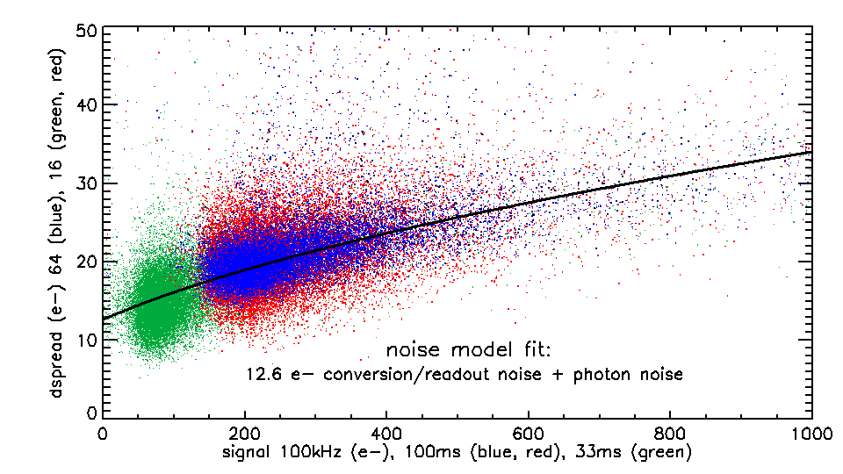
Noise model,
100 kHz readout
Full EM configuration
16 integrations, 400 ms
4 x 16 integrations, 400 ms
16 integrations,
100 ms
very clean signal
18 µm pixel spreads:
gaussian noise
< 5% înterpixel variability
(presentation by P. Haffoud)
readout / conversion noise
10 - 12 e- (reference pixels) In line with expectations for HxRG
12.5 - 14.5 e- (connected pixels)
readout noise assumption for the performance model: 20 e- (18 µm) → 40 e- (36 µm)

Slide 7
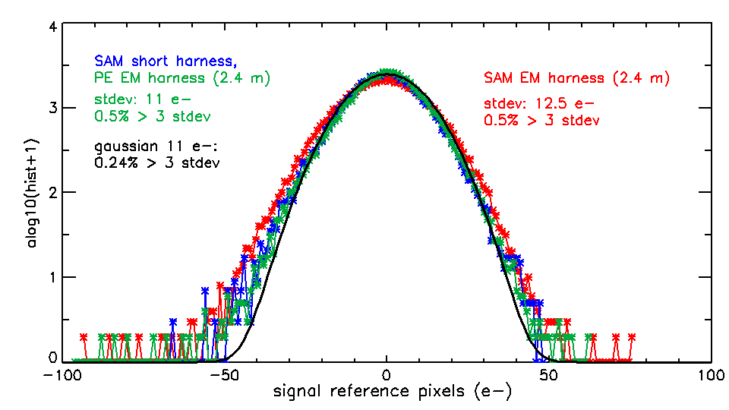
100 kHz readout: signal behavior for reference pixels
Photon noise is gaussian
reference pixels are dominated
by readout/conversion noise
log10(val+1): litmus test for
non gaussian behavior
Readout/conversion noise
Is very close to gaussian;
no significant outliers

Slide 8
De-spiking tests of 100 kHz readout data from the full EM configuration
Sample set: 8000 pixels (18 µm) with a 16-averaged signal of 158 e-to 162 e-
All 8000 x 16 samples: σ ~ 16.4 e- ~ sqrt((12.6 e-)² + 160 (photon noise)
- σ after sorting/averaging: smaller than “raw” σ, ratio depends on sorting strategy
- a negative bias (if selected set is not symmetrical) is proportional to raw σ
expected with observed
16.4 e- Gaussian spread with EM data
σ bias σ bias
3,1,0 (lowest of 3) 12.21 e- -13.5 e- 12.35 -12 e-
3,1,1 (middle of 3) 10.99 e- 0 10.92 +1 e-
3,2,0 (average of 2 lowest) 10.19 e- -6.7 e- 10.16 -5.4 e-
For 100 kHz readout, the assumptions for the de-spiking strategy, and the performance model are validated with 50% margins on the readout noise
(assumption: 20 e- for 18 µm pixels, actual 12.5 - 14.5 e-)

Slide 9
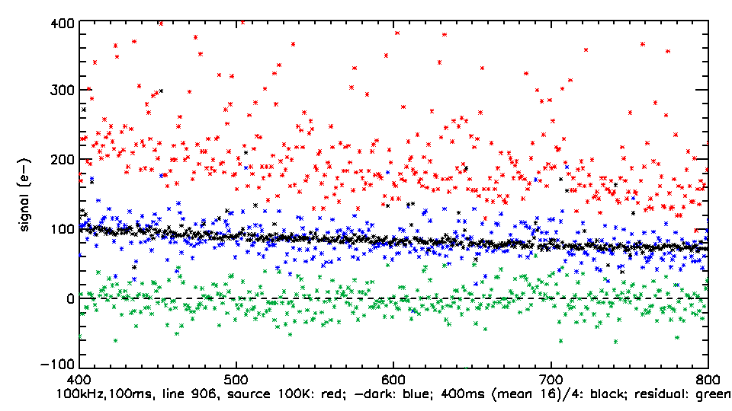
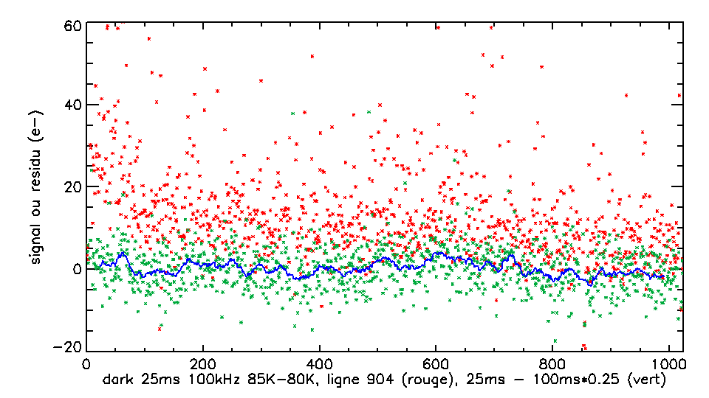
measuring weak signals
after dark subtraction
(HxRG trademark with 100 kHz readout)
100 e- signals from a “warm” (95K) screen)
100 ms (CDS)
100 ms (CDS,
dark subtraction)
400 ms / 4,
mean of 16
signal (e-)
Comparing with a better defined signal
scaled to the integration time:
→ reliability
→ linearity at low signal levels
residual
dark current at 80 K
- dark current at 71K
→ down to 10 e-
100 kHz, 25 ms
The MAJIS EM configuration is up to par
for low signals.
good news for challenging targets
(exospheres, rings…)
signal (e-)
25 ms – 100 ms / 4

Slide 10
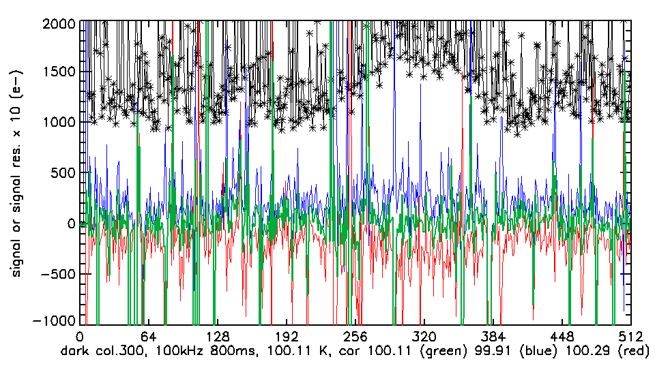
Recovering the relevant dark current when the temperature is changing
MAJIS approach:
Interpolating dark currents
measured before and after
the observation on the basis
of detector temperature HK
Even with a 0.4 K
temperature increase (+5%)
The dark current can be
reliably interpolated
with an accuracy of ~ 5 e-
measured dark current (e-), HK: 100.11
Residual (x10) subtracting “before” dark current HK: 99.91 K)
Residual (x10) subtracting “after” dark current (HK: 100.29 K)
Residual (x10) subtracting interpolated dark current for 100.11 K

Slide 11
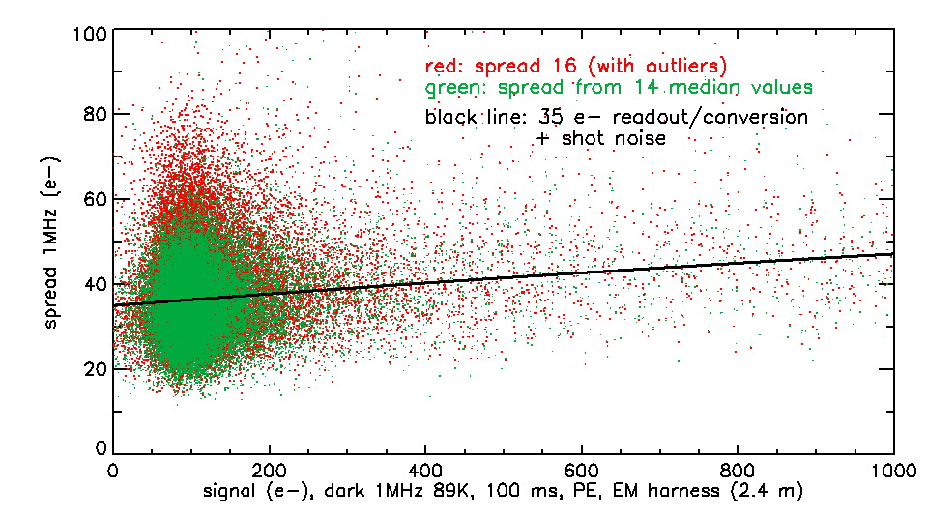
Noise model,
1 MHz readout
Full EM configuration
> 80% of MAJIS data
(Jupiter, satellites VISNIR,
satellites IR HR)
18 µm pixel spreads:
gaussian noise
1% of additional outliers
with EM harnesses
readout and conversion noise
28 - 30 e- (reference pixels) “slow” 1MHz readout + 12 bits ADC: specific to MAJIS
32 - 35 e- (connected pixels)
readout noise assumption for the performance model: 40 e- (18 µm) → 80 e- (36 µm)

Slide 12
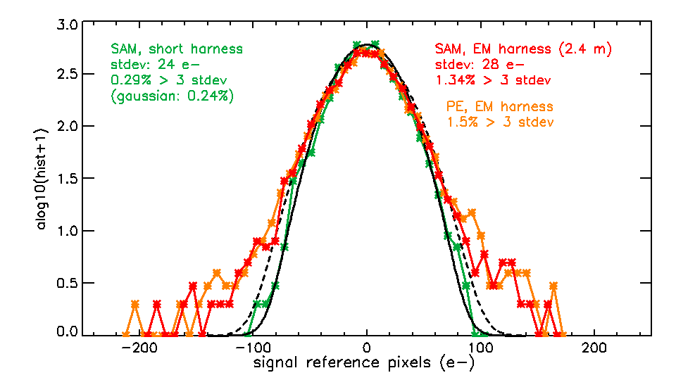
1 MHz readout: signal behavior for reference pixels
Signals < 1000 e- are dominated
by readout/conversion noise
short harness: Gaussian behavior
EM harness: 99% gaussian
with outliers (~ 1%, < 200 e-, 5σ)
0.5% are negative (hence selected
after sorting by de-spiking
EM config.: worst case
PFM harness: 2 m (< 2.4 m)
PE PFM: additional filtering
The performance model assumption (40 e- readout noise) is validated with margins
A capability for screening out the lowest value has been included for de-spiking,
In case the PFM configuration (or EMI/EMC effects) results in too many negative outliers

Slide 13
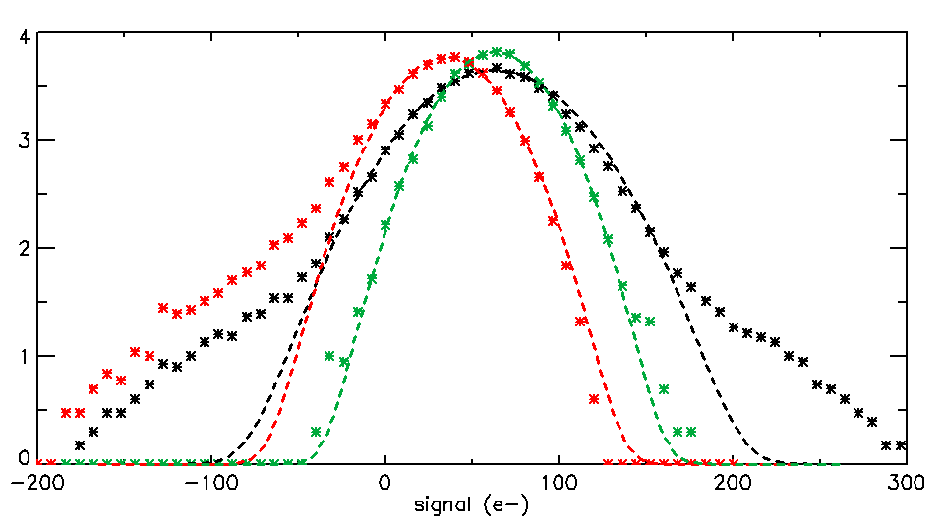
The impact of outliers on de-spiking procedures;
Ganymede HR observations: 2 to 3 sub-integrations
Observed standard deviations
for the bulk of selected pixels
are fully in line with expectations
with the Gaussian assumption
Low outliers are preferentially
selected if the lowest value
Is included in the sub-set
selected for averaging
EM outliers are small (< 200 e-),
Impact reduced after 2x2 binning
lowest of 3: σ ~ 24.5 e-
Low outliers x 3
middle of 3: σ ~ 22.8 e-
no outliers
All samples
σ ~ 34 e-
outliers

Slide 14
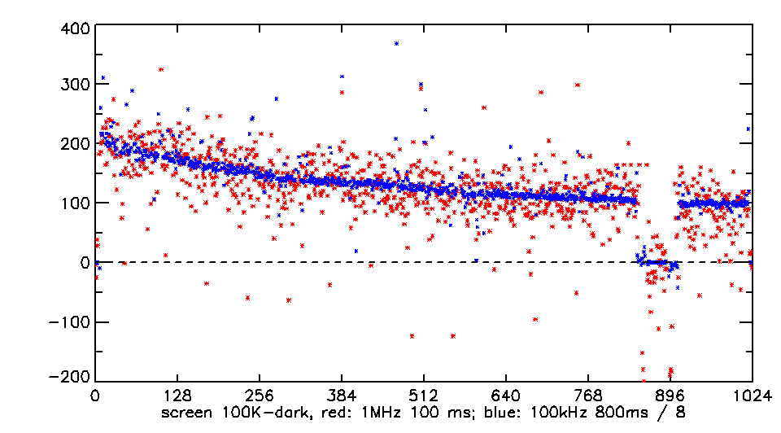
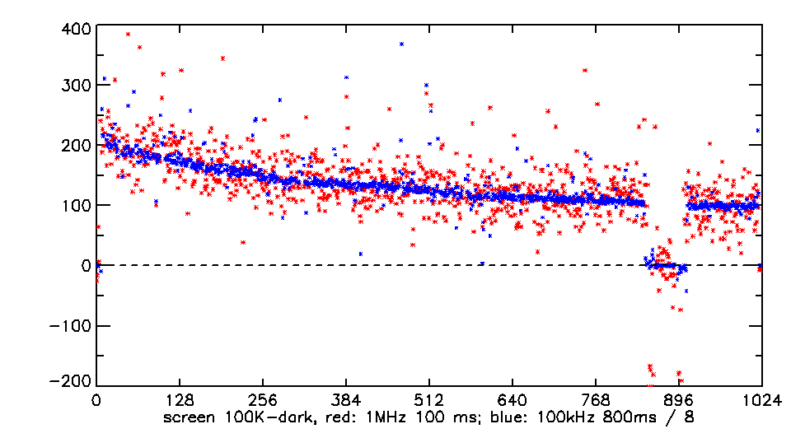
100 e- signals from a “warm” (95K) screen), 1 MHz readout
400 ms, 100 kHz / 4
Profile with 3,1,0 de-spiking (t_{int}: 100 ms)
compared with an average of 16 profiles
with t_{int} = 400 ms and 100kHz readout
Bias compensated assuming Gaussian model
3,1,0: low outliers
Profile with 3,1,1 de-spiking (t_{int}: 100 ms)
compared with an average of 16 profiles
with t_{int} = 400 ms and 100kHz readout
MAJIS can reliably observe low signals
with 1 MHz readout (albeit with higher noire)
400 ms, 100 kHz / 4
3,1,1: no low outliers

Slide 15
The impact of outliers on de-spiking procedures
Ganymede HR observations (“mild” spikes): 2 to 3 sub-integrations
Observed standard deviations
for the bulk of selected pixels
are fully in line with expectations
with the Gaussian assumption
Low outliers are preferentially
selected if the lowest value
Is included in the sub-set
selected for averaging
EM outliers are small (< 200 e-),
Impact reduced after 2x2 binning
lowest of 3: σ ~ 24.5 e-
Low outliers x 3
middle of 3: σ ~ 22.8 e-
no outliers
All samples
σ ~ 34 e-
outliers
De-spiking strategies with or without the lowest value can be implemented by TC
The SNR with 3,1,0 (σ : 24.5 e-) is lower than with 3,1,1 (σ : 22.8 e-)
The SNR with 3,2,0 = average of two lowest (σ : 21.3 e-) is only marginally better
Why not stick with 3,1,1 (middle of 3) ?

Slide 16
Spectral-spatial crosstalk at the sub-pixel level
Signal increase
PSF
Strong spatial gradients across a pixel
can result in a spectral jitter
after severe de-spiking
(only one sample selected)
λ₁
λ₁
λ₂
λ₂
λ₃
λ₃
1 sample / 3 2 samples / 3
The more samples, the better (3,2,0 superior to 3,1,1 in this respect)
PSF broadening and binning 2 x 2 mitigates the impact (4 / 8 samples per data element)
Nevertheless, caution will be required when interpreting weak spectral signatures
in regions with strongly varying signals
Weak signals: larger impact from outliers → 3,1,1
Strong signals with large gradients (e.g. Jupiter hot spots) → 3,2,0

Slide 17
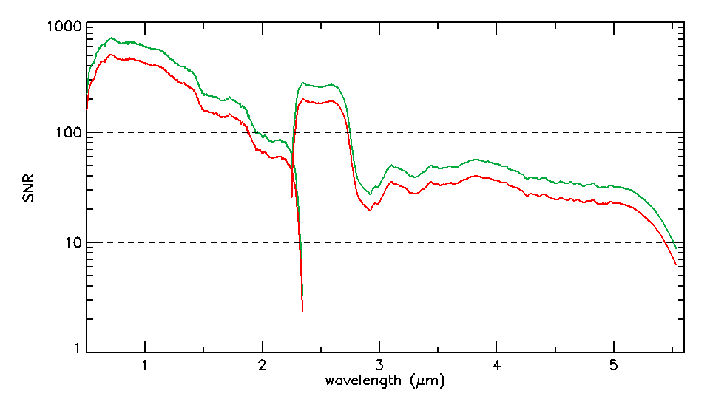
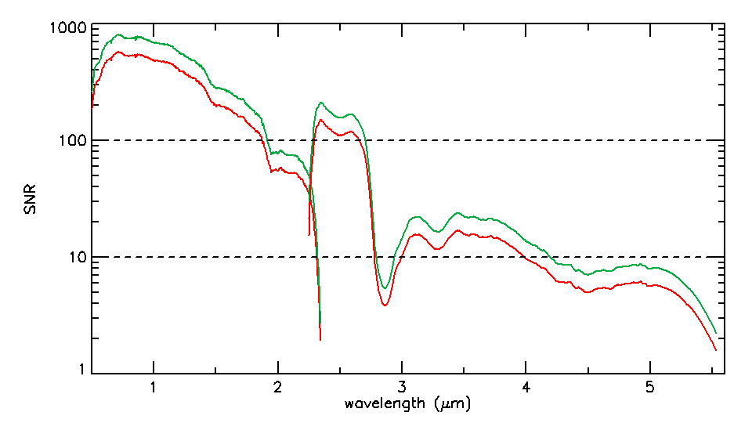
SNR after de-spiking
Ganymede HR
Spike rates adjusted on the basis of:
- Cluster size distribution (H1RG tests, Liège)
- Latest OH radiation model (10/2018)
- Reliability of series of sub-integrations:
500 ms → 600 ms for HR observations
with 3 sub-integrations
- SNR: > 30 (Ganymede), > 15 (Europa)
even in deep ice bands
Impact of EMI/EMC perturbations:
TBC after PFM integration
Binning x 2 (150 m/pixel)
No binning (75 m/pixel)
Europe HR
Binning x 2 (120 m/pixel)
No binning (60 m/pixel)

Slide 18
Take home message from EM configuration tests
There are still major issues to be solved
(in particular the tight schedule)
If we meet these challenges, MAJIS will provide outstanding data

