Slide 1
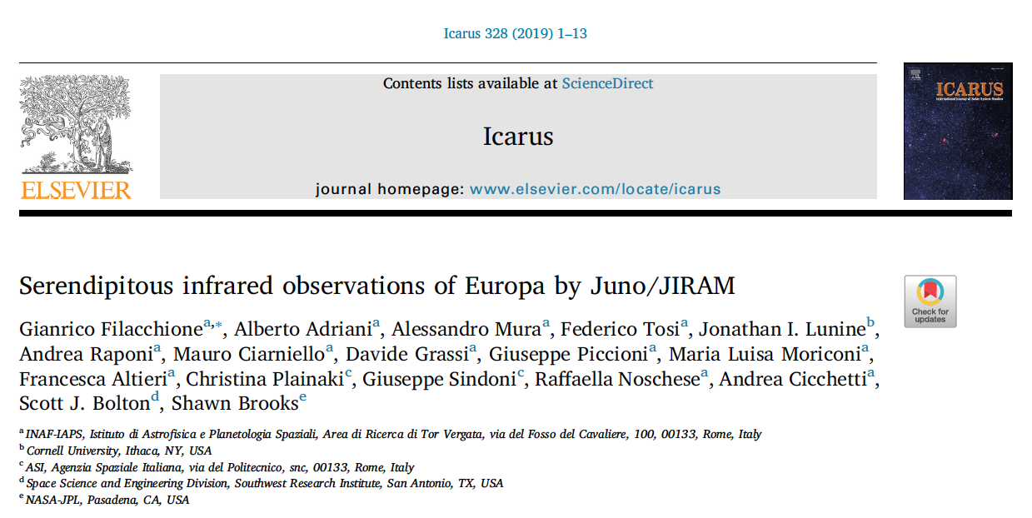

Slide 2

Juno
spinning S/C
2 rpm

Slide 3


Slide 4
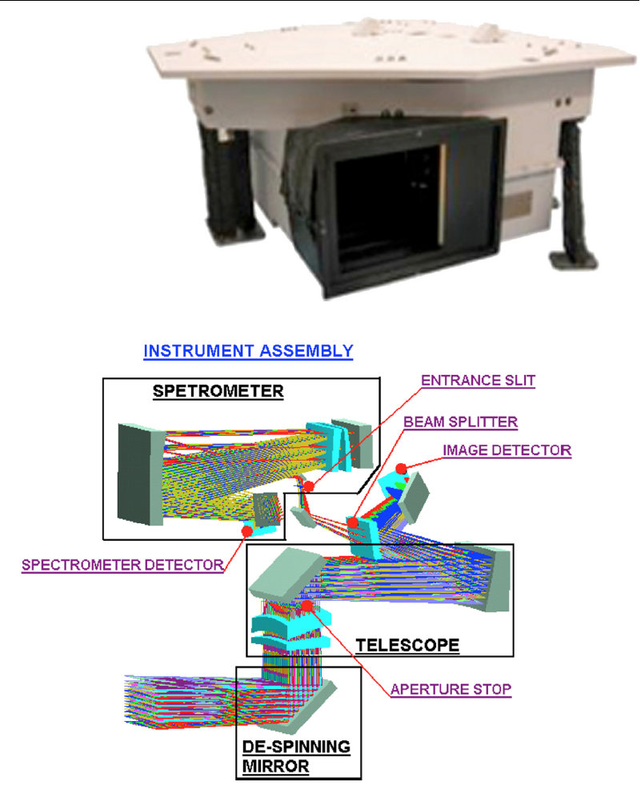
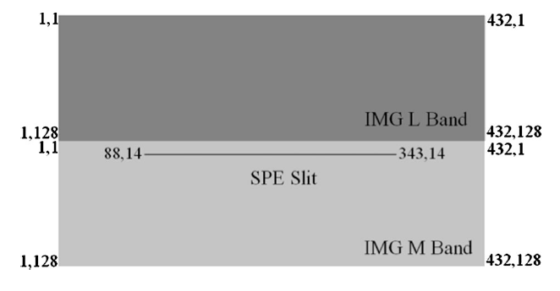
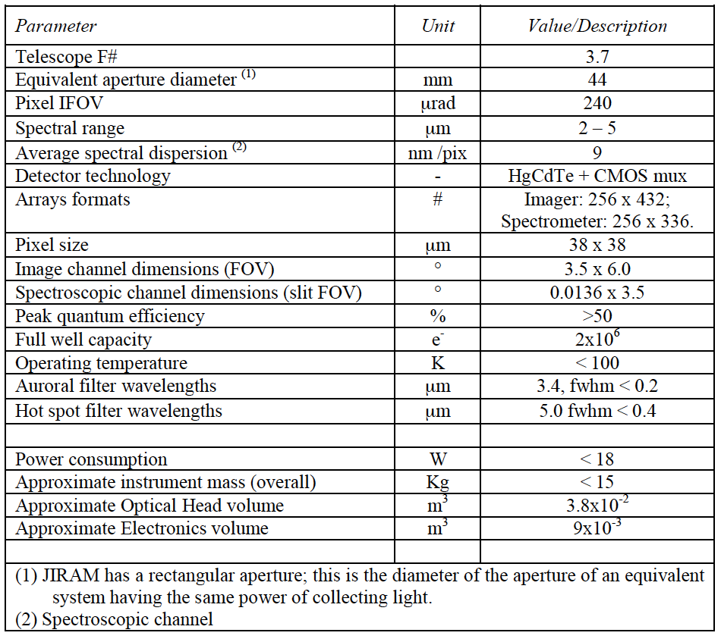
2 rpm
12°/sec
JIRAM
Adriani et al. SSR, 213 (2017)
SPC rotation

Slide 5
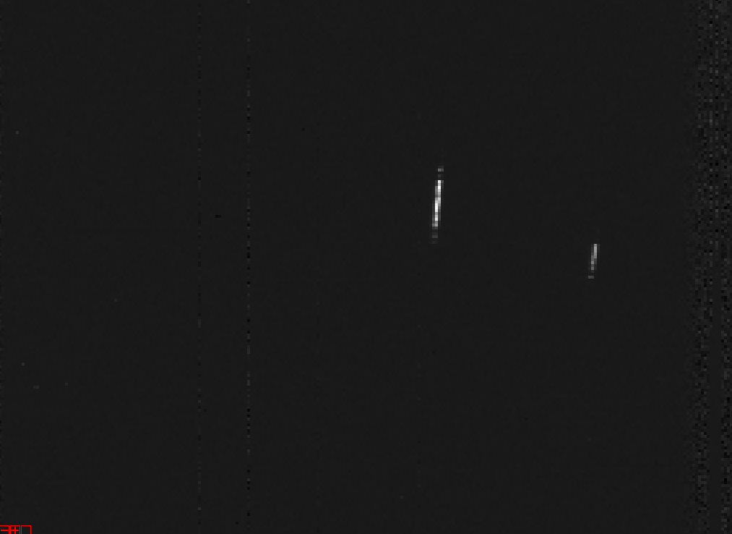
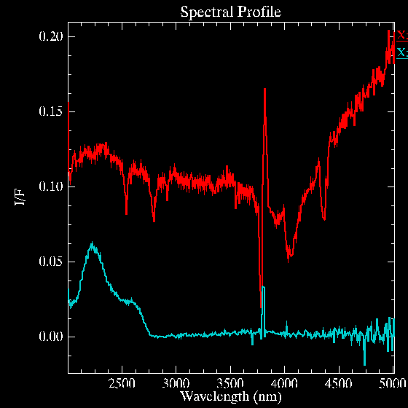
Galilean Satellites Observations by JIRAM
JIRAM produces “unconventional” 2-5 µm data cubes of Galilean moons:
pixels along the slit are contiguous but along time axis are independent.
2.2 µm pseudo-image from consecutive slits
JM0002_160802_213108
distance ≈8E6 km, phase 87°
IO
← time
EUROPA
slit

Slide 6
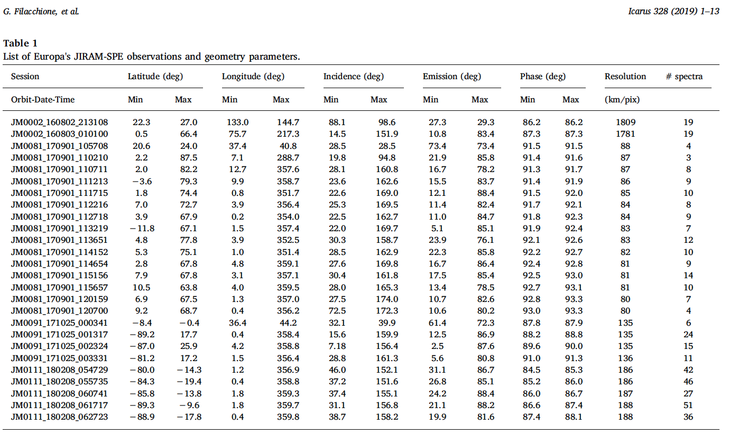
JIRAM dataset – Europa observations

Slide 7
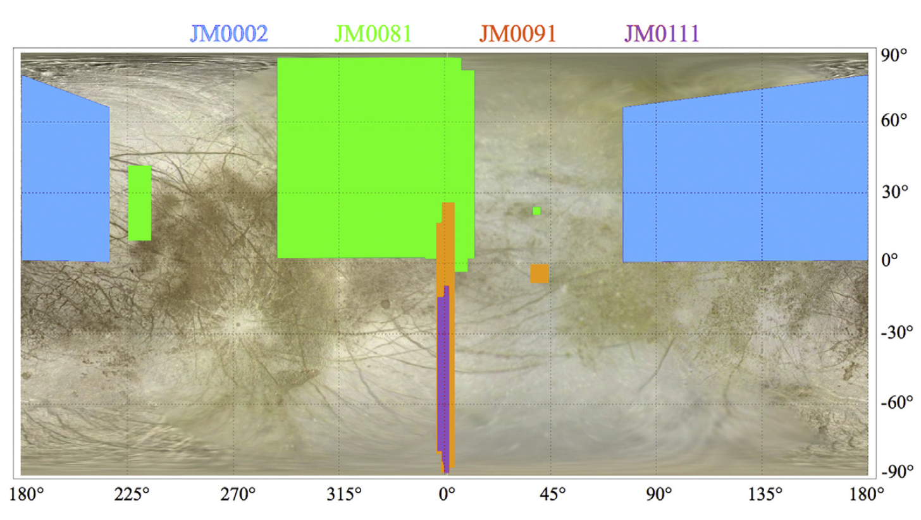
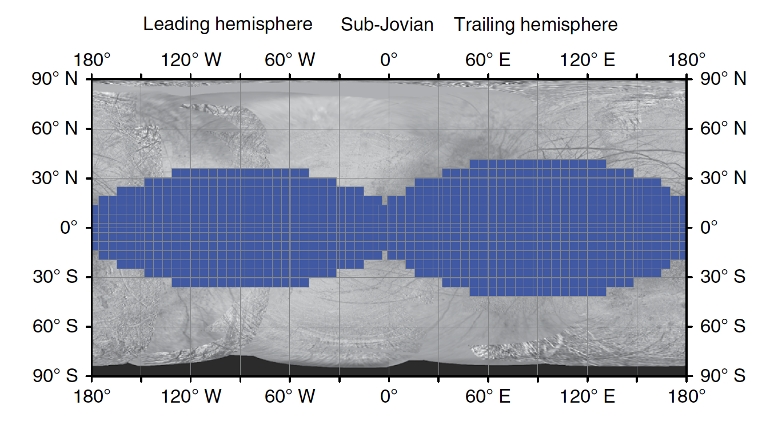
JIRAM data spatial coverage
Nordheim et al, 2018

Slide 8
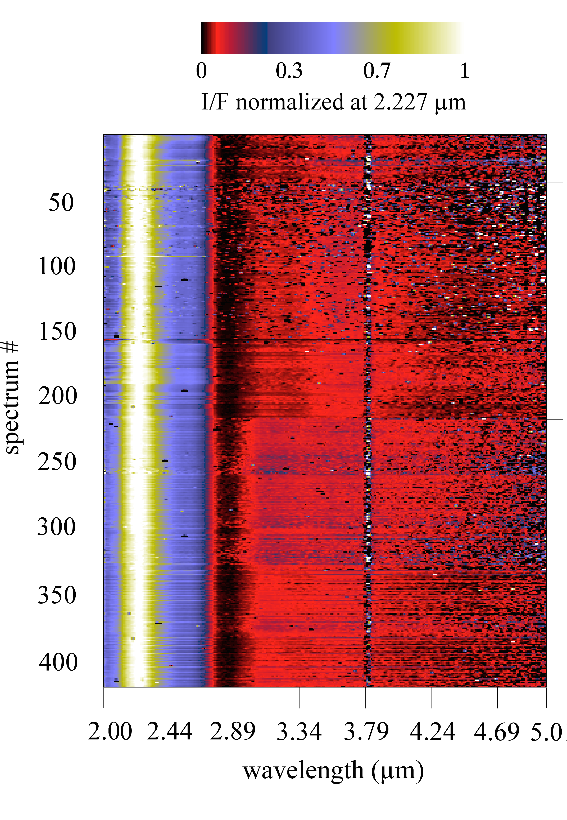
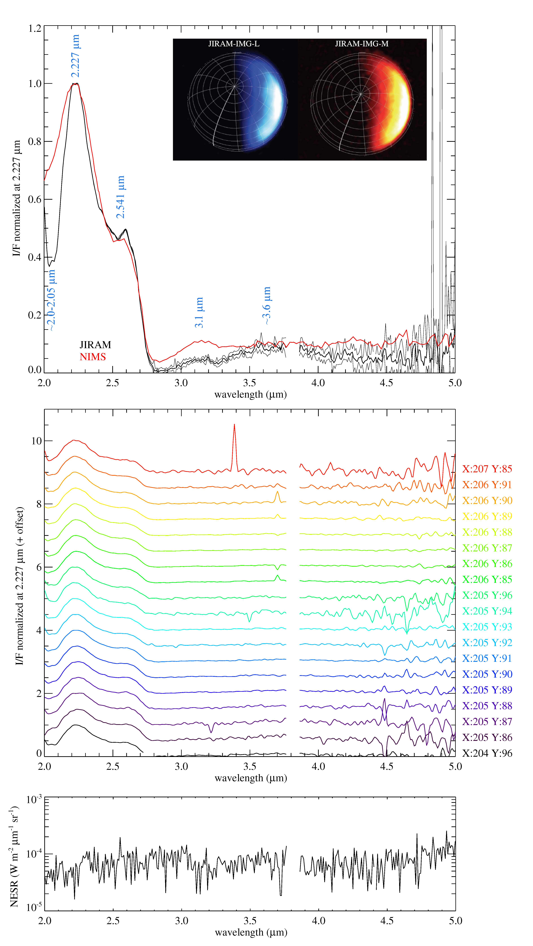
#2
JM0002_160802_213108
northern/antijovian hemisphere
#8
#9
#11

Slide 9
Europa median I/F spectra
NIMS avg spectrum is from Galileo's orbit G1 and include the north pole and bright limb (around lon=330°) observed at solar phase=31°, with incidence
angles varying from 4° to 84° and with emission angles from 3° to 84° (Hansen pers. comm. 2003)

Slide 10
Spectral Indicators
Tuned on pure water ice composition (from Cassini-VIMS previous studies):
2 μm band center wavelength, λ_{BC}(2 μm), is used as a proxy of the water ice amorphous/crystalline state and of the non-ice material composition;
2 μm band depth, BD(2 μm), is a proxy of water ice and non-ice material abundance, and regolith grain size distribution.
Ratio I/F(2.541 μm)/I/F(2.020 μm) is a proxy of the abundance of the non-ice material;
Ratio I/F(3.100 μm)/I/F(2.847 μm) is another proxy of the surficial water ice amorphous/crystalline state;
Ratio I/F(3.630 μm)/I/F(2.227 μm) is a proxy of water ice grain size;
Wavelength of the I/F peak around 3.6 μm, λ(3.6 μm), is a proxy of water ice temperature.

Slide 11
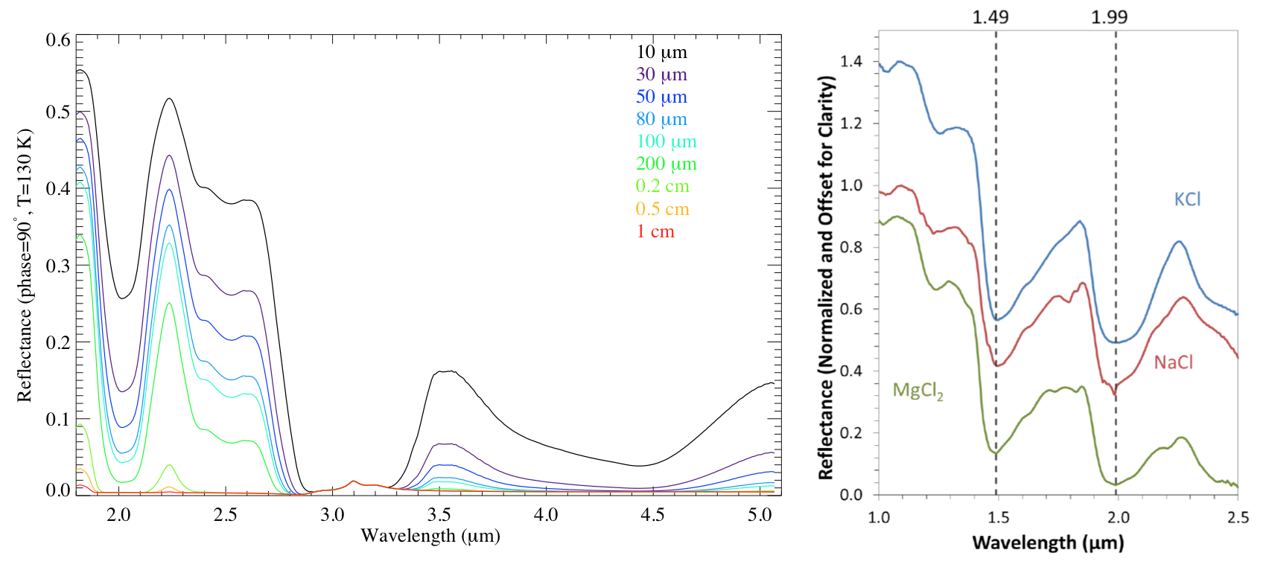
Water Ice vs. Chlorine Salts
Synthetic spectra of water ice grains with sizes between 10 μm to 1 cm (Raponi et al. 2016).
Laboratory reflectance spectra of frozen eutectic chlorine salts MgCl₂, NaCl, KCl at T=−30 °C (Hanley et al., 2014)

Slide 12
Water ice vs. Contaminants
water ice
contaminants

Slide 13
Water ice grain size 1/2
I/F(3.630 μm)/I/F(2.227 μm) ratio BD (2 µm)
average → 0.079 compatible with
grain sizes of 50-80μm and ≈0.5 cm
average → 0.60 compatible with
grain sizes of 10-30μm and ≈0.5 cm
BD decreases towards southern latitudes (smaller grains)

Slide 14
Water ice grain size 2/2
The size distribution on the surface of Europa is dominated by grains tens to hundreds of microns in size with a possible smaller fraction of millimeters size grains.

Slide 15
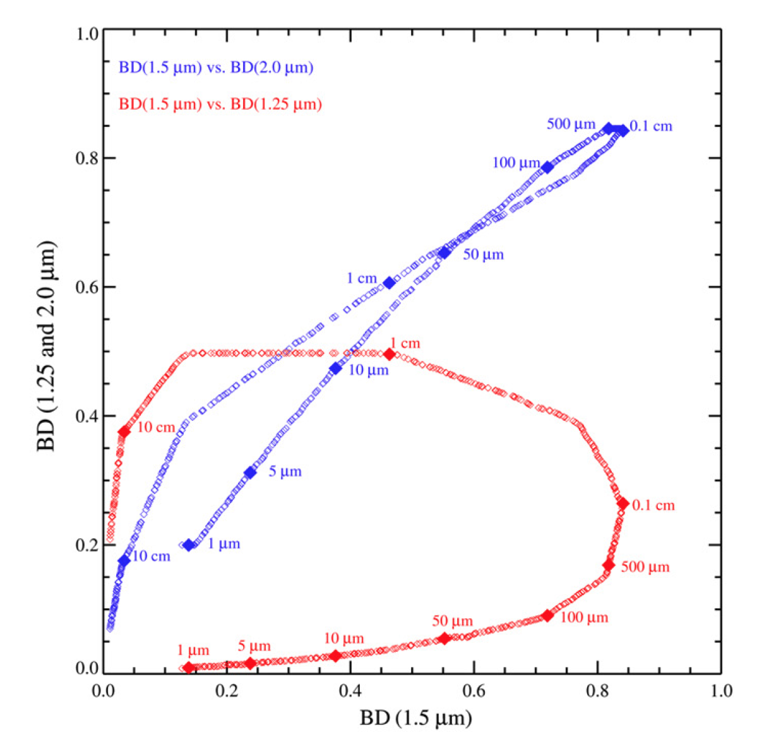
Water ice grain size from 1.25, 1.5 2.0 µm band depths
Filacchione etal., 2012

Slide 16
Water ice amorphization
≈10 cm optical skin depth
subµm optical depth skin
Am. Cr.
2 BC shows a prevalence of the crystalline form in the northern/antijovian
hemisphere (JM002) and a larger presence of amorphous form in the northern/jovian (JM0081) and in the southern/jovian hemisphere regions (JM0091 and JM0111 orbits) in agreement with telescopic spectral data (Ligier et al., 2016).

Slide 17
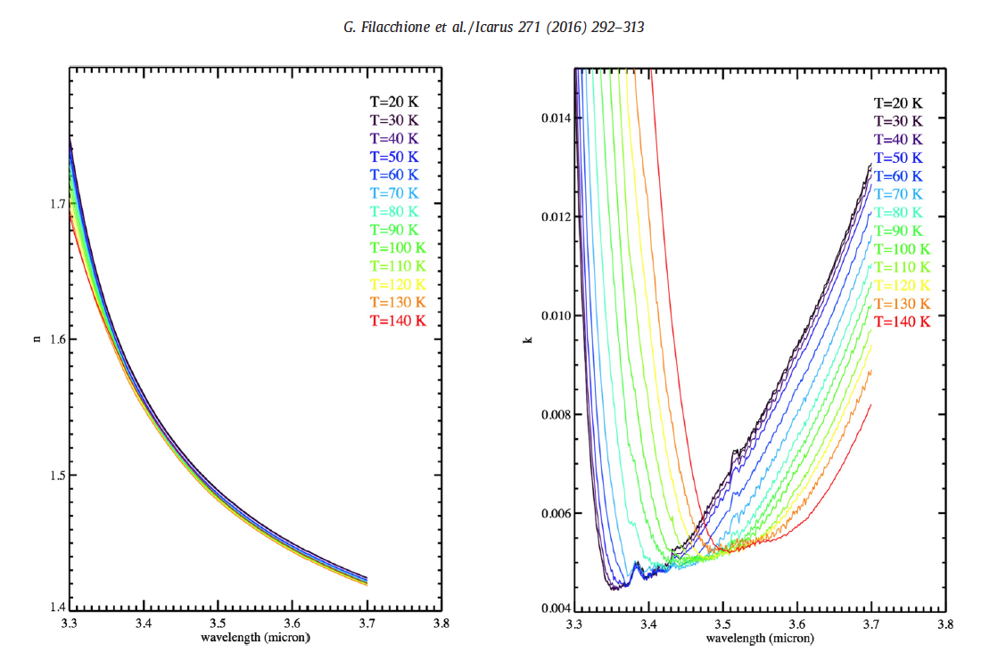
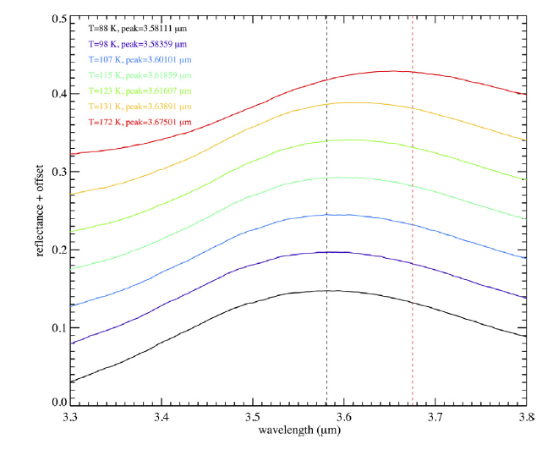
Temperature 1/2
Water Ice optical constants
(Mastrapa et al., 2009)
3.6 µm reflectance peak
(lab measurements, Clark)
The retrieval of the diurnal temperature by using the 3.6 µm peak wavelength has been
validated on Saturn’s icy satellites and rings (Filacchione et al., 2014, 2016).

Slide 18
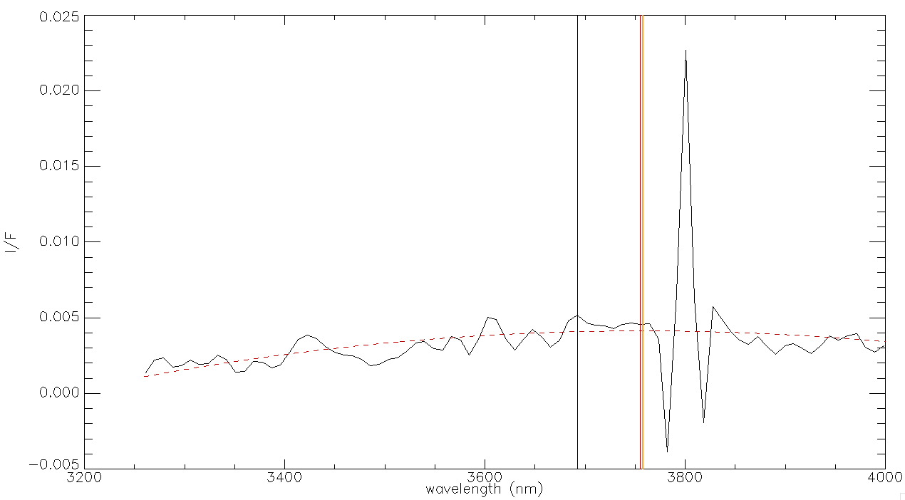
Temperature 2/2
Very low I/F
Order sorting filter at ≈3.6 µm
Temperature distribution is very noisy. Both median and average values indicate a
diurnal T<130 K (observations at solar phase angle ≈90°).

Slide 19
Conclusions
Europa’s surface composition appears dominated by water ice contaminated by the presence of non-ice endmembers, like hydrated salts and acid-rich compounds, necessary to equalize the ratio of the I/F within the 2 μm band to the 2.5 μm continuum.
More pure water ice is observed by JIRAM on the northern hemisphere than on the southern along the jovian meridian.
Water ice appears in both crystalline and amorphous forms: a prevalence of the first is obtained from the 2 μm band center wavelength on the northern hemisphere while the latter prevails when analyzing the properties of the 3.1 μm Fresnel peak. This result further evidences the different skin depth at which radiation is efficient in water ice amorphization.
The surface regolith grain size distribution encompasses tens to hundred of microns sizes with a possible tail towards larger grains suggesting possible water ice grain mobilization, aggregation and sintering. These processes cannot be excluded since the diurnal maximum temperature, derived from the 3.6 μm continuum properties, is 132 K and it is high enough to activate these processes.
Next steps: analyze new Europa observations and proceed with spectral modeling (within INAF Mainstream grant).

