Slide 1
The (other) Galilean moons as seen by JIRAM
after 3 years of the Juno mission
Federico Tosi, Alessandro Mura, Gianrico Filacchione, Giuseppe Sindoni, Alberto Adriani,
and the Juno/JIRAM Team
5th MAJIS Science Team meeting
Rome, 10 October 2019

Slide 2
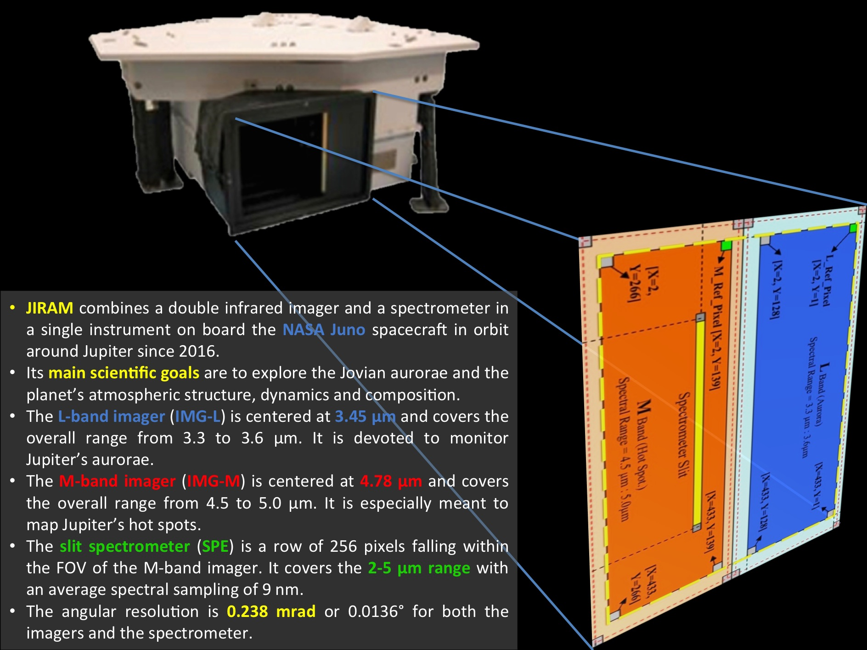

Slide 3
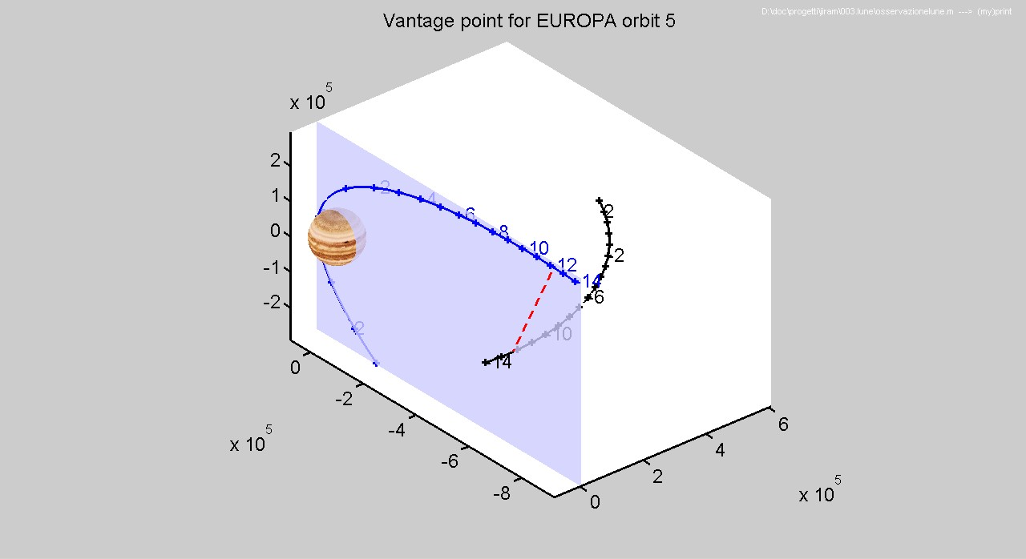
The Juno spacecraft orbits Jupiter along a polar orbit, with a period of ~53 days and 2 rpm spin
JIRAM can only point perpendicular to the spin axis.
An internal de-spinning mirror compensates for the S/C rotation, allowing exposure times up to 1 s.
At the beginning of the mission, the spin axis was roughly perpendicular to the orbit plane, and a satellite opportunity was like in the picture below: JIRAM could observe anywhere close to the orbit plane.
Thus, in the framework of the Juno mission, the Galilean satellites are targets of opportunity: JIRAM can observe them only if they fall by chance in its FOV. It should also be noted that JunoCam as well as UVS have smaller FOVs than JIRAM, so JIRAM is indeed the best remote sensing instrument to observe the satellites.
Due to orbit/FOV constraints, most of the observations of the Galilean satellites will have:
Polar view, meaning high latitudes (inbound: north; outbound: south)
~50% of leading, ~50% of trailing hemisphere (first orbits only)
~50% of dayside, ~50% of nightside.

Slide 4
Summary of the observations of the Galilean satellites by Juno/JIRAM
In the three-year period from the capture orbit until the completion of the 20th orbit around Jupiter, i.e. from 10 July 2016 to 29 May 2019, JIRAM had the opportunity to observe the Galilean satellites ~4900 times, both through images and spectra. Among the four satellites, Ganymede has been observed most frequently, while Callisto has a relatively small number of looks.
 | Considered periods | Total JIRAM data | # JIRAM imaging data | # JIRAM spectral slits | Range of altitudes over the surface (km) | Pixel resolution (km/px) | Target seen over JIRAM pixels # | Target's apparent angular radius (mrad) | Phase angle (deg)
Io | JM0041 – JM0201 | 1112 | 734 | 387 | 285,472 – 1,396,013 | 332 – 68 | 11 – 54 | 1.3 – 6.4 | 52 – 123
Europa | JM0001 – JM0181 | 1118 | 939 | 179 | 228,370 – 7,628,505 | 1814 – 54 | 2 – 58 | 0.2 – 6.8 | 80 – 97
Ganymede | JM0002 – JM0191 | 2127 | 1714 | 413 | 385,564 – 8,678,262 | 2063 – 92 | 3 – 57 | 0.3 – 6.8 | 78 – 103
Callisto | JM0041 – JM0071 | 569 | 441 | 128 | 1,243,202 – 1,802,578 | 429 – 296 | 11 – 16 | 1.3 – 1.9 | 77 – 106
In the best cases, the Galilean satellites were typically observed over 11 to 58 pixels, yielding spatial resolutions between ~54 and ~300 km/px depending on the target (Europa best, Callisto worst), but always at medium-to-high and high phase angle values, given the polar orbit rode by Juno.

Slide 5
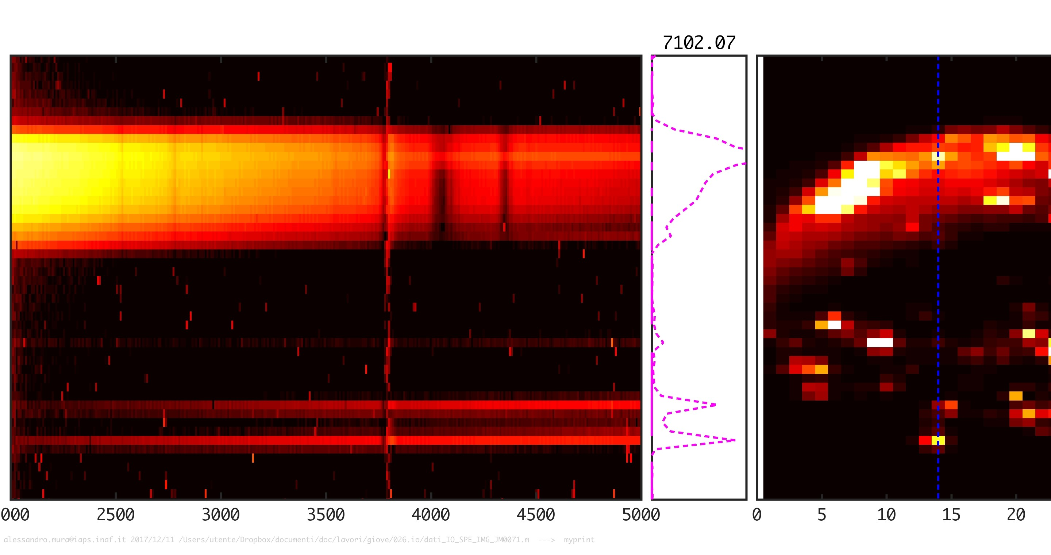
Left: Spectrogram (Y axis: spatial pixels, X axis: spectral pixels covering the overall 2-5 µm range)
Right: Image acquired with the M-band imager.
The vertical blue dashed line in the right image identifies the location where the JIRAM spectrometer took the data shown in the left spectrogram.
Notes:
Using JIRAM both as an infrared spectrometer and imager at the same time

Slide 6
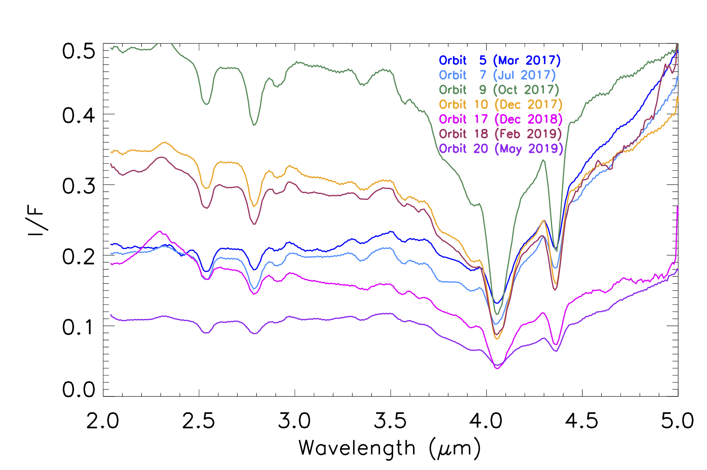
Average I/F spectra of Io as observed by Juno/JIRAM
i < 80°, e < 80°

Slide 7
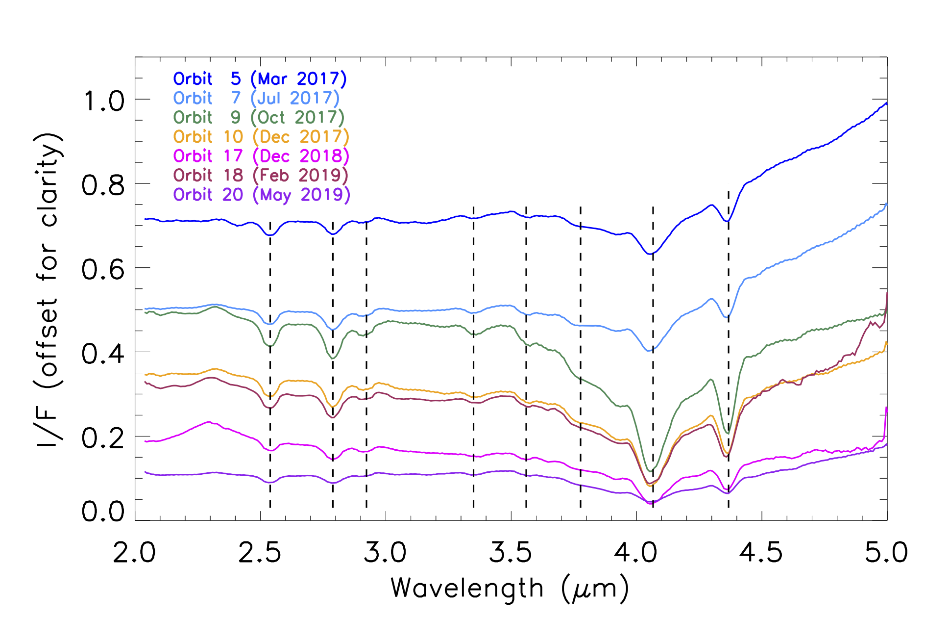
Average I/F spectra of Io as observed by Juno/JIRAM
Main spectral features of SO2 frost
v1+v2+v3
2v1
2v1+v2
v1+v3
3v1
3v2
3v3
2v1+v3

Slide 8
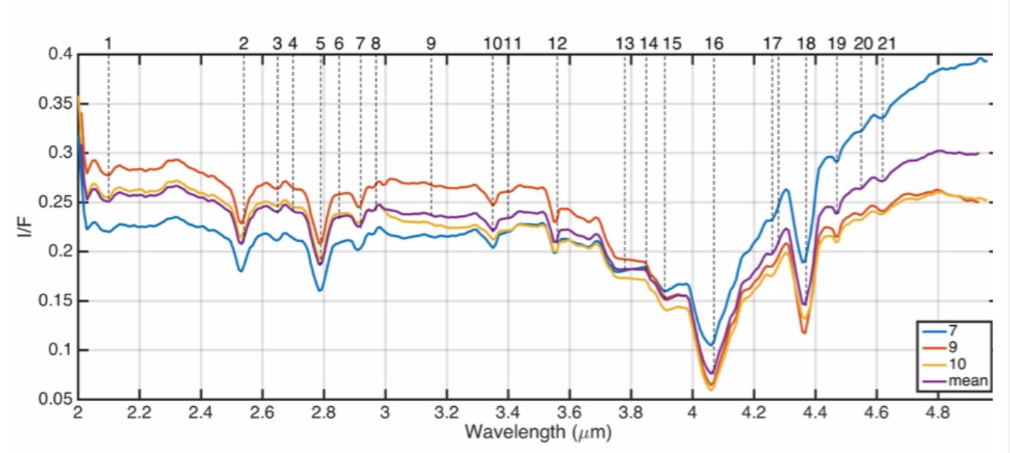
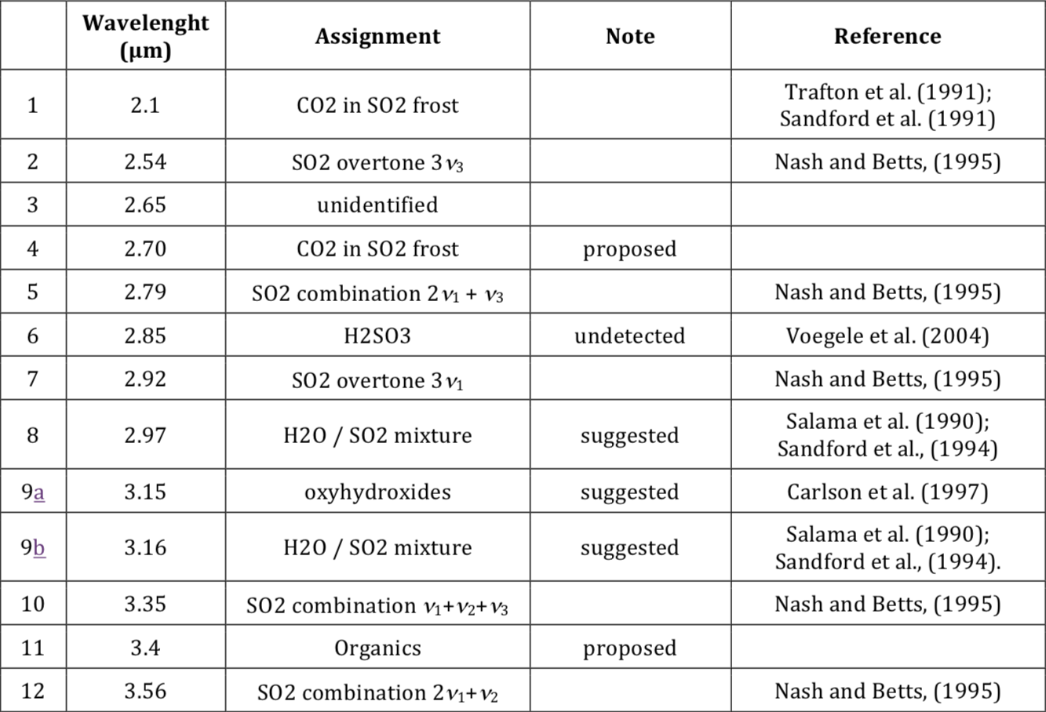
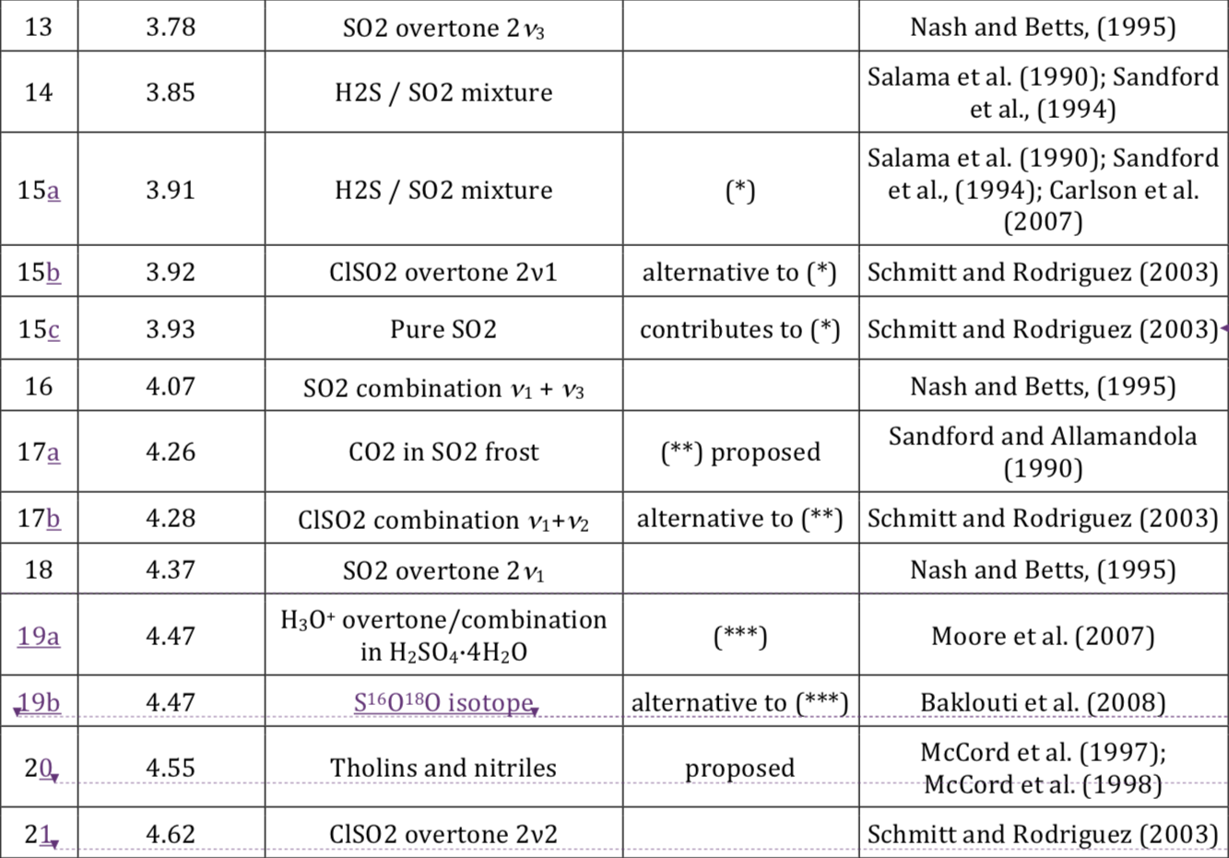
Mura et al., 2019, Icarus, submitted

Slide 9
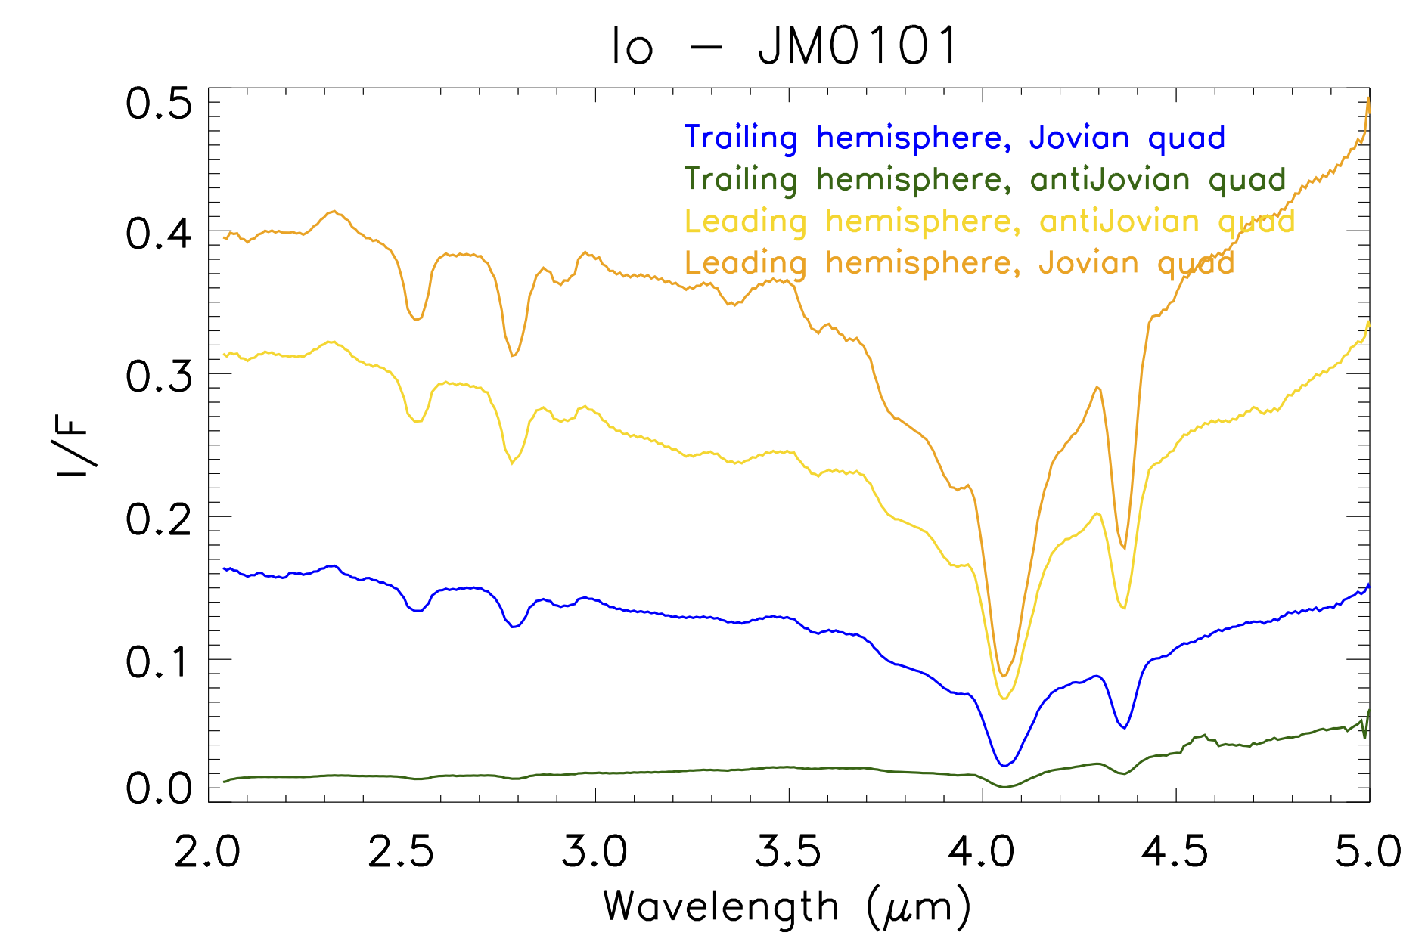

Slide 10
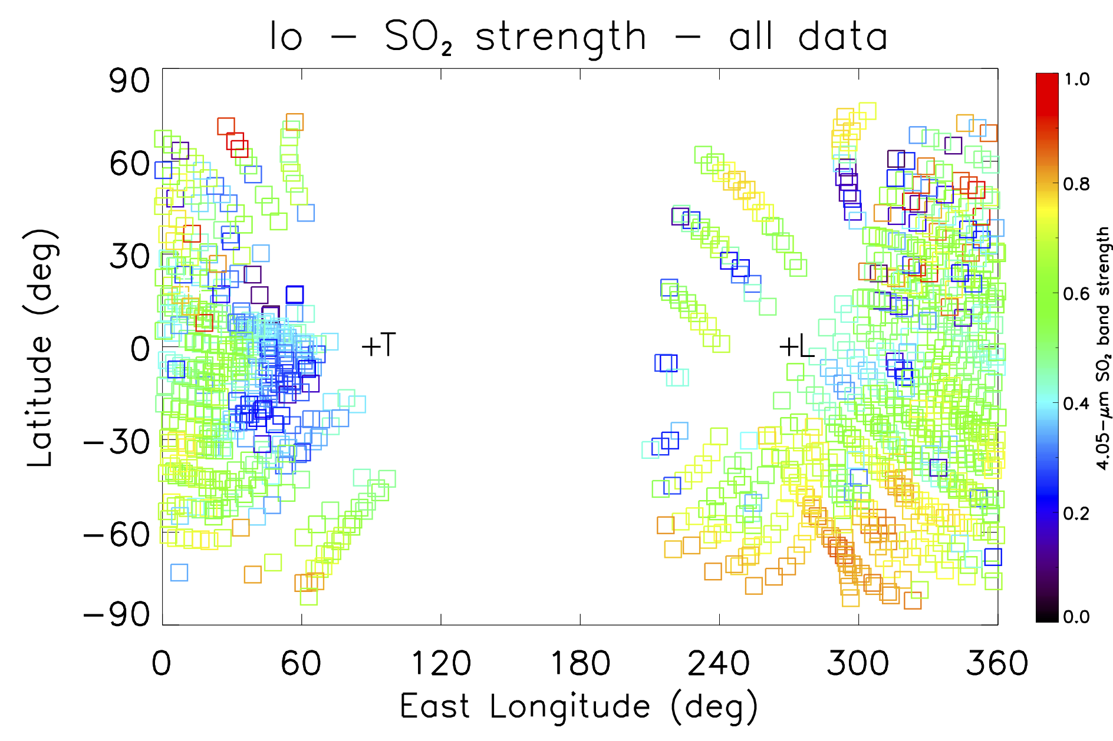

Slide 11
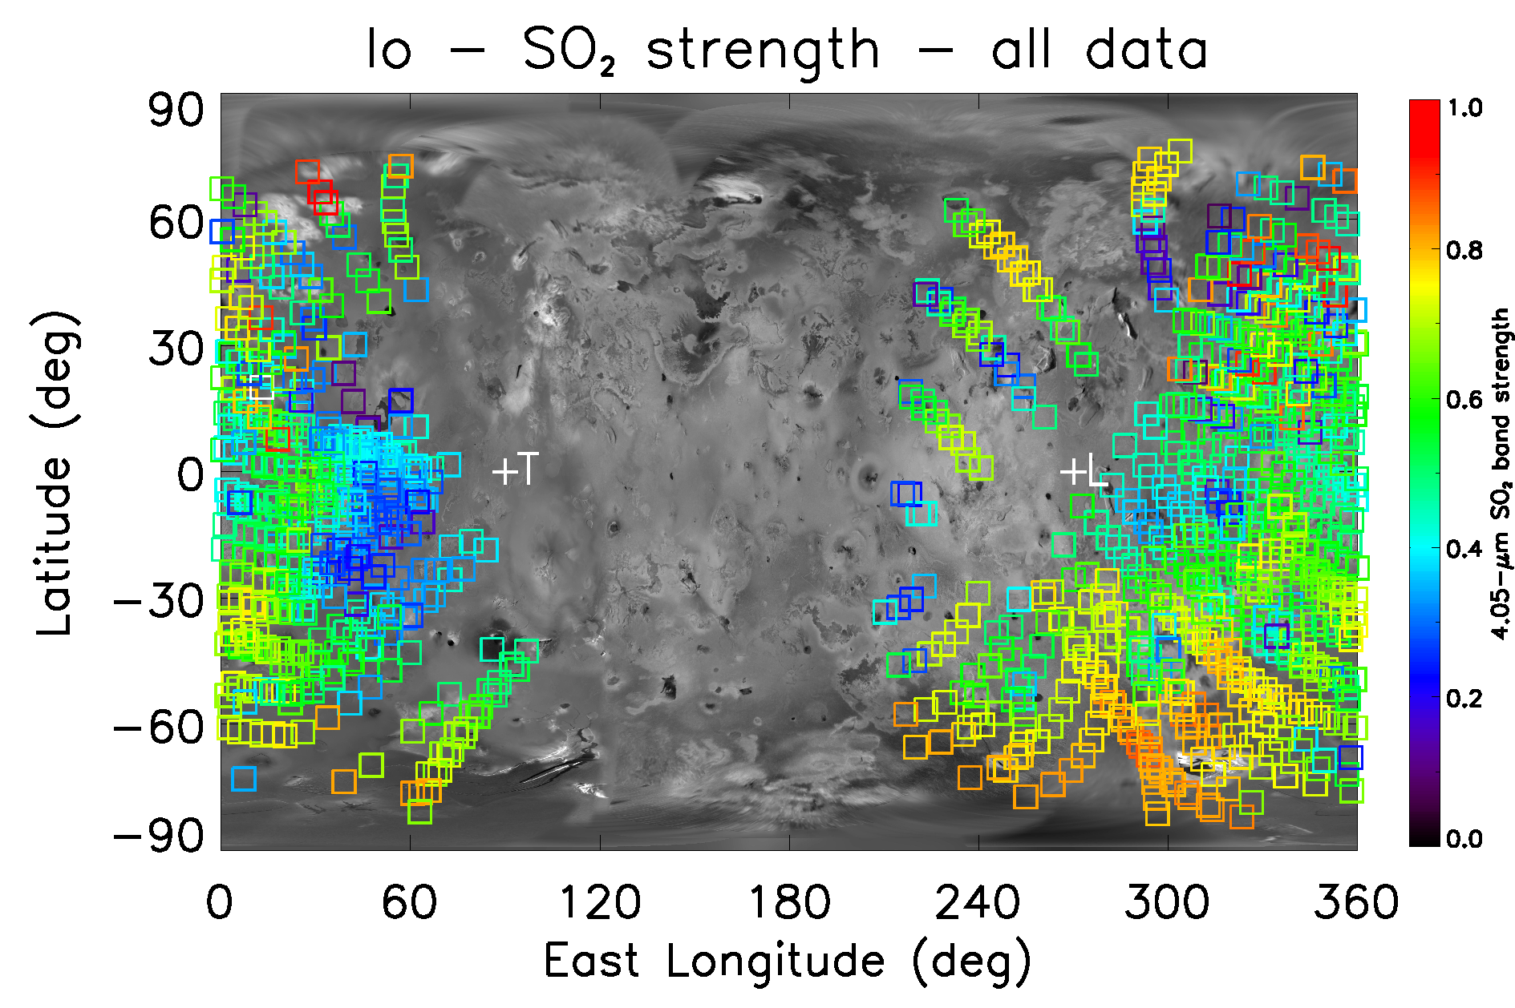

Slide 12
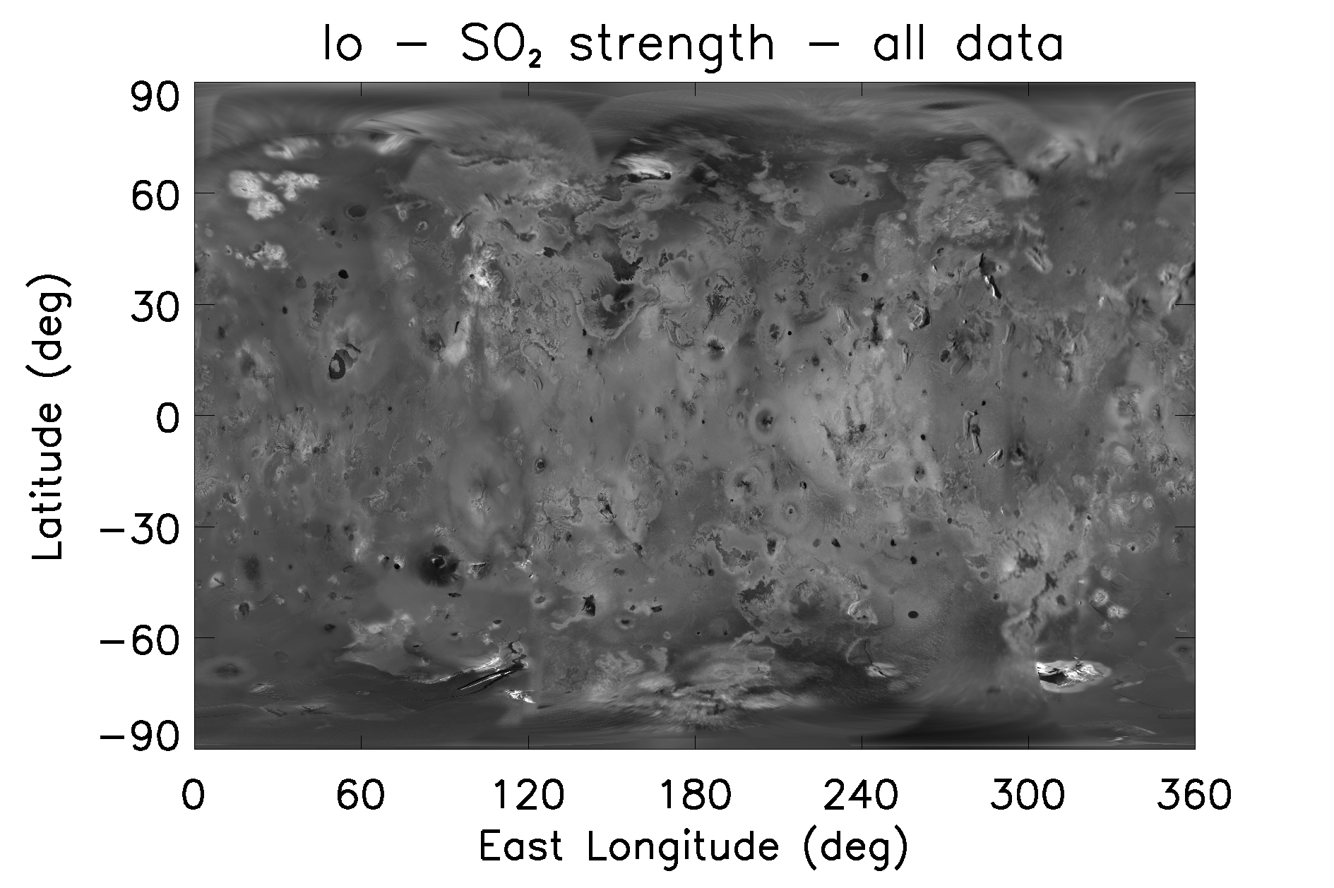
Tvashtar
Chalybes
Regio
Isum
Loki
Bosphorous Regio
Colchis Regio
Media Regio
Prometeus
Pele
Babbar
Tarsus Regio

Slide 14
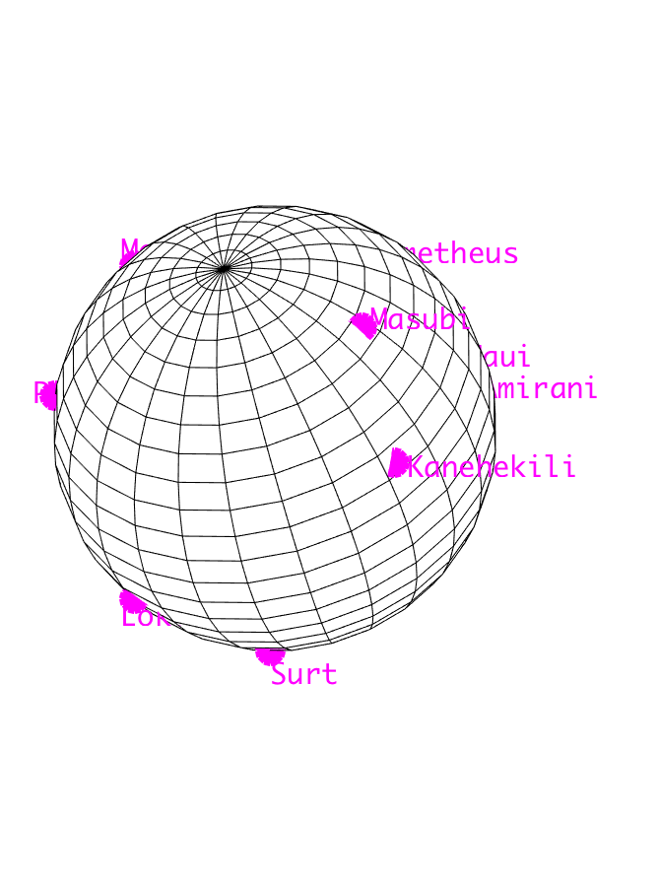
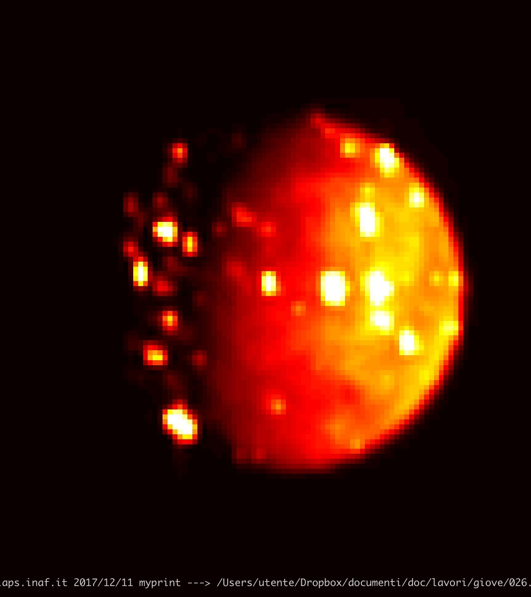

Slide 15
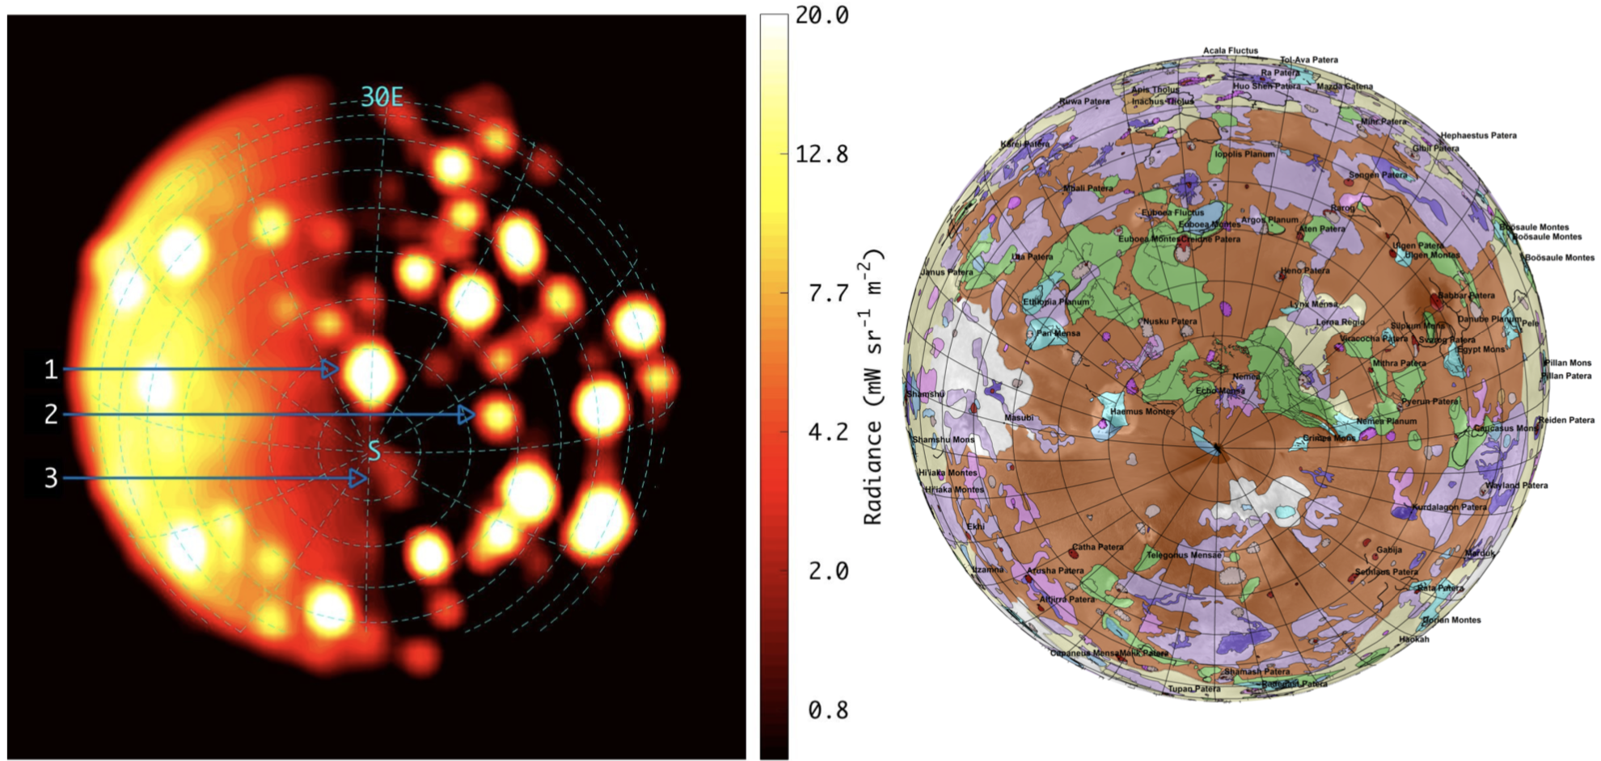
Discovering new hot features…
Orbit 10 (Dec 2017)
Mura et al., 2019, Icarus, submitted
Geologic map of Io by
D.A. Williams et al. (USGS website)
JIRAM discovers three new hot spots and lava flows
located close to the South pole

Slide 16
… and monitoring Io hot spots
Orbit 17 (Dec 2018)
Orbit 18 (Feb 2019)
Pre-eclipse
In-eclipse
Mura et al., 2019, Icarus, submitted

Slide 17
Io’s temperature retrieval
On the dayside of Io, the measured signal is essentially due to solar reflection. As a result, surface temperature values obtained far away from the hot spots are indeed to be interpreted as a thermal brightness associated to the measured radiance.
Within the first ten orbits, the JIRAM NESR was such that the minimum detectable temperature was typically around 170-180 K (in other words, this is the temperature that is retrieved for most sky background pixels).
We applied the thermal retrieval separately on each pixel across the spectrometer’s slit and in the 4.0-4.8 μm spectral range. Going through the geometric information derived for JIRAM spectroscopic data collected during a given Juno passage, one can ultimately obtain spatially resolved temperature maps. The maximum temperature values, ~250 K, are estimated with good accuracy and correspond to the major active volcanic centres.

Slide 18
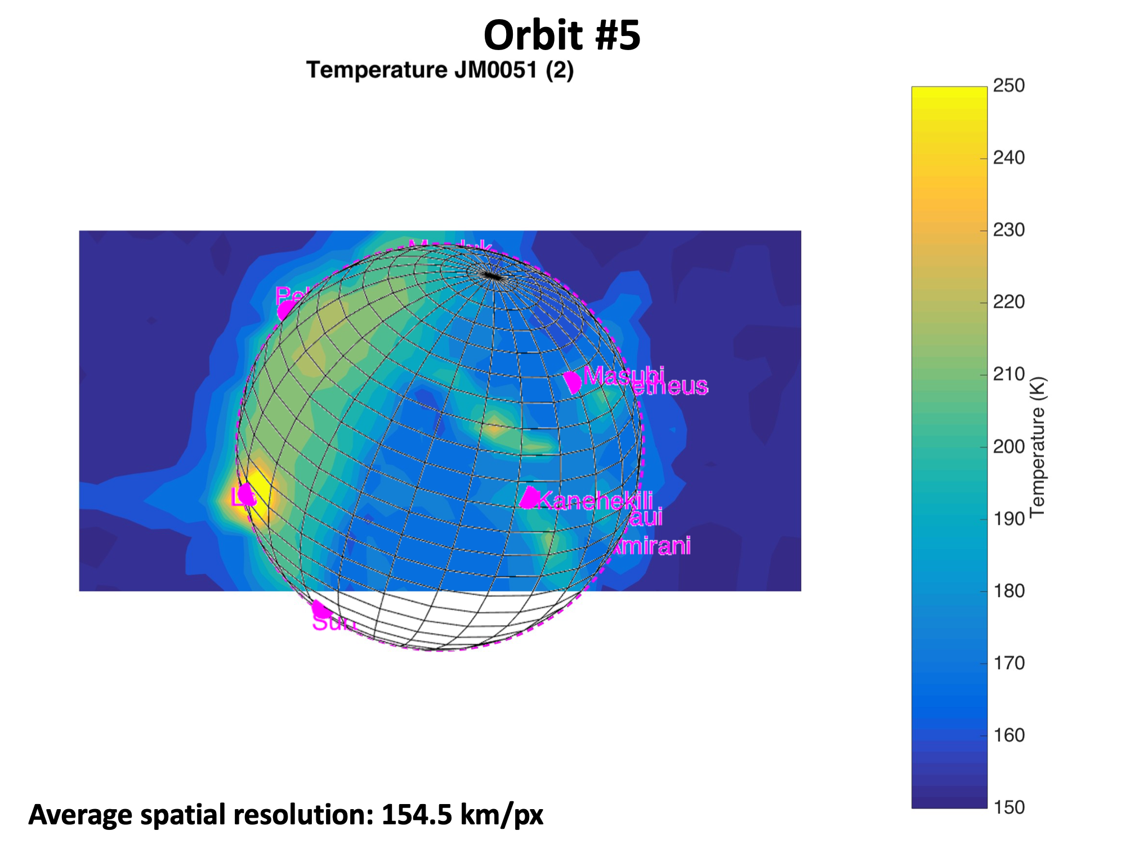
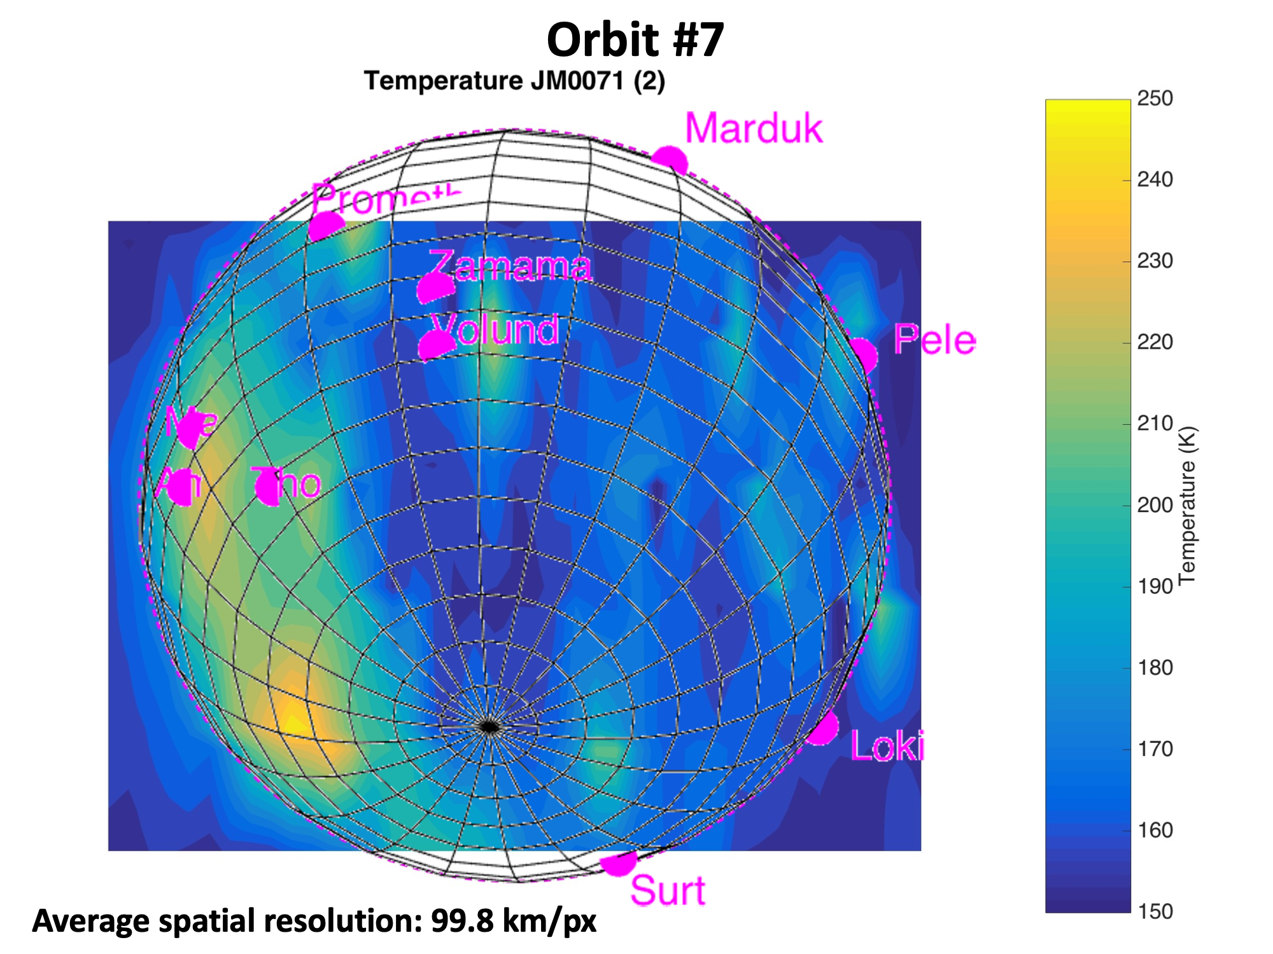
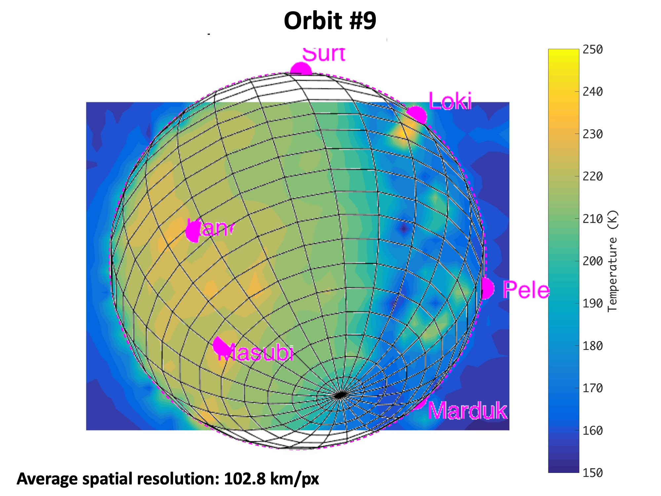
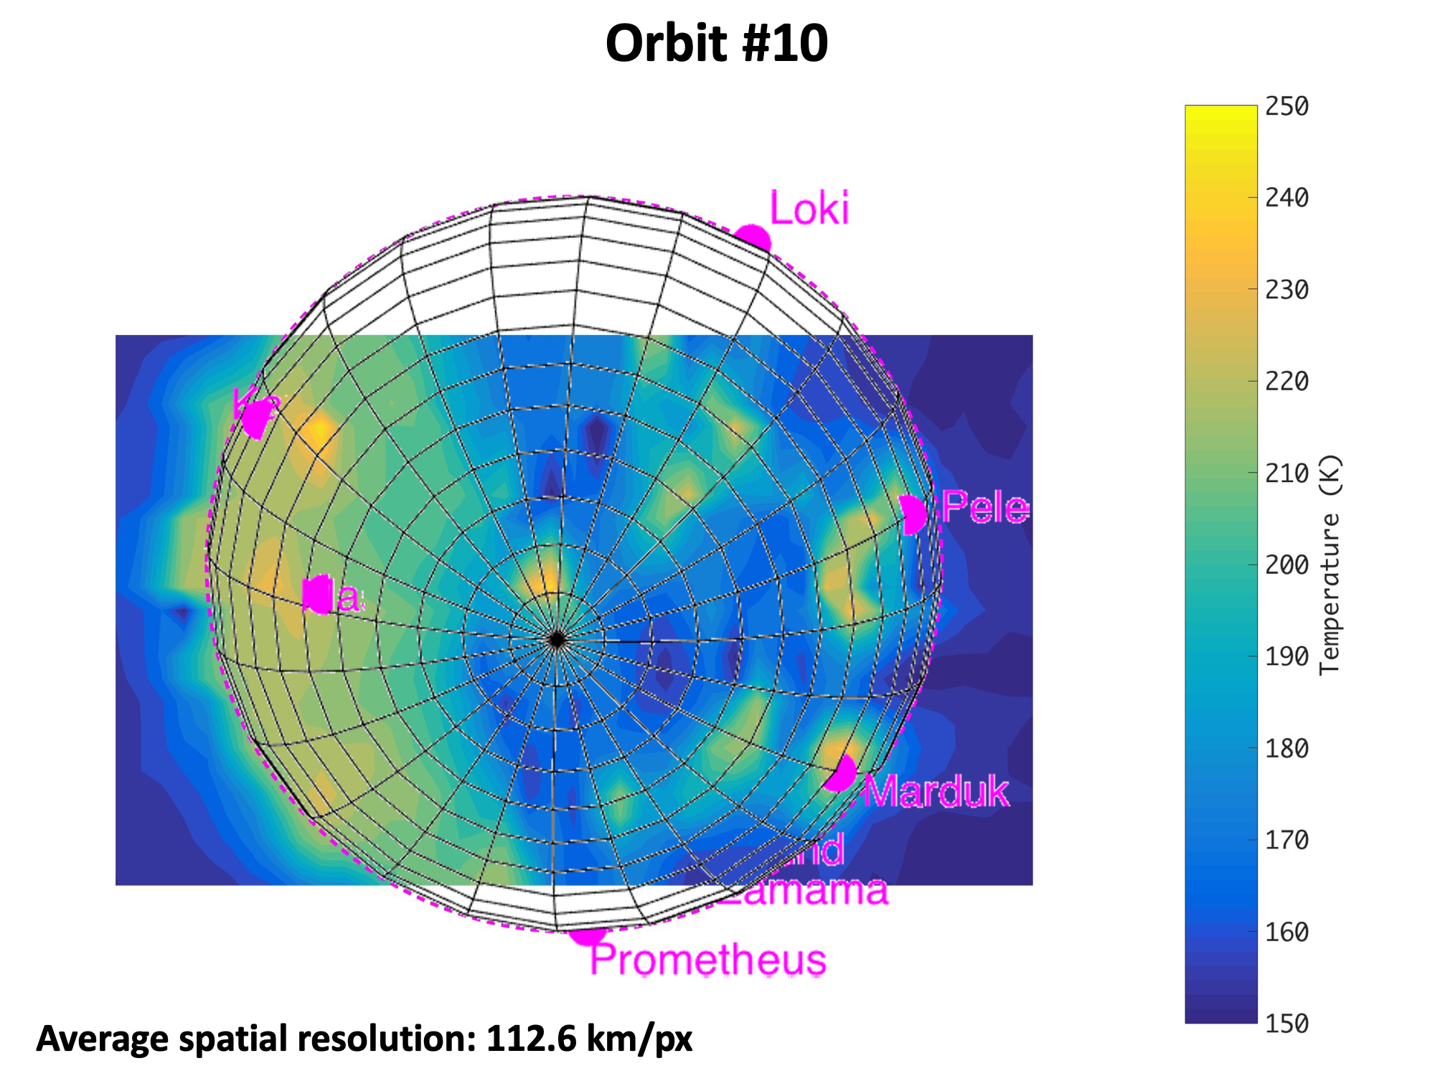

Slide 19
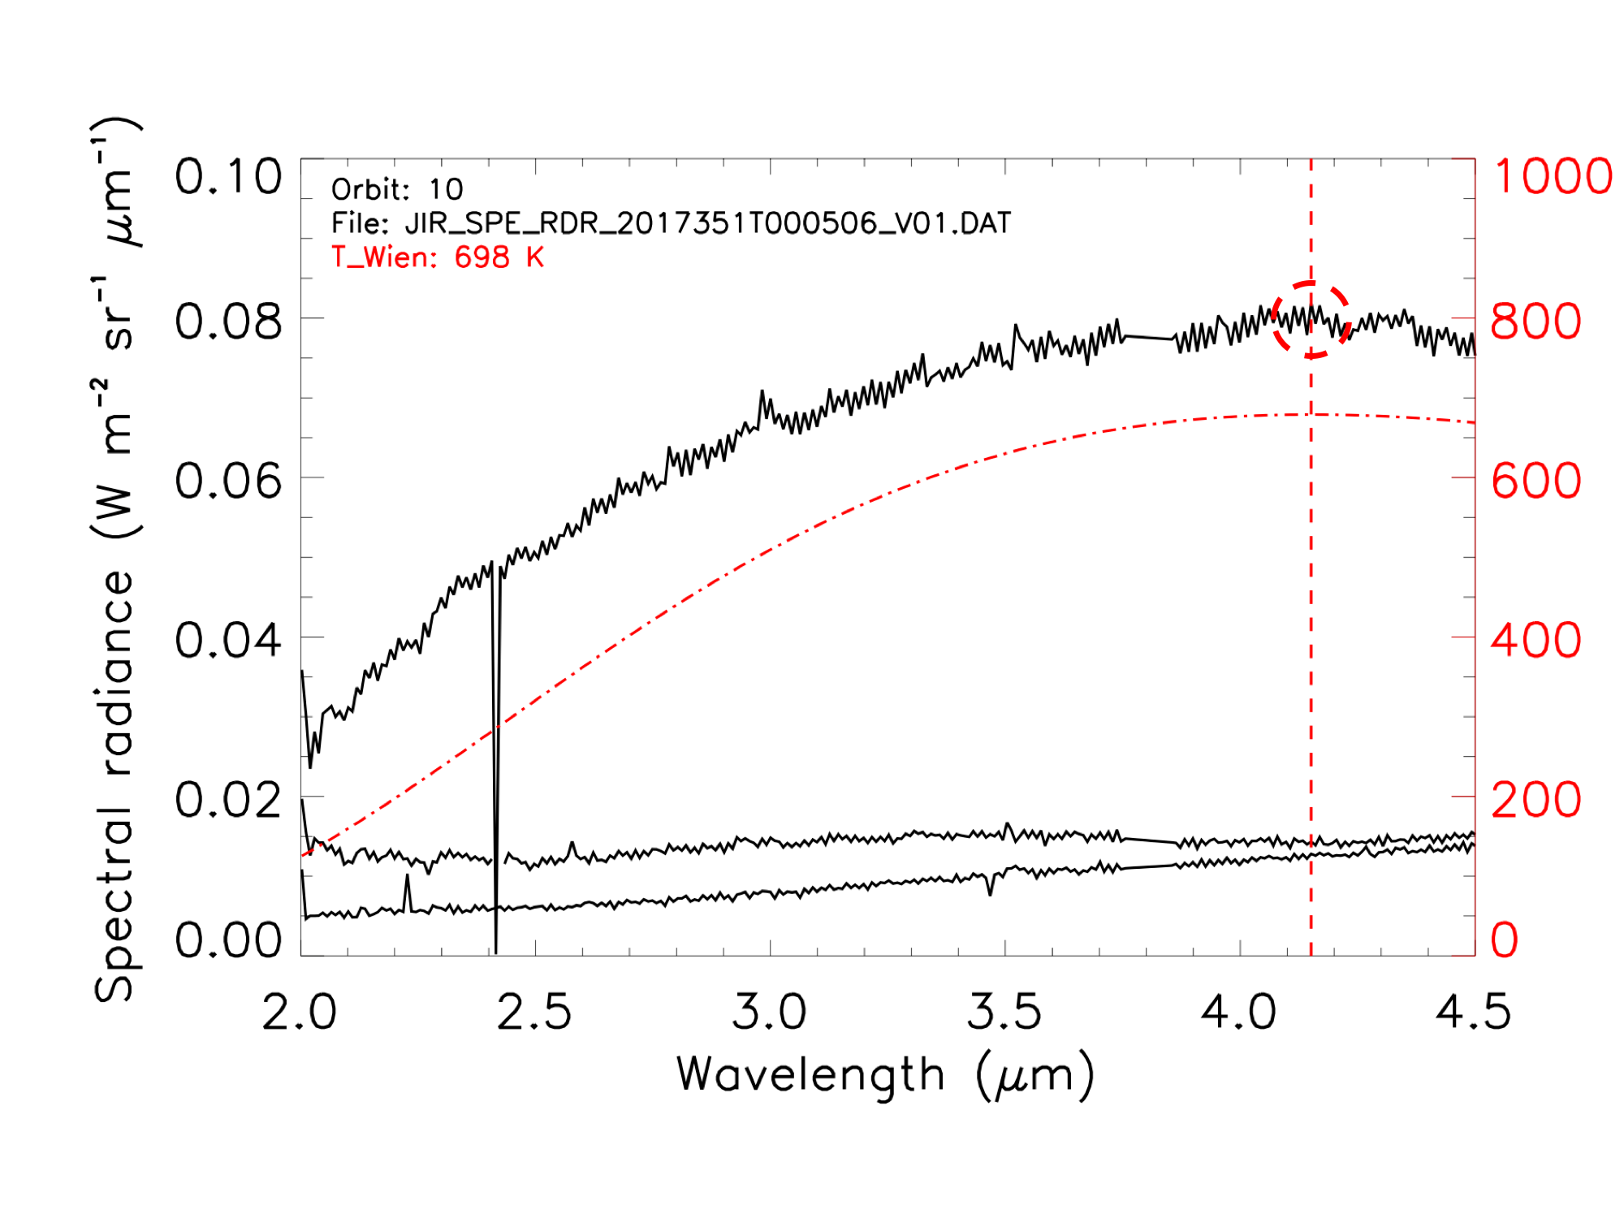
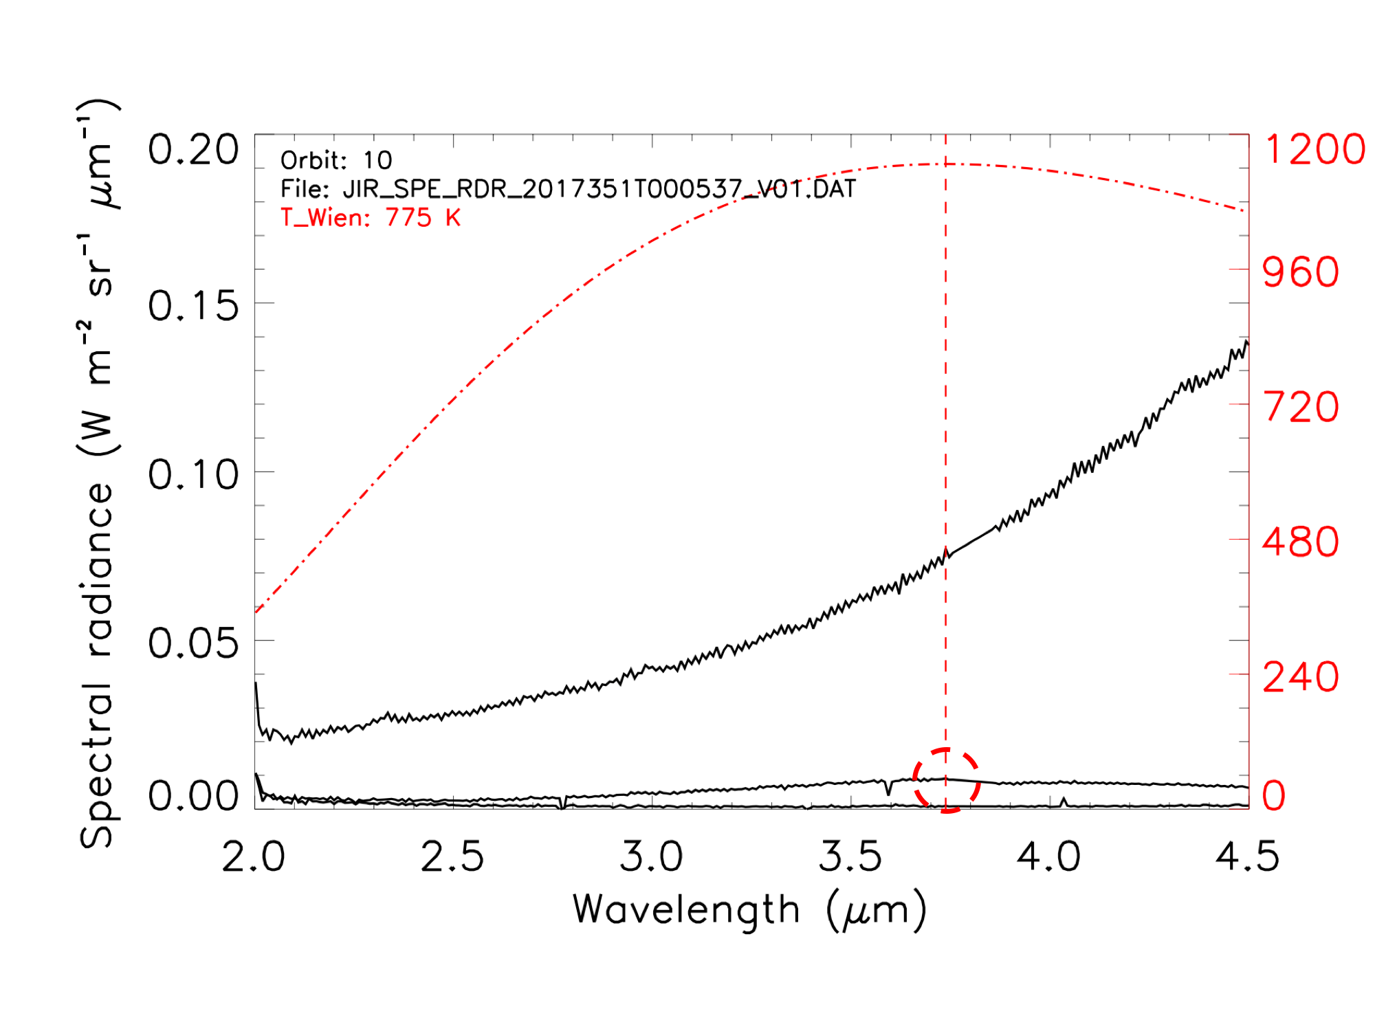
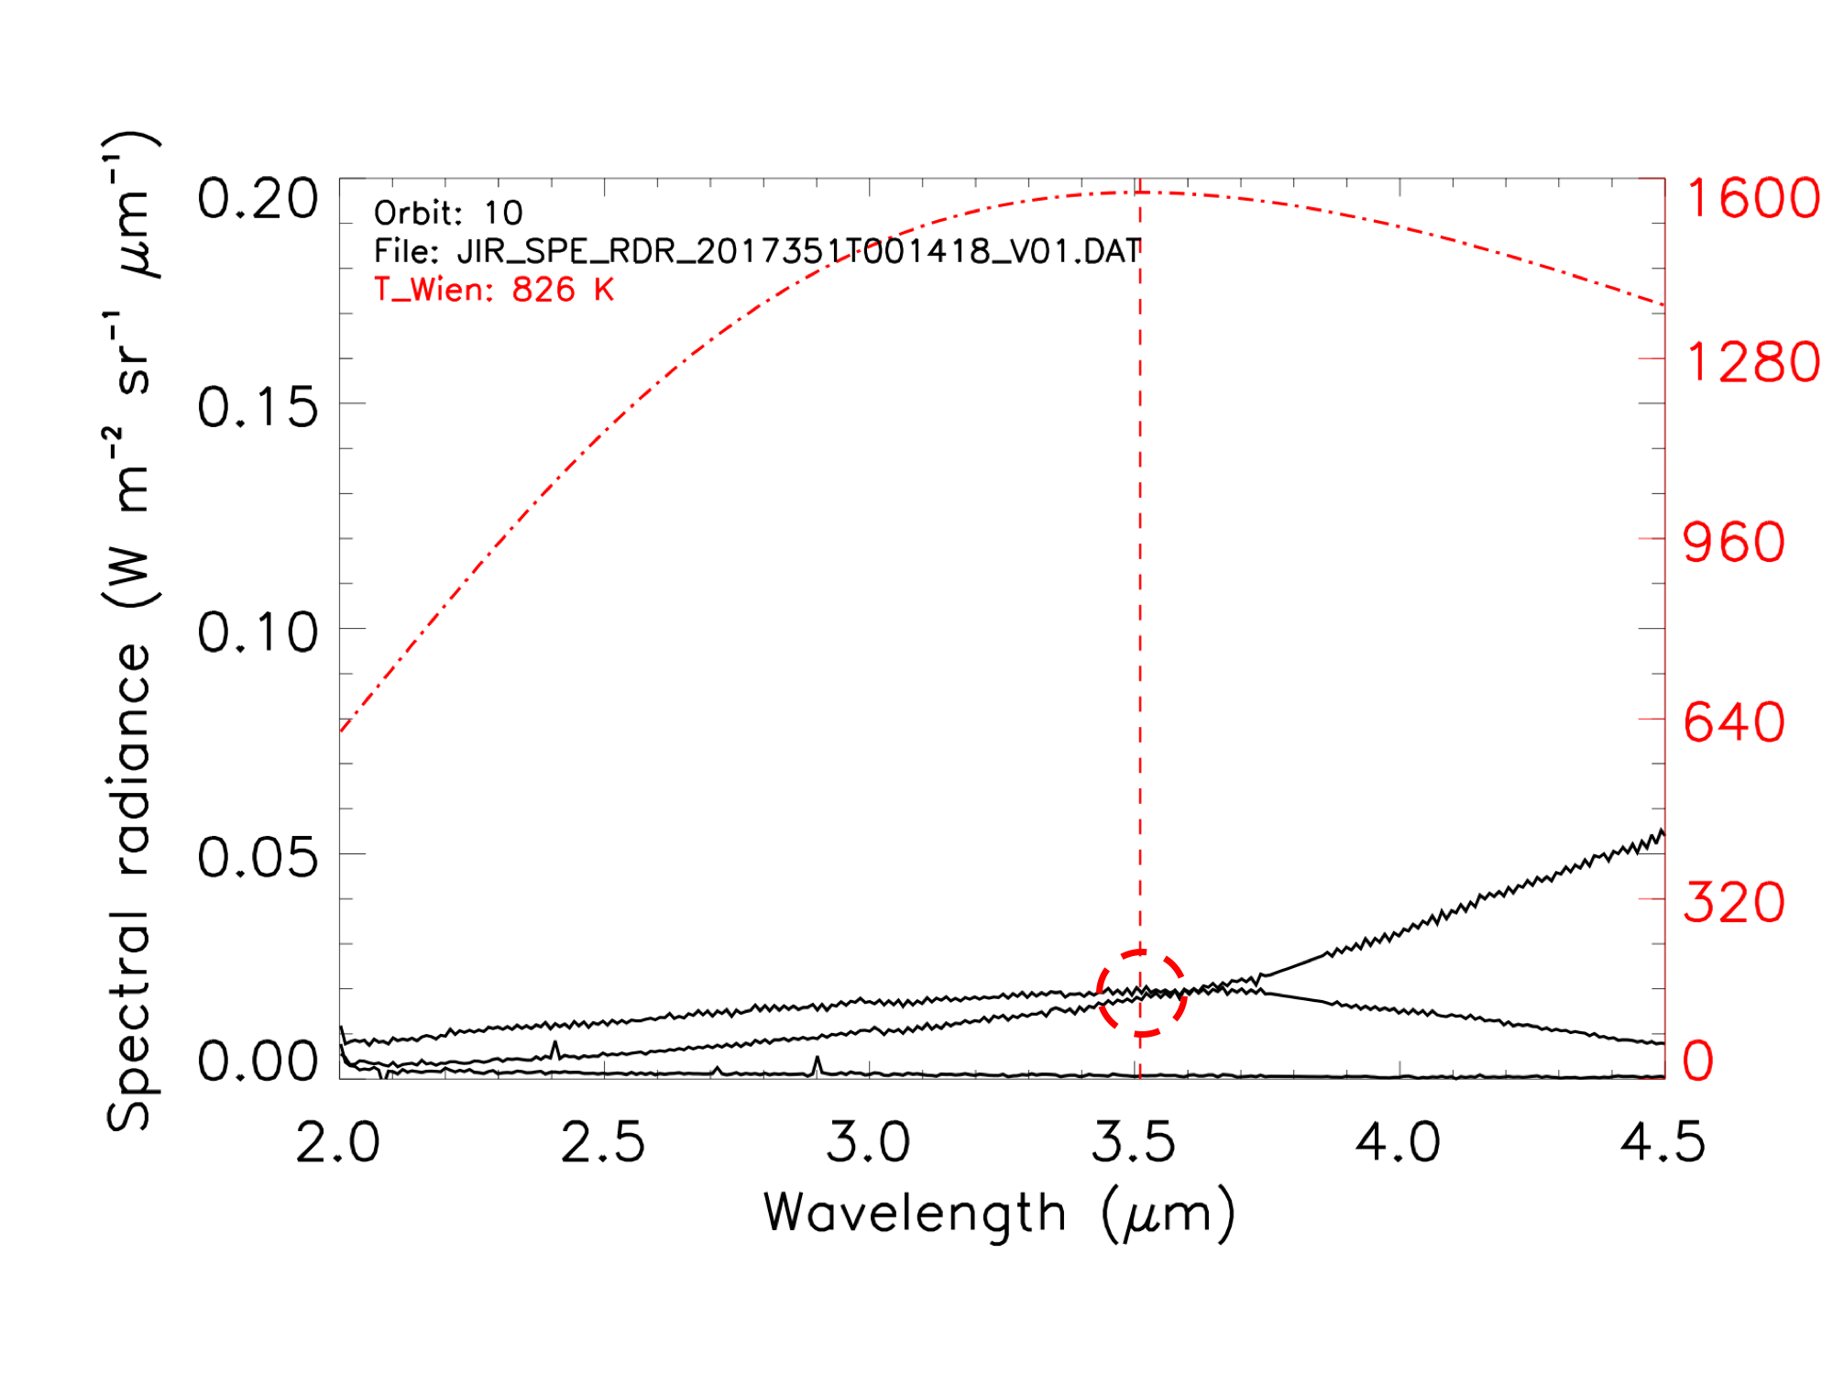
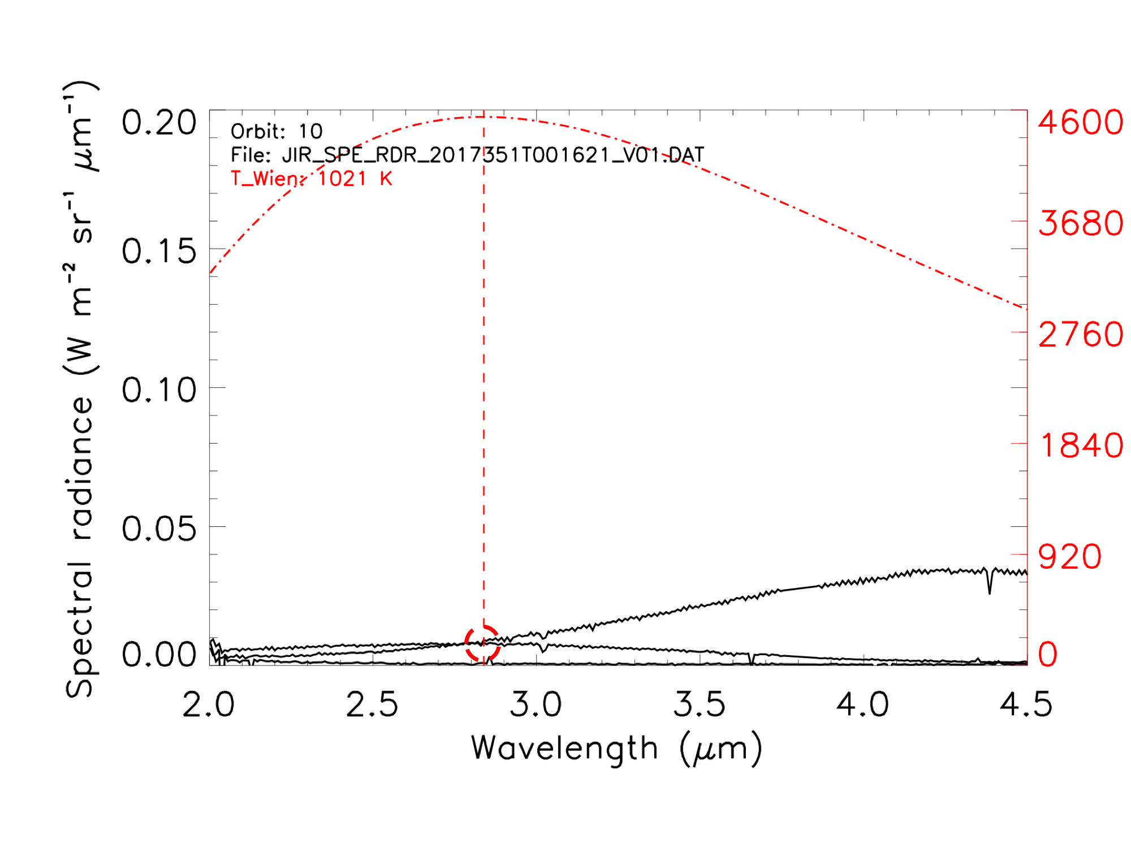

Slide 20
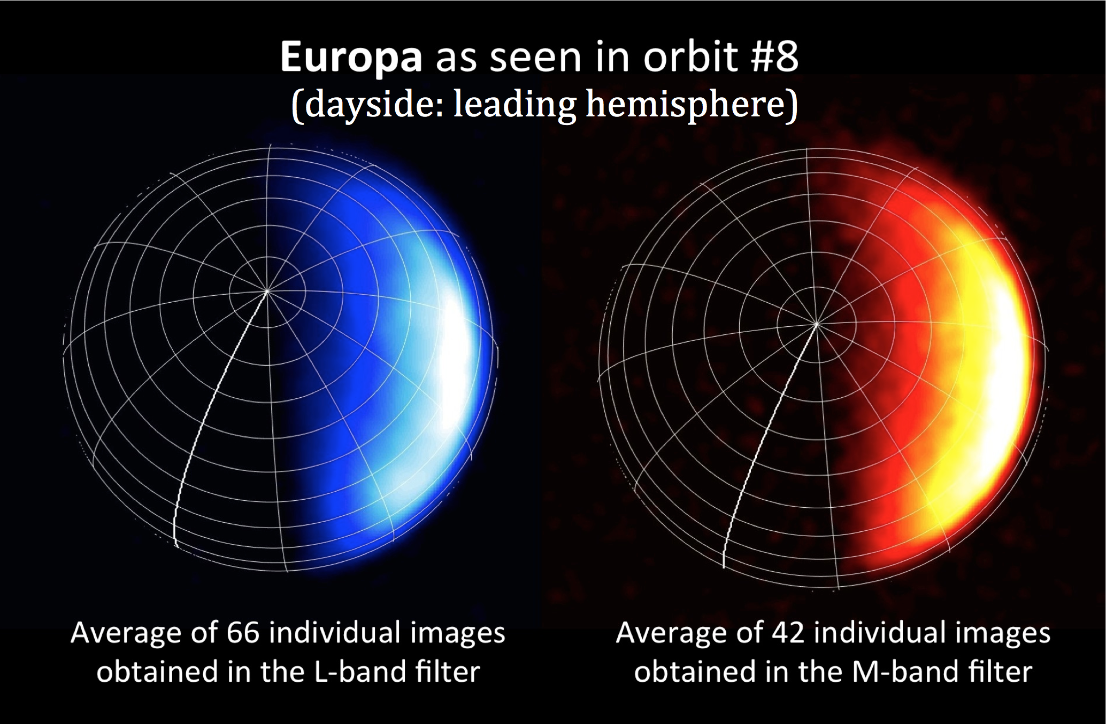

Slide 21
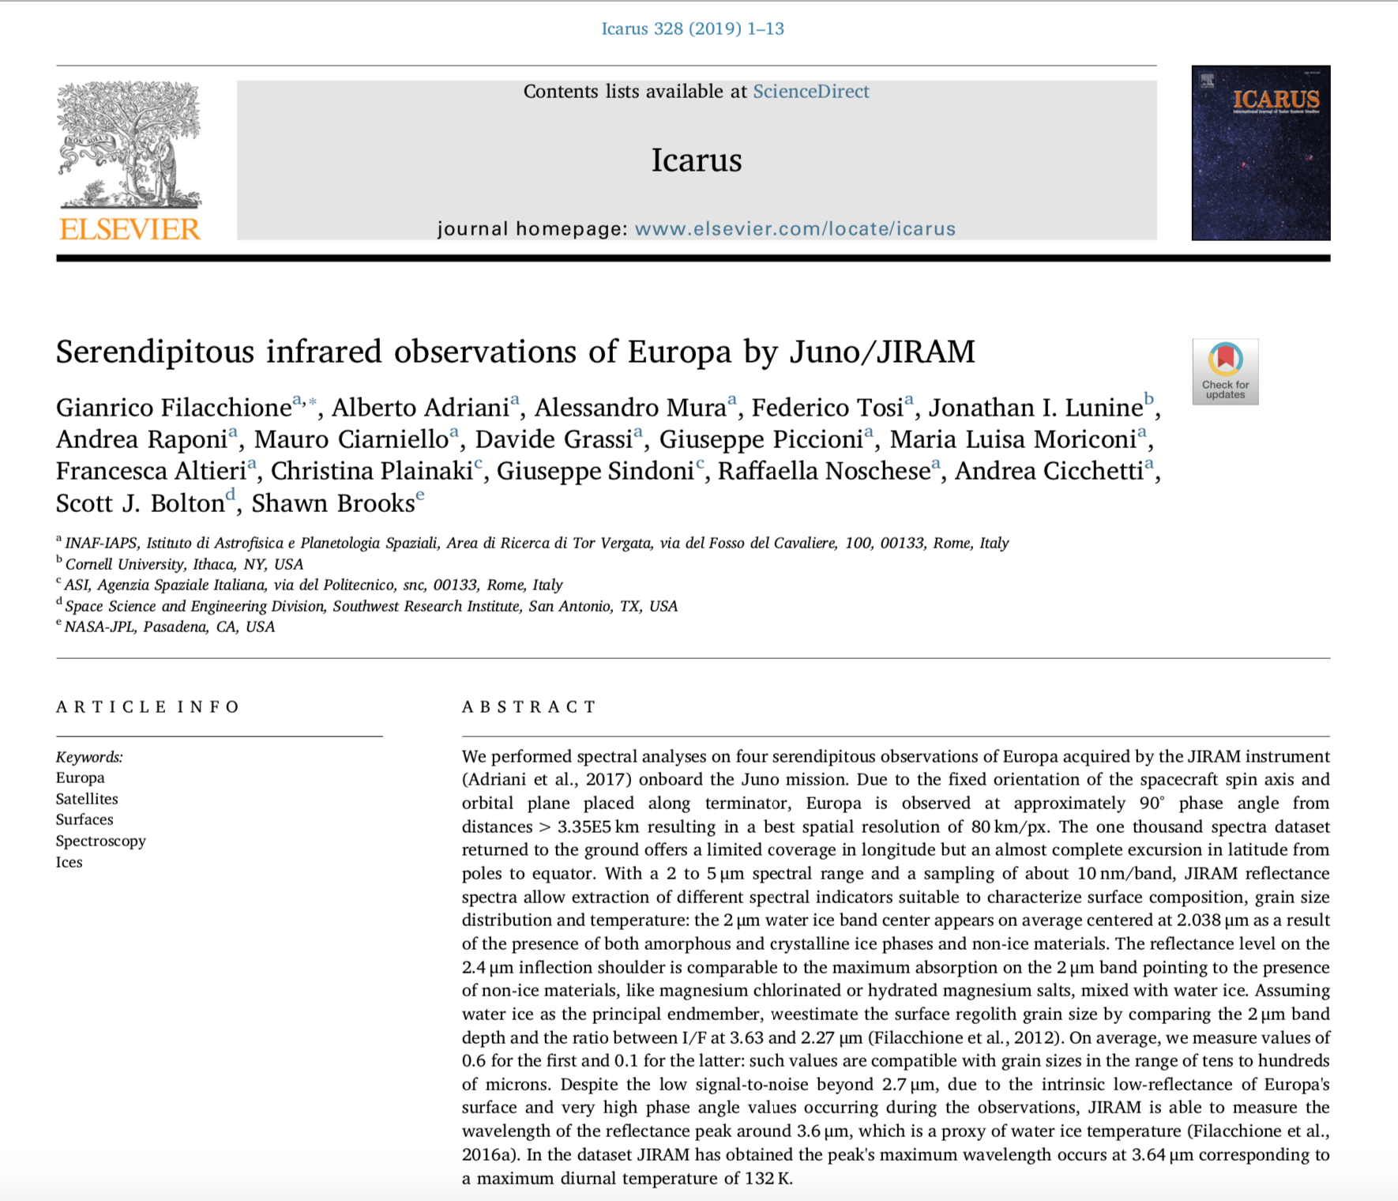
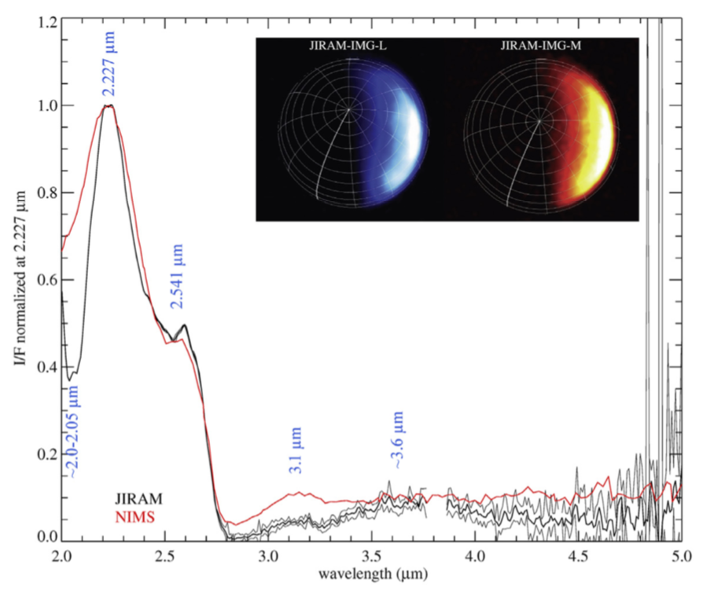
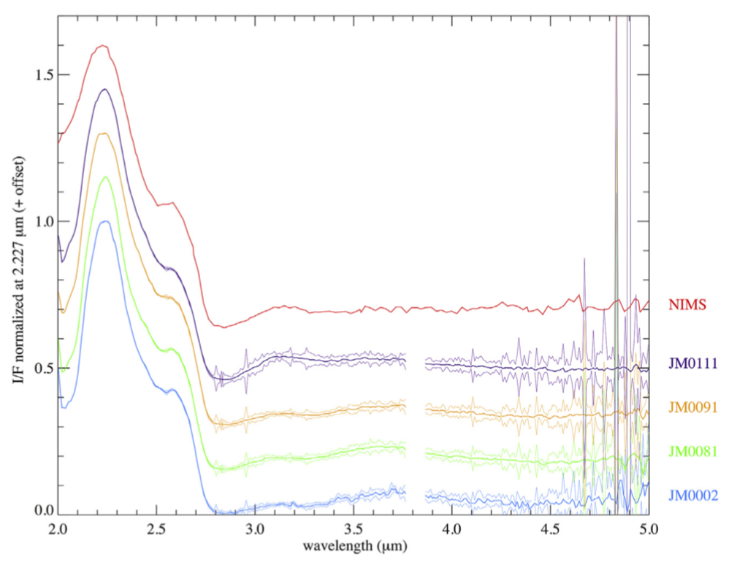
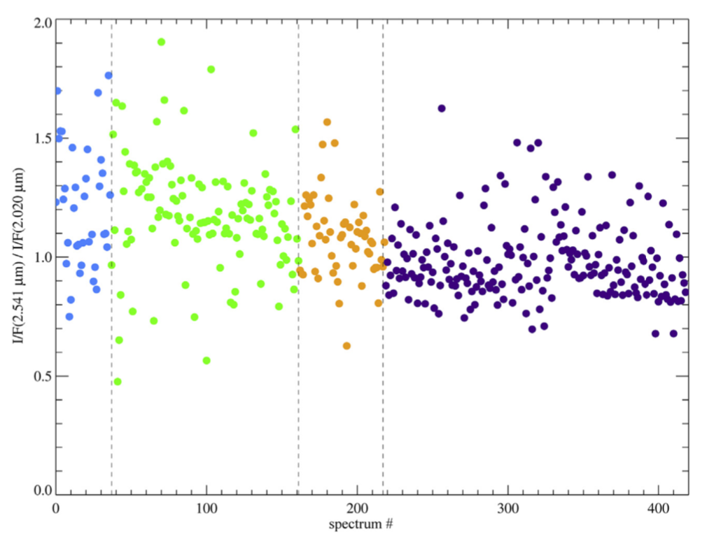
Filacchione et al., Icarus, 2019

Slide 22
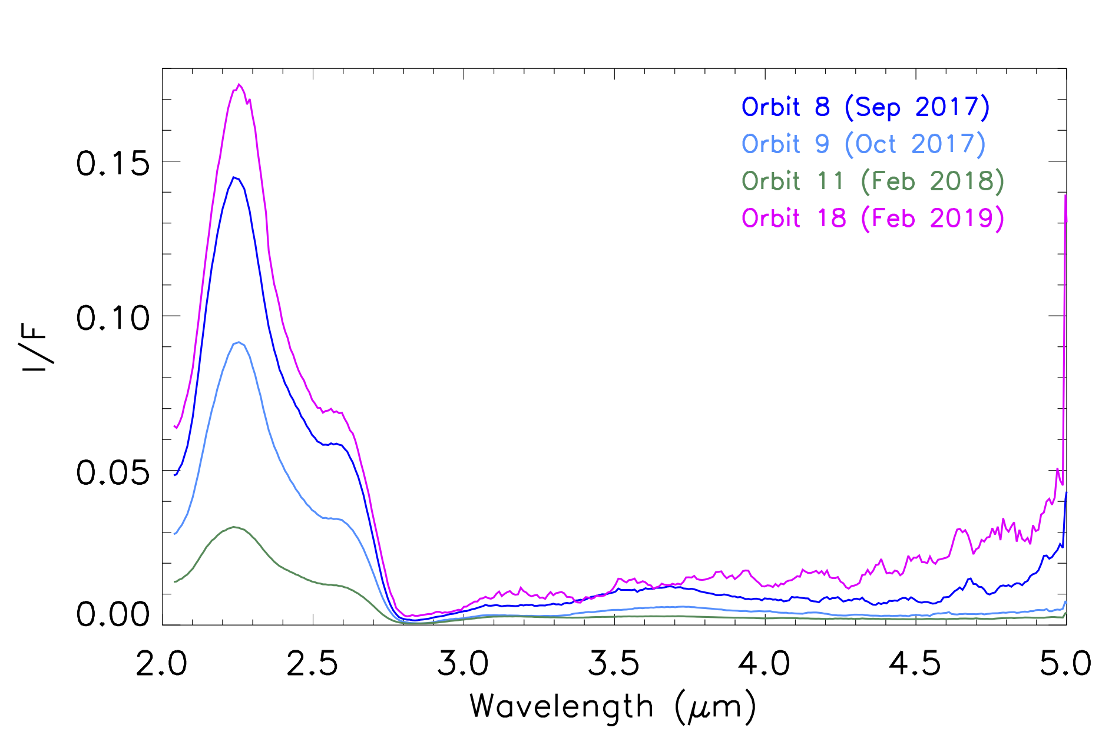
Average I/F spectra of Europa as observed by Juno/JIRAM
Water ice
Water ice
i < 80°, e < 80°

Slide 23
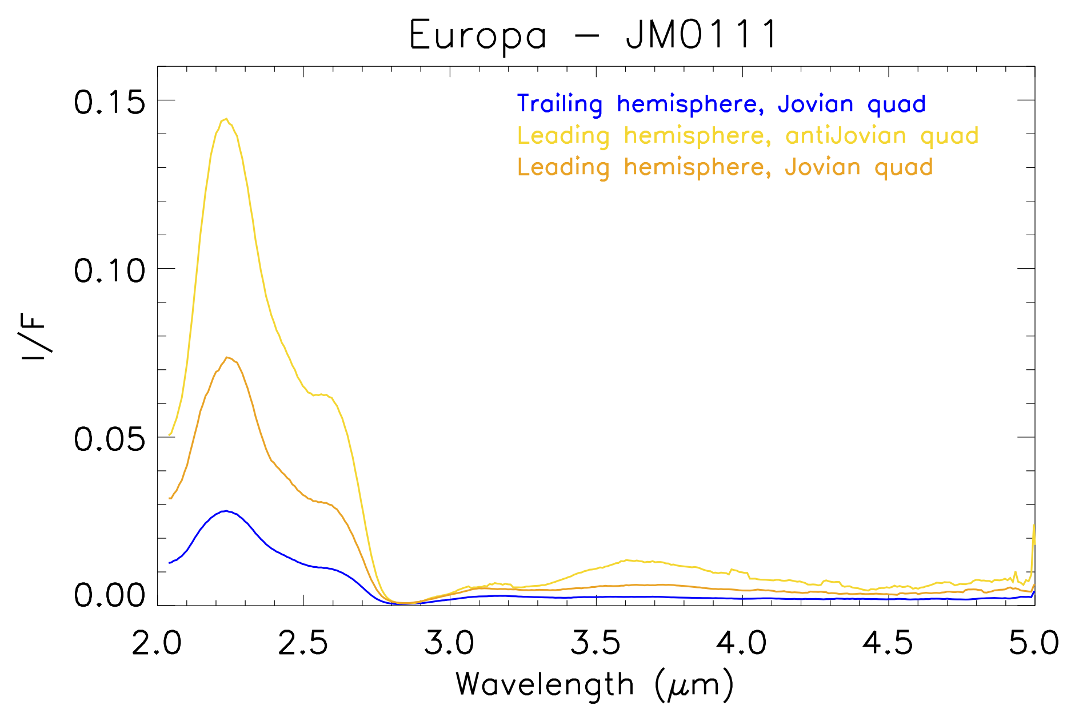
R_{C}
Band depth = (R_{C} – R_{B}) / R_{C}
R_{B}

Slide 24
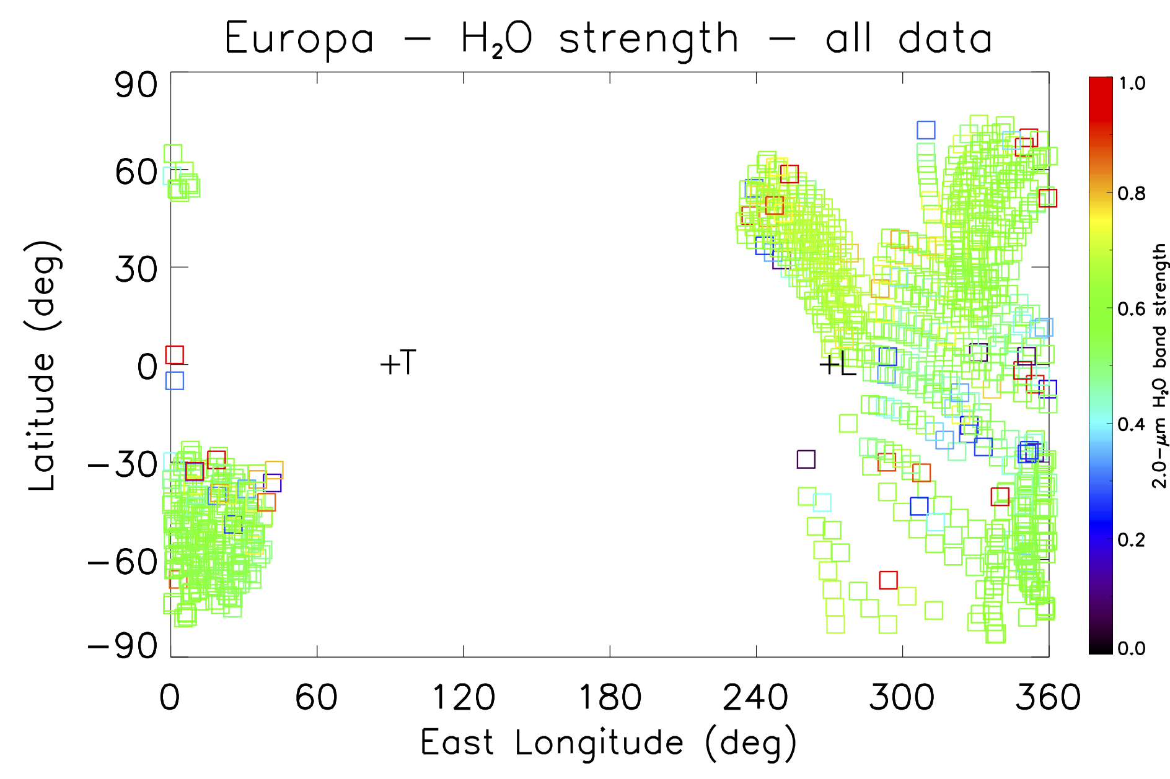

Slide 25
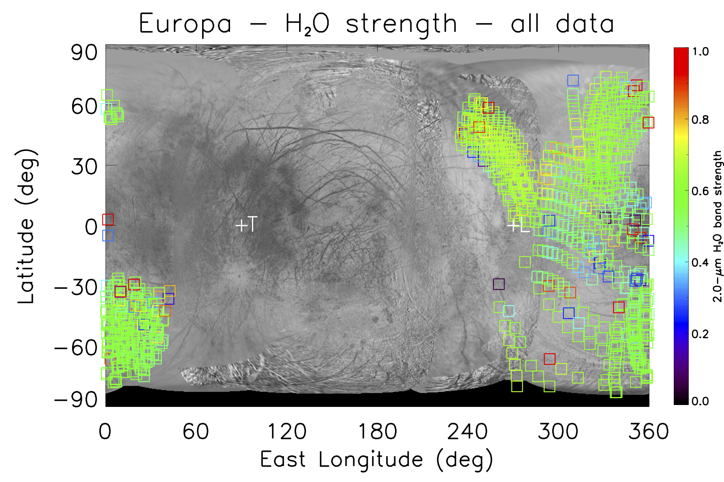

Slide 26
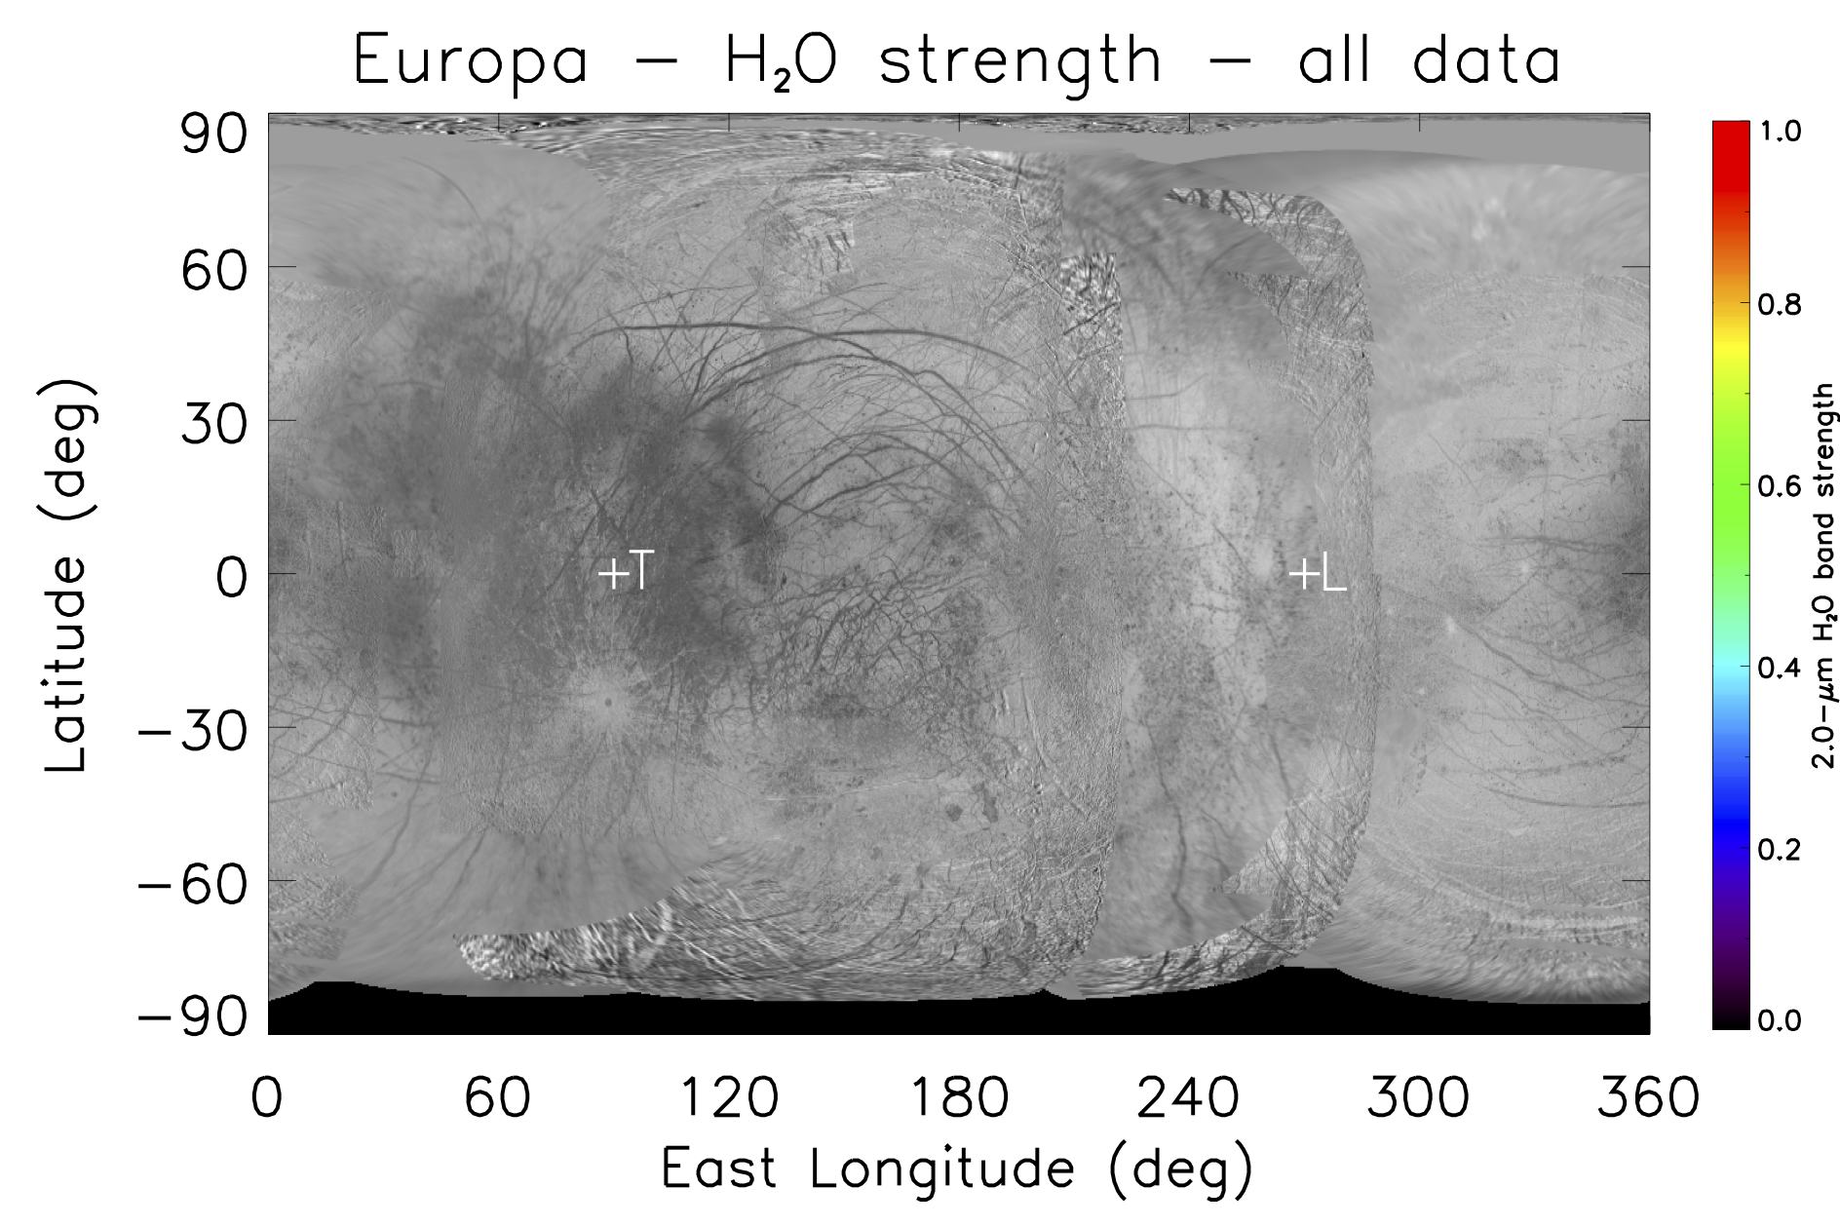
Falga Regio
Dyfed Regio
Tara
Regio
Annwn
Regio
Annwn
Regio
Powis Regio
Argadnel Regio
Pwyll
Thera and Thrace Macula
Balgatan Regio

Slide 27
GANYMEDE
L-band (3.45 µm)
M-band (4.78 µm)

Slide 28
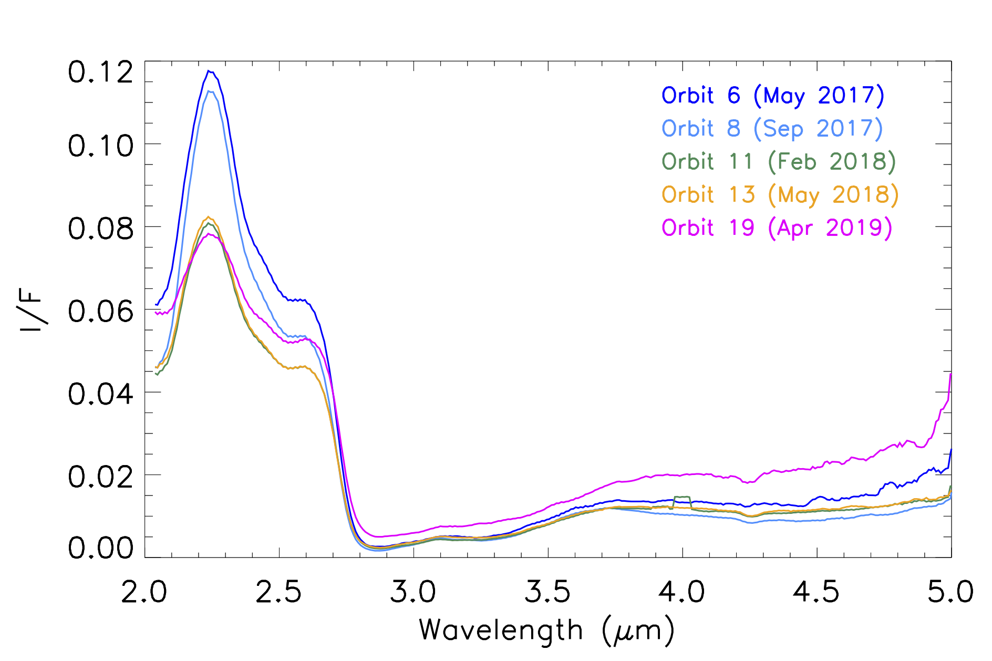
Average I/F spectra of Ganymede as observed by Juno/JIRAM
Water ice
Water ice
CO₂
i < 80°, e < 80°

Slide 29
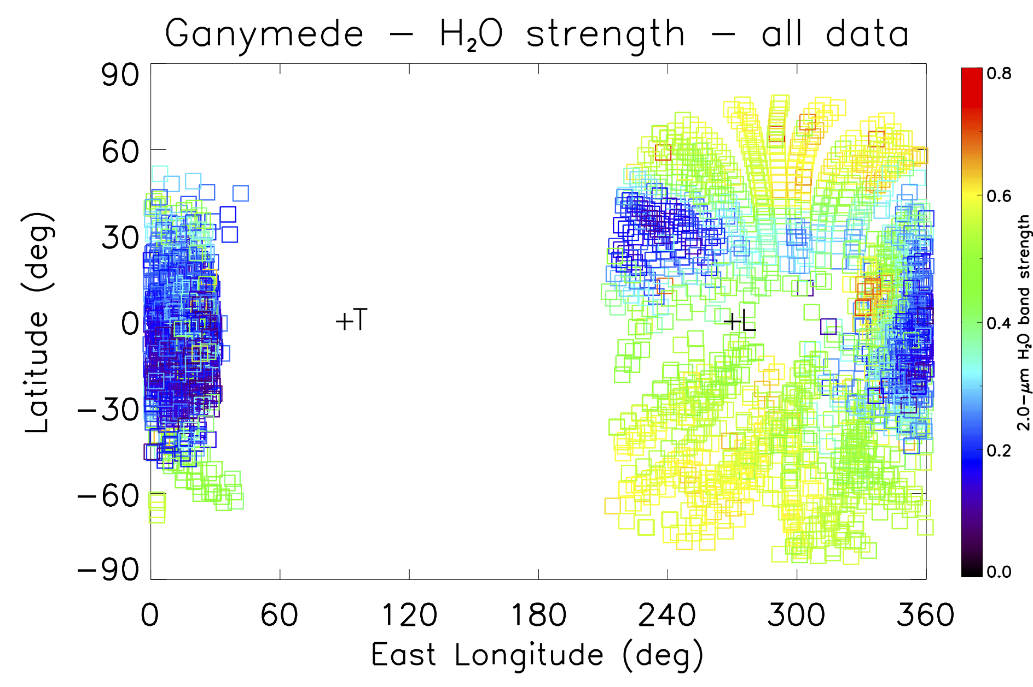

Slide 30
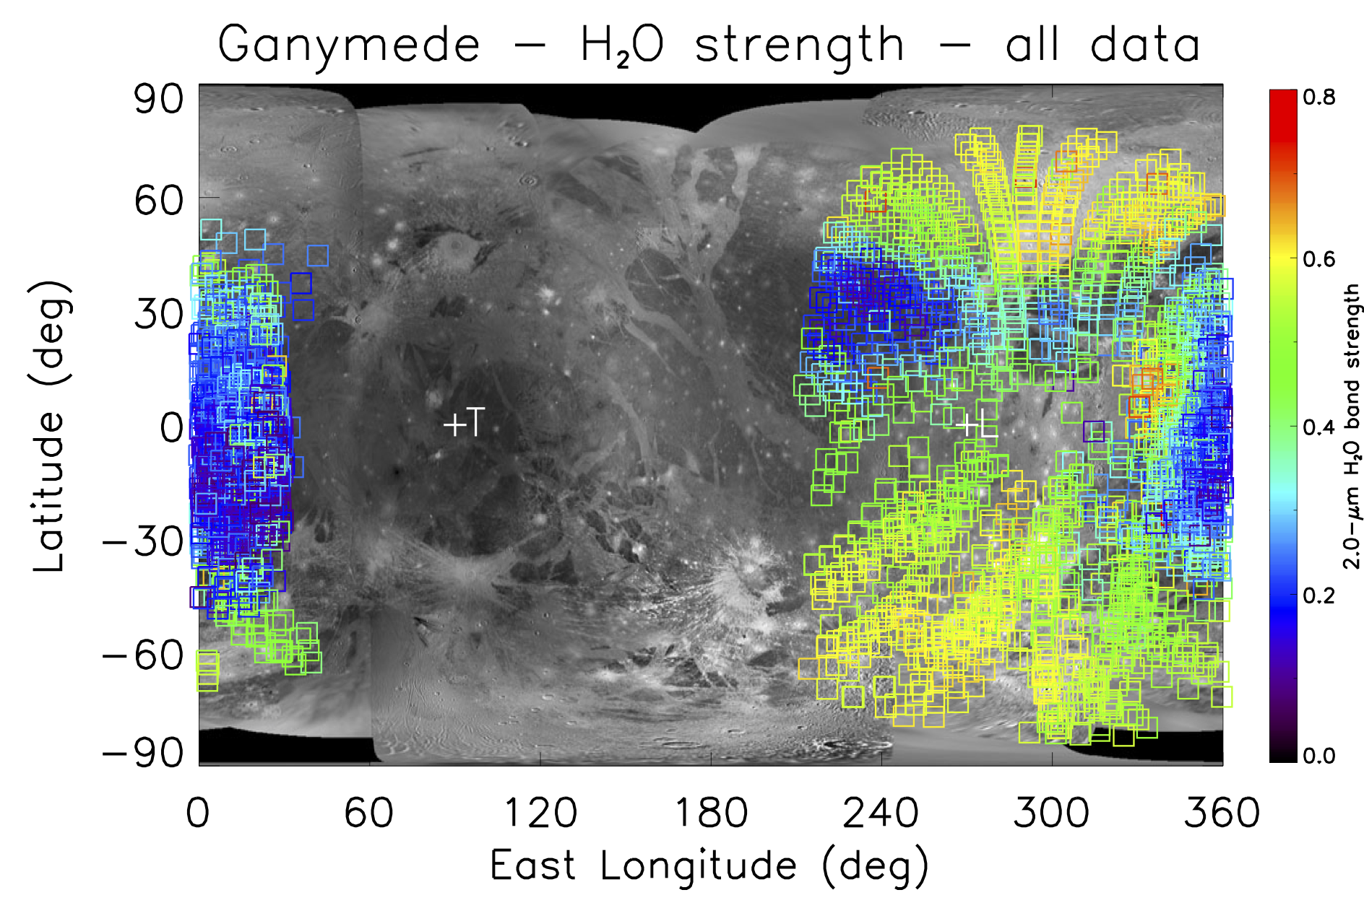

Slide 31
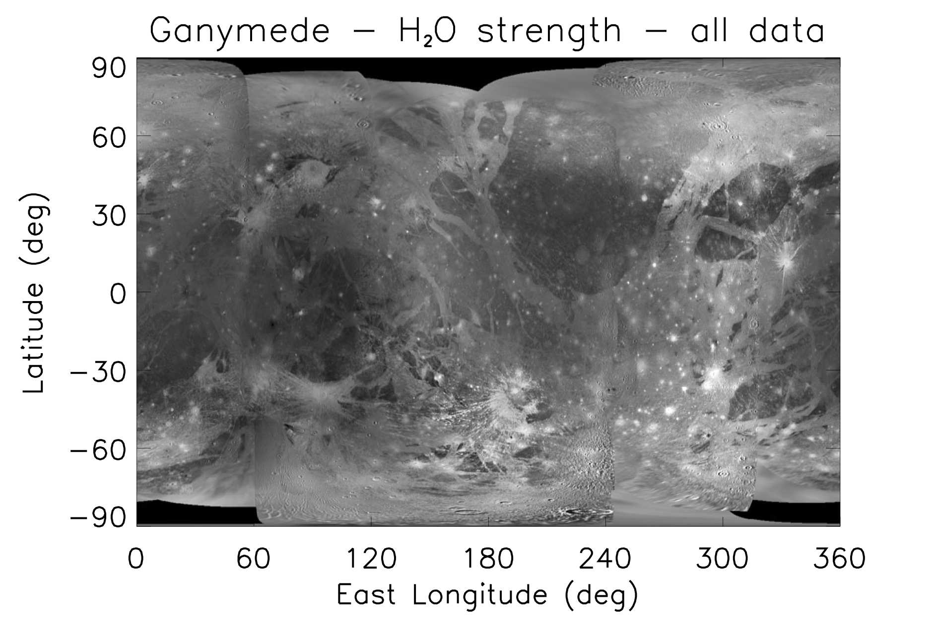
Hershef
Xibalba Sulcus
Galileo Regio
Perrine
Regio
Uruk Sulcus
Marius
Regio
Tros
Harpagia Sulcus
Tiamat Sulcus
Nicholson
Regio
Tashmetum
Cisti
Nicholson
Regio
Osiris

Slide 32
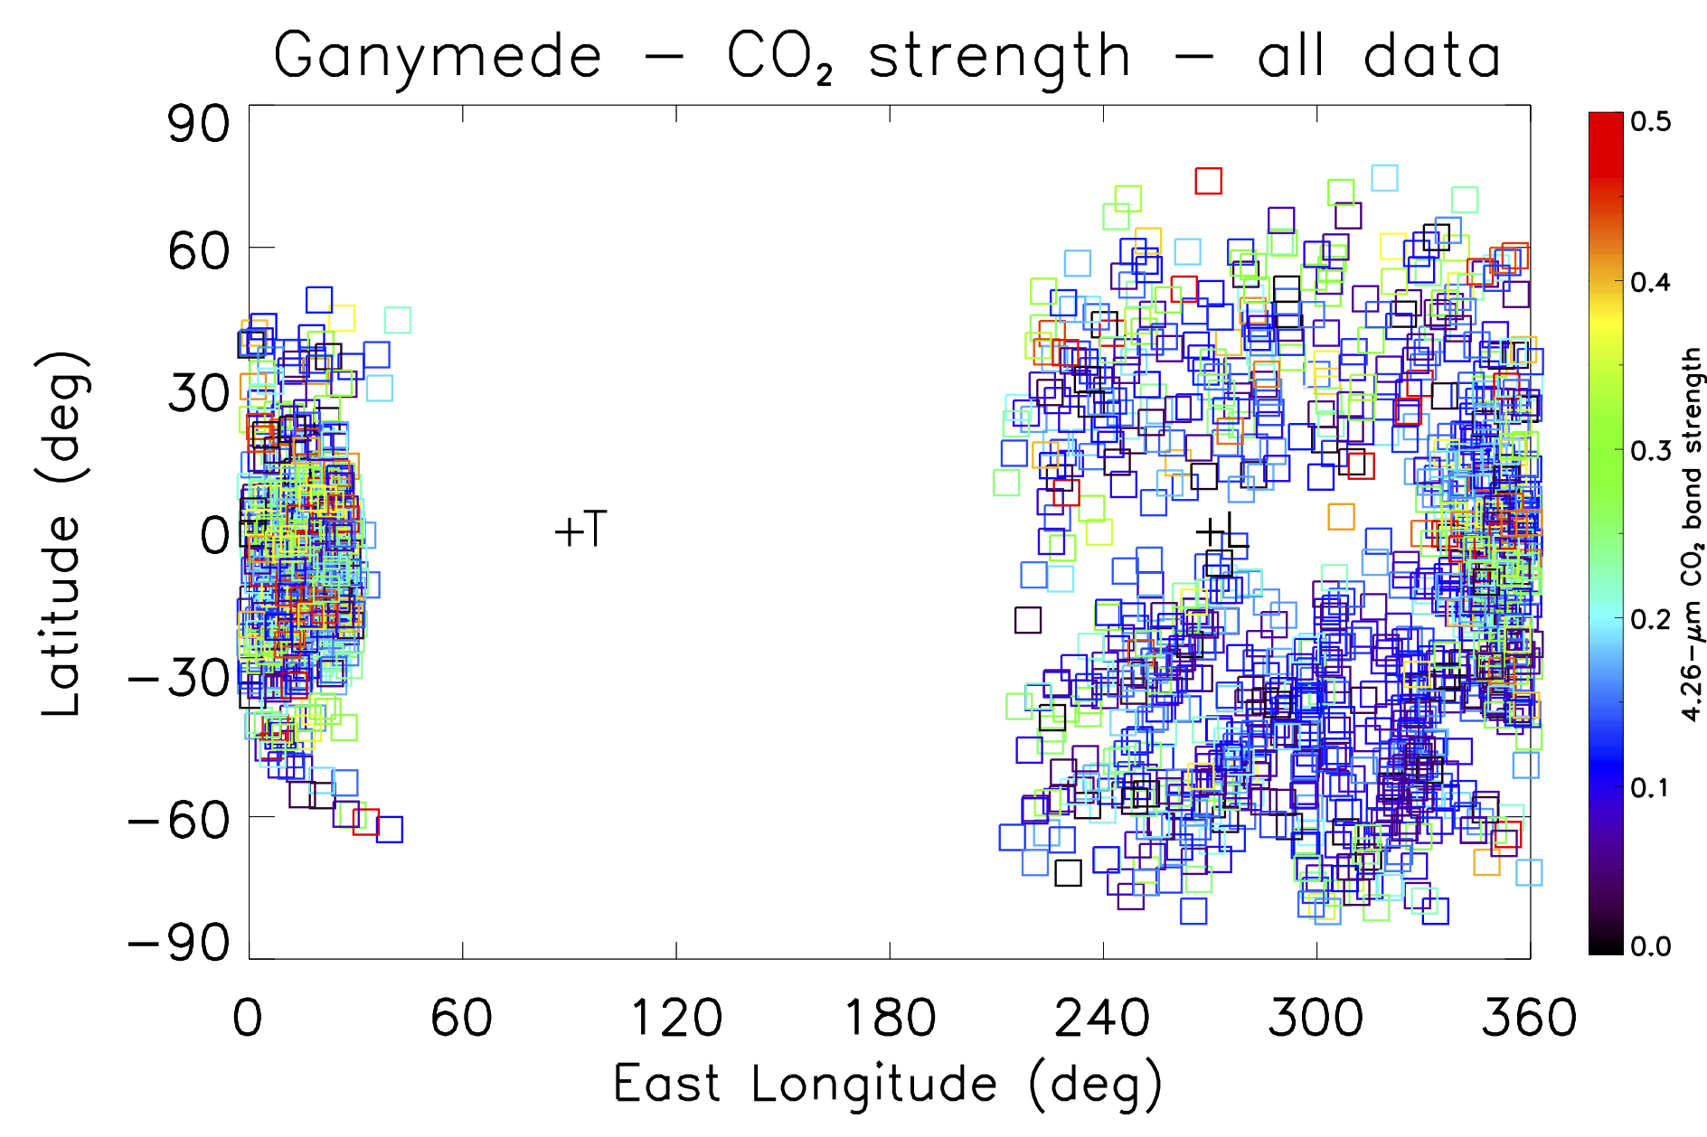

Slide 33
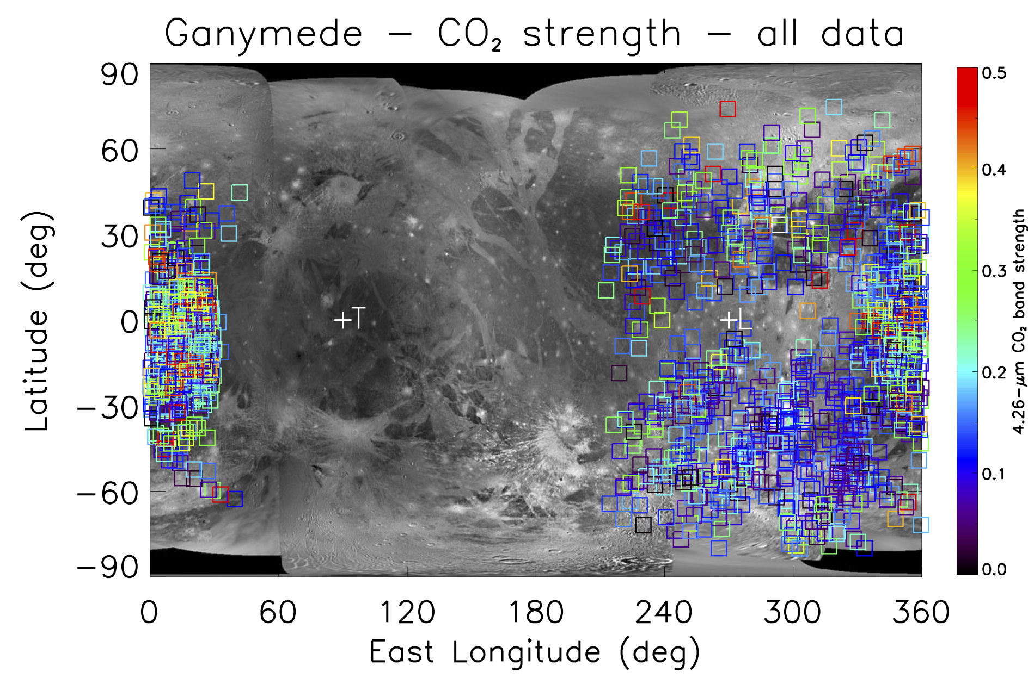

Slide 34
Xibalba Sulcus
Galileo Regio
Perrine
Regio
Uruk Sulcus
Marius
Regio
Tros
Harpagia Sulcus
Tiamat Sulcus
Nicholson
Regio
Tashmetum
Cisti
Nicholson
Regio
Osiris

Slide 35
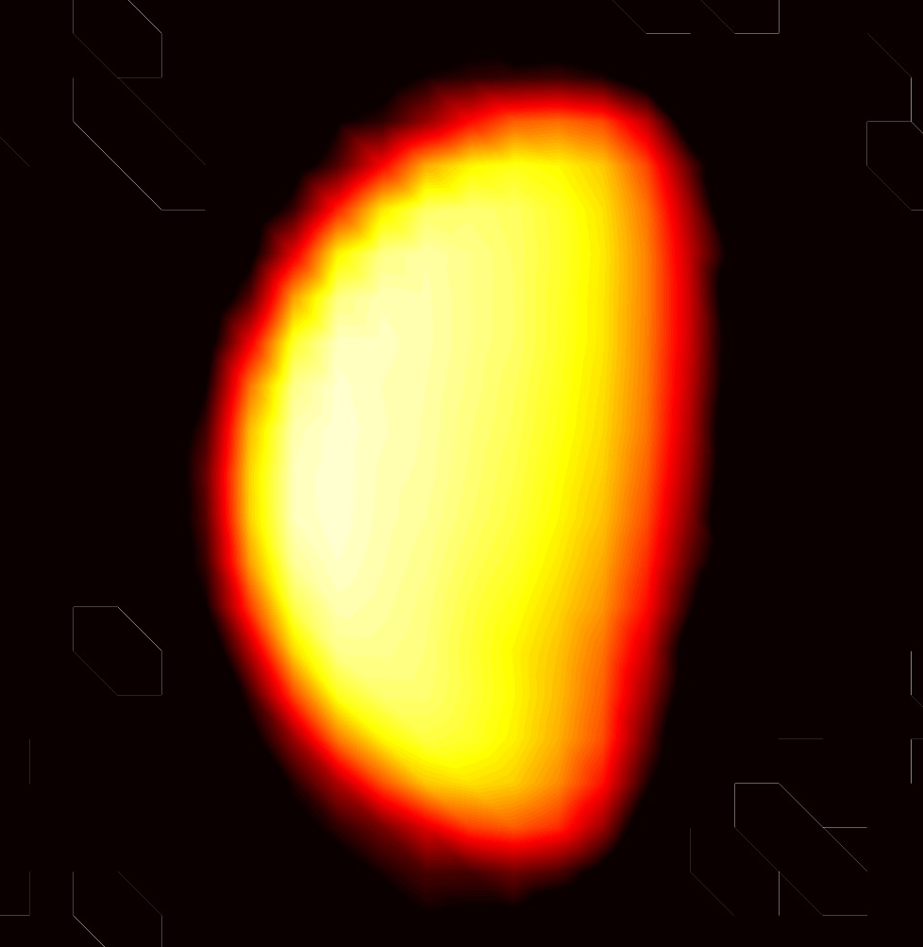
CALLISTO

Slide 36
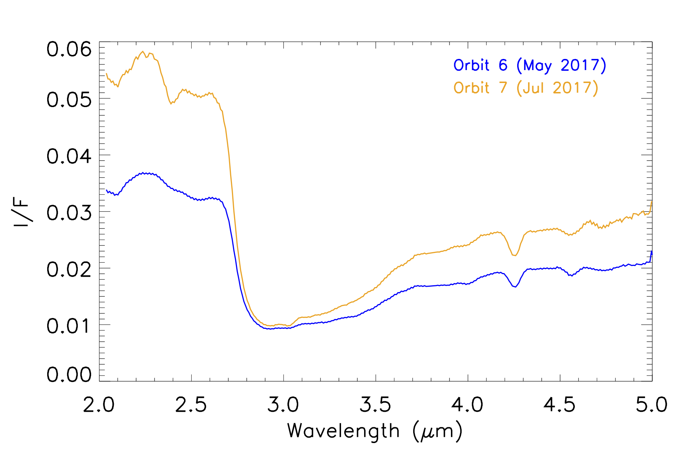
Average I/F spectra of Callisto as observed by Juno/JIRAM
CO₂
Tholins?
i < 80°, e < 80°

Slide 37
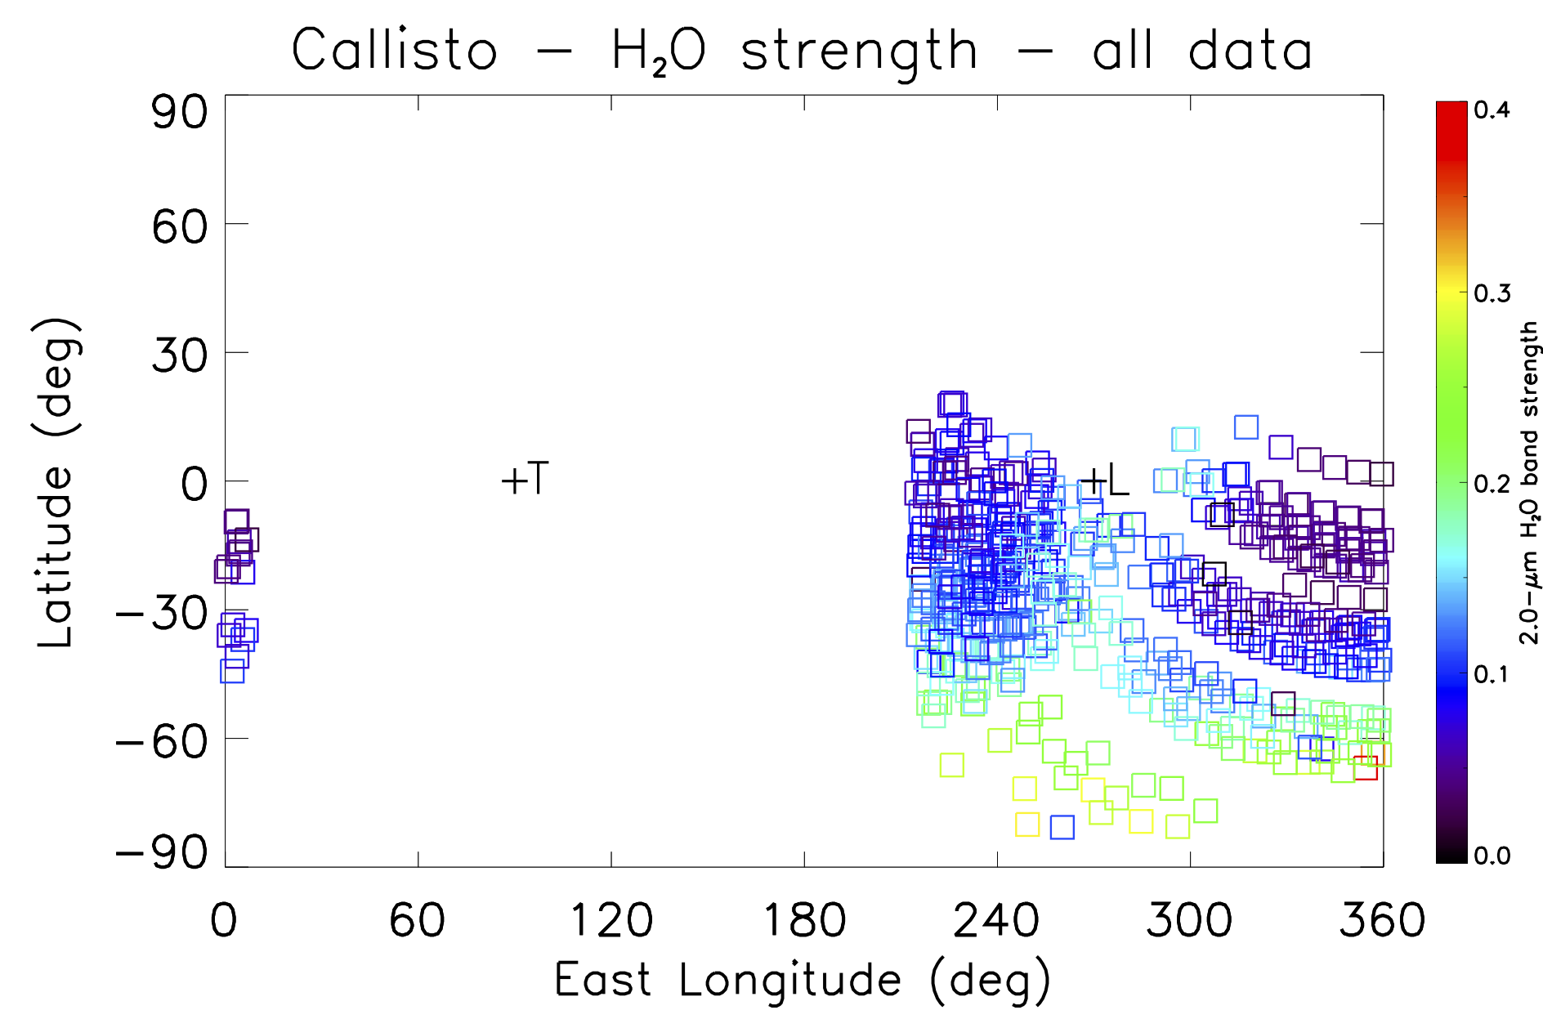

Slide 38
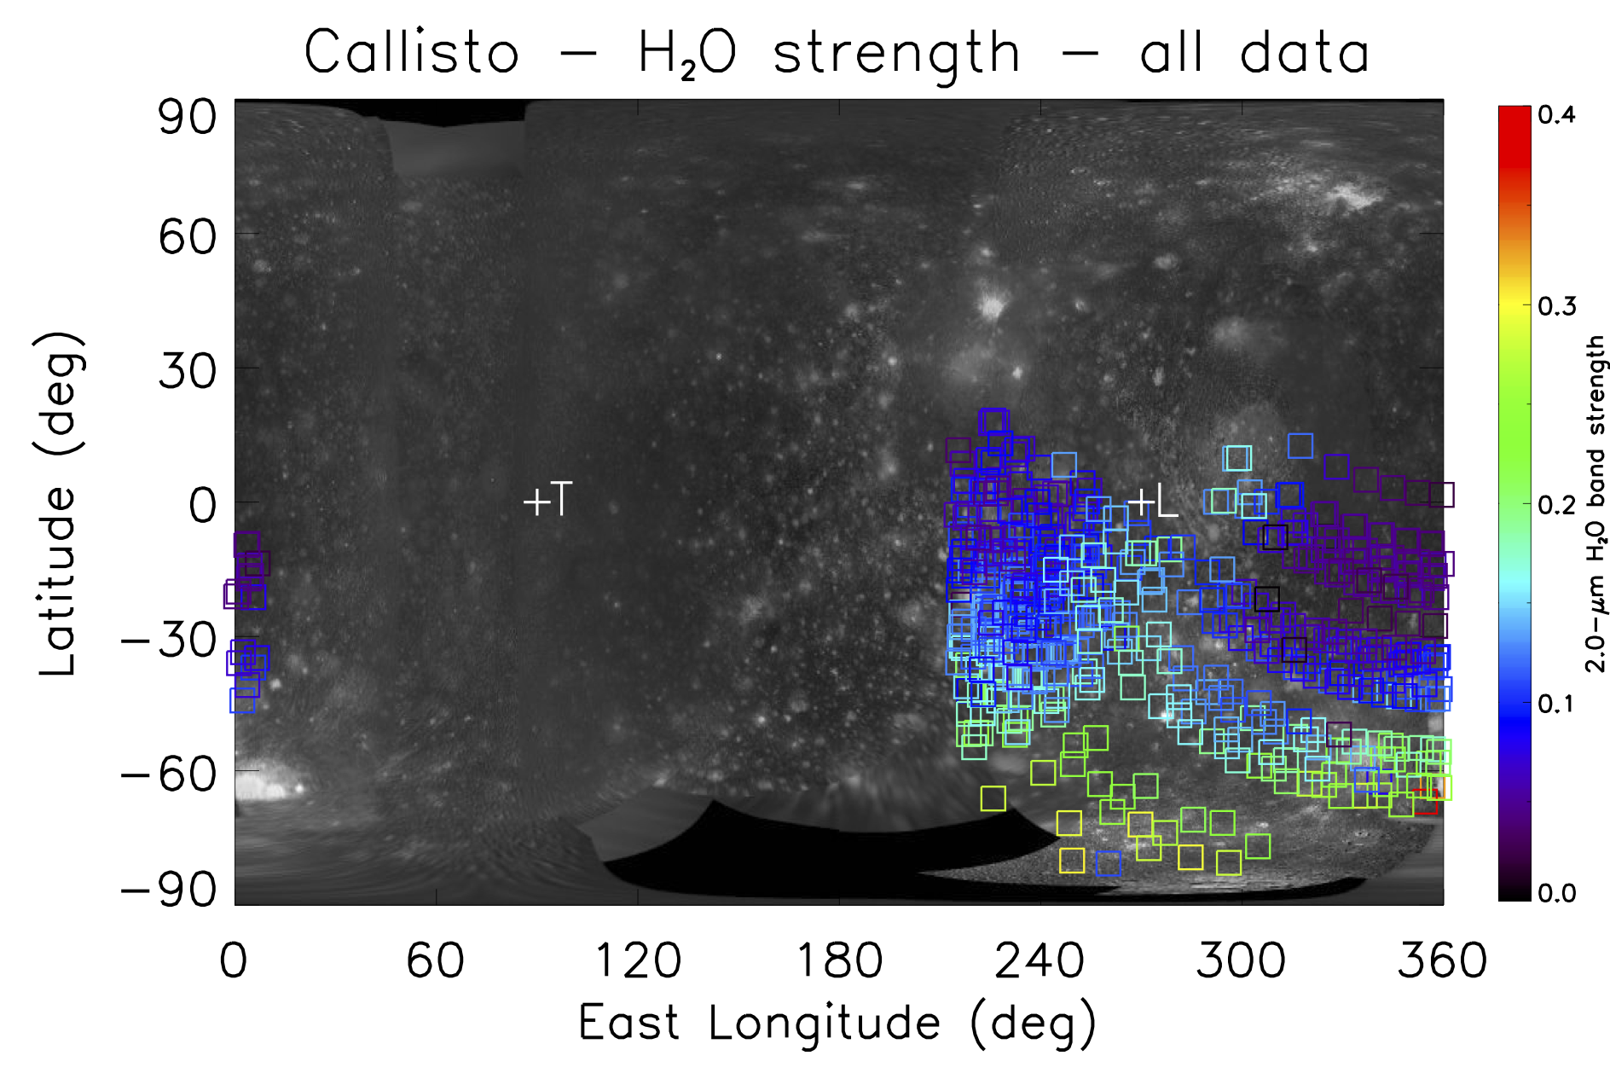

Slide 39
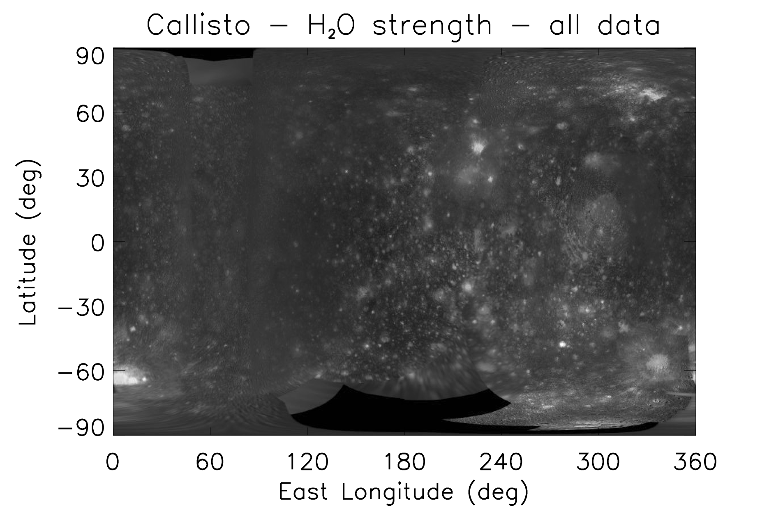
Valhalla
Asgard
Adlinda
Lofn

Slide 40
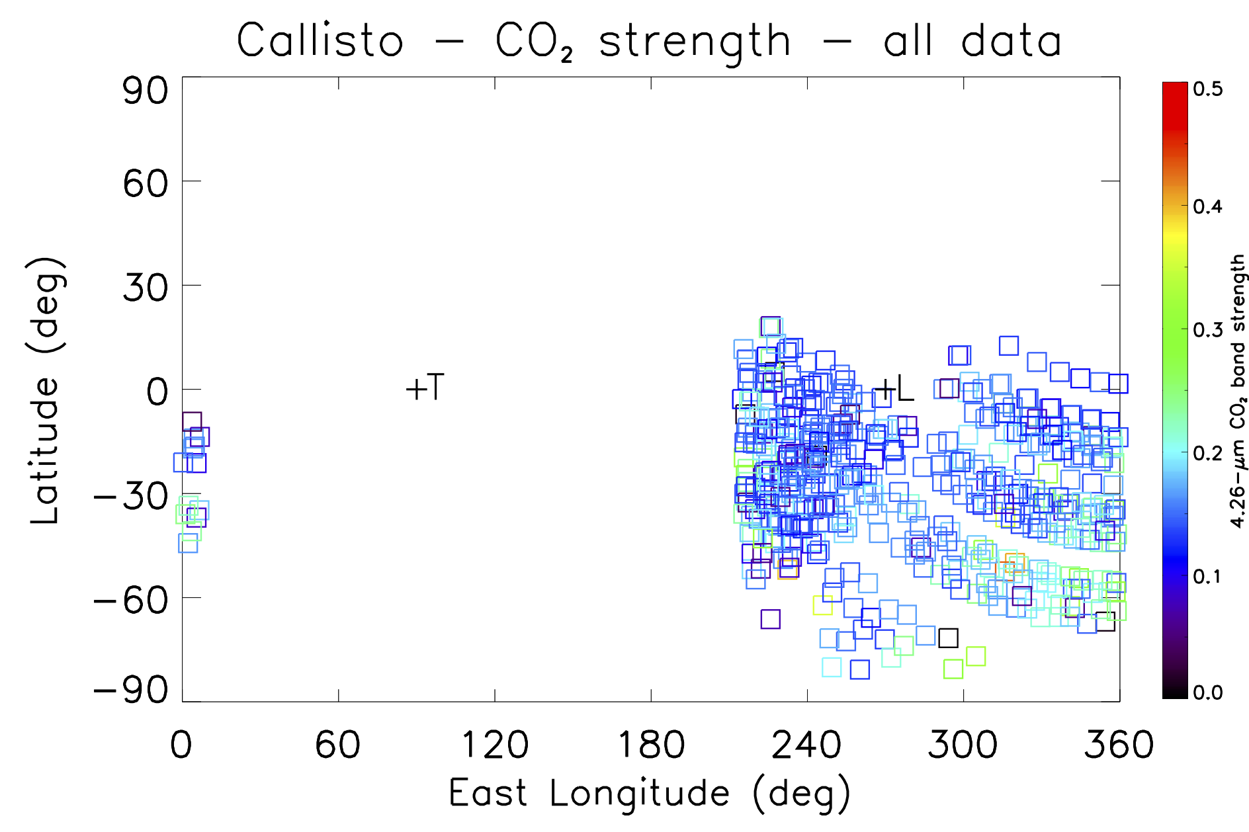

Slide 41
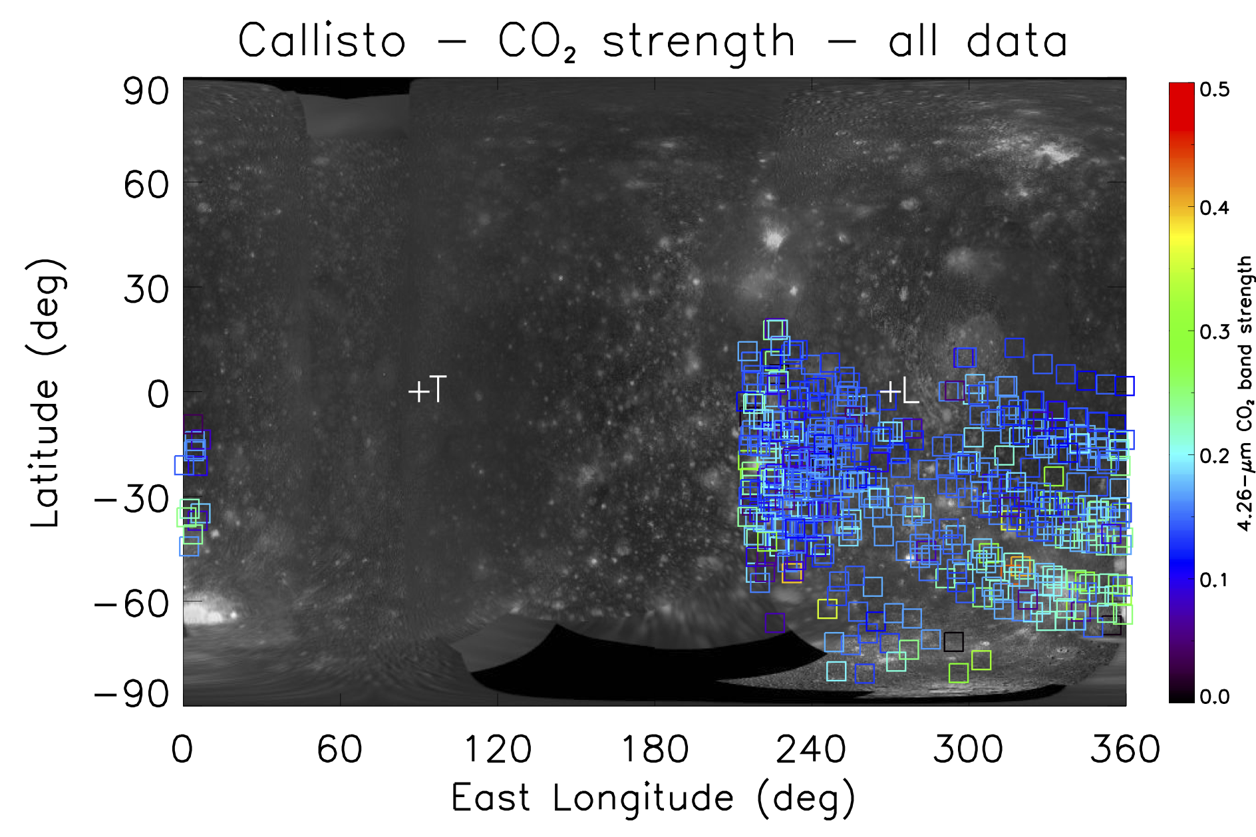

Slide 42
Valhalla
Asgard
Adlinda
Lofn

Slide 43
Wrap-up
Despite being targets of opportunity, the Galilean satellites have been observed by the JIRAM spectro-imager about 4900 times (combining imagery and spectral data) in the three-year period 2016-2019.
Although the achieved spatial resolution is not outstanding, the polar orbit of Juno around Jupiter makes it possible to perform observations of the moons at high latitudes, which are inaccessible to Earth-based or space-based telescopes.
The case of Io is intriguing with regard to thermal mapping: the surface of this satellite is dotted with numerous active volcanic centers, which make JIRAM a key instrument for the thermal monitoring of Io’s surface both at the local scale (where the sulfur-rich lavas erupted by volcanoes can be as hot as 1600 K) and at regional/hemispheric scale.
In the radiance spectra measured by JIRAM, Io’s hot spots show up as a thermal emission peaking at wavelengths < 4 μm, which leads to maximum temperature values up to ~1000 K or more provided by hot lavas at sub-pixel scale (the typical JIRAM resolution cell is 70-150 km/px).
JIRAM observations of Io are definitely more frequent than any scheduled Earth-based, infrared telescopic observations of Io.

Slide 44
Wrap-up (cont’d)
The good spatial resolution achieved by JIRAM on Europa already allowed a first publication, where the derived spectral indices are essentially consistent with the results already known from previous literature.
At the moment, Ganymede is the most observed satellite. Here, the spectral indices are also in line with the expectations on the basis of literature: increasingly pure ice going from the equator to the poles, and larger abundance of non-water-ice species (including volatiles such as CO2) in the dark regions.
Callisto is the least observed satellite, with a poor coverage and with the coarsest spatial resolution. However, we find the trends already known from literature regarding water ice (whose purity increases going towards the poles and in fresh craters) and CO2 (more abundant than on Europa and Ganymede on a global scale, but concentrated above all in fresh impact craters). Good results recommend planning new spectroscopic observations of Callisto that cover also northern latitudes.
During Orbit 24 (December 2019), JIRAM will have a unique opportunity to observe Ganymede from a minimum distance of ~104,000 km, close enough to achieve broad, regional coverage, both with its imager and its spectrometer, of the northern hemisphere with a spatial resolution as good as ~24 km/pixel.

