Slide 1

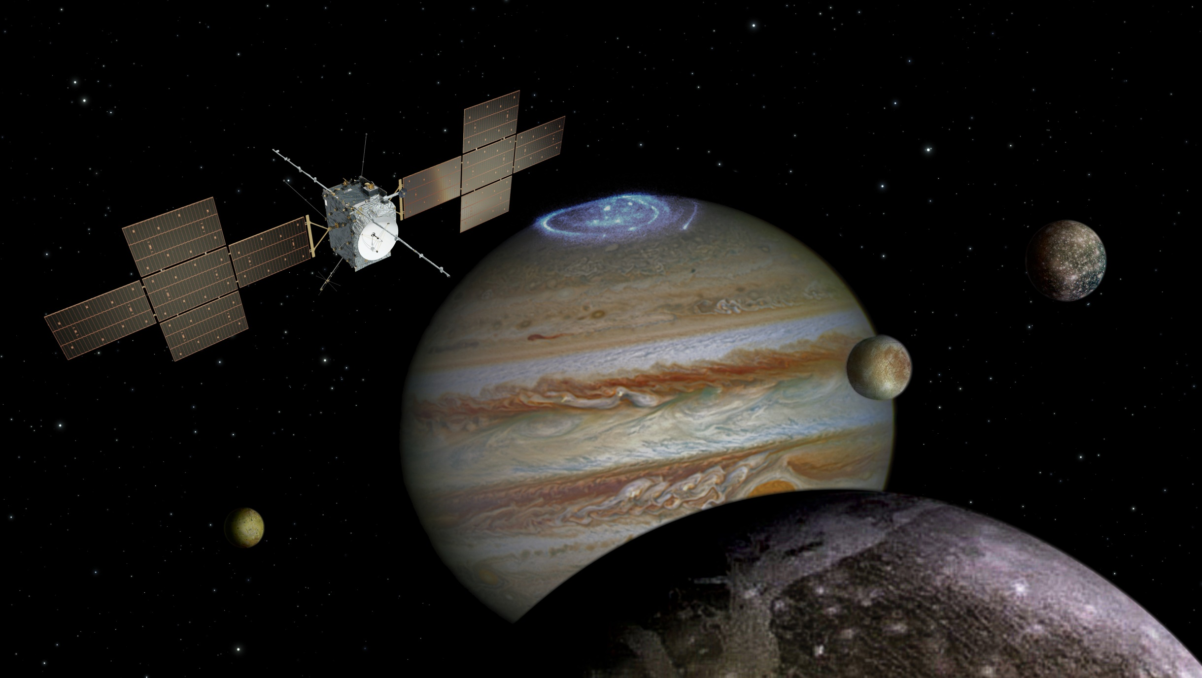
JUICE status report
MAJIS team meeting
10 October 2019
Olivier Witasse
Project Scientist

Slide 2
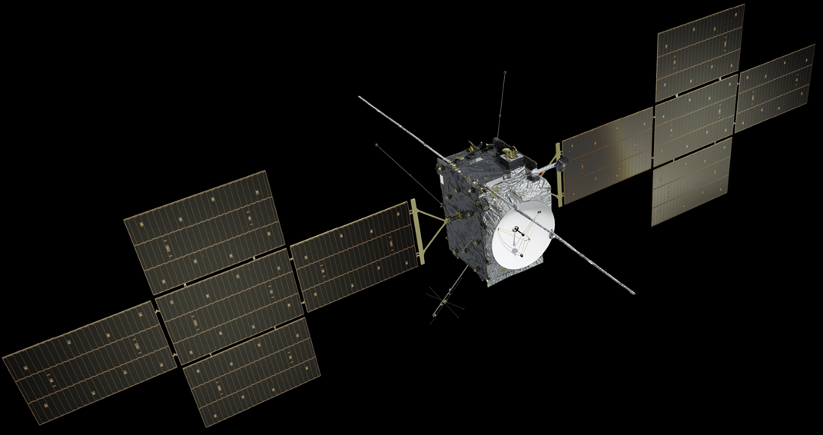
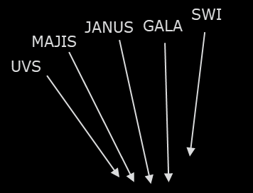
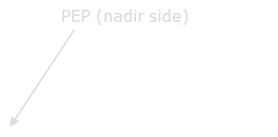

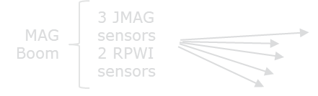

Langmuir Probe (4X)
3GM (Kat + USO) in the vault

Slide 3
Top-level schedule
May 2012: Mission selected
February 2013: Payload selected
July 2015: Prime industrial contractor selected
May 2022: Launch from Kourou (Ariane 5)
October 2029: Jupiter orbit insertion
August 2032: Ganymede orbit insertion
September 2033: End of mission
Sometimes in 2034: Impact on Ganymede

Slide 4
Activities in 2019
March 2019: Spacecraft CDR review
April 2019: Science Operations Centre core design review
June 2019: End of the instrument CDRs (formal board on 14/11)
June 2019: Launcher contract signature → Ariane 5 as a baseline for a launch in 2022
Start of the integration of the spacecraft flight model NOW
1st instrument FM (UVS) to be delivered soon

Slide 5
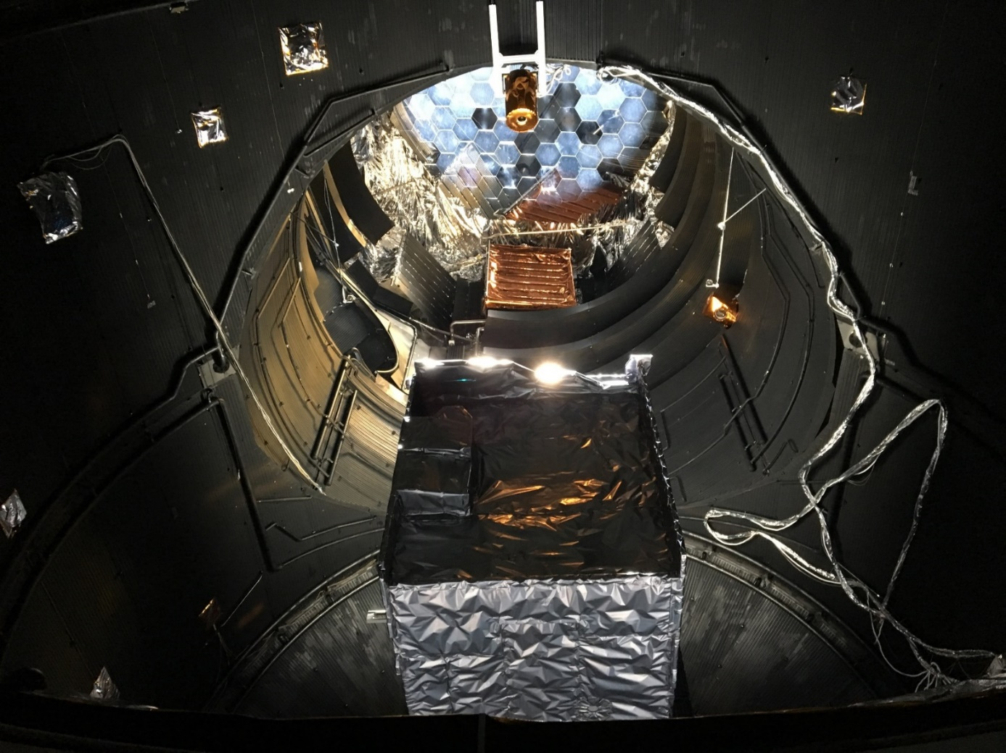
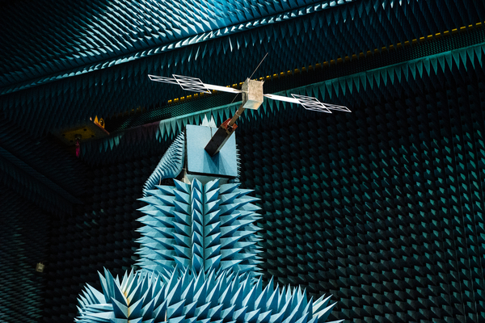
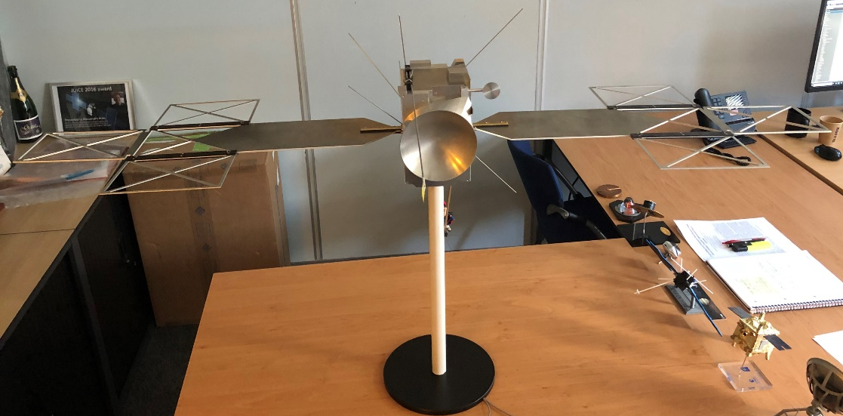

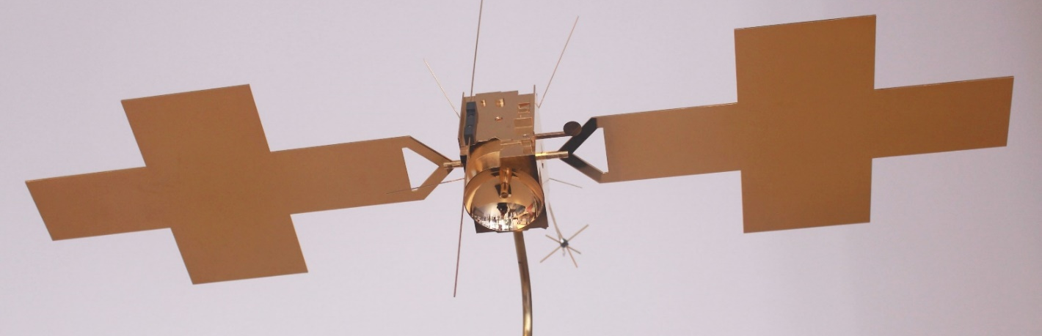
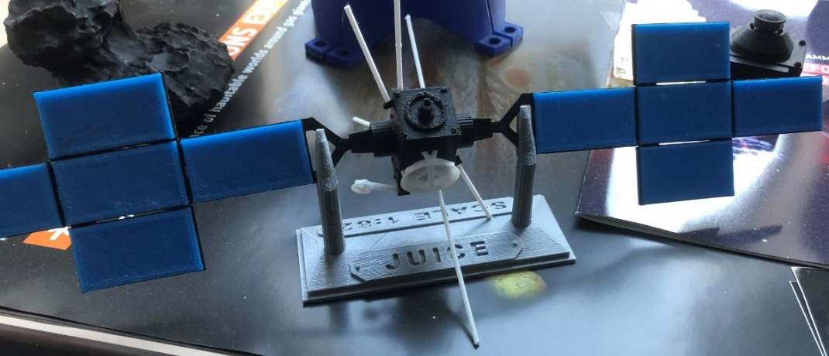
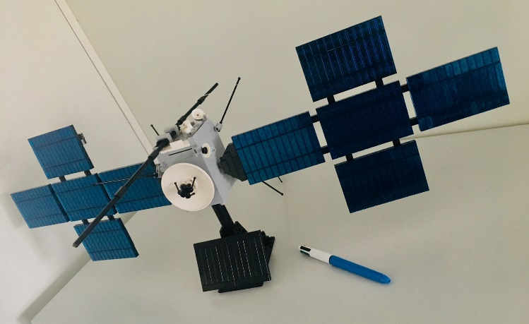
1:1
1:1
2017
2018
2019
1:1
1:18
1:18
2018
2019
2018
1:40
JUICE family of models
2018
1:82
2017
2019

Slide 6
Recent hardware:
Propellant tank and central structure

Slide 7
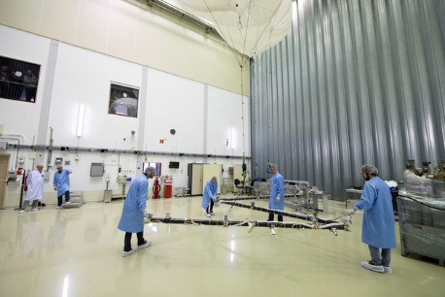
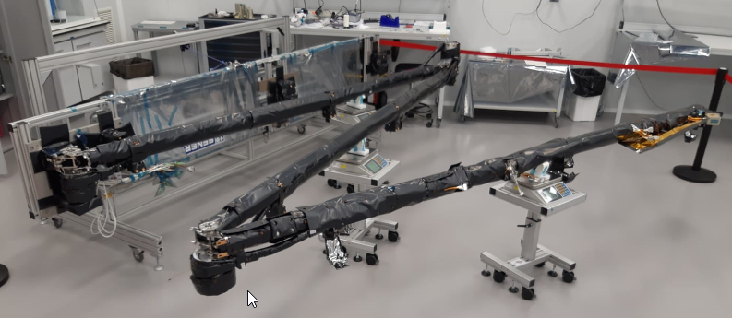
Recent hardware: Mag boom

Slide 8
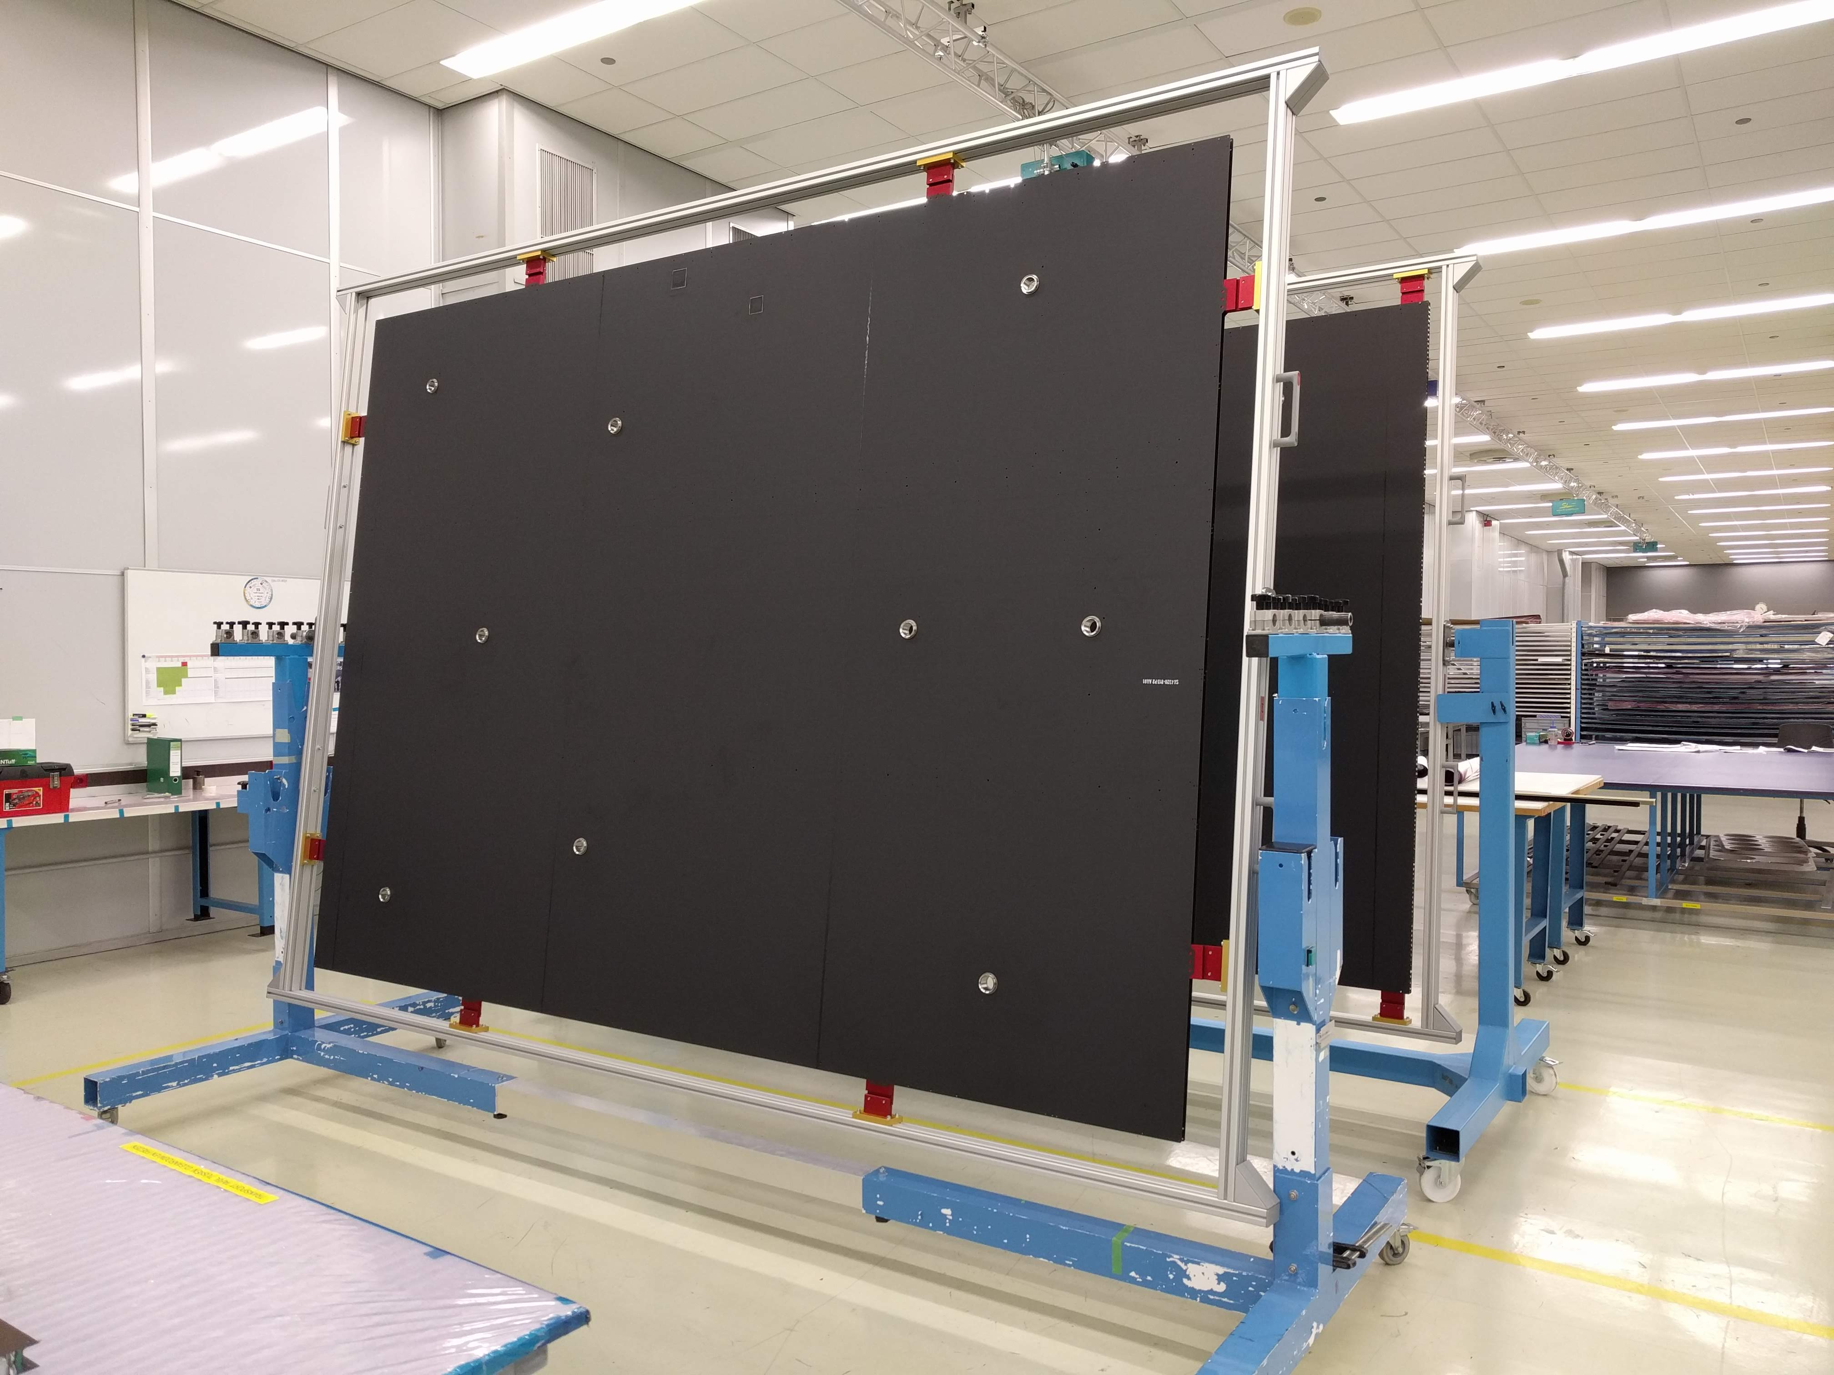
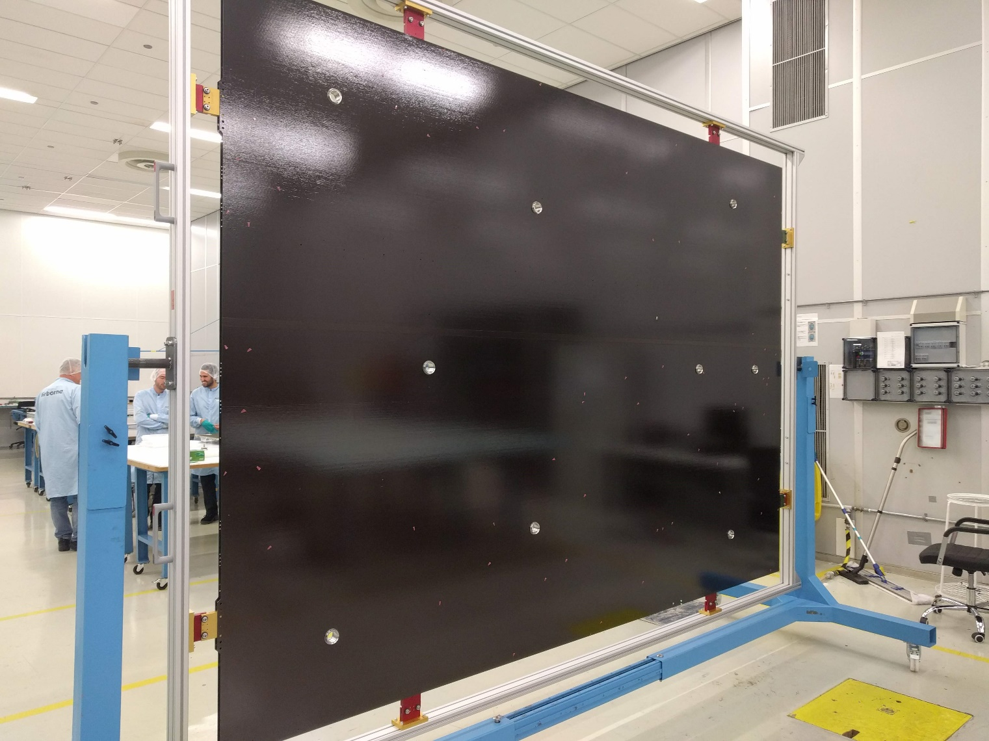
Recent hardware: solar panels

Slide 9

Summary: on track for a launch in May 2022☺

