Slide 1

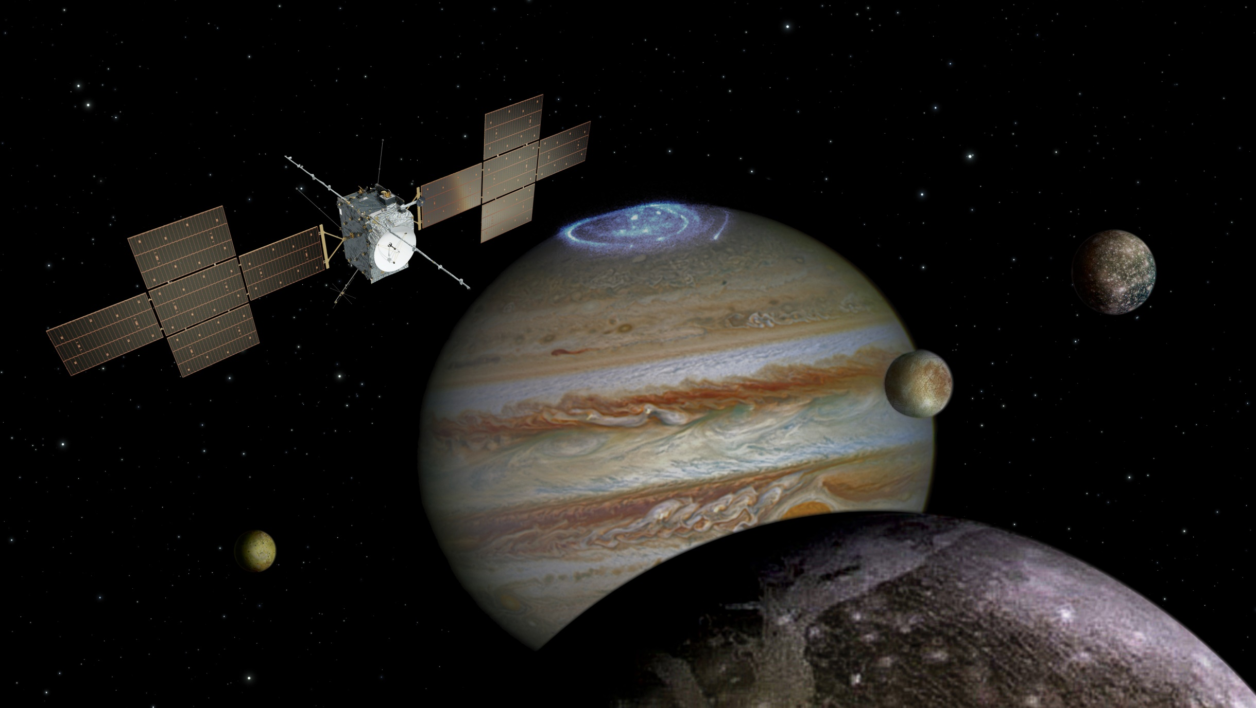
The JUICE tour
MAJIS team meeting
9 October 2019
Olivier Witasse
Project Scientist

Slide 2
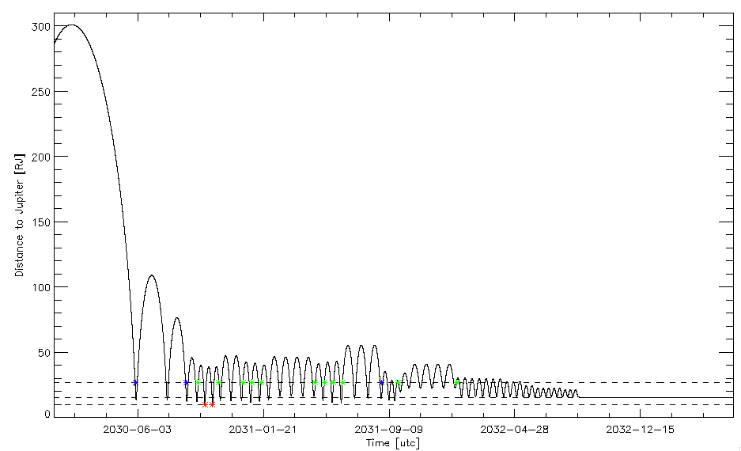
What is the Jupiter tour?
Phases:
1: Pre-JOI and 1st orbit
2: Energy reduction
3: Europa flybys
4. High-latitude
5. Transfer to Ganymede
6. Ganymede orbital phase
Tour: ~ 2 years
Ganymede
~ 9 months
1
2
3
4
5
6
11-15 Ganymede flybys
2 Europa flybys
12-17 Callisto flybys
9 minutes movie available on the ESA website
Jupiter orbit insertion
Ganymedeorbit insertion

Slide 3
Different trajectory files
CREMA 3.0:
→ Issued in October 2015
→ Used by all Working Groups for the segmentation
CREMA 3.1:
→ Issued in September 2016, for PDR
→ used in some engineering scenarios
CREMA 3.2:
→ Issued in April 2017, for the spacecraft PDR board meeting
→ Decrease of radiation dose, number of eclipses, better shadowing of Jupiter during the Europa flybys
→ Current baseline for the project and industry
→ Can be used by the SWT for specific scientific analysis
CREMA 4:0 (4.1 now, small updates in deltaV analysis):
  → Issued in May 2018, for the preparation of the spacecraft CDR
  → Main update is the new tour for a back-up launch in 2023.

Slide 4
JUICE science themes
Emergence of habitable worlds around gas giants
The Jupiter system as an archetype for gas giants
Ganymede as a planetary object and possible habitat
Europas’s recently active zones
Callisto as a remnant of the early jovian system
Jovian atmosphere
Jovian magnetosphere
Jovian satellite and ring systems

Slide 5
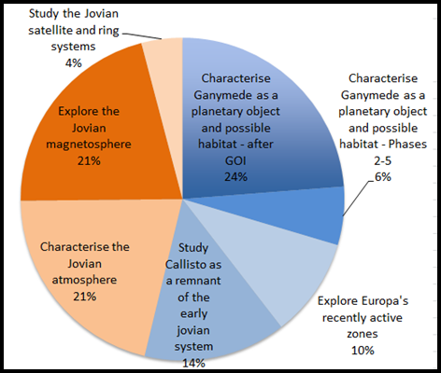
Level 0: Pie chart of the science return
Some flexibility wrt exact % is needed because
  → these % numbers are a help to balance the science objectives
  the link budget may evolve
  the trajectory will change (number of flybys will change etc…)
SWT decision:
→ maintain the balance between icy moons and Jupiter system: 55-45 ±1 %
→ ±2% variation around the nominal value for each objective

Slide 6
What is a segment?
A segment defines a clear scientific priority
One main target (a moon, Jupiter, etc…)
Drives the pointing
Secondary objectives
Power constraint
Total data volume allocation + data volume per target
No overlapping segment
Example: Elara segment
Priority is Elara moon observation
Pointing → Elara
Xx Gb for remote sensing
Yy Gb for in-situ payload
Power: Energy/battery model

Slide 7
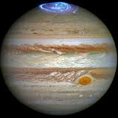

Basic plan for the level 0
Plasma
16 hours
Plasma
16 hours
Plasma
16 hours
Moon flyby
±12 hours
…
…
CA
±few min
Downlink
8 hours
Downlink
8 hours
Downlink
8 hours
Downlink
8 hours
Downlink
8 hours
Downlink
8 hours
Perijove ±50 hours
Downlink suspended only for a few
cases (Phase 2)
Priority: WG4 or WG3

Slide 8
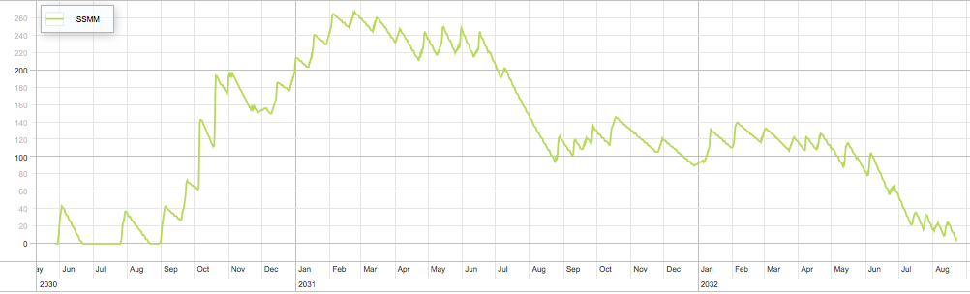
Example of mass memory being filled in
Suspended DL during +/-50hrs around PJ
Europa flybys
Alternate WG4 (remote+in-situ) and WG3 (in-situ) perijoves
Phase 2
3
Phase 4
Phase 5
…
Gb
Moons flybys
DSN support
(16hrs DL/d)
Carry over to phase 6: ~11.5 Gb

Slide 9
SWT recommendation (2016)
Basic 2018 plan
Improved 2019 plan
Work in progress
by SOC, PS, IDSs and WG to fit the recommended
SWT allocation

Slide 10
Overall constraints (0)
Downlink capability
Power/energy
Pointing capabilities
Flight dynamics slots
EMC

Slide 11
Overall constraints (1)
Downlink
  Capability (2.3 Gb/day) exceeds the requirements (1.4 Gb/day)
  Real downlink capability known in flight
  Support of NASA deep space network for 2 months around the Europa phase ☺
  But of course we always need more!
  Accelerometer and Navcam data to take into account
2. Power/energy for supporting the payload operations
  S/C CDR outcome: sufficient with margins in the sizing case of the Europa flybys; margins are reduced at the end of the mission.
  Total power consumption for the instruments has increased by ~40 W from SRR to CDR reviews → impact on the science operational timeline.
  Accelerometer power to take into account…

Slide 12
Overall constraints (2)
3. Pointing and navigation:
  Overall ok.
  One non-conformance during the Ganymede 500 km circular orbit has an impact on a JANUS science objective: the determination of Ganymede’s surface relative rotational position.
  Navigation Non-conformances: orbit prediction errors (AGE) at 95% confidence go up to 50 km and reconstruction (AGKE) errors up to 100 m → impact on MAJIS and on other instruments. Project/industry is working on that.
  Calibrations that require special pointing (e.g. PEP rolls before flybys, J-MAG rolls, etc…) to take into account
  Slew/tranquilisation times to take into account
  Micro-vibrations (SWI TBD)

Slide 13
Overall constraints (3)
4. Flight Dynamics slots (special segment)
  Weel-off-loading: once per day
  Maneuvres (e.g JOI, GOI, etc..)
  Navigation and ephemerides slots (use of the NAVCAM)
5. EMC
  Instrument-instrument disturbances may/will impact the science operation timeline
  RPWI-RIME TBC
  RPWI-GALA TBC

Slide 14
Messages
Instrument team meetings
Goal is to optimise as much as we can, and this takes time
Discussions
are important
At different levels
Working groups
We may have to compromise from time to time
SWT

Slide 15

Complex! But we will do it ☺

