Slide 1
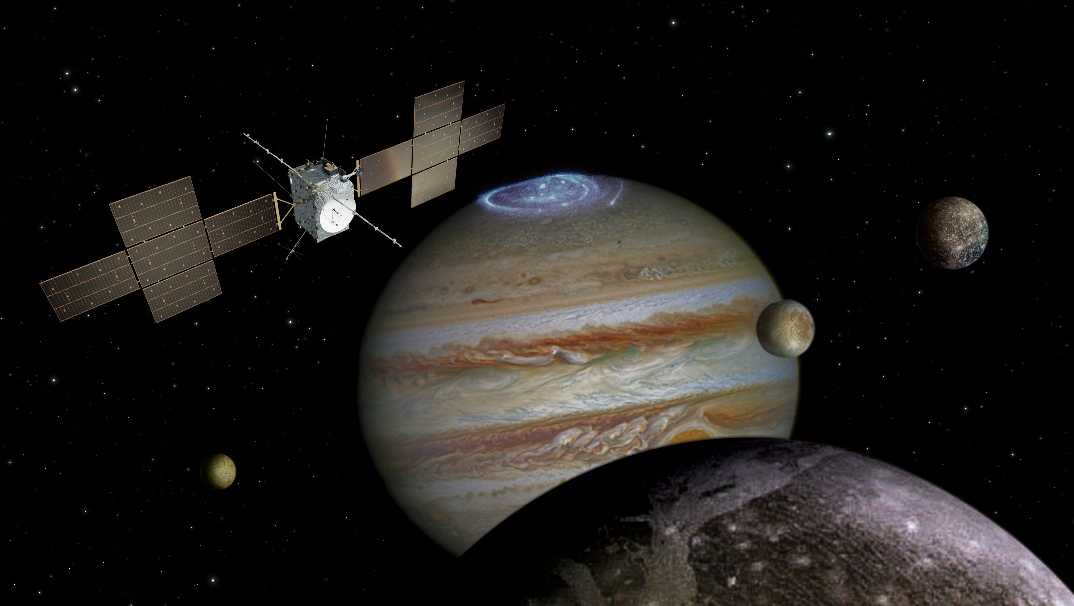
MAJIS: Status of the segmentation
for the Ganymede orbit phase
F. Tosi and the MAJIS Team
JUICE WG2 telecon, June 27th, 2019

Slide 2
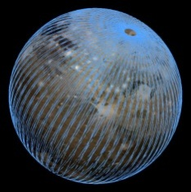
Ganymede orbit phase (CReMA 3.0) | Timeframe | Length
Ganymede (polar) 10,000 x 200 km & 5000 km 500 km circular | September 2032 – January 2033 January 2033 – June 2033 | 122 days 160 days
GCO5000
GCO500
GEO
GEO

Slide 3
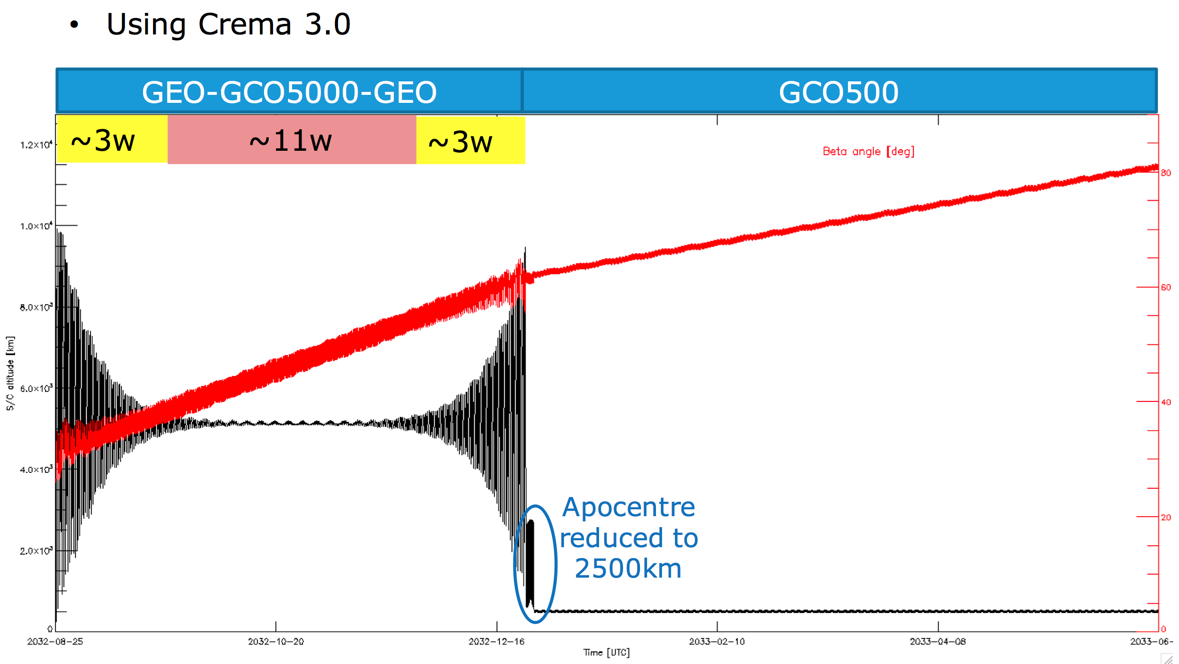
Ganymede orbital mission profile

Slide 4
Candidate target areas for Ganymede
Observation categories defined by geologic features and/or processes (updated and prioritized according to Stephan, 2019):
Category 1: Potential cryovolcanic areas
Category 2: Polar deposits
Category 3: Dark ray, floor, halo craters
Category 4: Impact crater morphologies (1 – peak, 2 – pit, 3 – dome, 4 – pedestal, 5 – palimpsest, 6 – basin, 7 – catena)
Category 5: Bright ray craters
Category 6: Evolution of the bright terrain
Category 7: Surface degradation
Increasing priority
 | Category 1 | Category 2 | Category 3 | Category 4 | Category 5 | Category 6 | Category 7
# Sites | 10 | 12 | 12 | 42 | 11 | 20 | 6
10/9/19
XIV Congresso Nazionale di Scienze Planetarie
4

Slide 5
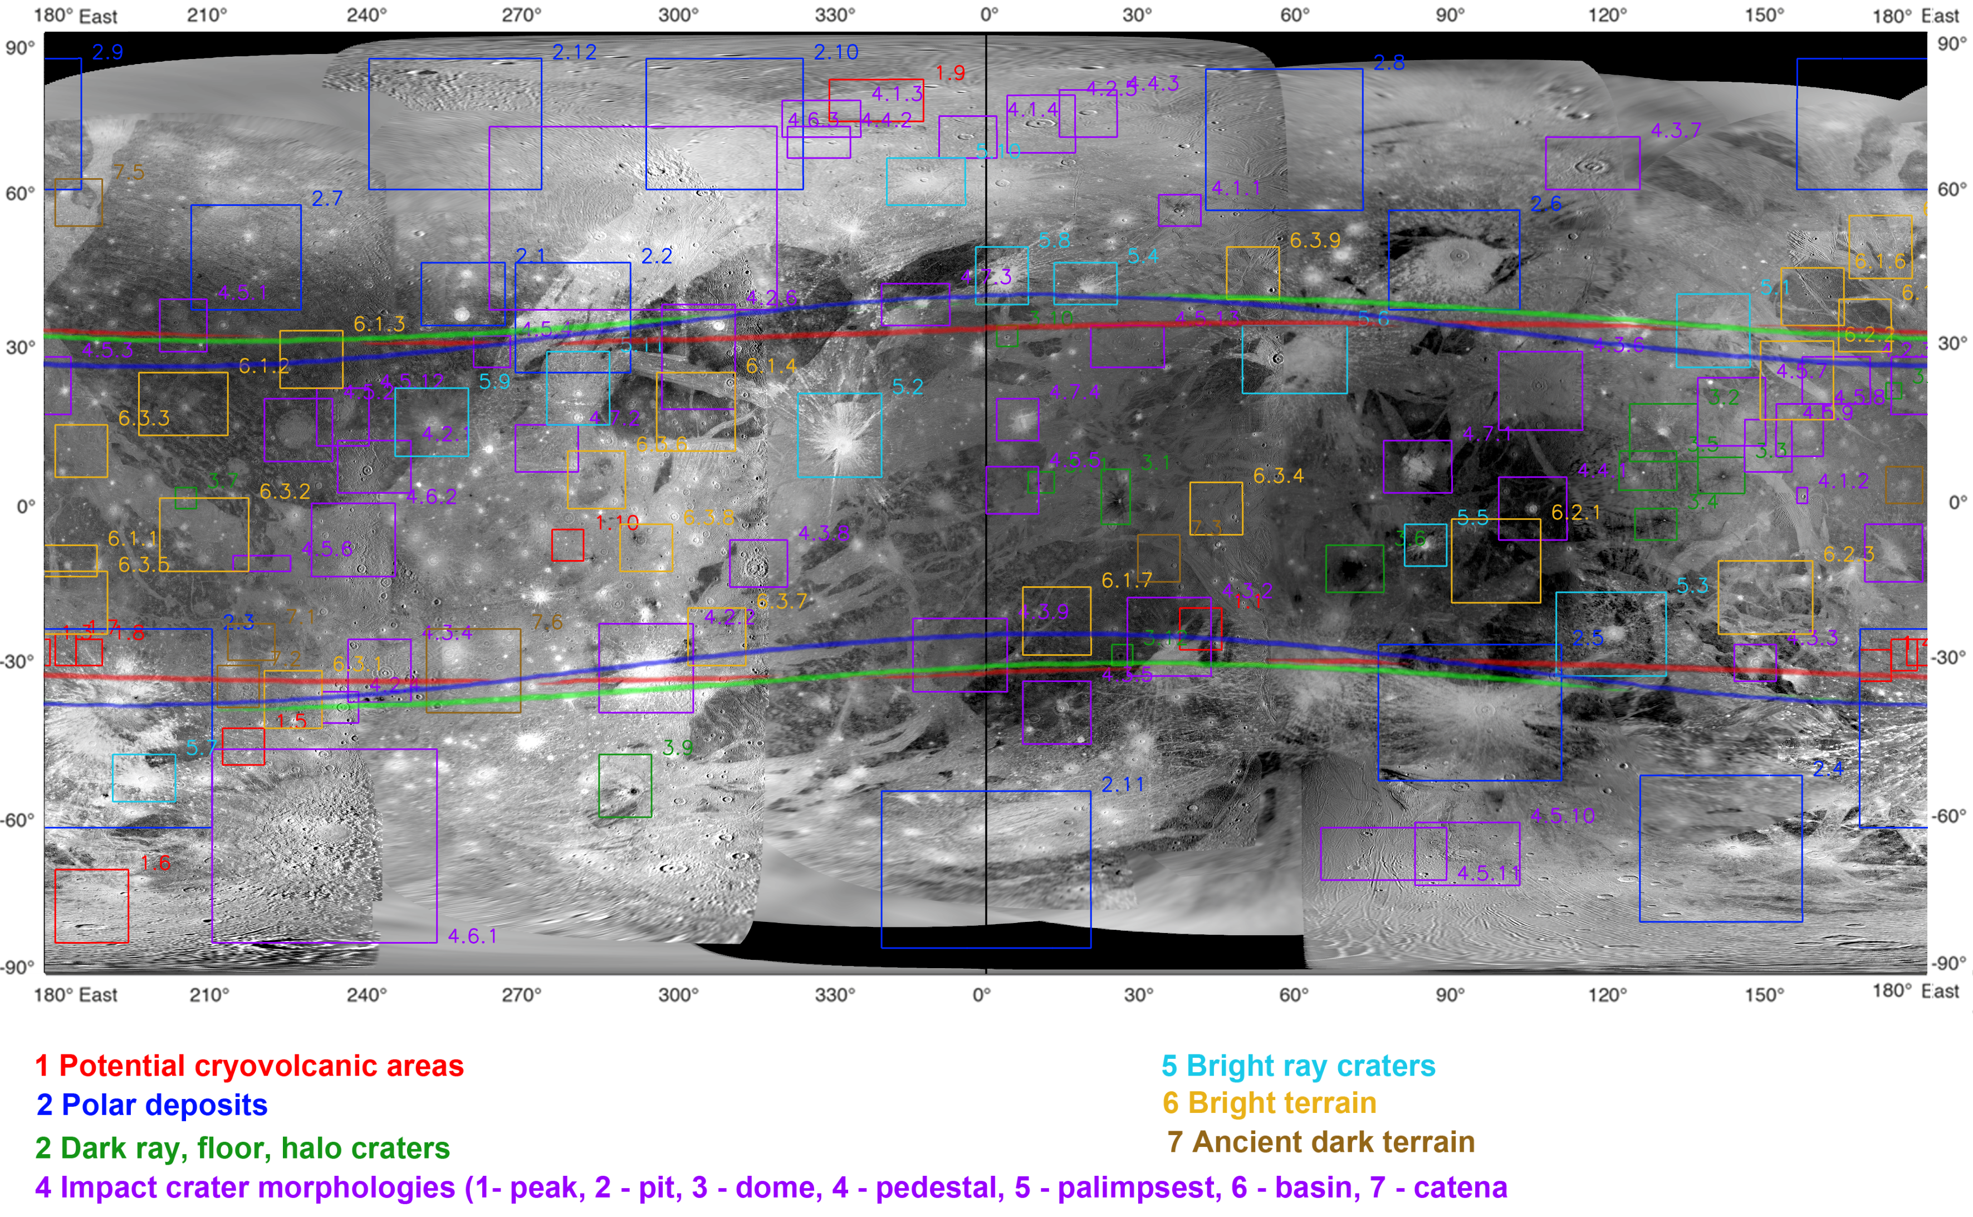
Candidate target areas for Ganymede

Slide 6
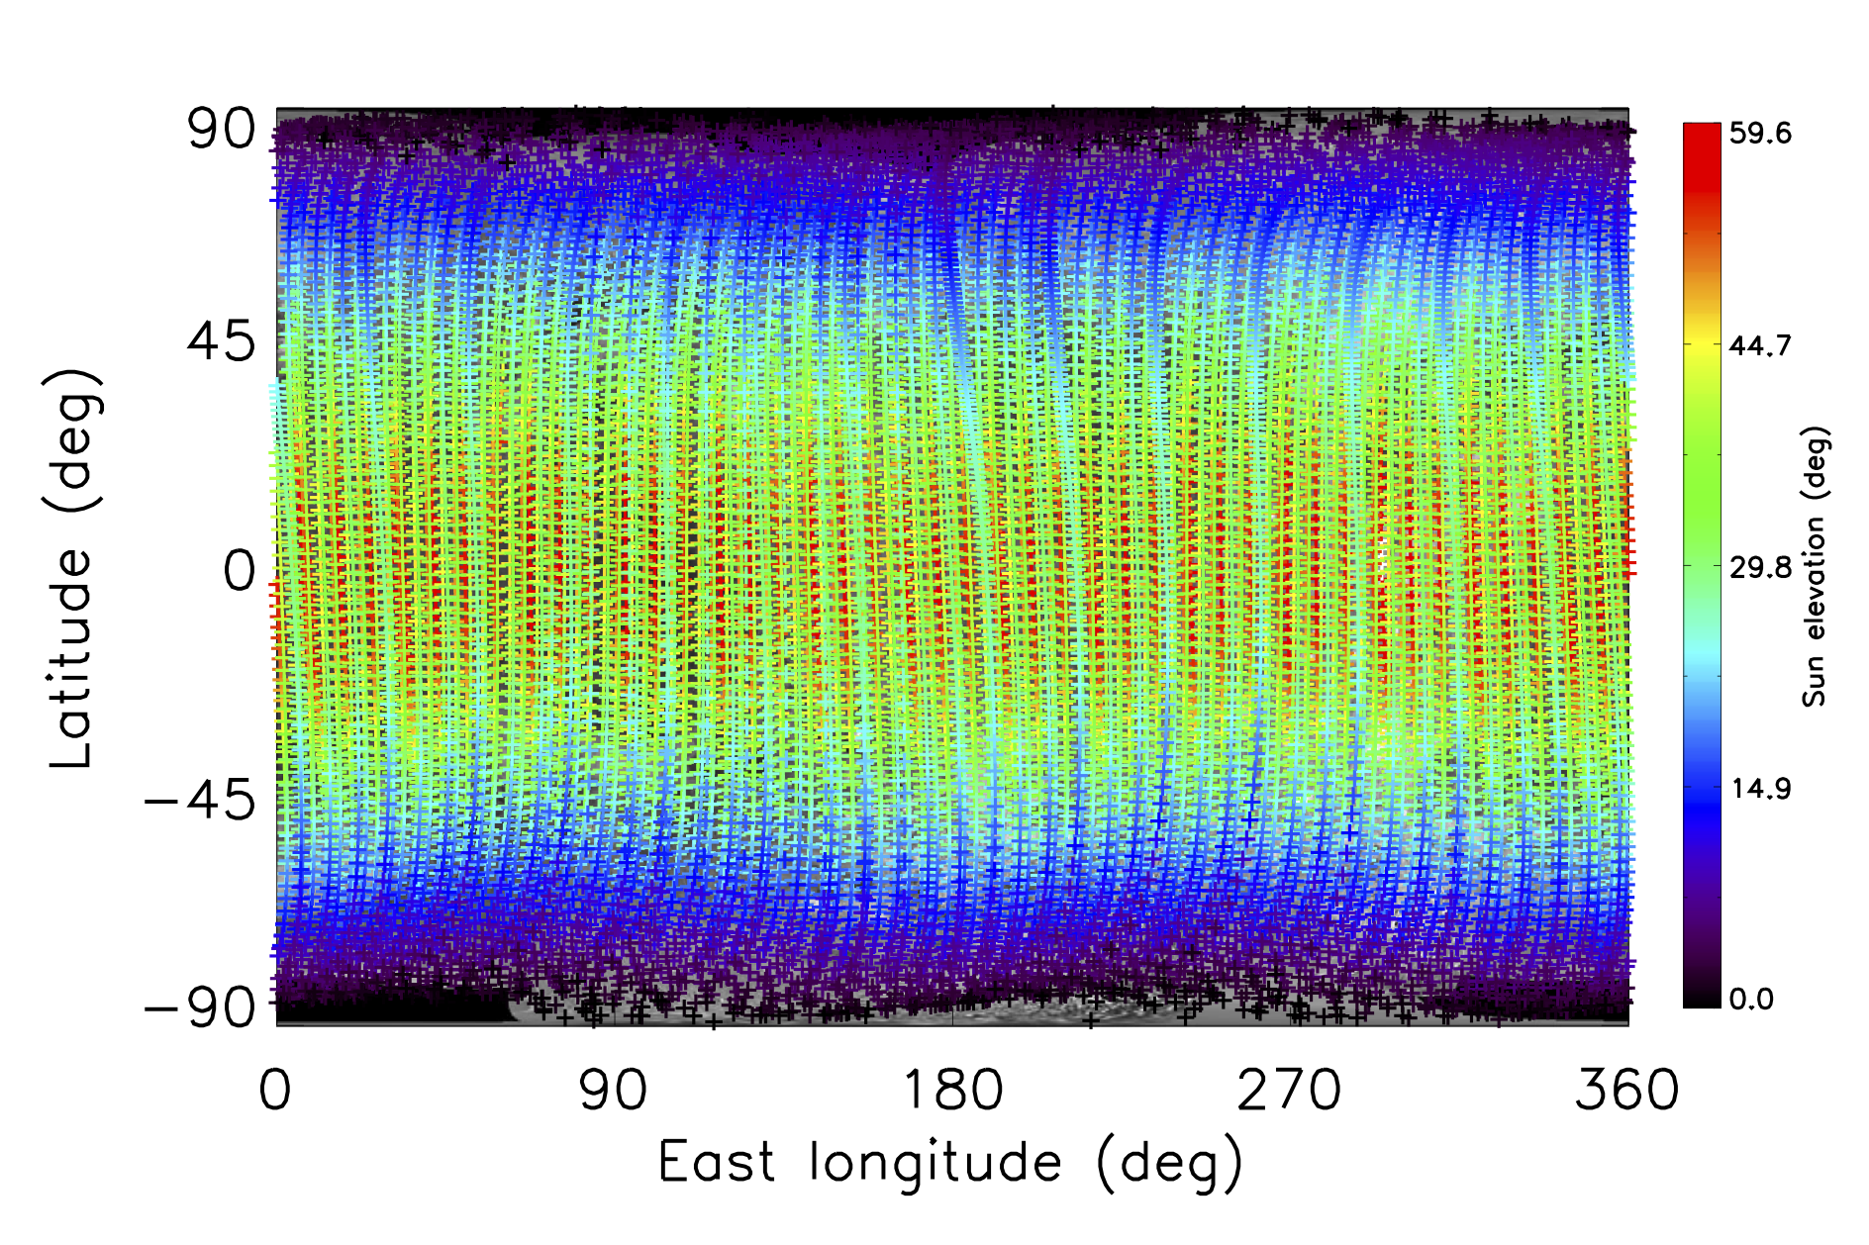
Solar illumination in GEO (CReMA 3.2)
Solar illumination in GCO5000 (CReMA 3.0)

Slide 7
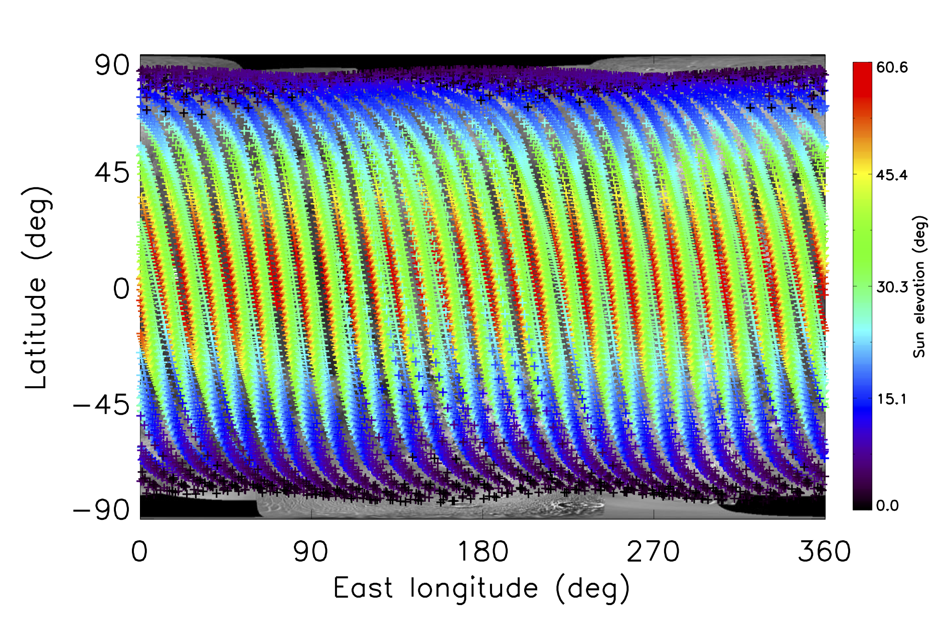
Solar illumination in GCO5000 (CReMA 3.2/4.1)

Slide 8
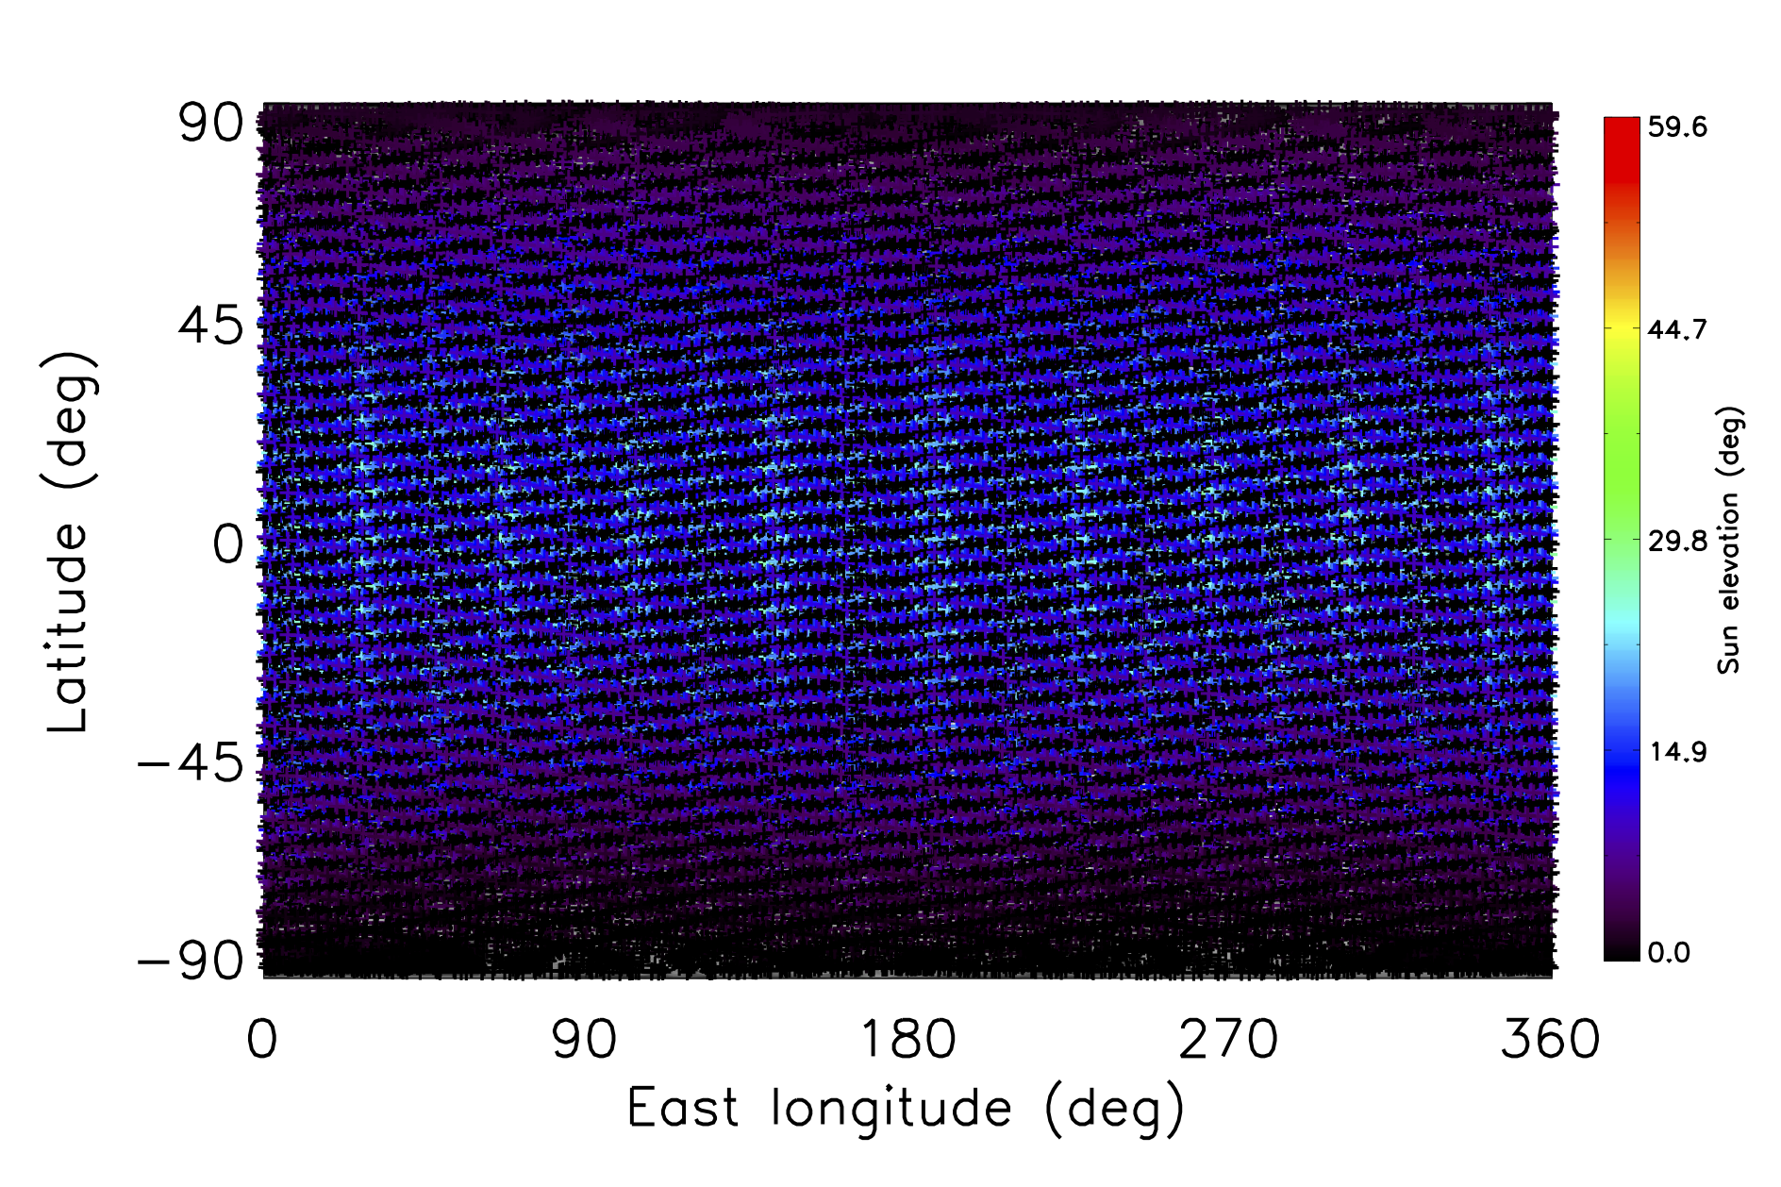
Solar illumination in GCO500 (CReMA 3.0)

Slide 9
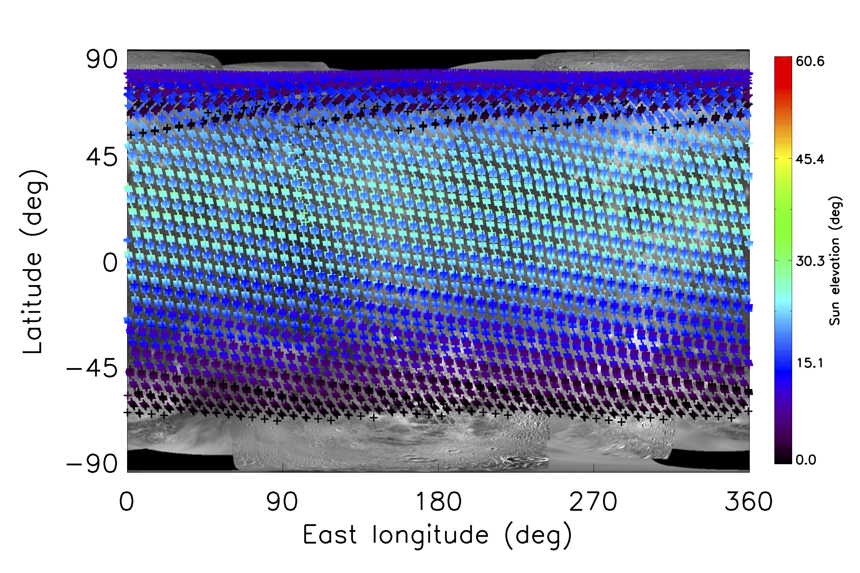
Solar illumination in GCO500 (CReMA 3.2/4.1)

Slide 10
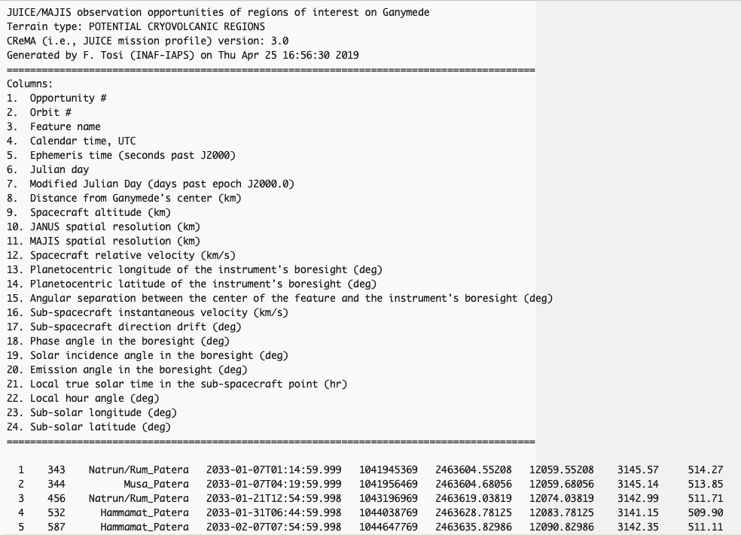

Slide 11
We carried out an exercise to check out how many regions of interest it is possible to observe with MAJIS during the orbital phase at Ganymede. Here we assume CReMA 3.0 and a solar incidence angle <70°:
 | Category 1 | Category 2 | Category 3 | Category 4 | Category 5 | Category 6 | Category 7
GEO+GCO5000 | 3 | 7 | 8 | 34 | 4 | 5 | 2
GCO500 | 5 | 1 | 12 | 14 | 7 | 6 | 3
The number of observation opportunities changes significantly if CReMA 3.0 or a more recent trajectory is used. However, when using CReMA 3.2 / 4.1, the results are distorted by the fact that, as explained above, in the GCO500 phase the ground tracks are redundant, therefore the same regions of interest are indeed observed multiple times.
At the same time, a bias introduced by CReMA 3.0 is an imbalance between the duration of the “high” orbital phase and that of the “low” orbital phase, with the GCO500 lasting longer.

Slide 12
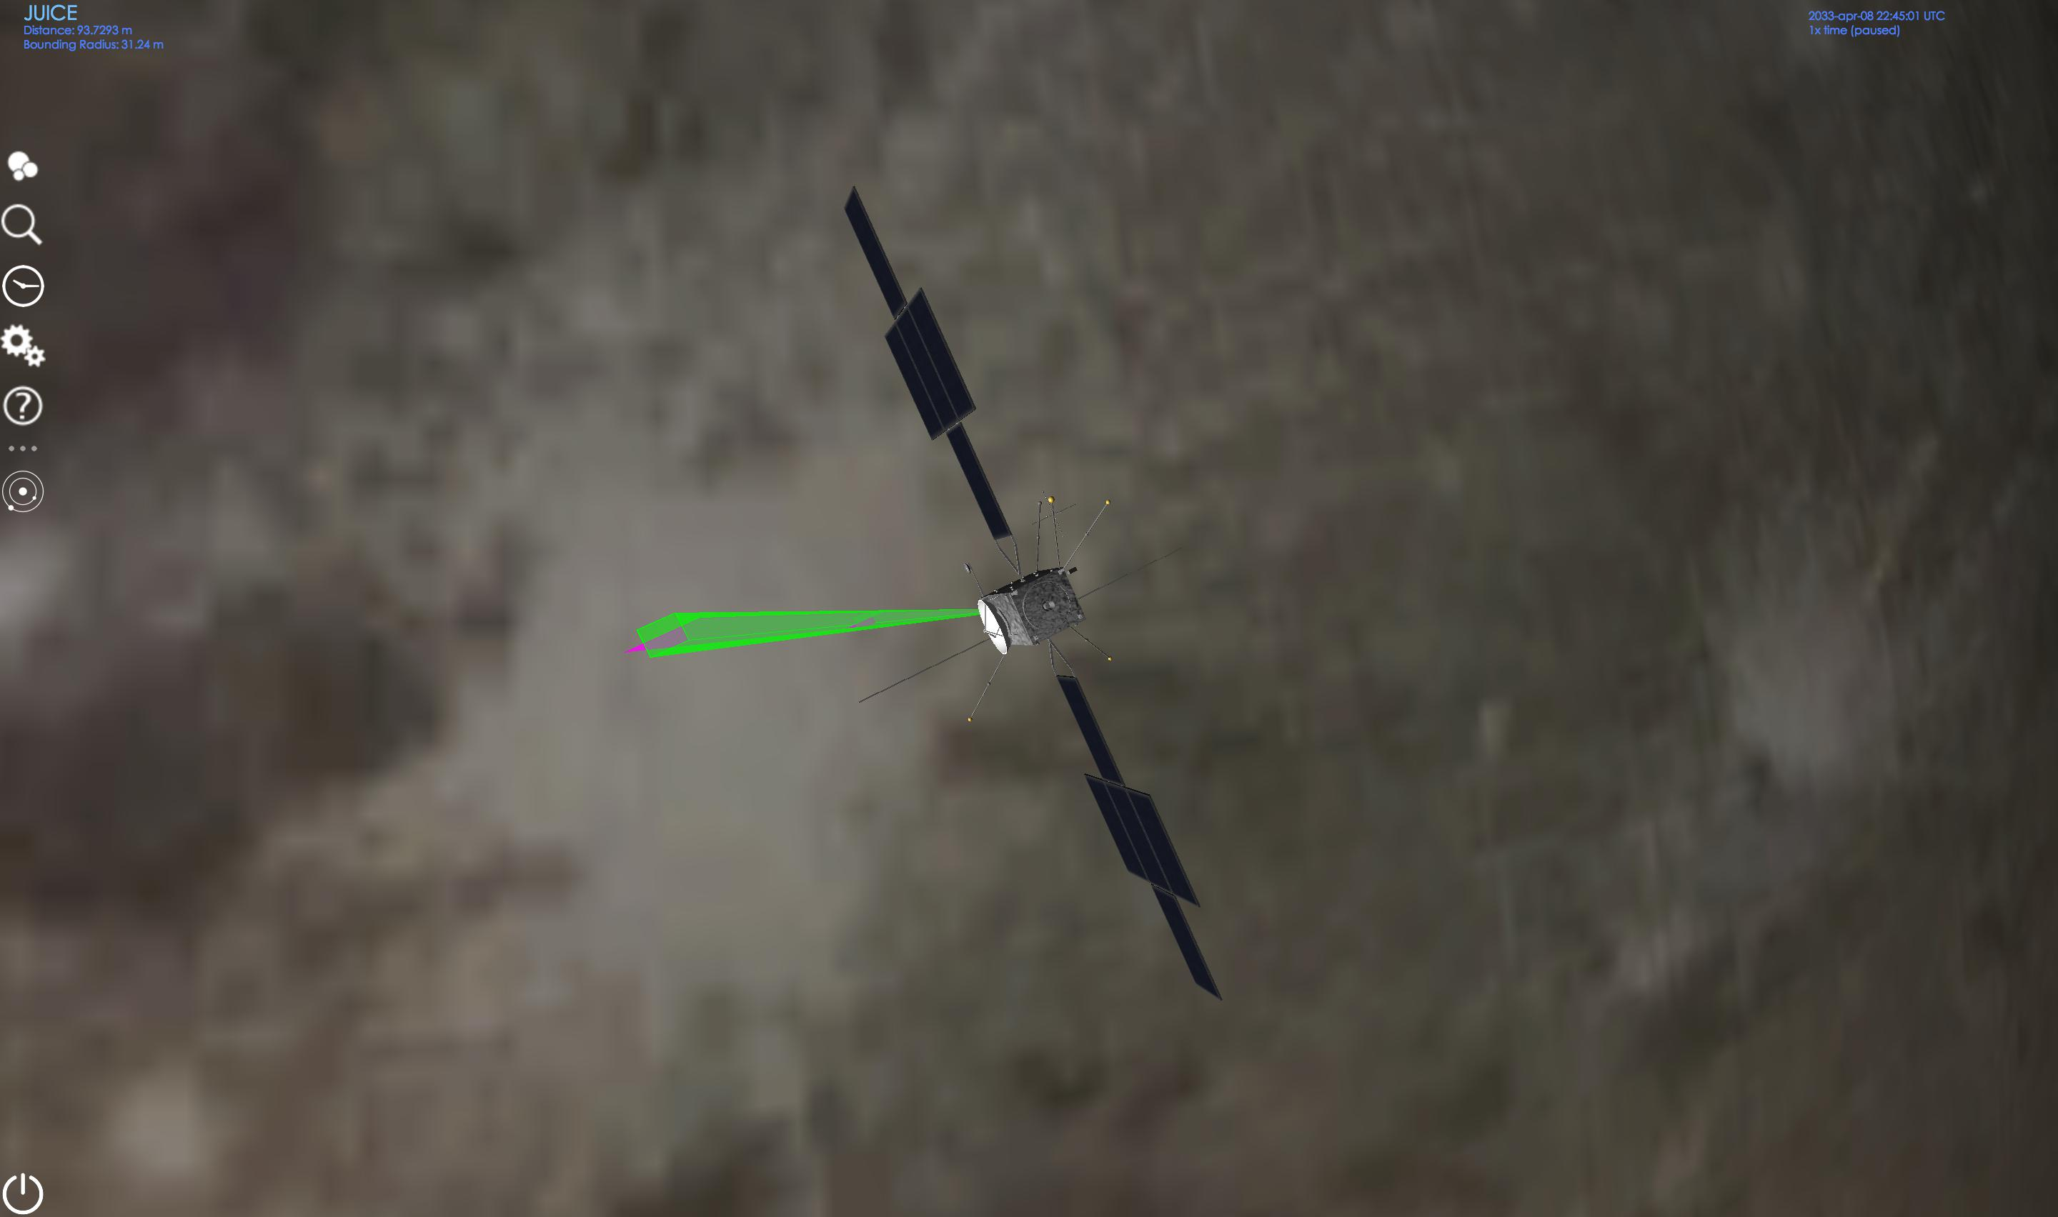
Shu crater
Orbit #715
Take-away message: whenever a ROI is in the field of view of JANUS, it is always in the filed of view of MAJIS too, whereas the vice versa does not apply, due to the different FOVs
→ simultaneous JANUS+MAJIS observation opportunities are in fact driven by JANUS.

Slide 13
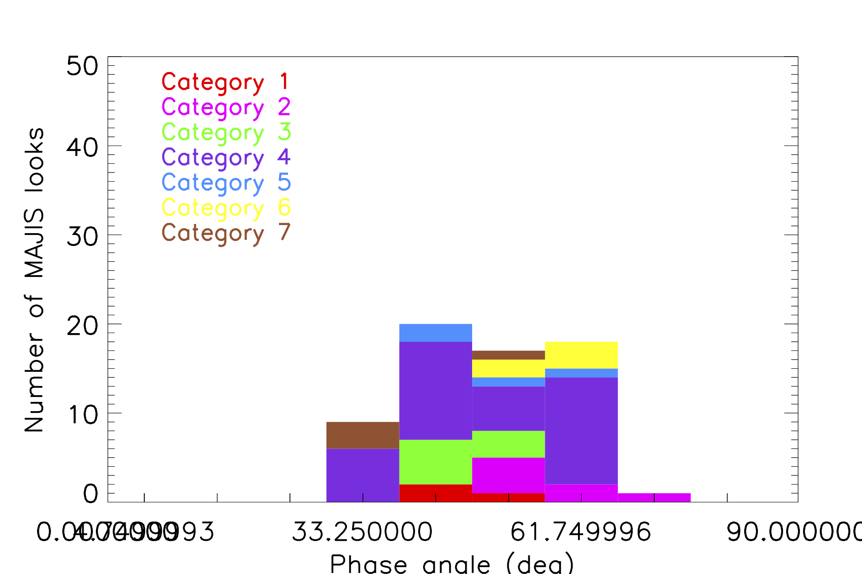
Phase angle distribution in GEO+GCO5000

Slide 14
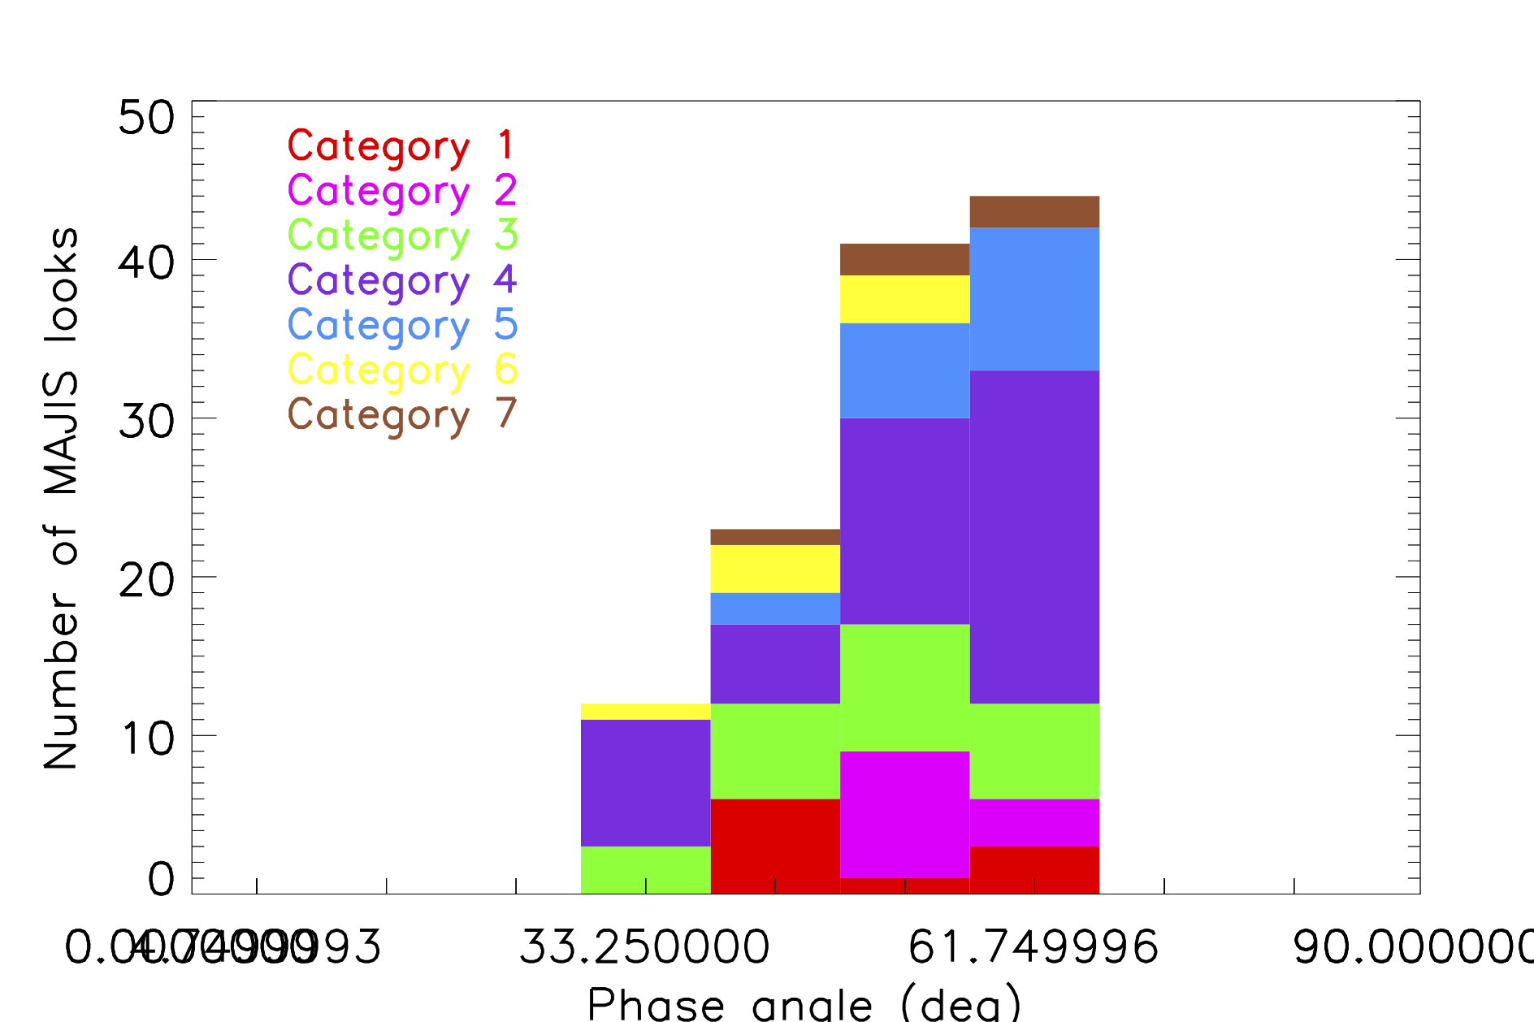
Phase angle distribution in GCO500

Slide 15
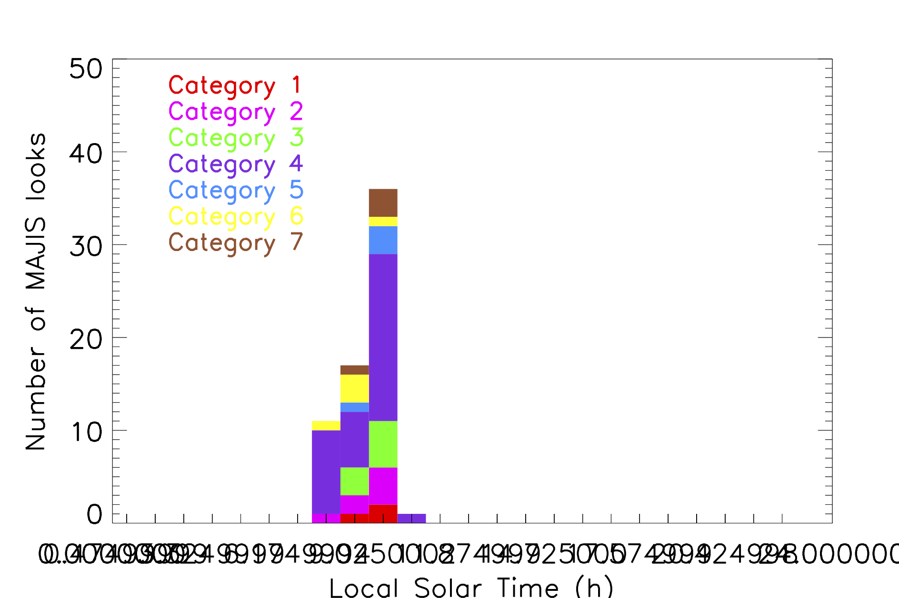
LST distribution in GEO+GCO5000

Slide 16
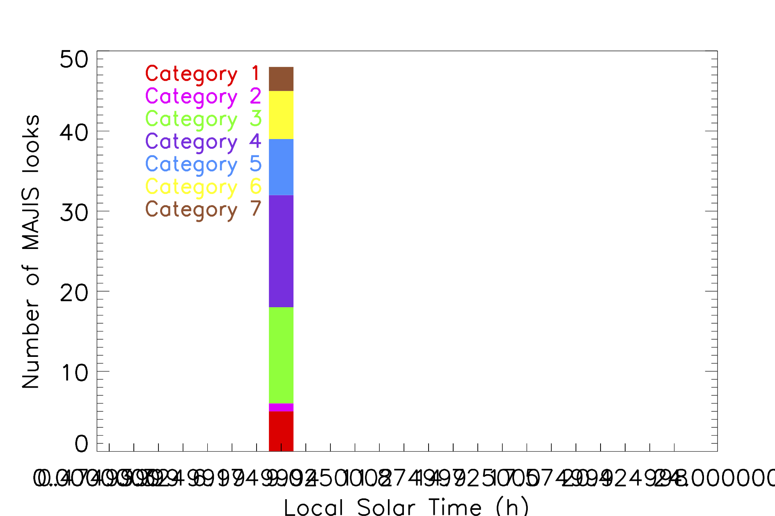
LST Distribution in GCO500

