Slide 1
EM-IR Performances summary
MAJIS-IR FPA
Paolo Haffoud, Y. Langevin, F. Poulet & MAJIS team

Slide 2
EM-IR Characterization objectives
Prepare and test IAS microcodes with SAM and PE
Prepare and test the BIRD setup (H/W and S/W)
Prepare the FM/FS characterization campaign
Clarify FPA Temperature estimation
Evaluate FPA performances and comparison with TIS measurements:
Dark Current characterization
Noise characterization

Slide 3
EM-IR Characterization objectives
Prepare and test IAS microcodes with SAM and PE
Prepare and test the BIRD setup (H/W and S/W)
Prepare the FM/FS characterization campaign
Clarify FPA Temperature estimation
Evaluate FPA performances and comparison with TIS measurements:
Dark Current characterization
Noise characterization

Slide 4
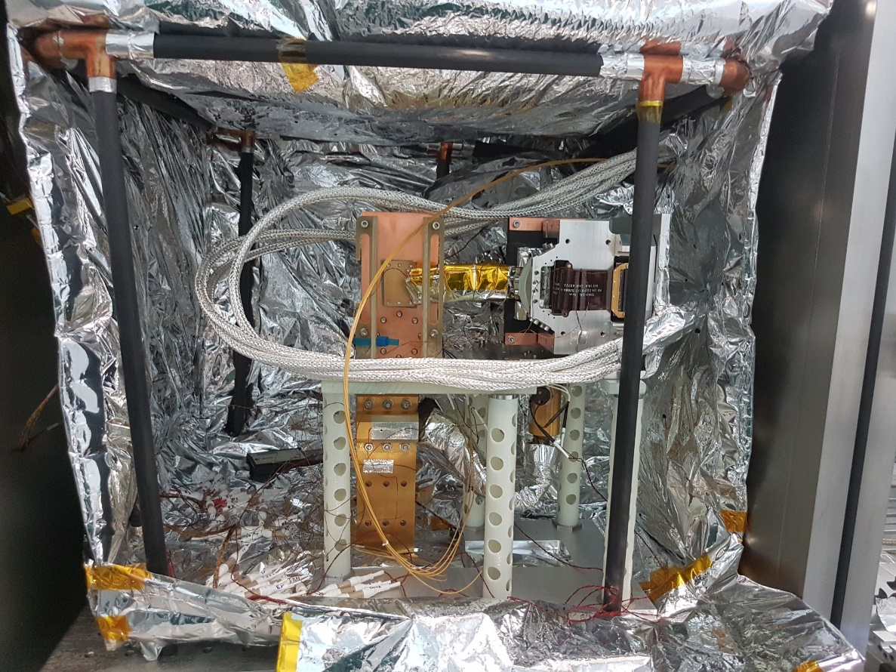
Setup used
FPU
IR emitter
Pump
Monochromator
Vaccum Tank

Slide 5
Summary of series available for performance analysis
 | FPA Temperatures (K) | FPE Temperatures (K) | N° Series (512x1024 – 16 CDS images)
Slow 100kHz | 84 | 141 | 4
 | 88 | 141 | 2
 | 89 | 140-145 | 11
 | 90 | 140 | 2
 | 91 | 140 | 2
 | 94 | 141 | 2
 | 98 | 142 | 2
Slow 1MHz | 84 | 141 | 6
 | 88 | 141 | 2
 | 89 | 140-154 | 22
 | 90 | 155 | 2
Slow 100kHz | 72 | 120 | 2
Slow 1MHz | 72 | 120 | 2

Slide 6
FPA Temperature
Two FPA temperature sensors available:
Cernox sensor, directly on the FPA (Not nominal, 11K inaccuracy reported by Teledyne at room temperature)
PT100 calibrated and nominal, on the external face of the FPU (do not provide the temperature of the FPA)

Slide 7
Basepoint for temperature estimation
The 68K FPA temperature setpoint subtraction eliminates any residual straylight.
Comparison with TIS measurements: the 86K setpoint leads to a 90K FPA temperature.

Slide 8
Basepoint for temperature estimation
Actual FPA T° (K) | Setpoint (K) | Cernox (K) | PT100 (K)
90 | 86 | 101.08 | 88.63

Slide 9
PT100 Error
Because the PT100 is on the FPU, its response to temperature changes is delayed.
The Cernox error is assumed to be negligible.
From measurements the precision of the PT100 is: $+0.9K$/$−0.1K$

Slide 10
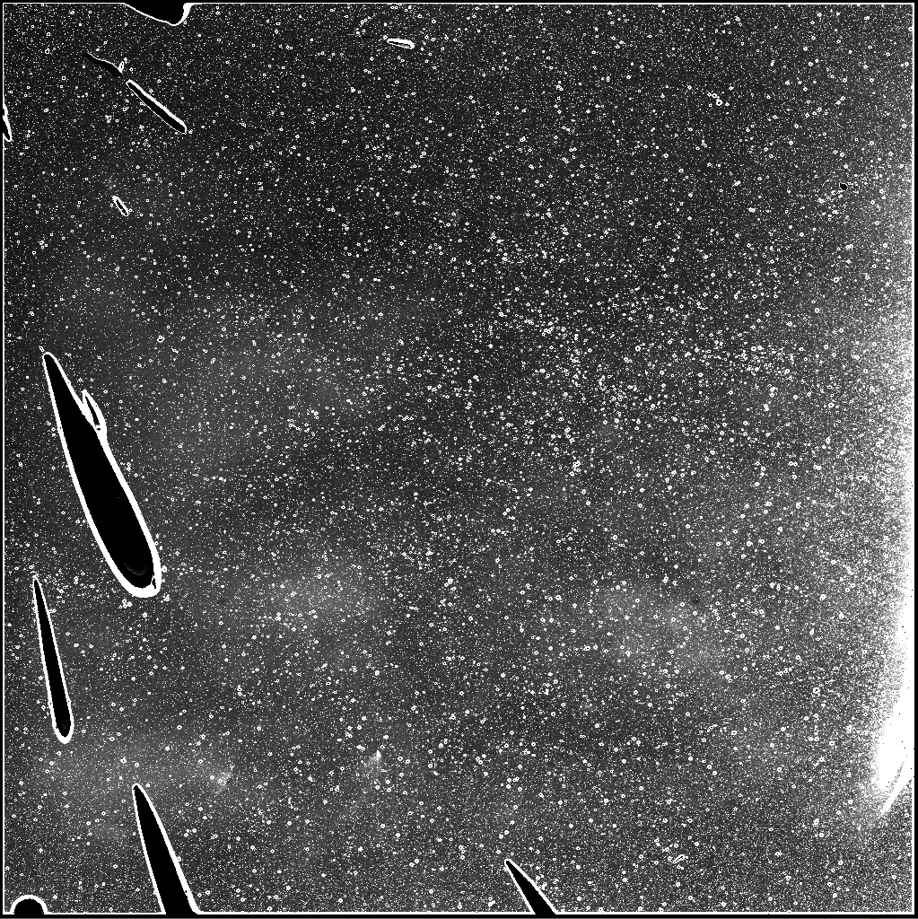
FPA Image at 90K
Top Half
Bottom Half

Slide 11
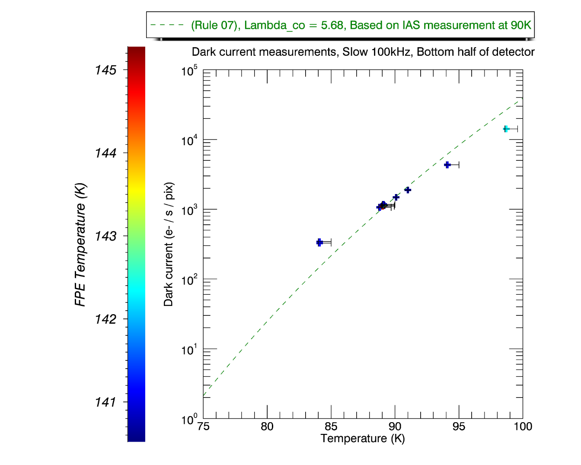
EM Dark Current Slow 100kHz

Slide 12
EM Dark Current Slow 1MHz

Slide 13
FPA Noise model
For any given pixel, the noise model is :
$$σ_{noise}=\sqrt{R^{2}+S}$$
where R is the read-out noise, S is the signal measured on the pixel due to the dark current and the incoming photon-flux.

Slide 14
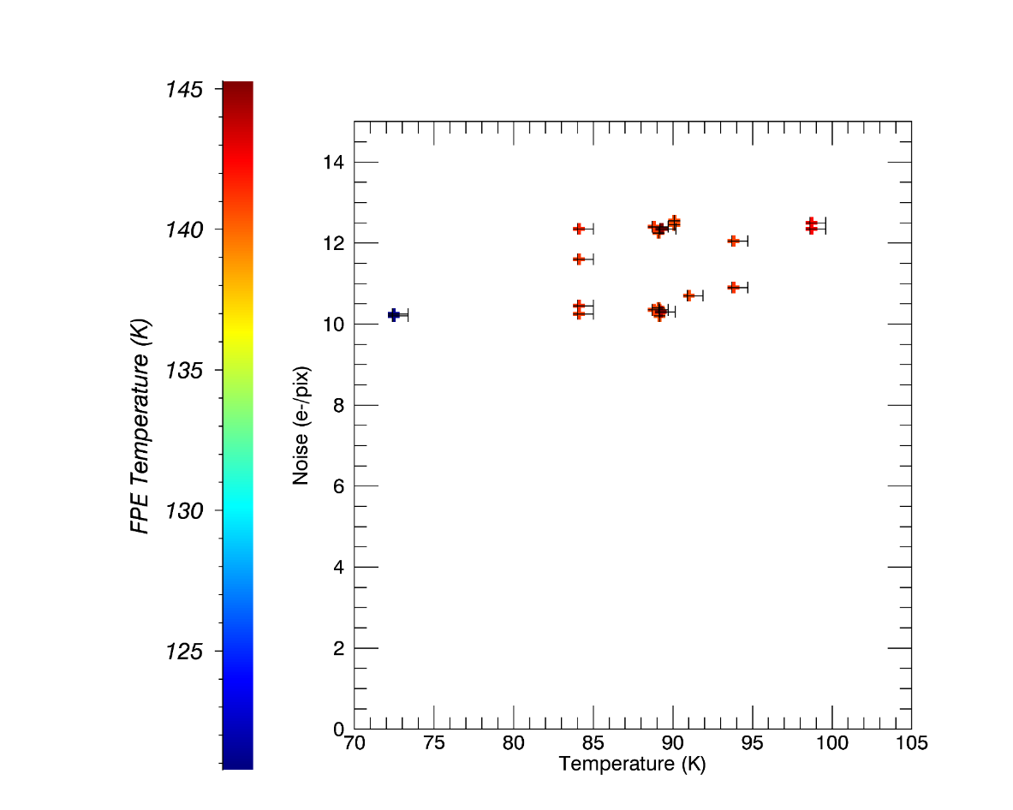
EM Read-out Noise Slow 100kHz – REFERENCE PIXELS
Connected pixels
CDR Expectations

Slide 15
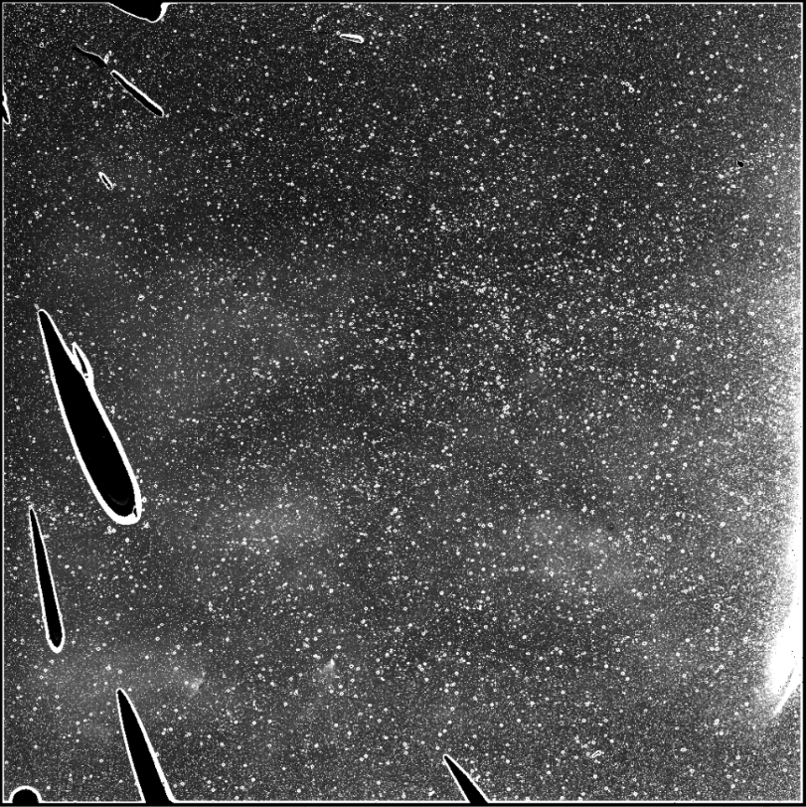
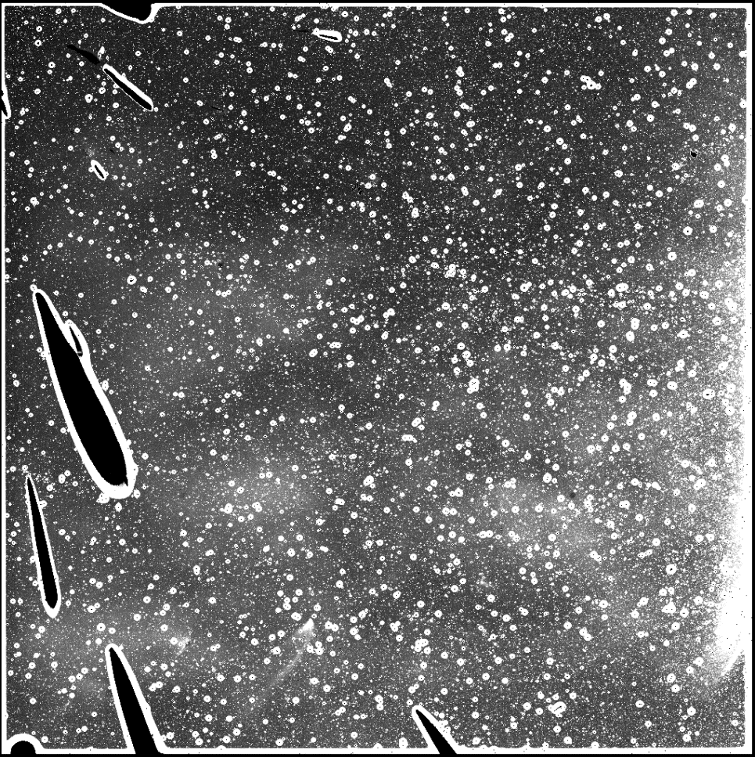
Operability 90K vs 98K
Operability decreases with increasing temperature
Quantitative analysis required to accurately estimate the decrease in operability
90K
98K

Slide 16
Conclusions and Lessons Learned
Very difficult to eliminate all the straylight but subtraction of residual signal (<300 e-) at low temperature makes possible to evaluate the performances of FPA @ operating larger temperatures
Dark does not follow perfectly the rule of 07
Dark does not increase with increasing FPE T°
Noise model well understood
Operability decreases with increasing T°
Operations:
Provide thermal constraints (FPE T°)
Provide time overhead
Fine-tune the acquisitions

