Slide 1
MAJIS data flow

Slide 2
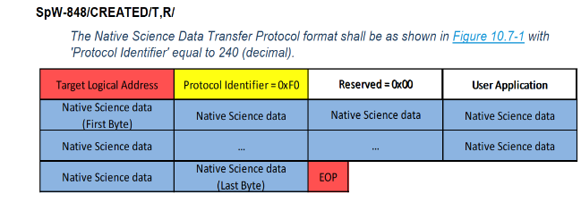
MAJIS DATA FLOW
FPU (FPE) | PE | CU/DPU/ME | CPCU/DPU/ME
Detector Frame | PE frame | CU frame | NSDP
Spatial windowing Spatial undersampling (x2, x4) Spectral undersampling (x2) | Spatial binning (x2) Spectral binning(x2)/Spectral oversampling CDS subtraction/Reference line pixel correction/Dark subtraction Despiking (see YL presentation) | Frame averaging of PE-frames into a single CU-frame Spectral editing, binning (x2x4) Spatial binning (x2x4) Browse formatting NSDP formatting: bit-packing or 3D compression | Frame acquisition TM Send Native Science Data Packet to SSMM Each logical address defined the directory in the SSMM file
Nominal size: 800x1024 Full Frame (calibration) : 1024 x 1024 | PE Frame nominal size: 400 pixels x 508 to 640 spectels PE Full Frame (calibration) : 1024 x 1024 | CU frame: data element which is compressed and formatted for downlink by the CU Spectral size: 127, 254, 508 Spatial size: 100, 200, 400 | Compressed data Segmented into consecutive NSDP
1024
400
800
4 reference pixels
4
508 to 640 max
640 when « oversampling »
on some of the 8 (max) PE bands
1
Variable size depending on spectral and spatial binning/editing
1024

Slide 3
MAJIS DATA FLOW
FPU (FPE) | PE | CU/DPU/ME | CPCU/DPU/ME
Detector Frame | PE frame | CU frame | NSDP
Spatial windowing Spatial undersampling (x2, x4) Spectral undersampling (x2) | Spatial binning (x2) Spectral binning(x2)/Spectral oversampling CDS subtraction/Reference line pixel correction/Dark subtraction Despiking (see YL presentation) | Frame averaging of PE-frames into a single CU-frame Spectral editing, binning (x2x4) Spatial binning (x2x4) Browse formatting NSDP formatting: bit-packing or 3D compression | Frame acquisition TM Send Native Science Data Packet to SSMM Each logical address defined the directory in the SSMM file
Nominal size: 800x1024 Full Frame (calibration) : 1024 x 1024 | PE Frame nominal size: 400 pixels x 508 to 640 spectels PE Full Frame (calibration) : 1024 x 1024 | CU frame: data element which is compressed and formatted for downlink by the CU Spectral size: 127, 254, 508 Spatial size: 100, 200, 400 | Compressed data Segmented into consecutive NSDP
1024
400
800
4 reference pixels
4
508 to 640 max
640 when « oversampling »
on some of the 8 (max) PE bands
1
Variable size depending on spectral and spatial binning/editing
1024

Slide 4
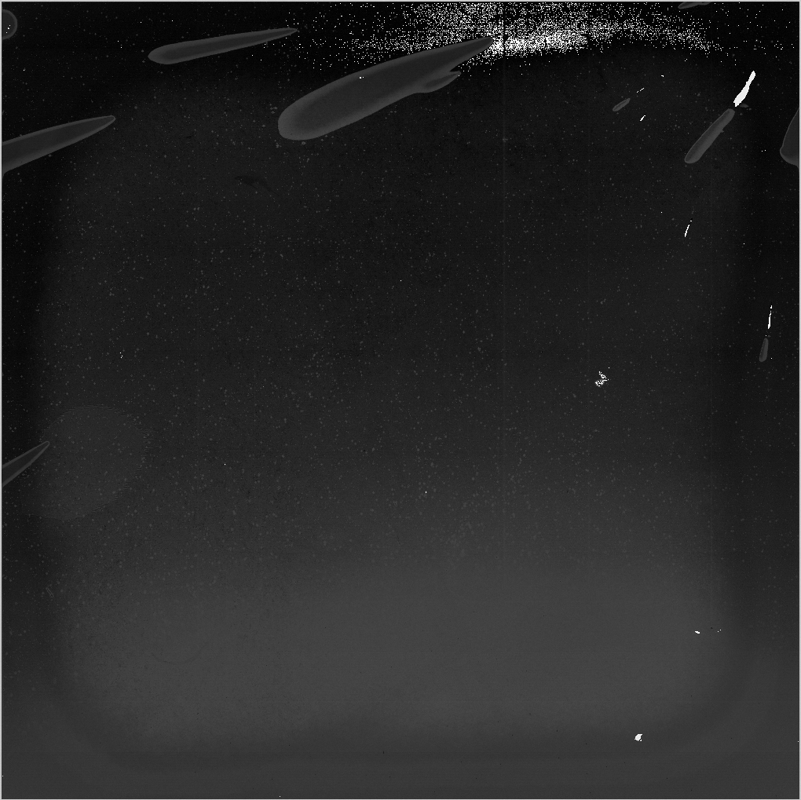
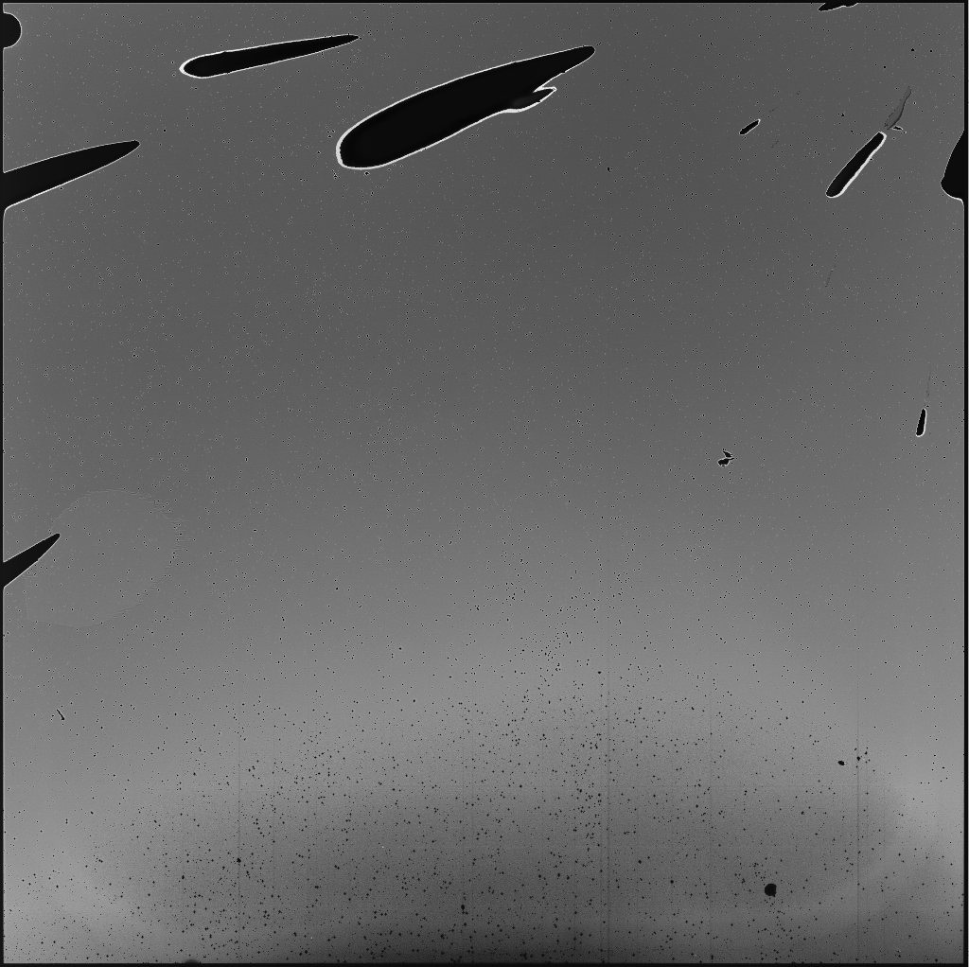
CDS correction
Single frames:
H1RG_R01_M01_N01.fits
H1RG_R01_M01_N02.fits
H1RG_R02_M01_N01.fits
H1RG_R02_M01_N02.fits
H1RG_R03_M01_N01.fits
H1RG_R03_M01_N02.fits
…
CDS images:
CDS_1 = H1RG_R01_M01_N02.fits - H1RG_R01_M01_N01.fits
CDS_2 = H1RG_R02_M01_N02.fits - H1RG_R02_M01_N01.fits
CDS_3 = H1RG_R03_M01_N02.fits - H1RG_R03_M01_N01.fits
…

Slide 5
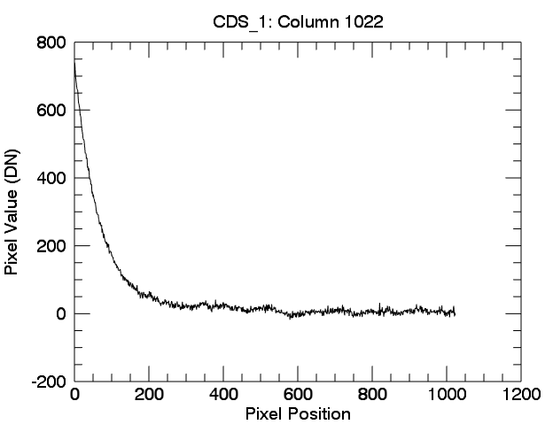
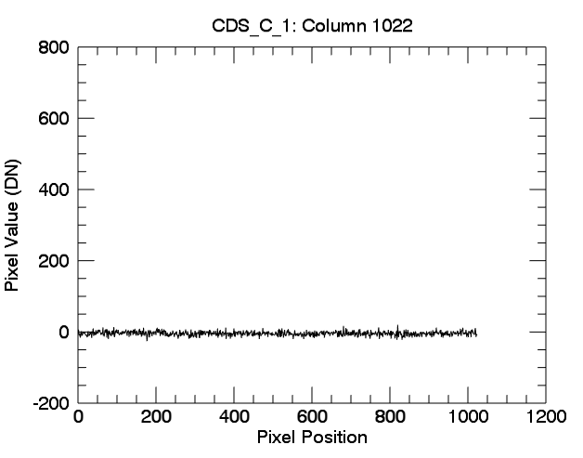
Line Correction
On CDS images, a reset perturbation can be seen along reference columns. This reset perturbation is highly visible on reference pixels but is actually present on the entire CDS image.
The objective of the line correction processing is to compensate the perturbation on the entire image. Therefore, this post-processing leads to a reference signal centered around 0.

Slide 6
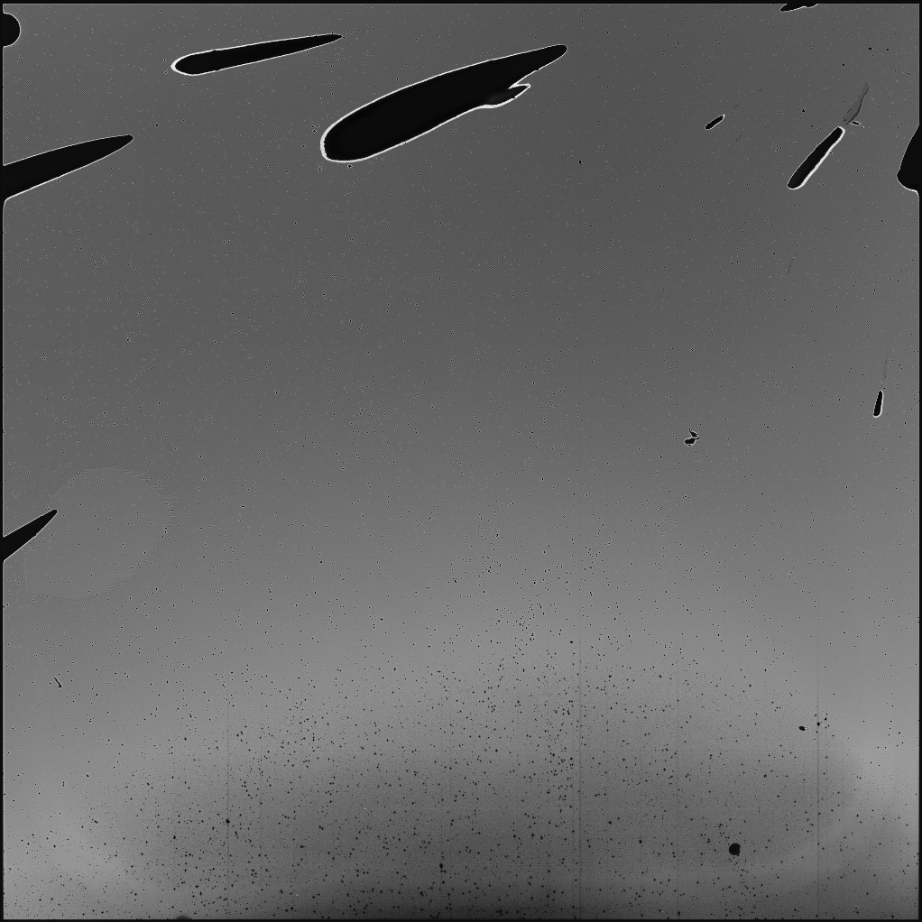
CDS & Line correction
Single frames:
H1RG_R01_M01_N01.fits
H1RG_R01_M01_N02.fits
H1RG_R02_M01_N01.fits
H1RG_R02_M01_N02.fits
H1RG_R03_M01_N01.fits
H1RG_R03_M01_N02.fits
…
CDS images:
CDS_1 = H1RG_R01_M01_N02.fits - H1RG_R01_M01_N01.fits
CDS_2 = H1RG_R02_M01_N02.fits - H1RG_R02_M01_N01.fits
CDS_3 = H1RG_R03_M01_N02.fits - H1RG_R03_M01_N01.fits
…
Line-corrected CDS images:
CDS_C_1 = CORRECT(CDS_1)
CDS_C_2 = CORRECT(CDS_3)
CDS_C_3 = CORRECT(CDS_3)
…

Slide 7
MAJIS DATA FLOW
FPU (FPE) | PE | CU/DPU/ME | CPCU/DPU/ME
Detector Frame | PE frame | CU frame | NSDP
Spatial windowing Spatial undersampling (x2, x4) Spectral undersampling (x2) | Spatial binning (x2) Spectral binning(x2)/Spectral oversampling CDS subtraction/Reference line pixel correction/Dark subtraction Despiking (see YL presentation) | Frame averaging of PE-frames into a single CU-frame Spectral editing, binning (x2x4) Spatial binning (x2x4) Browse formatting NSDP formatting: bit-packing or 3D compression | Frame acquisition TM Send Native Science Data Packet to SSMM Each logical address defined the directory in the SSMM file
Nominal size: 800x1024 Full Frame (calibration) : 1024 x 1024 | PE Frame nominal size: 400 pixels x 508 to 640 spectels PE Full Frame (calibration) : 1024 x 1024 | CU frame: data element which is compressed and formatted for downlink Spectral size: 127, 254, 508, 640 Spatial size: 100, 200, 400 | Compressed data Segmented into consecutive NSDP
1024
400
800
4 reference pixels
4
508 to 640 max
640 when « oversampling »
on some of the 8 (max) PE bands
1
Variable size depending on spectral and spatial binning/editing
1024

Slide 8
MAJIS DATA FLOW
FPU (FPE) | PE | CU/DPU/ME | CPCU/DPU/ME
Detector Frame | PE frame | CU frame | NSDP
Spatial windowing Spatial undersampling (x2, x4) Spectral undersampling (x2) | Spatial binning (x2) Spectral binning(x2)/Spectral oversampling CDS subtraction/Reference line pixel correction/Dark subtraction Despiking (see YL presentation) | Frame averaging of PE-frames into a single CU-frame Spectral editing, binning (x2x4) Spatial binning (x2x4) Browse formatting NSDP formatting: bit-packing or 3D compression | Frame acquisition TM Send Native Science Data Packet to SSMM Each logical address defined the directory in the SSMM file
Nominal size: 800x1024 Full Frame (calibration) : 1024 x 1024 | PE Frame nominal size: 400 pixels x 508 to 640 spectels PE Full Frame (calibration) : 1024 x 1024 | CU frame: data element which is compressed and formatted for downlink Spectral size: 127, 254, 508, 640 Spatial size: 100, 200, 400 | Compressed data Segmented into consecutive NSDP
508 to 640 max
640 when « oversampling »
on some of the 8 (max) PE bands
Variable size depending on spectral and spatial binning/editing

