Slide 1
New Management scheme

Slide 3
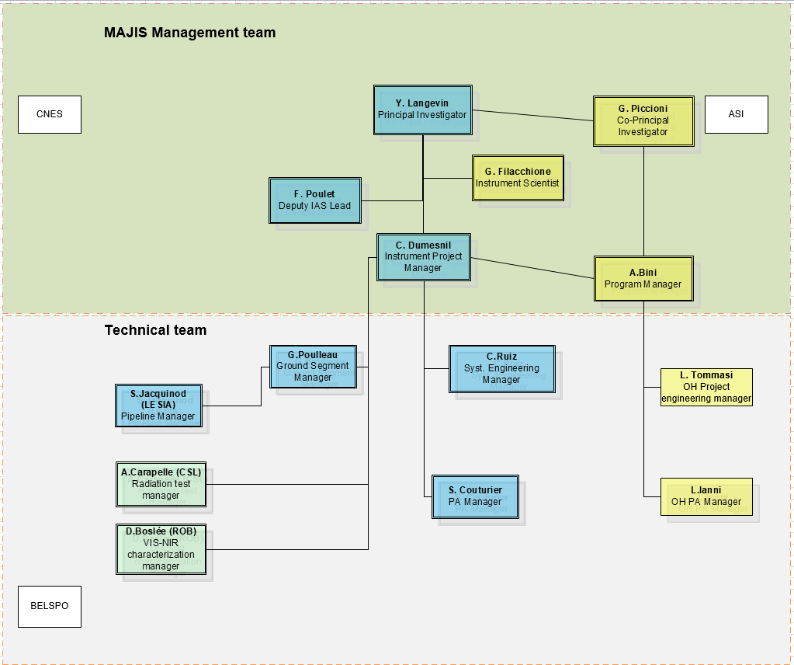

Slide 4
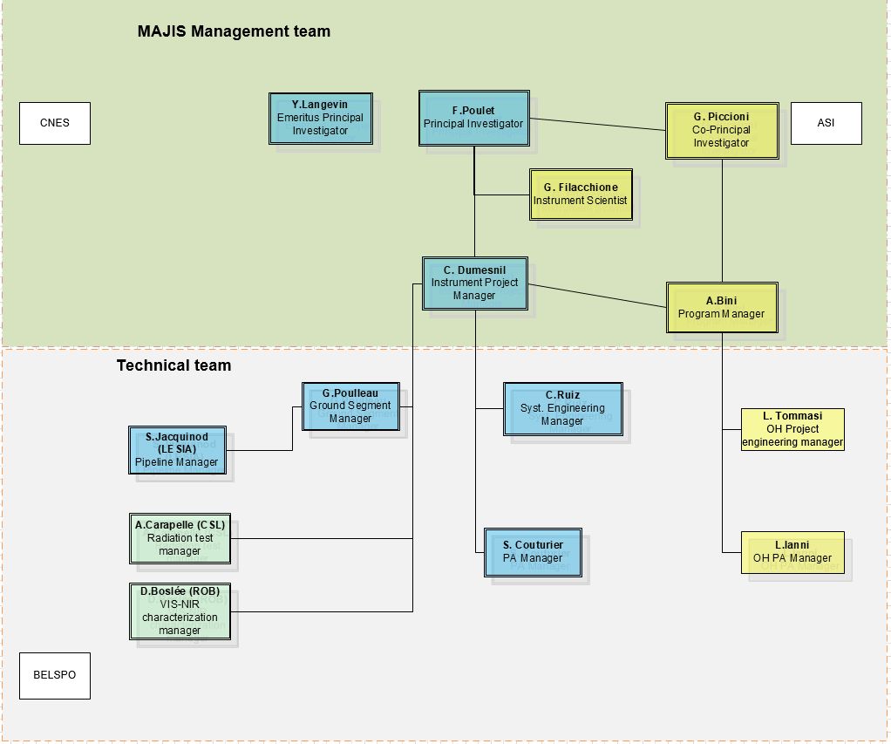
Validated by ESA (beginning of September)

Slide 5
Duties of PI Emeritus
Principal Investigator “Emeritus”, responsibilities
As the former PI, the PI emeritus supports the PI by providing information on the science rationale for the decisions which led to the MAJIS instrument design at ICDR, so as to provide continuity after ICDR in terms of science / technical trade-offs.
Similarly to the co-PI, the PI emeritus can represent the PI for instrument and project activities after the ICDR
Within the MAJIS management team, the PI emeritus is the contact point for technical issues of specific interest: software development and on-board data compression (in coordination with the software architect) and detector development (in particular microcode development).

Slide 6
Major contributions of Yves
Consolidation of the MAJIS consortium after the selection

Slide 7
Major contributions of Yves
Consolidation of the MAJIS consortium after the selection
Consolidation of the radiometric modeling and implementation of despiking approach

Slide 8
Major contributions of Yves
Consolidation of the MAJIS consortium after the selection
Consolidation of the radiometric modeling and implementation of despiking approach
Overcome of the death of Pascal Eng

Slide 9
Major contributions of Yves
Consolidation of the MAJIS consortium after the selection
Consolidation of the radiometric modeling and implementation of despiking approach
Overcome of the death of Pascal Eng
Development of the microcode (Yves is now a contender of Markus… His next car could be a Porsche !)

Slide 10
Major contributions of Yves
Consolidation of the MAJIS consortium after the selection
Consolidation of the radiometric modeling and implementation of despiking approach
Overcome of the death of Pascal Eng
Development of the microcode (Yves is now a contender of Markus… His next car could be a Porsche !)
Development of the on-board software and data compression

Slide 11
Major contributions of Yves
Consolidation of the MAJIS consortium after the selection
Consolidation of the radiometric modeling and implementation of despiking approach
Overcome of the death of Pascal Eng
Development of the microcode (Yves is now a contender of Markus… His next car could be a Porsche !)
Development of the on-board software and data compression
Validation of the FPA performances

Slide 12
Major contributions of Yves
Consolidation of the MAJIS consortium after the selection
Consolidation of the radiometric modeling and implementation of despiking approach
Overcome of the death of Pascal Eng
Development of the microcode (Yves is now a contender of Markus… His next car could be a Porsche !)
Development of the on-board software and data compression
Validation of the FPA performances
Patient discussions with TIS… (famous sentence: “when TIS says black, it is likely white !”)

Slide 13
Major contributions of Yves
Consolidation of the MAJIS consortium after the selection
Consolidation of the radiometric modeling and implementation of despiking approach
Overcome of the death of Pascal Eng
Development of the microcode (Yves is now a contender of Markus… His next car could be a Porsche !)
Development of the on-board software and data compression
Validation of the FPA performances
Patient discussions with TIS… (famous sentence: “when TIS says black, it is likely white !”)
Support the JUICE project for the mission analysis

Slide 14
Major contributions of Yves
Consolidation of the MAJIS consortium after the selection
Consolidation of the radiometric modeling and implementation of despiking approach
Overcome of the death of Pascal Eng
Development of the microcode (Yves is now a contender of Markus… His next car could be a Porsche !)
Development of the on-board software and data compression
Validation of the FPA performances
Patient discussions with TIS… (famous sentence: “when TIS says black, it is likely white !”)
Support the JUICE project for the mission analysis
The only one to calculate (in his head !) the number of DN/sec in one MAJIS pixel from a given position of JUICE (and vice versa)… A kind of Sudoku !
…

Slide 15
Yves, huge thanks for your personal effort !
The MAJIS project always counts on your unfailing support until the launch (and after) !

