Slide 1
Laboratory measurements to investigate O₂ on Ganymede’s surface
Migliorini A.¹, Kanuchova Z.^{2,3}, Jones N.C.⁴, Ioppolo S.⁵, Strazzulla G.³, Piccioni G.¹, Tosi F.¹
¹IAPS-INAF, Rome, Italy
²Astronomical Institute of SAS, Slovakia
³Osservatorio Astrofisico di Catania, INAF, Catania, Italy
⁴ Aarhus University, Denmark
⁵ Queen Mary University of London

Slide 2
Scientific rationale
O₂ strong feature at 577.3 nm and a weaker one at 627.5 nm were detected in the Ganymede’s trailing surface (Spencer et al. 1995), but no evidence of the same bands in its leading face.
Europa’ and Callisto’ spectra present the same features, less intense than in the case of Ganymede (Spencer and Calvin, 2002).
Ground-based observations of the Galilean satellites were performed at TNG (HARPS-N) and at the Asiago telescope (1.8m-telescope).
Laboratory measurements confirmed the nature of these bands, possibly due to a double electronic transition in adjacent O₂.
We performed new laboratory measurements to better constraint the nature of the observed bands.
This study is in support and in preparation to the future MAJIS/JUICE observations.

Slide 3
Band depth is on the order of 1.8% for Ganymede, 0.30% for the average Europa spectrum and 0.33% in the single Callisto spectrum.
Spencer and Calvin, 2002

Slide 4
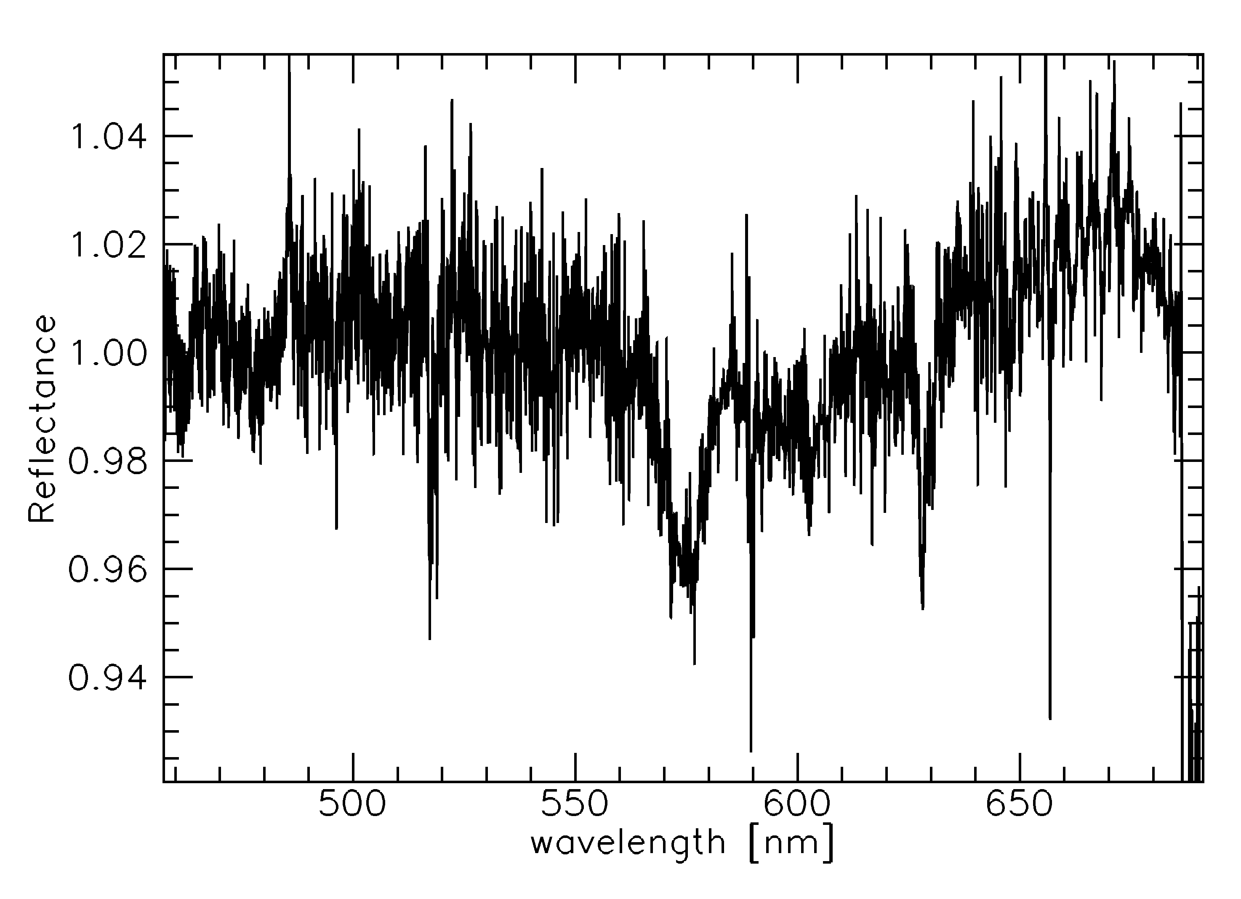
Ganymede spectrum with HARPS-N
Ganymede observed with TNG/HARPS on 5 January 2014 during its transit on Jupiter

Slide 5
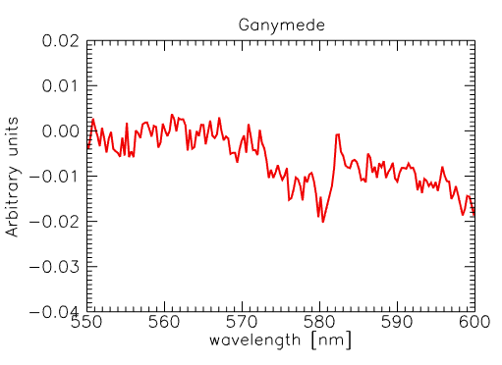
Ganymede spectrum at Asiago
578 nm
Date | Object | # spectra
30-Oct-2014 | Io - LF | 98
 | Ganymede - LF | 100
 | Callisto - LF | 87
02-Nov-2014 | Europa - LF | 99
 | Callisto - LF | 95
12-Dec-2014 | Callisto - LF | 86
 | Europa - LF | 34
12-Jan-2015 | Callisto - LF | 40

Slide 6
Facility at ISA
The AU-UV beam line is the first beam to become operational on the new 3rd generation light source ASTRID2 (Aarhus STorage RIng in Demmark) at ISA. It can accomodate a large variety of endstation experimental setups.
The one used in the present investigation is provided by The Open University.
Technique: low energy electron bombardment and annealing effects on samples in vacuum
Data were acquired during two runs in the framework of the ISA programs 2018 and 2019.
We prepared O₂, O₂:H₂O, O₂:CO₂, O₂:NH₃, O₂:N₂ slabs to investigate the behaviour of O₂ after bombardment and annealing. We monitored the O₂-O₂ bond bands at 577.3 nm and 627.5 nm.

Slide 7
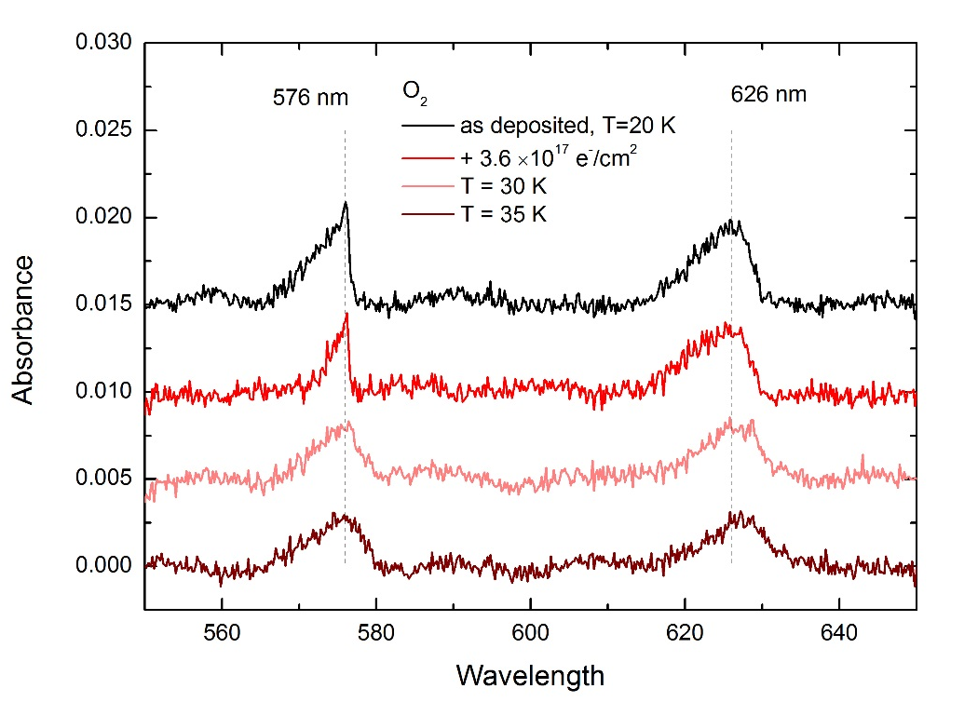
Results 1/3
The position of the 1-0 band deposited at 20K doesn't change when heating to 30K and 35 K. The position of the 0-0 band is slightly shifted to longer wavelengths when heated.

Slide 8
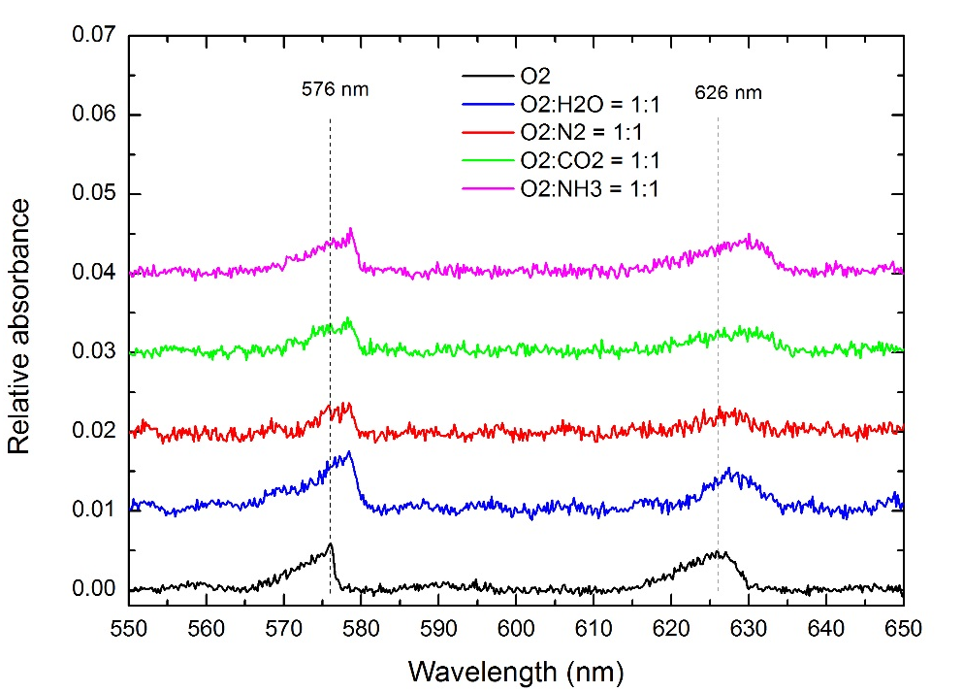
Results 2/3
The shift of band positions between pure oxygen and the mixture with H₂O deposited at 26 K was detected by Vidal et al. (1997). The same shift is observed in the other mixtures with CO₂, N₂ and NH₃. The shift of band positions may be related to a different environment causing different photon excitations during optical absorption (N. J. Sack and R. A. Baragiola, 1993, Phys. Rev. B 48, 9973; in Vidal et al. 1997).

Slide 9
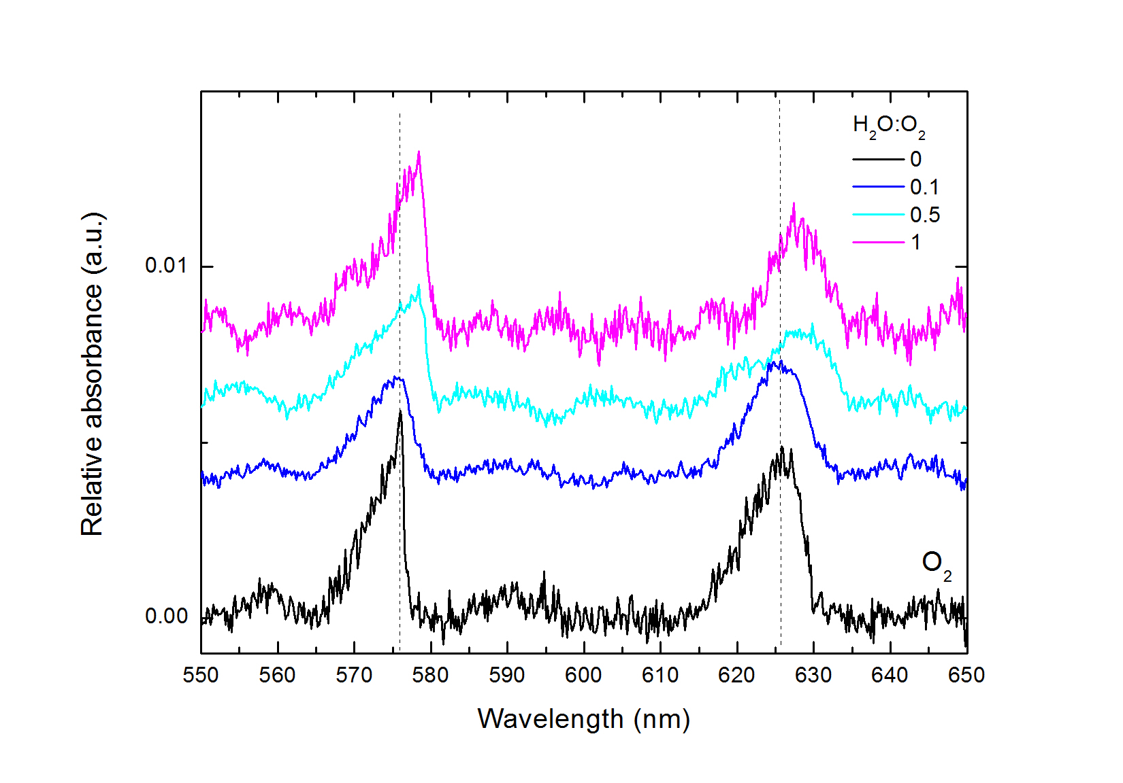
Results 3/3
The shift is visible when the ratio of water to oxygen is 1:2, but it is no longer visible in case of water amount 10 times less than oxygen (0.1). The shape of both bands is still affected.
Mixtures of CO₂:O₂ and N₂:O₂ in different proportions as well as H₂O:O₂:N₂ (1:1:1) have been also investigated.

Slide 10
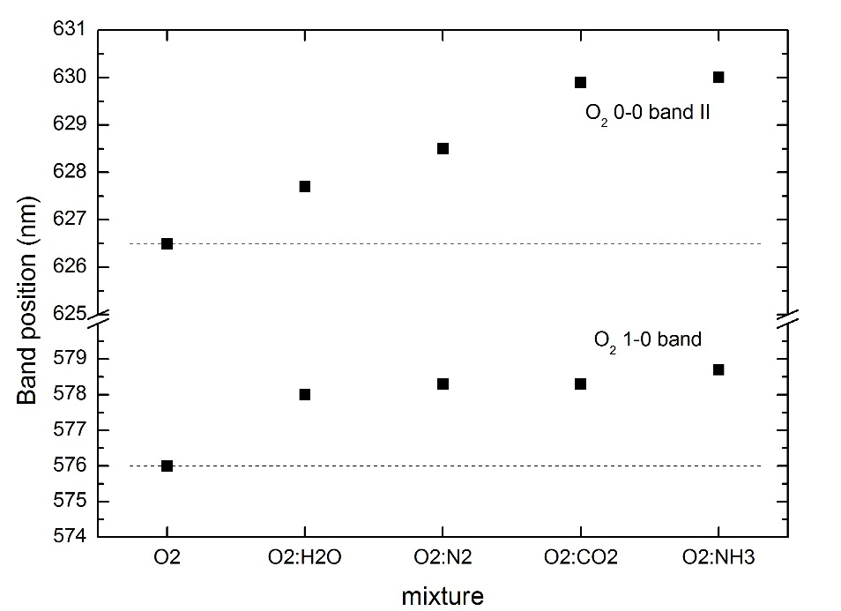
Results 4/4
HARPS-N
1.8m-Asiago
*
*

Slide 11
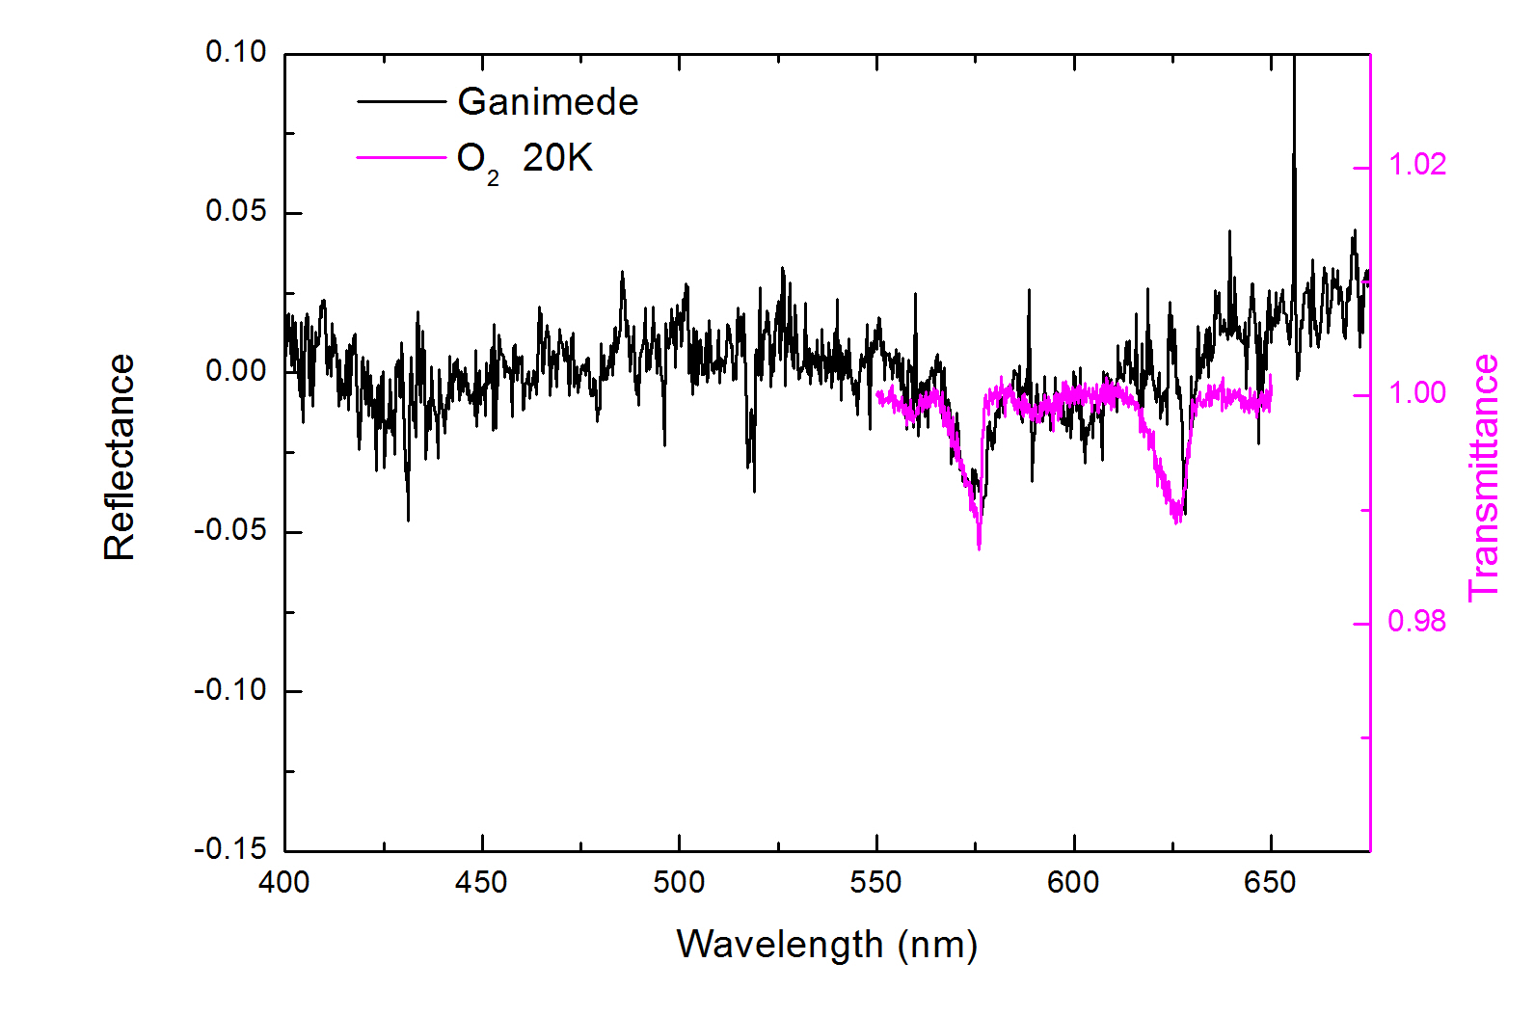
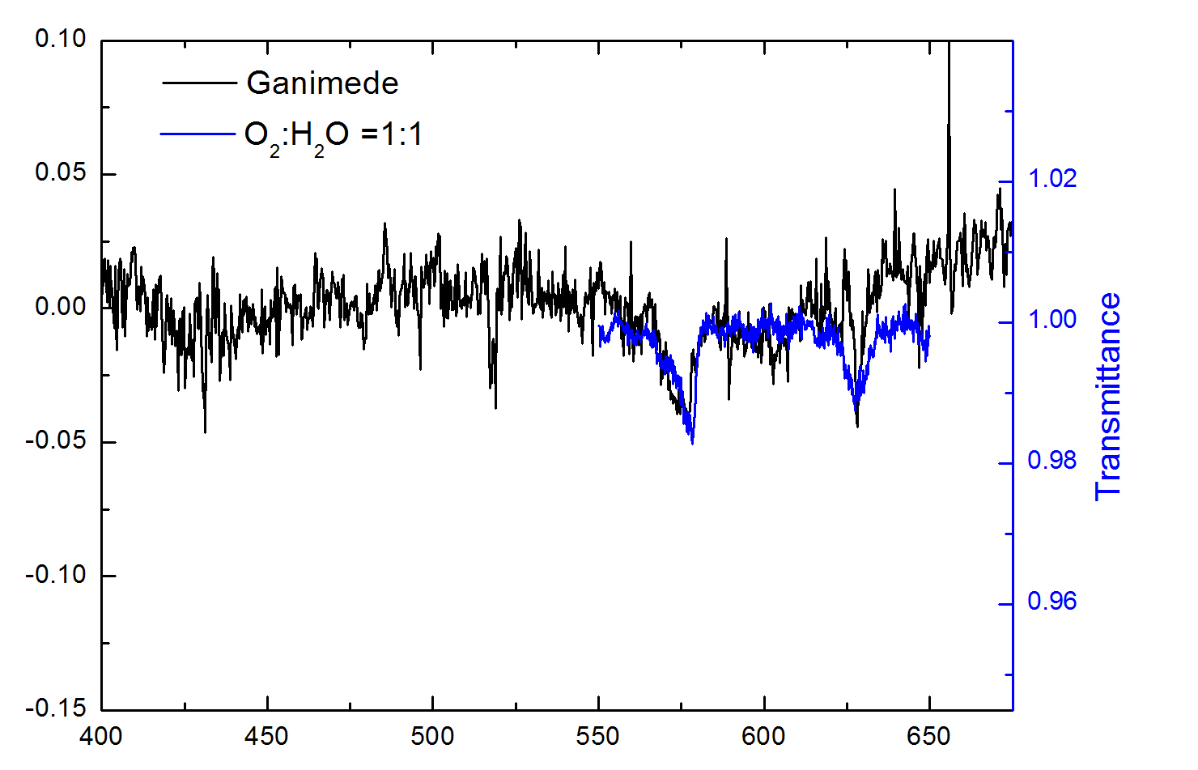
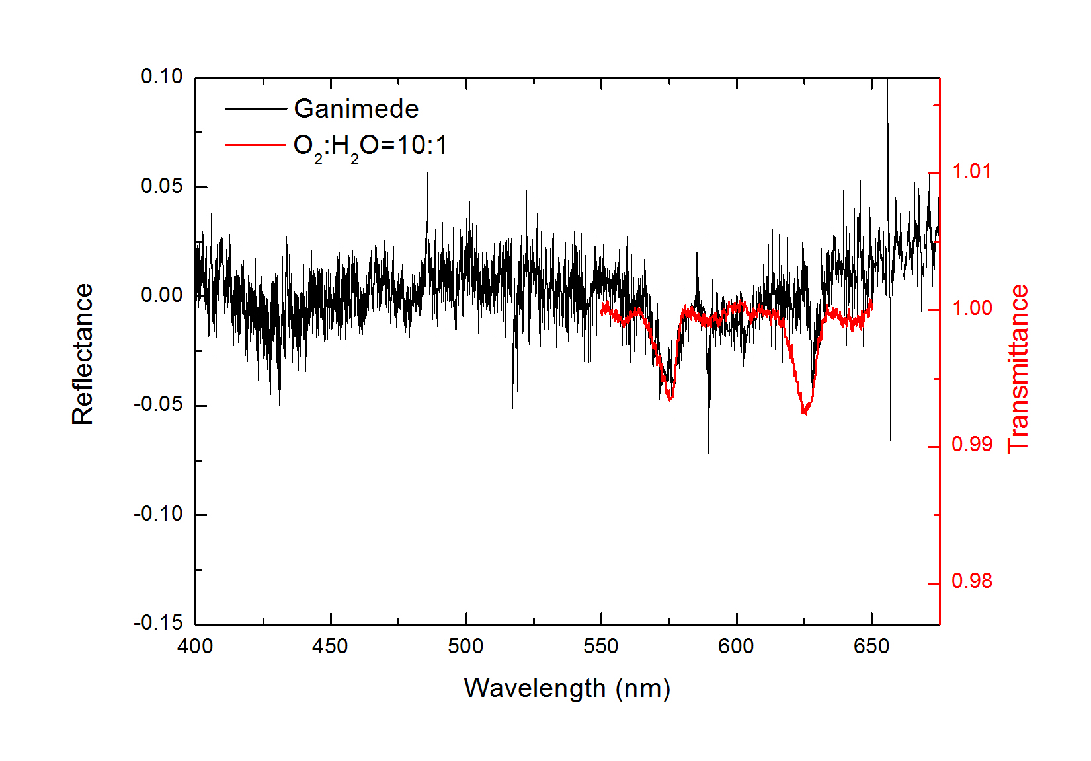
Comparison gb-lab
Mixture O₂:H₂O = 10:1 seems to reproduce the observed band at 577.3 nm in the Ganymede’s data.

Slide 12
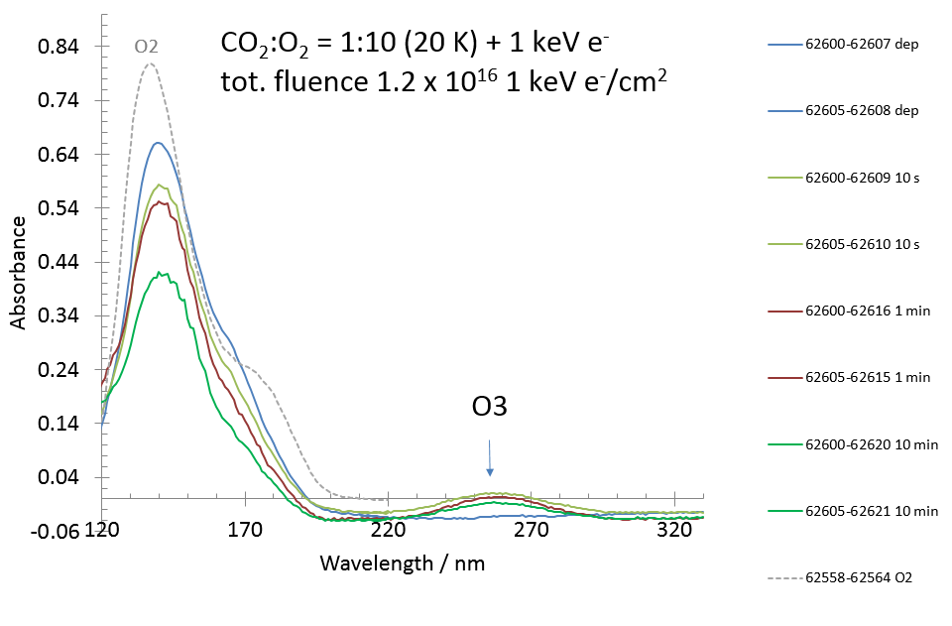
UV range 1/3
A different proportion of the two species to investigate the influence of CO₂ in the mixture.
Formation of CO and O₃ is observed

Slide 13
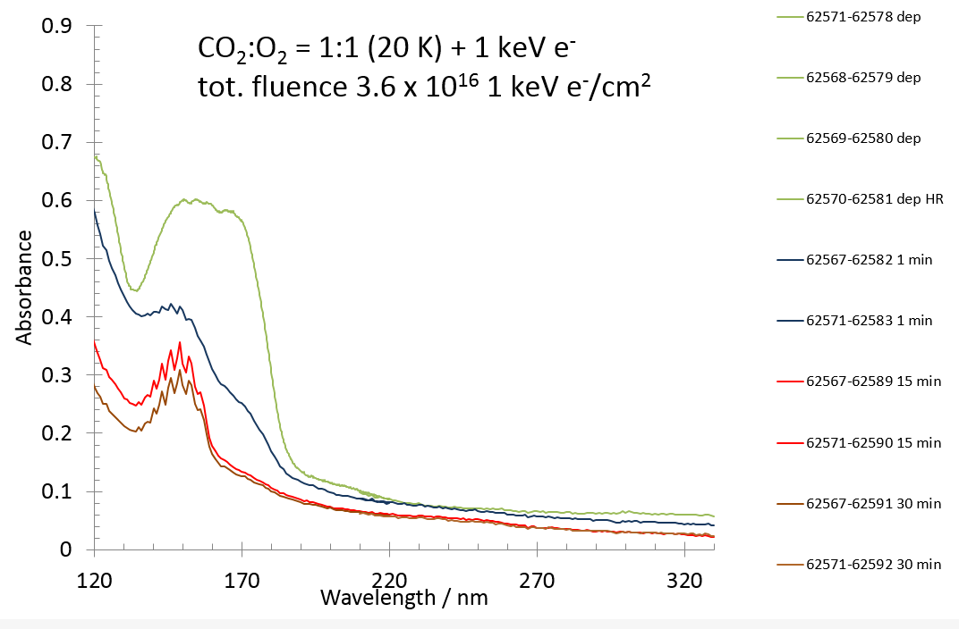
UV range 2/3
Measurements of the O₂ and its mixtures in the UV (110-330 nm) to extend the dataset.
Formation of CO is observed.

Slide 14
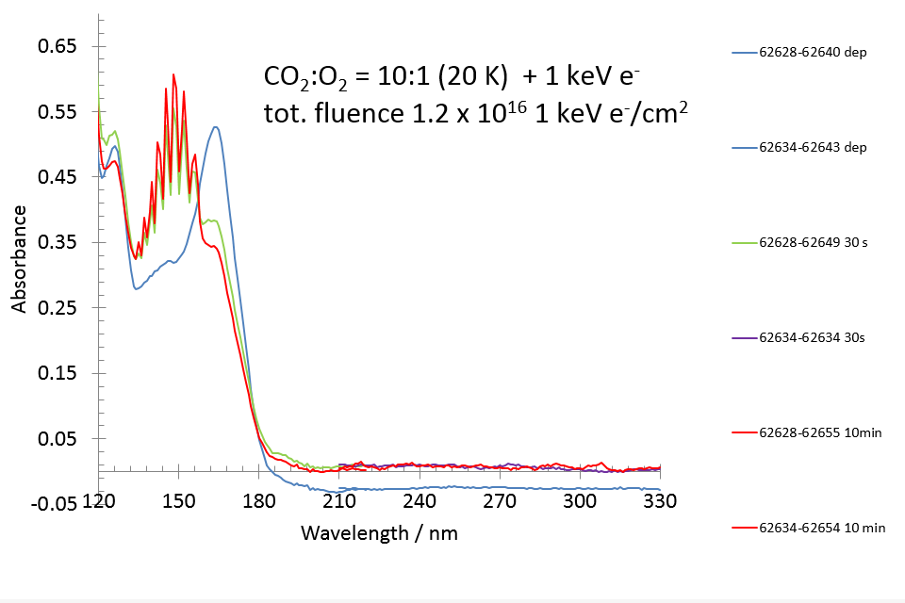
UV range 3/3
Measurements of the O₂ and its mixtures in the UV (110-330 nm) to extend the dataset. Formation of CO is observed.

Slide 15
Application and interest for JUICE
Although these bands are at the limit of noise with MAJIS (NESR of 0.031918 W m⁻²μm⁻¹sr⁻¹ and 0.019264 W m⁻²μm⁻¹sr⁻¹ calculated at b= 0.5764 μm and 0.6274 μm – from model by Tosi F.), they can be detected by averaging tens of spectra.
IR spectral range (4000-600 cm⁻¹) is also available, by using the facilities at The Open University.
Laboratory measurements of ices and mixtures at mid spectral resolution. Analogs of the Galilean satellites surfaces.
Database for interpreting the JUICE data

Slide 16
Summary
New laboratory measurements to investigate the properties of pure O₂ ice and mixtures in the visible and UV ranges. Band shifts are observed in mixtures.
Comparison with ground-based observations seem to favour the presence of a mixture rather than a pure O₂ ice layer
Build up a database for MAJIS data analysis
Future measurements in the UV-VIS are foreseen at ISA on other mixtures.

