Slide 1
Potential Observations of Jovian Rings with MAJIS

Slide 2
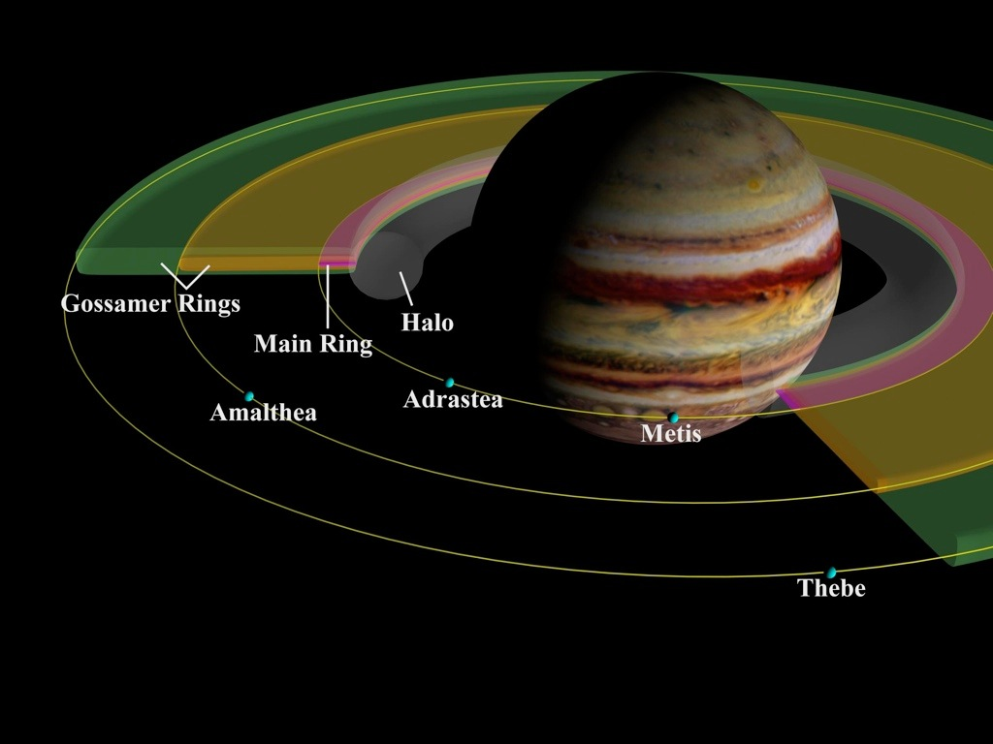
Scientific goals
See STM#2 for ring overview

Slide 3
Scientific goals
Composition of the jovian rings
Look for compositional variations between macroscopic bodies and dust component
Monitor phase curves of rings
Study 3-D structure and particle size distribution of the system
Composition of irregular satellite Amalthea
See STM#4 for rings overview

Slide 4
Ring observations by MAJIS: very challenging!
Low phase: I/F(main rings as viewed edge-on) ~ 10⁻⁷ -10⁻⁶ => <1e⁻/px/s
High phase: I/F(main rings) ~ 2.10⁻⁵ => ~10-20 e⁻/px/s
Surface brightness of optically thin rings brightens as 1/sin|B| (B elevation angle), since the particles appear to be packed more closely as seen from the observer’s perspective.
Operational constraints
100 kHz readout mode (lowest RON)
Acquisition at far distance (>8.10⁵ km at closest approach) to mitigate the spikes issue (<1 e- impacts/s) impacting the resolution (IFOV=120 km before binning)
Baseline: spatial binning x4 providing IFOV = 480 km, swath = 100 pixels, spectral binning (x4), Integration time (per line): ~10 s
Expected SNR ~10 (at best)

Slide 5
MAJIS observations listed for WG2 and level 0 analysis
A- Radial mosaic of the jovian rings at high phase
B- Radial and azimuthal structure of the main rings region at low elevation (~<0.5deg), high phase
C- Main ring observation at low phase
D- Monitor phase curves of main rings
E- Composition of inner satellite Amalthea (few pixels)
F- Star occultations

Slide 6
Estimate of DV
 | S/C pointing | Number of observations | Single cube DV (Mb) | Data Volume (Mb)
Objective A | Ring plane/ Horizontal orientation of slit | 12 | 2.55 | 30.5
Objective B | Ring plane/ Horizontal orientation of slit | 2 | 10.2 | 20.3
Objective C | Ring extremity/ Horizontal orientation of slit | 2 | 2.55 | 5.1
Objective D | Ring extremity/ Horizontal orientation of slit | N | 2.55 | Nx2.55 (N =number of phase angles)
Objective E | Amalthea | 2 | 0.4 Mb | 0.8 Mb
Objective F | Inertial pointing of the star from Callisto distance/ Star maintain in the slit | M | 0.041xL | Mx(0.041xL)

Slide 7
Observation opportunities
Low DV request
Opportunities studied by Nicolas and Claire (star occultation excluded) for level 0, case 4 segmentation plan
On-going iteration
Occultation observations need to be consolidated in the future (star atlas, signal, Tint, S/C inertial capabilities)
Occultations are challenging as star to be kept in the slit:
MAJIS Rq: 15,5 arcsec vs 16,6 arcsec (SC last pointing error budget for ACE)

