Slide 1
MAJIS Ground segment

Slide 2
Requirements (JUI-EST-SGS-RS-002)
Calibration (sub-system and instrument levels);
Analysis of observation opportunities;
Preparation of instrument’s timelines and commanding sequences;
Telemetry-to-raw data pipeline;
Raw-to-calibrated data pipeline;
Monitoring of instrument operations;
Maintenance and test the instruments On-Board software
Quick-look data analysis;
Data delivery to MAJIS team;
Data Archiving

Slide 3
Implementation
Calibration (sub-system and instrument levels);
Analysis of observation opportunities;
Preparation of instrument’s timelines and commanding sequences;
Telemetry-to-raw data pipeline;
Raw-to-calibrated data pipeline;
Monitoring of instrument operations;
Maintenance and test the instruments On-Board software
Quick-look data analysis;
Data delivery to MAJIS team;
Data Archiving
MAJIS SGS structure in 5 WPs:
Calibration
Planning
Commanding, Monitoring & calibrated data generation
Science Activity
Archiving

Slide 4
Implementation
Calibration (sub-system and instrument levels);
Analysis of observation opportunities;
Preparation of instrument’s timelines and commanding sequences;
Telemetry-to-raw data pipeline;
Raw-to-calibrated data pipeline;
Monitoring of instrument operations;
Maintenance and test the instruments On-Board software
Quick-look data analysis;
Data delivery to MAJIS team;
Data Archiving
JUICE SOC/SGS development in 2 steps:
SOC CORE SYSTEM [ready by launch]
Full SGS SYSTEM
[ready ~ 1 year before JOI]
MAJIS SGS development shall follow the same 2-step scheme

Slide 5
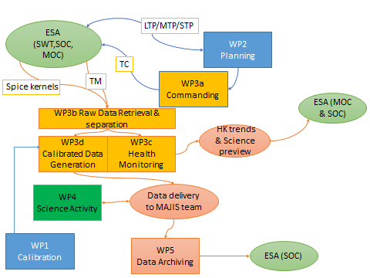
Implementation

Slide 6
Implementation
LESIA
IAS, IAPS, LDO, IASB

Slide 7
Implementation
LESIA
IAS, IAPS, LDO, IASB

Slide 8
WP Planning
There are existing tools developed by IAPS and IAS => WG2, WG4
However:
One needs to sustain these activities for more than a decade
SPICE Kernels shall change
One needs to take into account the MAJIS resources
Evaluation of SNR shall be included to select the best opportunities
Objective: To develop a E2E MAJIS Operation Simulator
MAJIS GEOMETRY FINDER (per segment, per object, per ROI,…)
MAJIS OBSERVATIONAL CASES
(levels 0+, LTP, MTP, STP, cruise)
MAJIS RADIOMETRIC SIMULATOR (Signal, SNR)
JUICE SPICE KERNEL
TC
MAJIS RESOURCES SIMULATOR
(DV, Power)
Coordination/conflict with other instruments (MAPPS)

Slide 9
WP Planning
There are existing tools developed by IAPS and IAS => WG2, WG4
However:
One needs to sustain these activities for more than a decade
SPICE Kernels shall change
One needs to take into account the MAJIS resources
Evaluation of SNR shall be included to select the best opportunities
Objective: To develop a E2E MAJIS Operation Simulator
MAJIS GEOMETRY FINDER (per segment, per object, per ROI,…)
MAJIS OBSERVATIONAL CASES
(levels 0+, LTP, MTP, STP, cruise)
MAJIS RADIOMETRIC SIMULATOR (Signal, SNR)
JUICE SPICE KERNEL
TC
MAJIS RESOURCES SIMULATOR
(DV, Power)
Coordination/conflict with other instruments (MAPPS)
Call for tender recently issued

Slide 10
WP Planning
There are existing tools developed by IAPS and IAS => WG2, WG4
However:
One needs to sustain these activities for more than a decade
SPICE Kernels shall change
One needs to take into account the MAJIS resources
Evaluation of SNR shall be included to select the best opportunities
Objective: To develop a E2E MAJIS Operation Simulator
MAJIS GEOMETRY FINDER (per segment, per object, per ROI,…)
MAJIS OBSERVATIONAL CASES
(levels 0+, LTP, MTP, STP, cruise)
MAJIS RADIOMETRIC SIMULATOR (Signal, SNR)
JUICE SPICE KERNEL
TC
MAJIS RESOURCES SIMULATOR
(DV, Power)
Every MAJIS team member is more than welcome to participate to this activity !
Coordination/conflict with other instruments (MAPPS)

Slide 11
Implementation
IAS management
(M. Dexet)

Slide 12
Take Home Message
Do not hesitate to participate to the MAJIS SGS !

