Slide 1
SOME RECENT DEVELOPMENTS POTENTIALLY INTERESTING FOR MAJIS (1/3)
SOC has been developing so far mostly to address its own functional needs…
…but we NEED to start a close-collaboration with the ‘MAJIS SOC’ in order to
Mutualize tools when possible
Cross-check our computations
Ensure that our planning concept remains aligned
We are going to release more or less regularly a ‘Newsletter: ‘What’s up with the SOC’ to keep all PI teams aware of recent development/evolution
TOOL/PLANNING WORKSHOP first half of next year

Slide 2
SOME RECENT TOOL DEVELOPMENTS POTENTIALLY INTERESTING FOR MAJIS (2/3)
Flyby database (‘Event overview tool’, latest version currently deployed for 3.0 only )
→ New fields indicating:
flight direction (driven by S/C illumination during pushbroom!)
ground track velocity
moon true anomaly
Stellar occultation database: MAJIS stars [ANTARES, POLLUX, SPICA, REGULUS] all opportunities computed for each crema – (still useful ? So you want on-line access ? )
Operational scenarios now performed with MAPPS equipped with a new BATTERY POWER MODELING [SC/and solar arrays orientation] and current Airbus AOCS MODEL ensuring pointing/slew feasibility checks

Slide 3
SOME RECENT TOOL DEVELOPMENTS POTENTIALLY INTERESTING FOR MAJIS (3/3)
SPICE CK for TOUR: latest version [to be released soon] – include pushbroom attitude around Moon’s Closest Approach with the proper S/C orientation
MAJIS/MAPPS area created (‘Sandbox’ based on latest Europa flyby + full Jupiter orbit scenario)
→ you can generate the CKs resulting from our planning and visualize the pointings yourself [More on this during Friday’s telecon]
→ you can develop your own pointings [on-line tool help for complicated cases like MOSAICS…]
TIMELINE TOOL : new time-series and events available (RINGS…), let us know if you have specific wishes!
GANYMEDE/CALLISTO ROIs : Region of Interest [ROI] observation opportunities available on-line [assuming NADIR with up to 5deg offset] computed using the ROI definition by WG2 [Katrin Stefan, T. Roatsch] –if you want to do some theoretical coverage checks –
(Do you have your own list of ROIs ? )

Slide 4
SEGMENTATION NEWS (1/2)
RING CAMPAIGN IMPLEMENTATION (MAJIS/WG2)
→ RING_HP, RING_LP and RING_PHASCURV segments have been defined following MAJIS definition (F. Poulet)→ list of opportunities is available for all crema including geometrical information
RULES FOR OPPORTUNITY COMPUTATIONS ARE (SO FAR…):
RING HIGH PHASE:
→ Primary condition: eclipse events
Secondary conditions: SC elevation above the ring plane is lower than 0.5 deg AND distance to Jupiter is larger than 8e5 km
RING LOW PHASE
Solar phase at one of the ansae < 10 deg, SC elevation < 0.2 deg, distance to Jupiter > 8e5 km
RING PHASE CURVE : [question: phase bin too narrow ? Suggestions?]
→ Solar phase at one of ansae in bins [5,10,15…,170 deg], SC elevation < 0.5 deg, SC distance to Jupiter > 8e5 km
Coverage analysis (.csv) of opportunities includes, for all RING segments:
- Jupiter distance, ansae solar phases, sun and observer elevations, at beginning and end of segment, and min-max values over segment

Slide 5
SEGMENTATION NEWS (2/2)
JUPITER MONITORING (MAJIS/WG4/D. Grassi)
+-5 h of each perijove
Repetition pattern:
one segment every 3 days until next and previous apojoves reached
Offset segments (other than Perijove ones) overlapping with Malargue visibility
JUPITER PHASE (MAJIS/WG4/D. Grassi)
→ Jupiter Phase Min
→ Jupiter Phase Max
Opportunity criteria: SC-JUP distance < 2e6 km
Phase min segment centered +- 5h around min phase value when going below 5 deg (150 deg for high-phase)
Offset to avoid Malargue Downlink, up to 20 deg phase offset tolerated
Remove when overlapping with solar conjunctions/Eclipses [for max phase]
QUESTION TO YOU: [COMPATIBILITY WITH JANUS/WG4 SEGMENTS ????? ARE WE NOT DUPLICATING THINGS ? ]
Typical values for segments coverage analysis ?

Slide 6
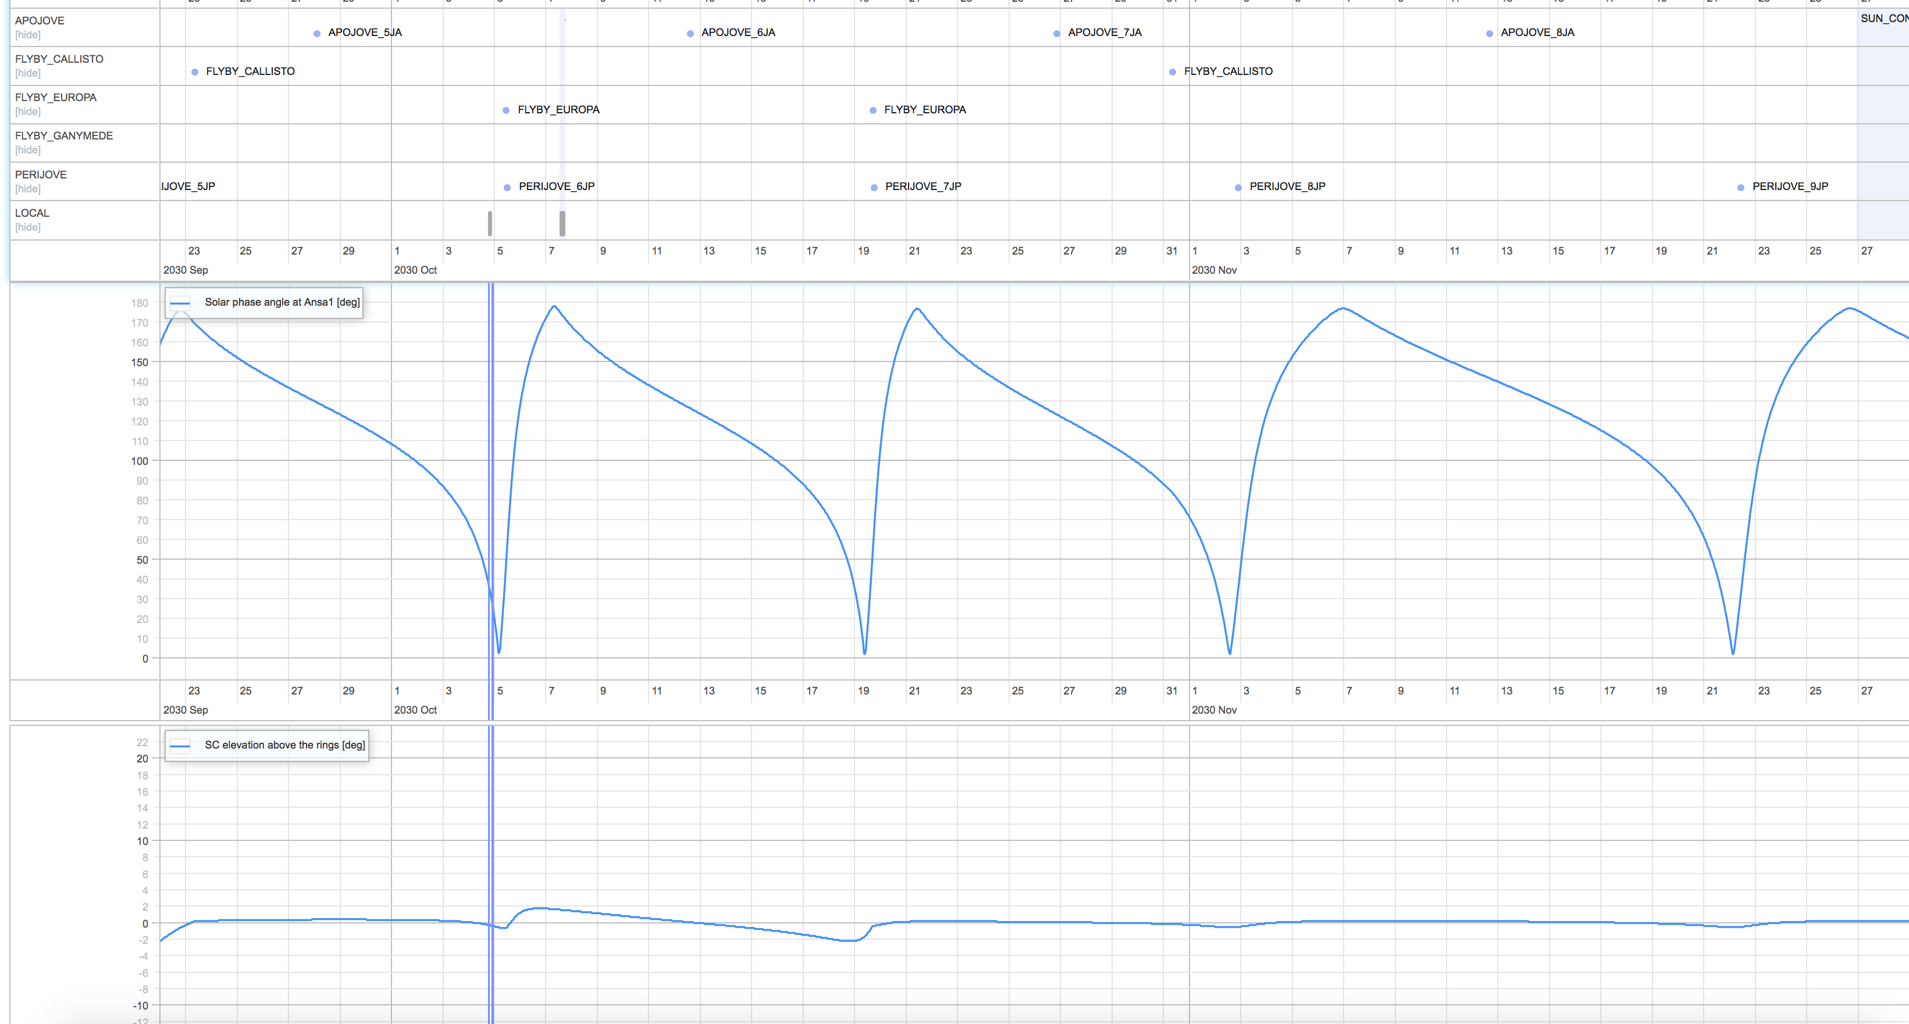
https://juicesoc.esac.esa.int/timeline/CREMA_3_0#

