Slide 1
Status of development
Cydalise Dumesnil for the MAJIS team

Slide 2
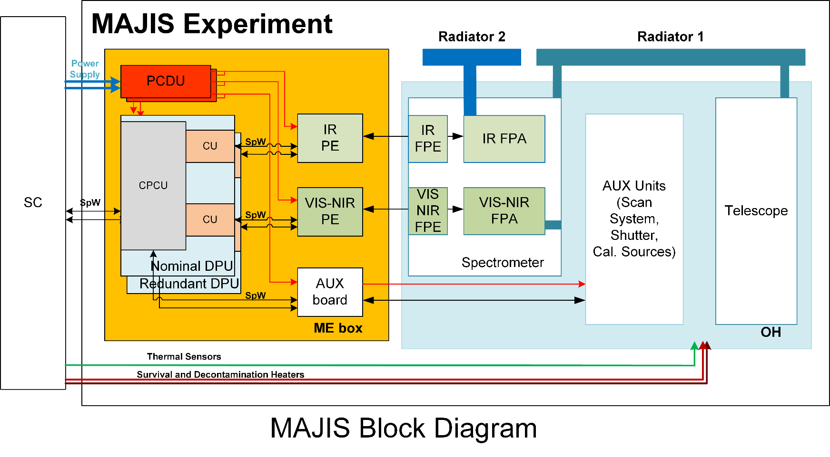
MAJIS DESIGN: Functional Overview
3 Main HW UNITS:
Optical Head (OH)
Main Electronics Box (ME)
Instrument External Harnesses (IEH)
+ Software
JUI-IAS-MAJ-RP-005_3.0
Notes:
2

Slide 3
MAJIS Critical Design Review
ICDR passed with success in June 2019 with 2 main issues
  OH and FPU notching request to be consolidated
  Development plan to be adapted to meet the delivery date of 1/08/20 for the ME PFM
RIDs | Status after co-location | Status @ 01/10/19
Open | 2 | 0
Closed | 79 | 79
Closed with Action | 54 | 16 RIDs waiting for feedback
Total | 135

Slide 4
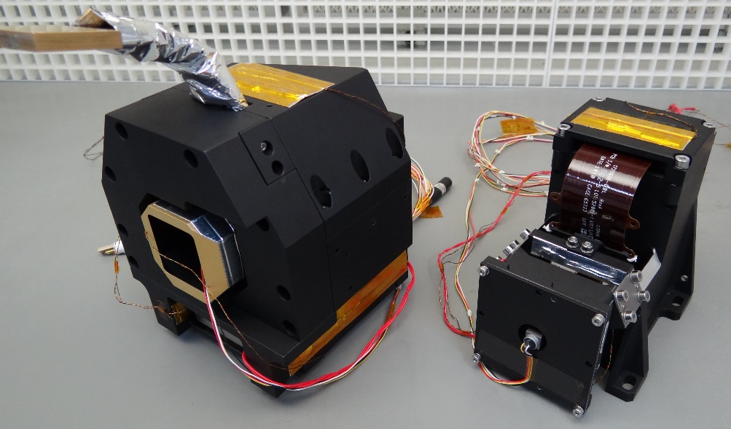
What is new since IPDR
DESIGN
OH and ME designs consolidated
HARDWARE
Units tests
  FPU STMs
  ME STM
Instrument interfaces with spacecraft
  OH + Harness + ME EM → tests on EM spacecraft
First FM deliveries
  VIS-NIR and IR detectors, FPE
  IR LVF

Slide 5
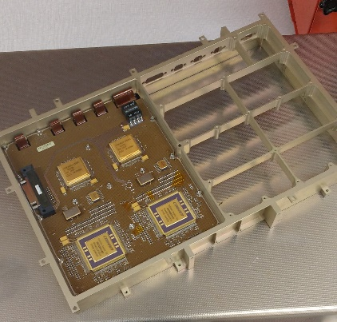
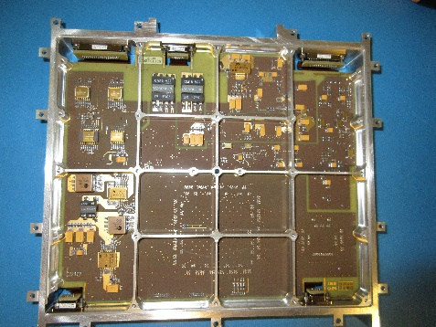
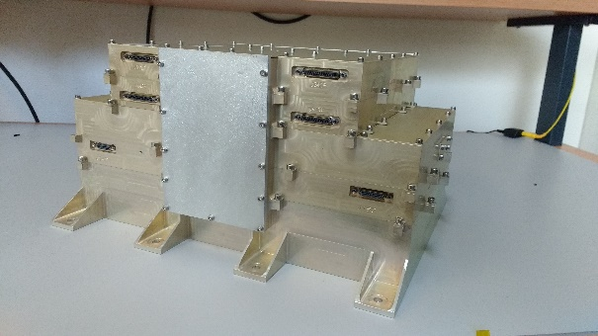
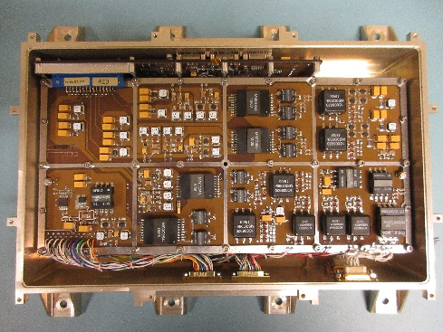
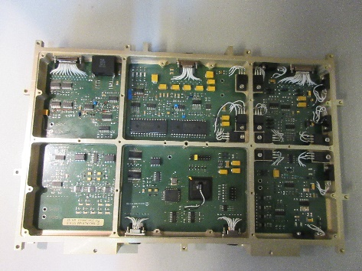
ACTIVITIES OF PAST MONTHS EM
DPU
PE
PCDU
EM Assembled ME
PCDU
AUX

Slide 6
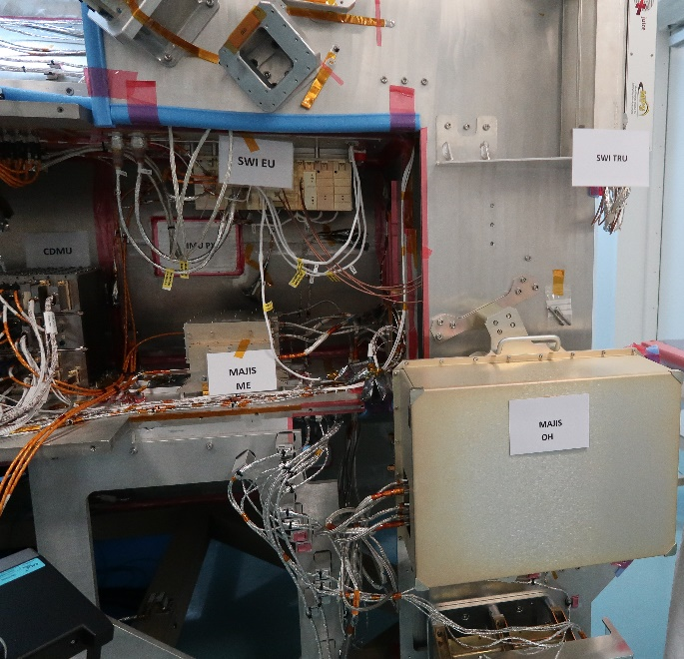
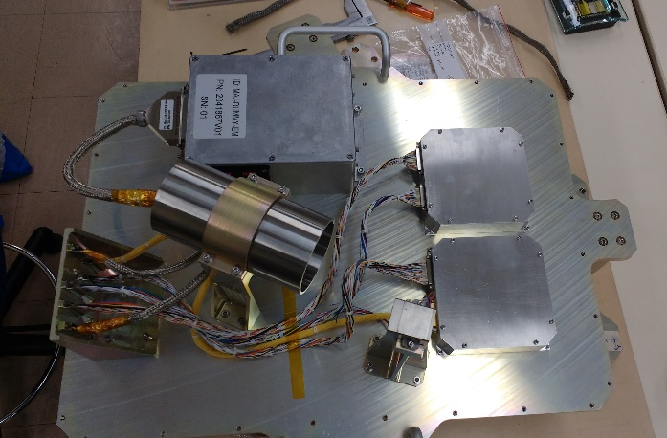
ACTIVITIES OF PAST MONTHS EM
OH EM box
MAJIS EM assembled with its harness on S/C
OH EM internal dummy loads

Slide 7
MAJIS EM MODEL
MAJIS representative with some limitations
  Electronic boards : engineering components
  OH auxiliary units and detector simulated, no Asic firmware
  Software : Diag 3 and science mode tested via Diag 2, Some FDIR functionalities not implemented, XM not qualified
Tests with spacecraft in July 19 : Collaborative week
  S/C interfaces (PUS services) validated
  Only two NCRs raised → already solved
  Science case : first instrument having tested the SSMM but the NSDP have not been yet transferred to the MAJIS team

Slide 8
VALIDATED MAJIS FUNCTIONALITIES AT EM LEVEL ( COLLABORATIVE WEEK)
Science operation sequences:
  Configuration and implementation of series of acquisitions in both the « fixed number » and « continuous » modes
  EM limitation : Same configuration for the IR and VIS channels, no CU frames summing, no compression
MAJIS data flow:
  Simulated data generated by the IR PE and VIS PE,
  CU spectral and spatial binning
  CU formatting into NSDPs (uncompressed data)

Slide 9
DESIGN STATUS
Optical Head Unit (details presented later)
  Detector (see performance presentation)
  Optical design
  Thermal design assessed but change of paint since IPDR
Main Electronics Unit (details presented later)
  Electrical architecture defined
  Software architecture defined
  Components ordered

Slide 10
MAJIS OH design & status
G. Piccioni on behalf of L. Tommasi, LDO and the MAJIS team

Slide 11
MAJIS Overview
MAJIS is an imaging spectrometer in the VIS-IR spectral range.
It follows and extends a long LDO heritage in this class of optical instruments for planetary observation:
  VIMS-V Cassini
  VIRTIS Rosetta
  VIRTIS Venus Express
  VIR Dawn
  JIRAM Juno
Parameter | Value | Unit | Remarks
Aperture | 56x85 | mm² | 56 mm spectrum x 85 mm space
Aperture equiv. diameter | 75 | mm
Telescope focal length | 240 | mm
IFOV | 150 | μrad
Spectral range VIS-NIR | 0.5 – 2.35 | μm
Spectral range IR | 2.25 – 5.54 | μm
Pixel size | 36 | μm | = pixel pitch
Number of pixels | 400 | # | Both channels
Number of spectels | 508 | # | Both channels
Leonardo and Thales Alenia Space have responsibility for the design, development and testing of the Optical Head and AUX Electronics Board of MAJIS.

Slide 12
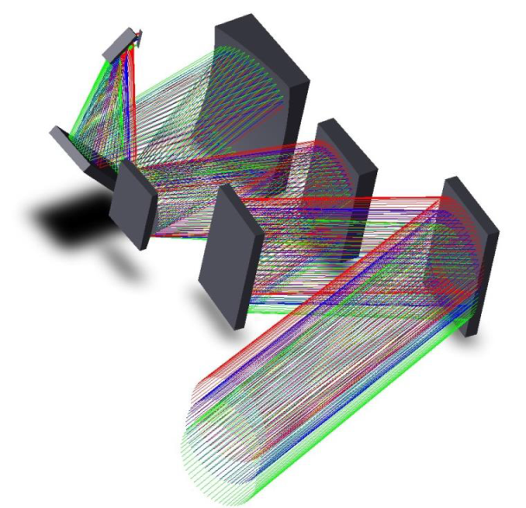
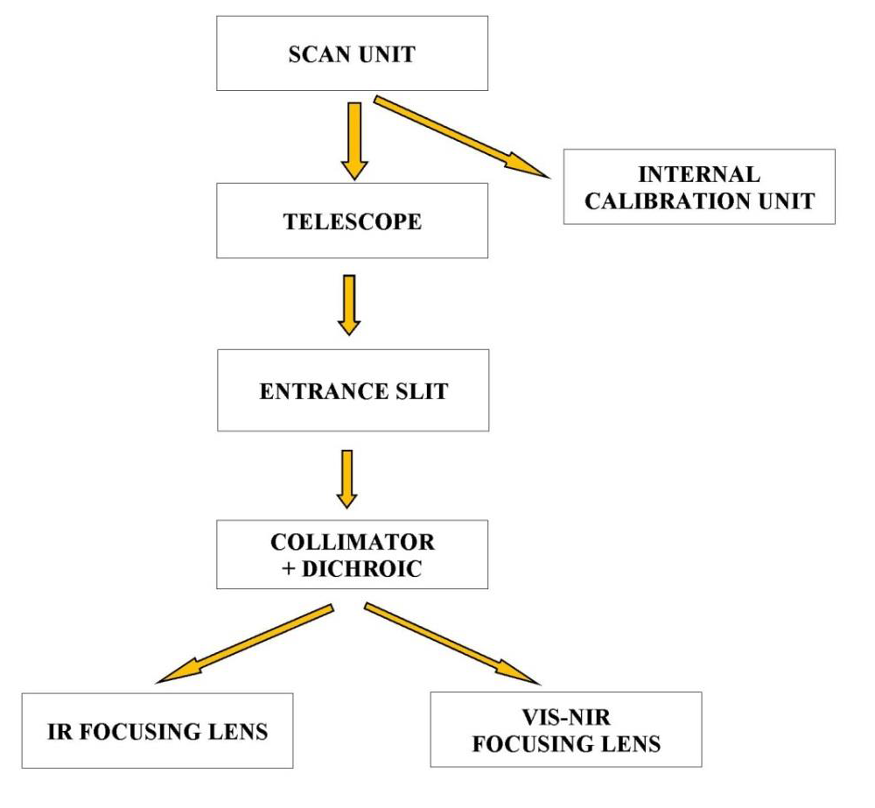
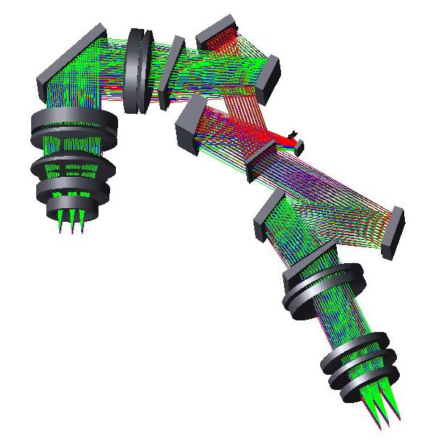
MAJIS Optical Design 1/2
VIS-NIR Channel
IR Channel

Slide 13
MAJIS Optical Design 2/2
The optical path is folded several times for best compactness, with the driver of having the detectors close to the electrical connectors to minimize harness length.
The optical bench is populated on both sides:
  Telescope (incl. scan unit and calibration unit) on the lower side of the bench, facing the S/C
  Spectrometers (incl. detectors) on the upper side of the bench, facing the space through radiators.
Optical design has been developed in close loop with radiation and thermal analysis to guarantee the EOL performance.
Dedicated radiation shields for the most sensitive optical elements have been added where the existing housings and structures were not enough to provide the required protection.

Slide 14
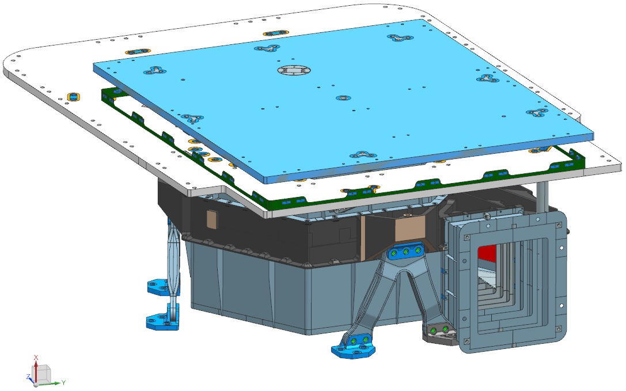
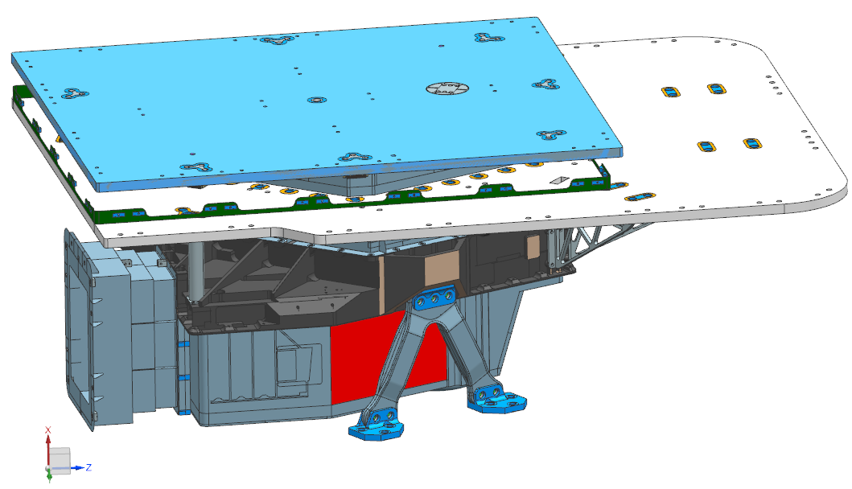
MAJIS OH Mechanical Design 1/3
Main drivers for the final mechanical design:
  Accommodation constraints on the S/C
  High mechanical leves at the S/C I/F
Most critical items for mechanical design:
  Bipods
  Optical bench
  Radiators and supports
In addition, opto-mechanical design has been optimised for cryogenic operations (choice of materials, shapes, solutions)

Slide 15
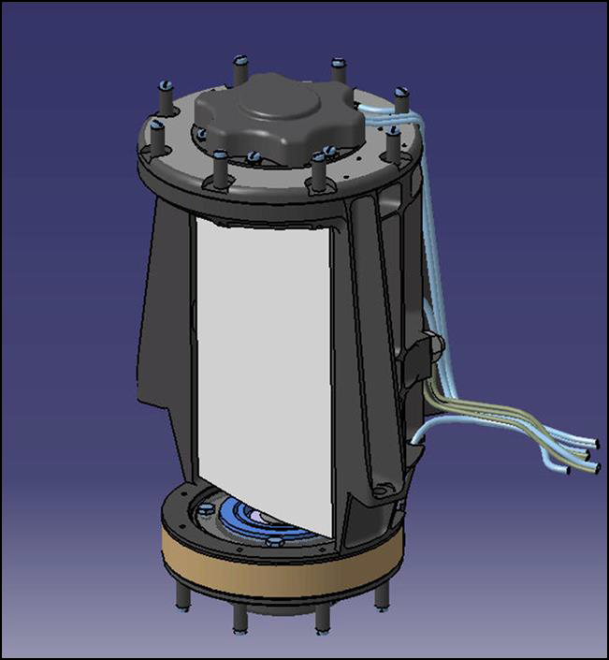
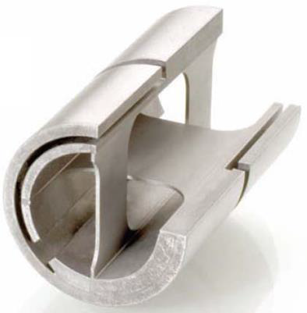
MAJIS Mechanical Design 2/3
Scan Unit design (based on heritage) has features to maximize its realiability:
  Flexural pivots (no bearing)
  Lightweight Be mirror
  Self-locking mechanism with temperature (based on combination of CTE)
  Fail safe nadir mirror orientation

Slide 16
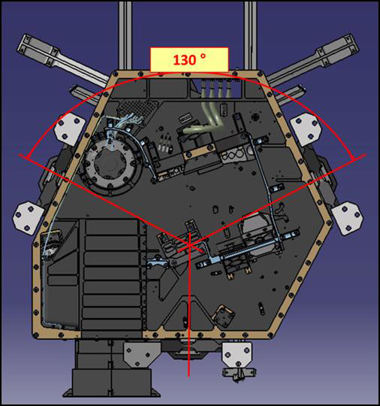
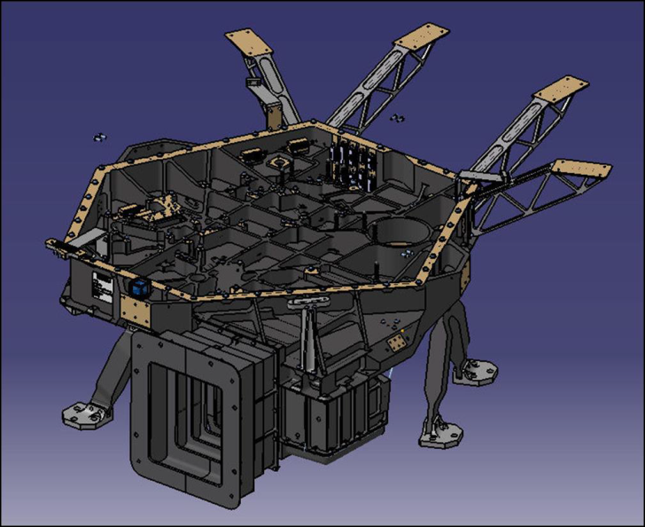
MAJIS Mechanical Design 3/3
Bipods are in the closest possible position to 120°to each other (compatibly with accommodation constraints)
Optical bench is stiffened with ribs for best stiffness/mass ratio
Brackets support the large warm radiator

Slide 17
MAJIS Thermal Design 1/2
Passive thermal design is aimed at achieving the required operative temperatures still minimizing the mass of thermal hardware:
  Insulating CFRP bipods for interfacing the OH to the S/C
  Warm radiator (Al Honeycomb) to cool down the Optical Bench including VISNIR detector (< 140 K)
  Cold radiator (Al honeycomb) to cool down the IR detector (< 90K)
  Double MLI barrier around OH (outer goes all around OH warm radiator and is fixed to the S/C bench, too)
Radiator paint, which is a key for thermal performance, had to be changed close to ICDR after ESA warning about charging of the previous baseline.

Slide 18
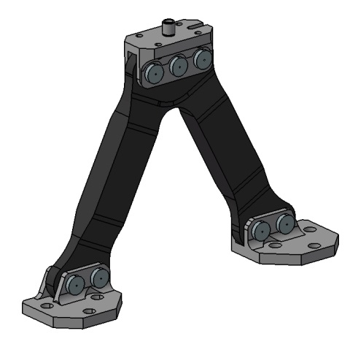
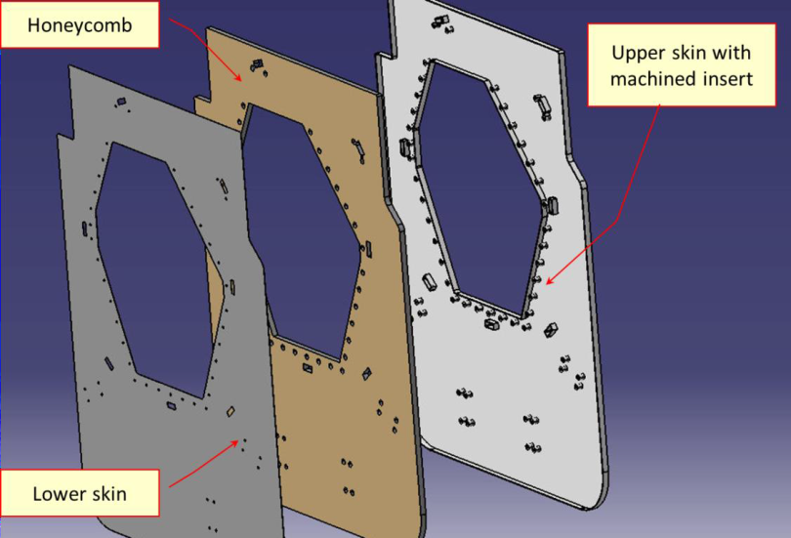
MAJIS Thermal Design 2/2
CFRP legs with foam core
Ti fittings
Design optimised for low fracture risk
Design verification through dedicated test campaign
Al honeycomb design
Heat does not flow through honeycomb, inserts are machined directly into the upper skin

Slide 19
MAJIS OH Status
All the parts for MAJIS OH STM and PFM launched/ordered, but the radiators and the Be parts (incl. scan mirror). Mitigation actions in place to avoid impacts on schedule
  STM radiators with PCBE paint instead of Z93
  Scan Unit breadboard (without BE parts) to allow AUX debug
  Service mirror to allow optical alignment of the OH elements
PCB and EEE parts for AUX board QM and PFM ordered through CPPA. Some delays are being managed with alternative parts.

Slide 20
MAJIS DESIGN: Main Electronics
Issues coming from ICDR
  Electrical components vibration levels → solved
  Electrical components radiation levels → solved
  Thermal design : high temperature → solution in progress
Main current development
  FPGA design → architecture completely defined
  Manufacturing and electrical components procurement in progress
Notes:
20

Slide 21
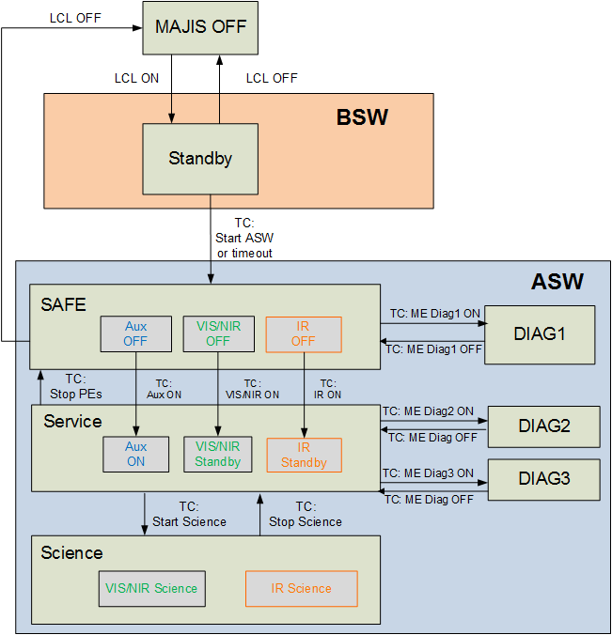
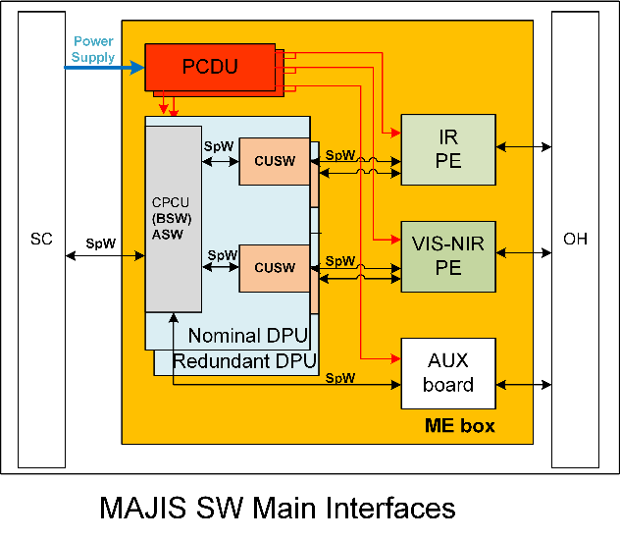
MAJIS DESIGN: Software
DPU Boot ESA
LVCUGEN baseline
21
Notes:
21

Slide 22
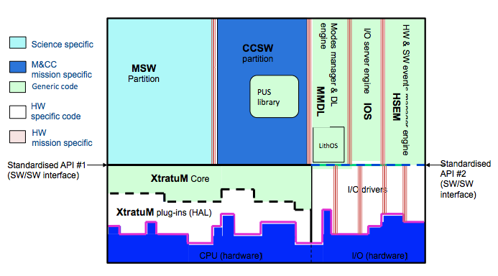
Boot SW (ESA)
ASW (IAS / CNES)
= LVCUGEN
CUSW (IAS)

Slide 23
MAJIS DESIGN: Software
Functions already implemented
  Boot software configuration file 3.1.5 → FM
  XMQ 2.0.1
  CCSW 2.3 main I/F with the S/C → last version expected November 8th, to be validated for the SW CDR in December 19
Main current development
  Upgrade from EM functionalities → PFM
  Science operation sequences : different configurations for the two channels
  CU frame binning and formatting into NSDPs (compressed data)
  Scrubbing
  MSW and CUSW FDIR
23
Notes:
23

Slide 24
MODEL PHILOSOPHY
PROPOSED FOR ICDR
OH EM, STM and PFM
ME EM, STM, QM and FS
AFTER ICDR BOARD due to JUICE project constraints
ME EM, STM, PFM
OH and ME development philosophy are similar BUT two deliveries to the spacecraft
→ OH PFM calibrated with FS

