Slide 1
JUICE SOC uplink activities
1. Strategic Planning
2. Detailed instrument Operations Planning
1.-2. Link and Mutual feedback
by SOC team

Slide 2
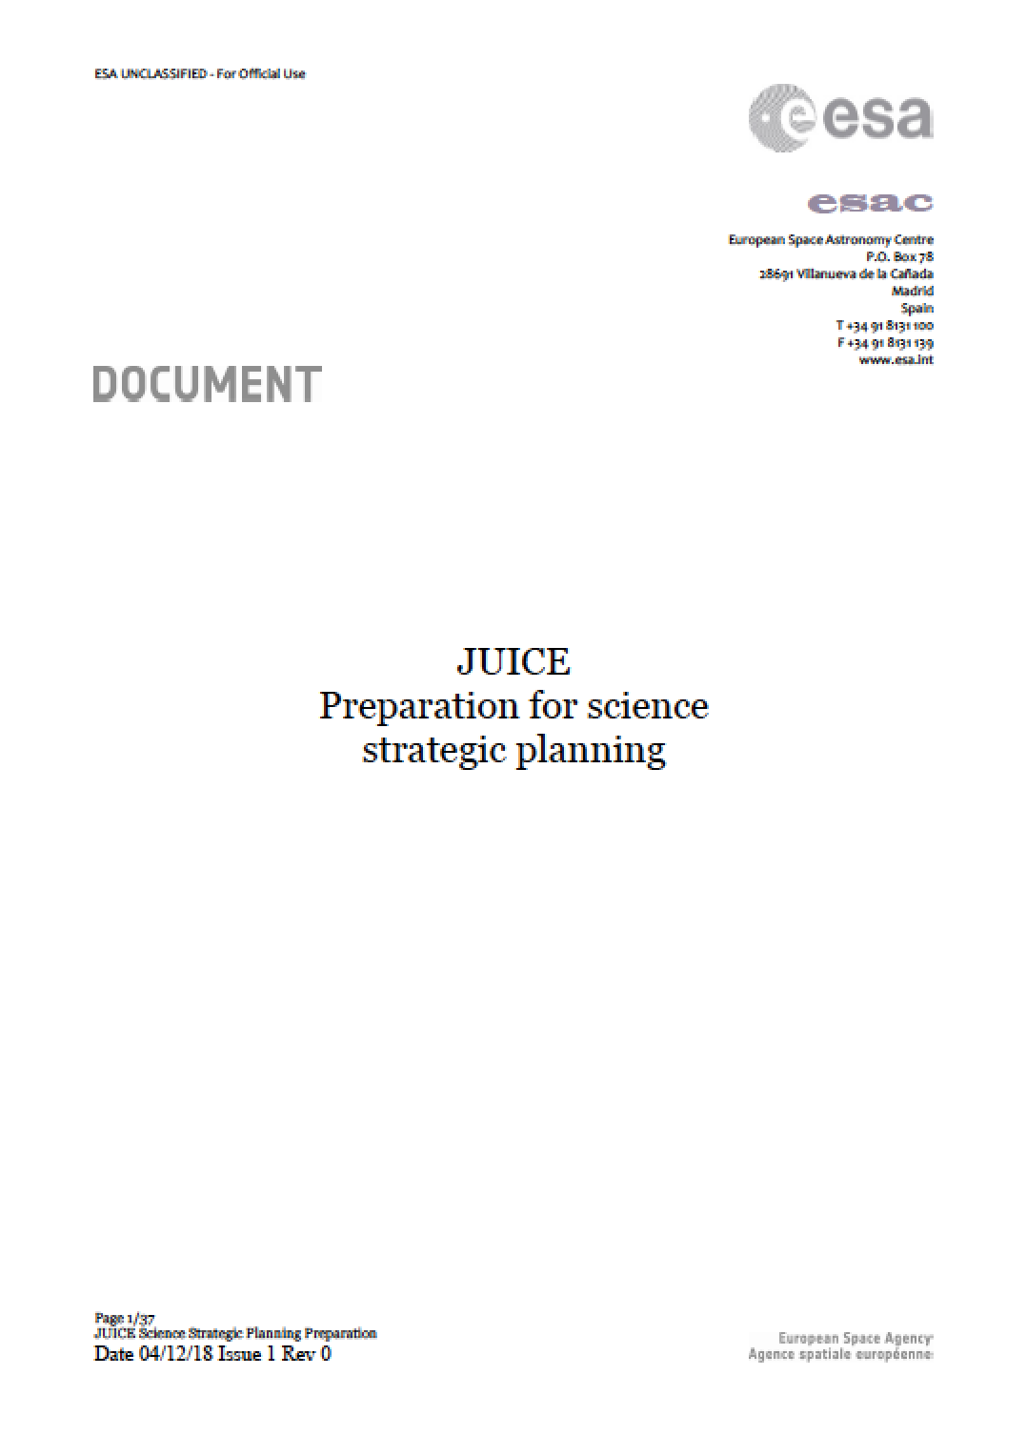
SOC SCIENCE OPERATIONS DURING DEVELOPMENT PHASE
WHAT: SCIENCE ACTIVITY PLAN (SAP)
JUI-ESAC-SGS-TN-024
WHY: Early identification of both limiting resources and/or potential scientific and operational conflicts is key to the overall mission success
HOW: The SAP will be the result of two complementary tasks:
SCIENCE PRIORITY: STRATEGIC PLANNING
FEASIBILITY AND PERFORMANCES: DETAILED INSTRUMENT OPERATIONS PLANNING
WHAT: The JSOC is supporting the Science Working Team in defining and maintaining the Science Activity Plan (SAP) that will be eventually translated into instrument operational timelines

Slide 3
SOC SCIENCE OPERATIONS DURING DEVELOPMENT PHASE
DEVELOPMENT PHASE
NOMINAL SCIENCE PHASE
ONE YEAR BEFORE JOI
STRATEGIC PLANNING
SCIENCE ACTIVITY PLAN
………
NOMINAL PLANNING CYCLES
SWT + SOC
DETAILED INSTRUMENT OPERATIONS PLANNING
PROJECT
SOC
SWT
INSTRUMENT TEAMS
SOC
SWT

Slide 4
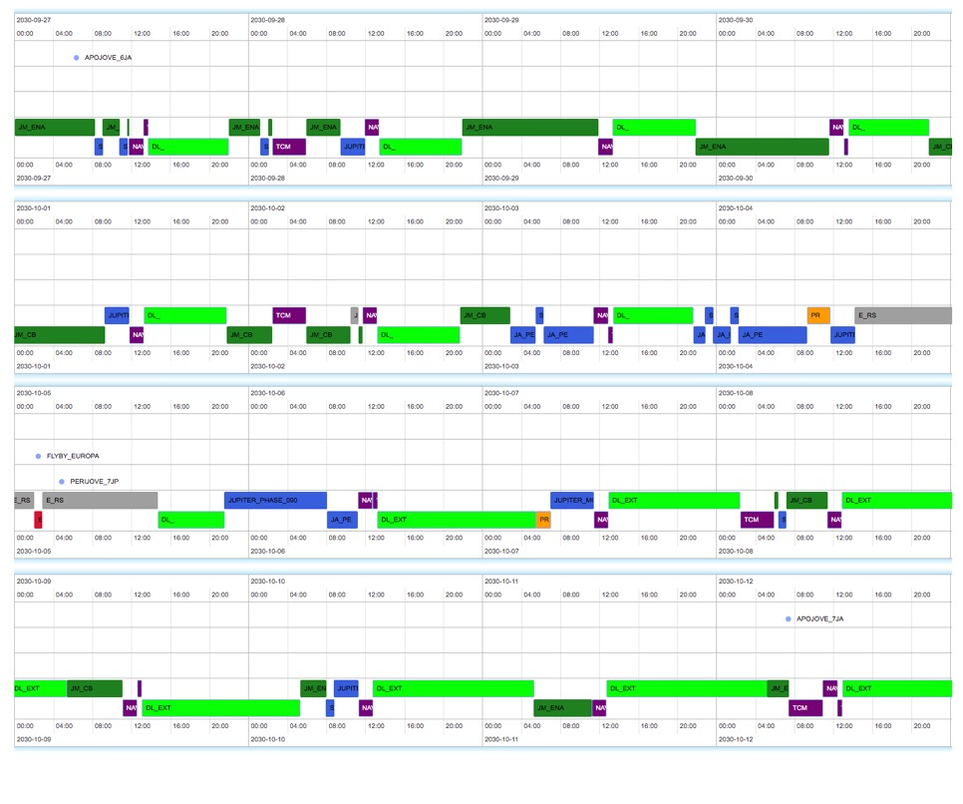
1. STRATEGIC PLANNING (TOUR PHASE)

Slide 5
1. STRATEGIC PLANNING (TOUR PHASE)
STRATEGIC PLANNING: IDENTIFICATION OF THE HIGHEST PRIORITY SCIENCE OBJECTIVE FOR EACH PERIOD ALONG THE TRAJECTORY
ORBIT #7 crema 3.1
 | DOWNLINK
 | FLIGHT DYNAMICS
 | WG1
 | WG2
 | WG3
 | WG4
 | OUTREACH

Slide 6
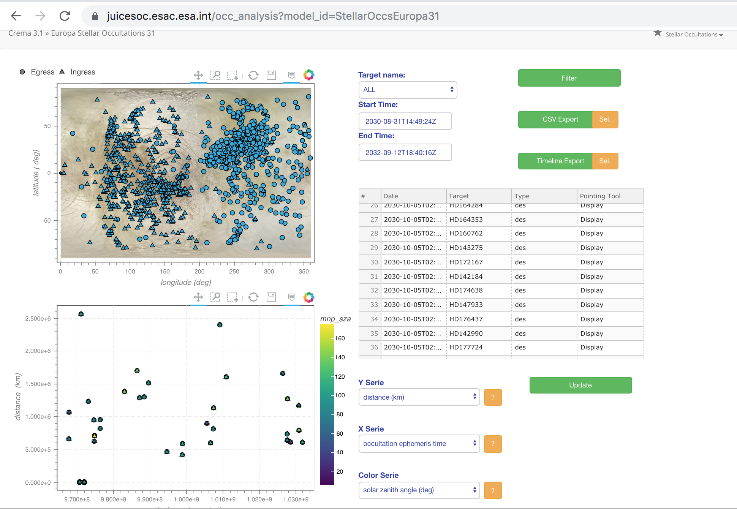
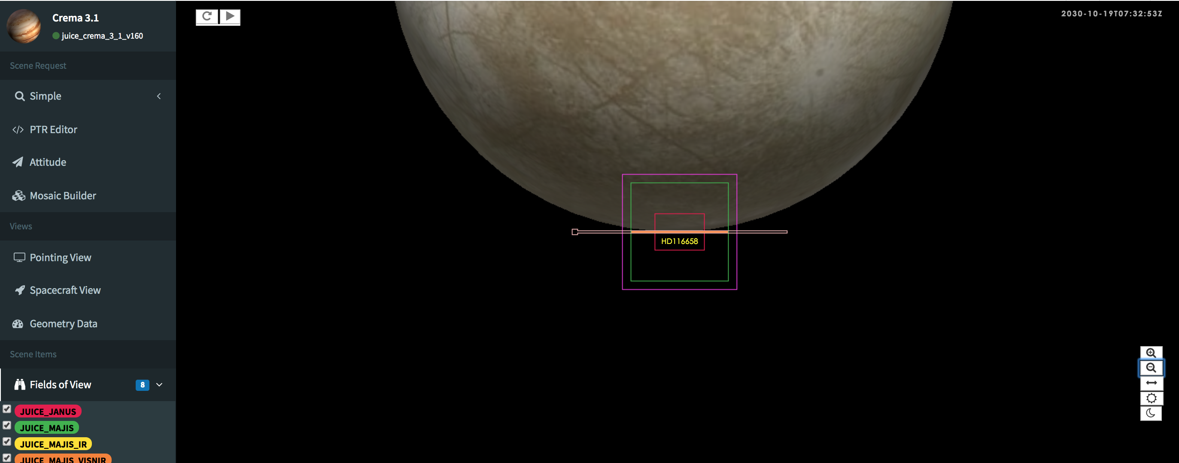
1. STRATEGIC PLANNING (TOUR PHASE)
1. IDENTIFICATION OF EVENTS
https://juicesoc.esac.esa.int/occ_analysis?model_id=CREMA_3_1
anything needed for MAJIS ?
PI + WG + SOC

Slide 7
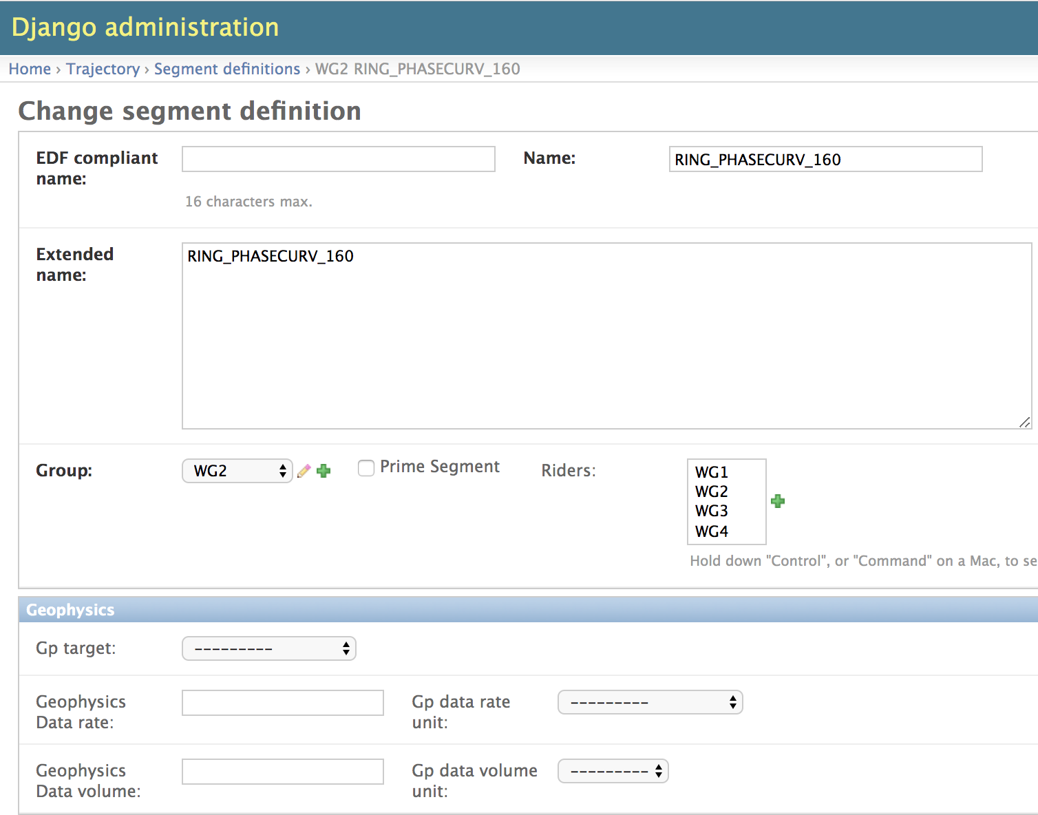
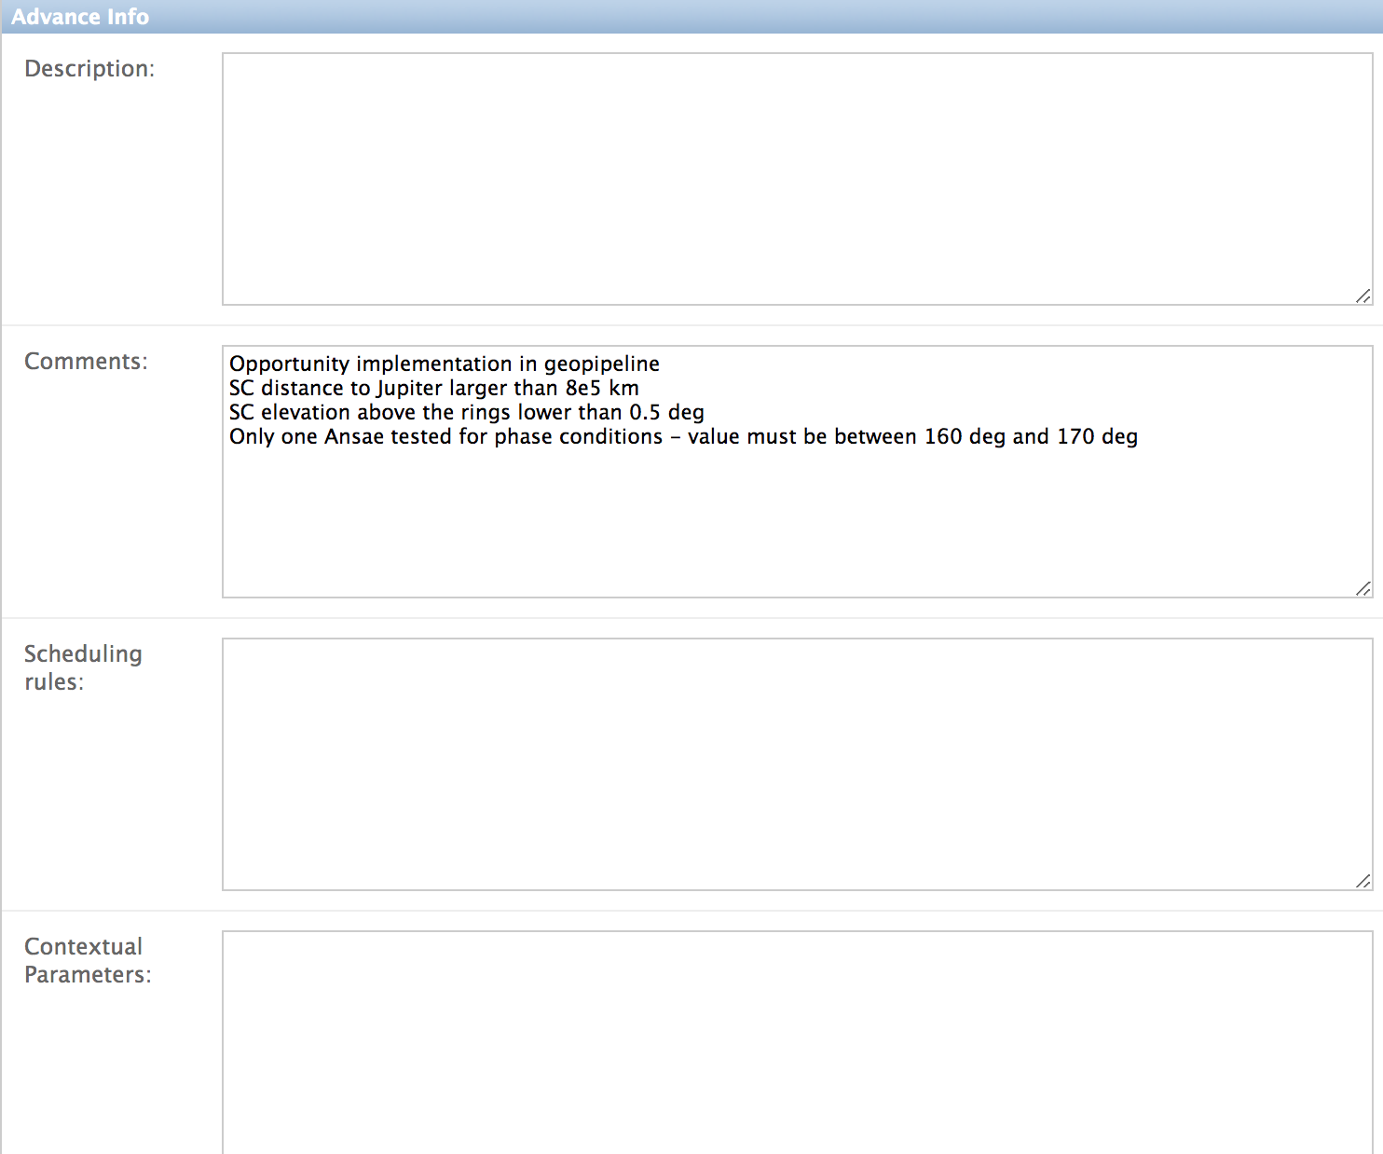
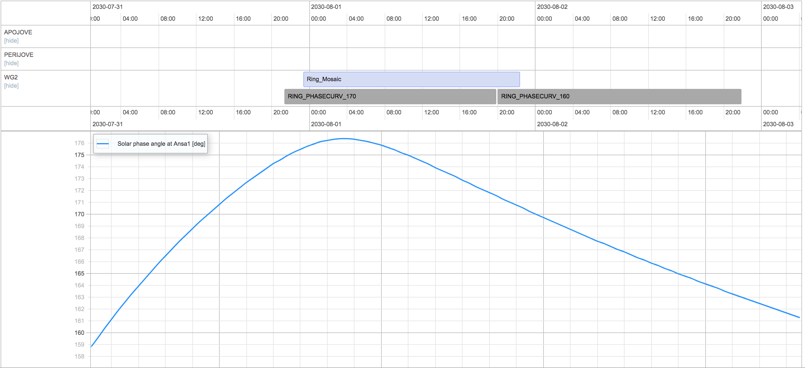
1. STRATEGIC PLANNING (TOUR PHASE)
2. SEGMENT DEFINITION AND COMPUTATION:
@geometrical conditions
@ instrument level
segment database
timeline tool
dump of the database to check ?
anything else to be defined ? (WG in the loop)
PI + WG +SOC
contextual geometry

Slide 8
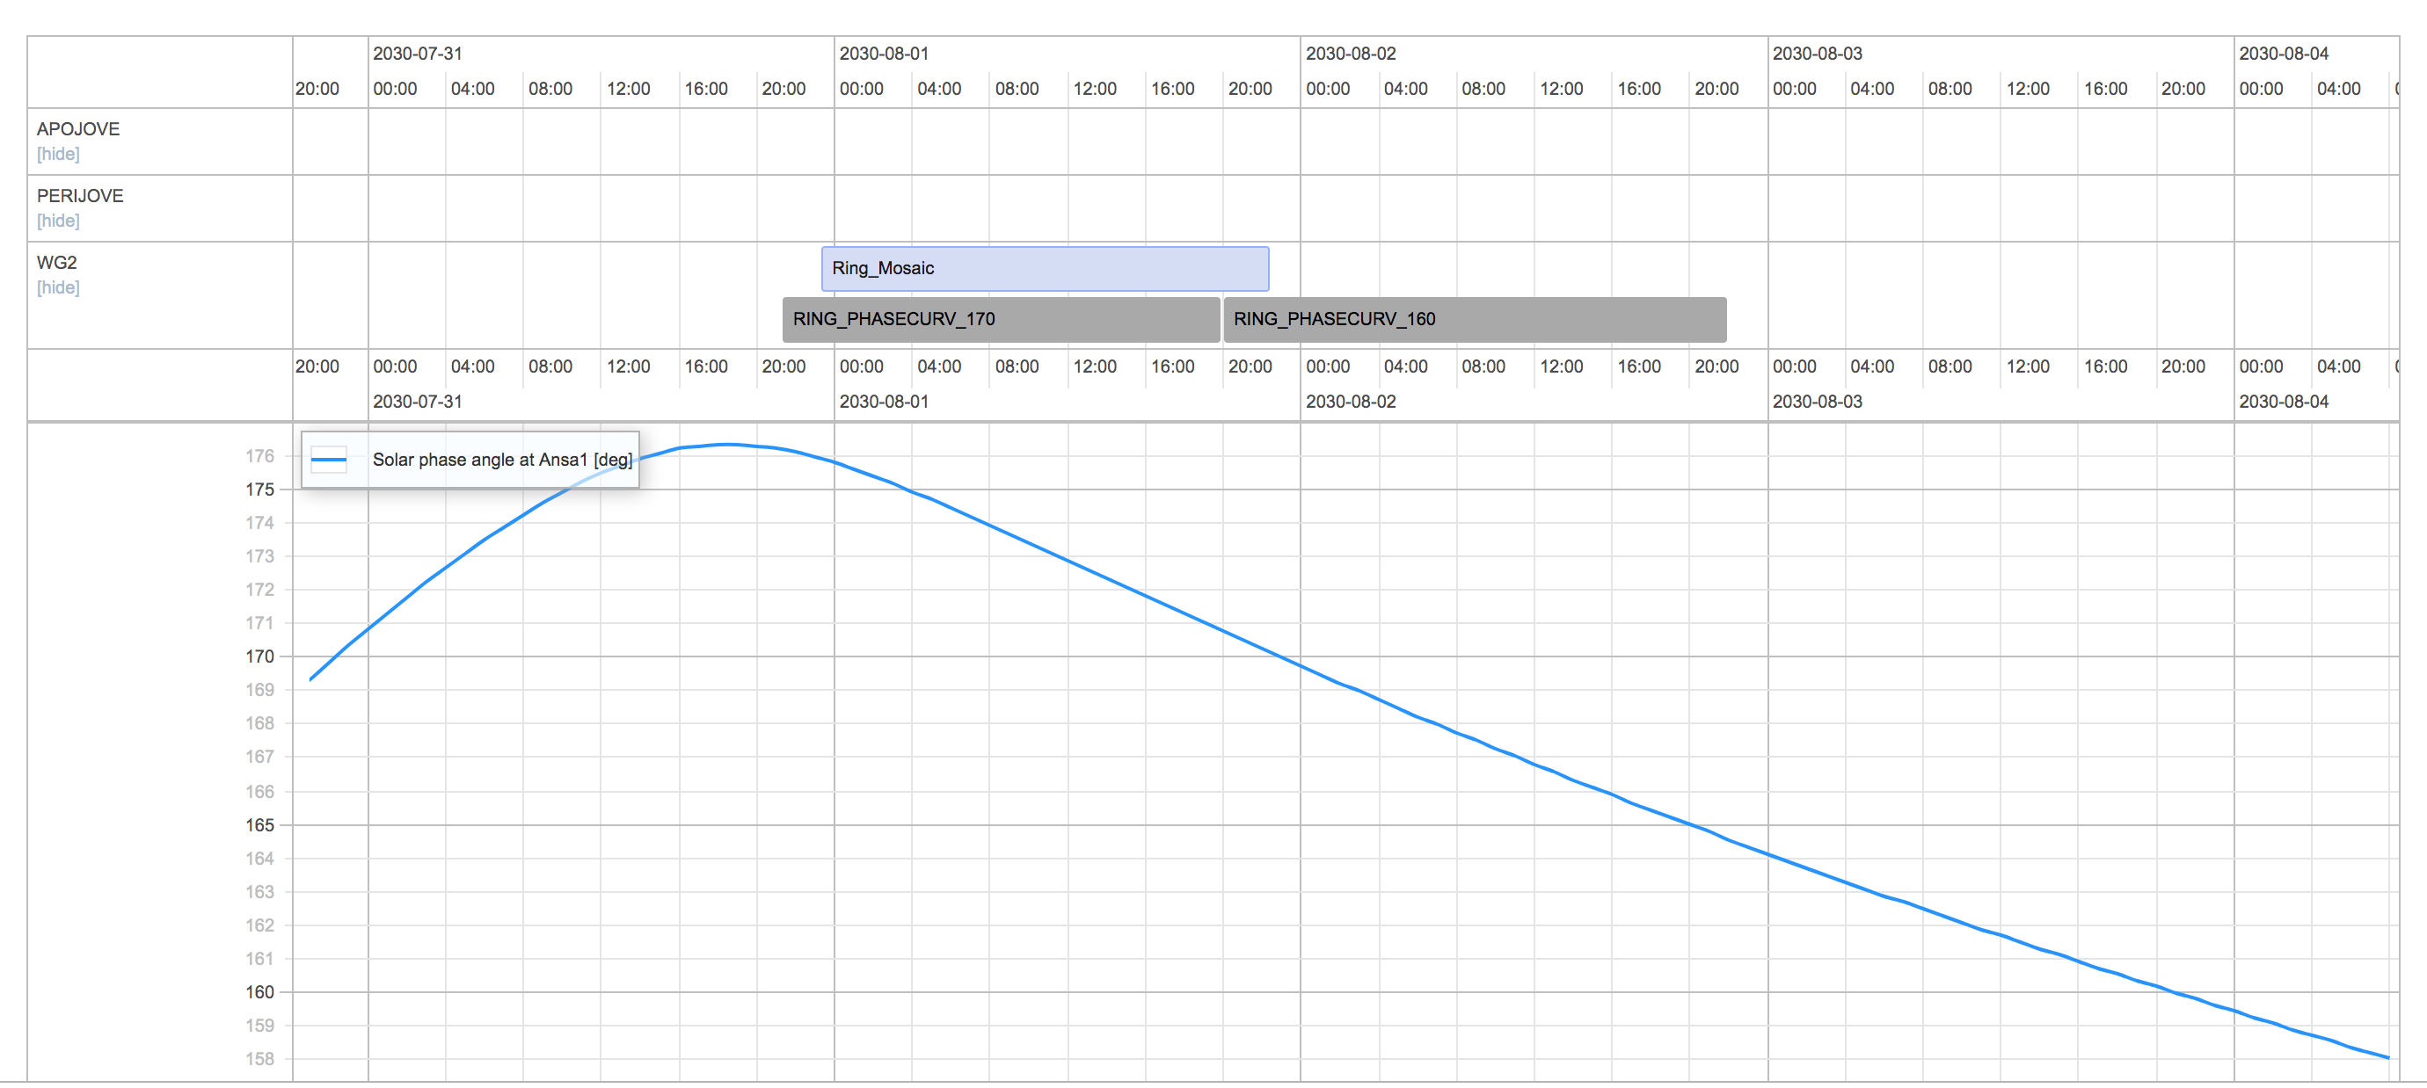
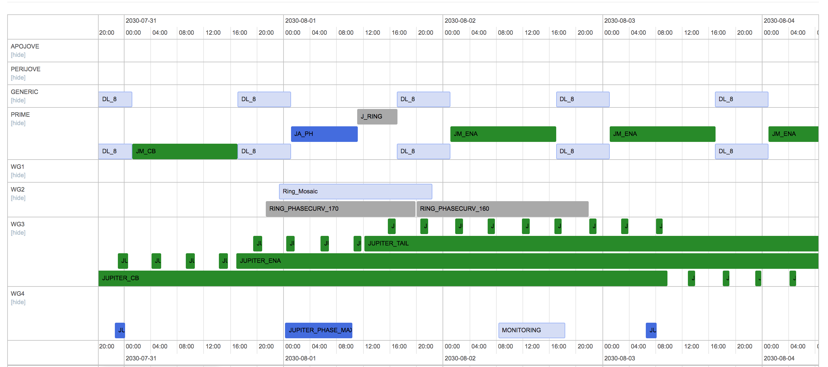
1. STRATEGIC PLANNING (TOUR PHASE)
3. PRIME SEGMENT DEFINITION (SCIENCE PRIORITY)
@ DISCIPLINE LEVEL
WITH ASSIGNED RESOURCES (data rate or data volume …)
segment database
WG+ SOC
RING
 | WG1
 | WG2
 | WG3
 | WG4

Slide 9
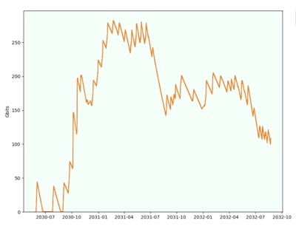
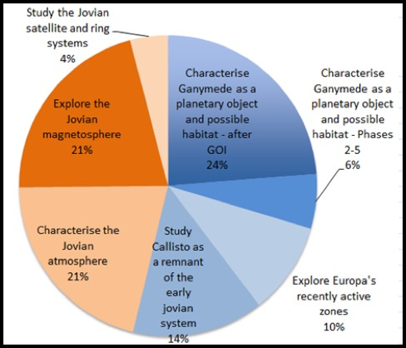
1. STRATEGIC PLANNING (TOUR PHASE)
4. SEGMENTATION
timeline tool
SWT + WG + SOC
5. ASSESSMENT OF THE SEGMENTATION
RESOURCES
Downlink capabilities
Data share between disciplines/targets
….???
SCIENCE
COVERAGE ANALYSIS (#scheduled/#opportunities)
anything for MAJIS?
SWT + WG + SOC
SWT + WG + SOC
????

Slide 10
1. STRATEGIC PLANNING (TOUR PHASE)
GETTING DOWN TO NUTS AND BOLTS …
AUTOMATION: the strategic planning should be PARTIALLY automated, in order to quickly adapt to new
Trajectories
Constraints
Scientific requests
FLEXIBILITY and HUMAN CONFLICT RESOLUTION should also play an important role in order to ensure the scientific return of the mission

Slide 11
2. DETAILED INSTRUMENT OPERATIONS PLANNING

Slide 12
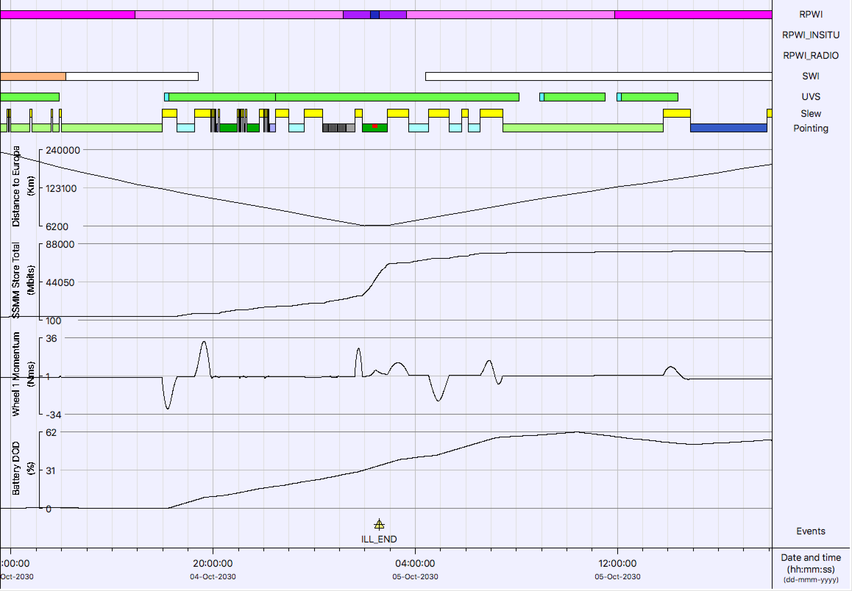
2. DETAILED INSTRUMENT OPERATIONS PLANNING
DURING ARCHETYPAL/CRITICAL PARTS OF THE MISSION
BASED ON REALISTIC INSTRUMENT REQUESTS from the teams
IN THE FRAMEWORK OF REALISTIC SPACECRAFT RESOURCES
EUROPA FLYBY
LEADING TOOL: MAPPS
SSMM
ATTITUDE (wheel momentum)
BATTERY CHARGE

Slide 13
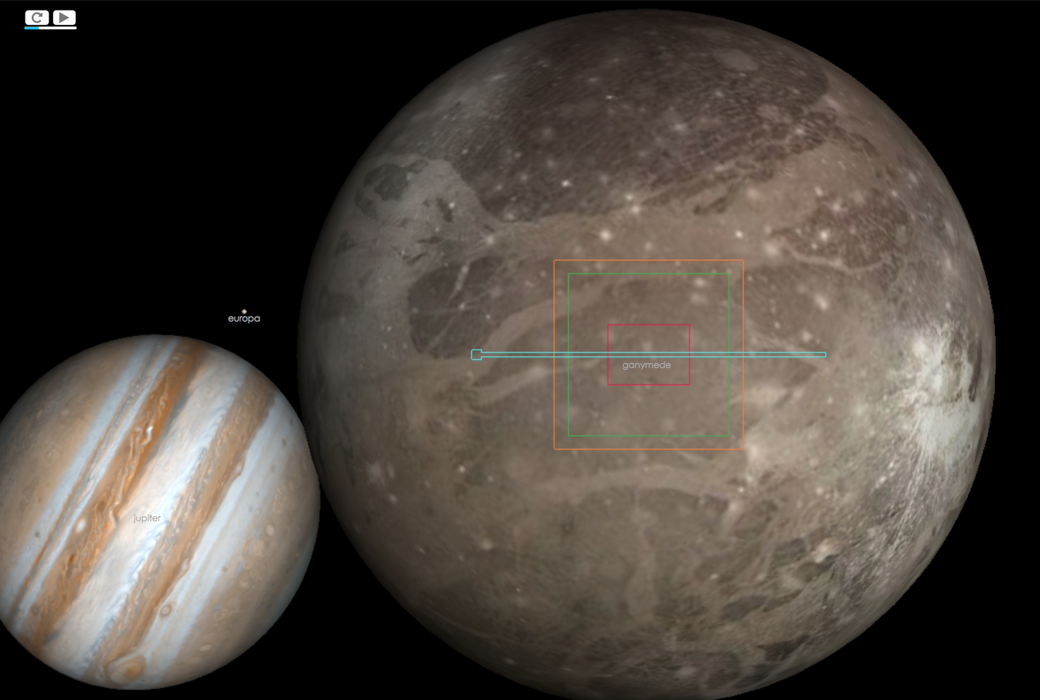
2. DETAILED INSTRUMENT OPERATIONS PLANNING
TOOLS
MAPPS:
S/W installation
Distributed on demand
Pointing tool:
https://juicept.esac.esa.int/
”ITL builder”
SEGMENT
OBS1
OBS3
BLOCK2
OBS1
LIST OF OBSERVATIONS DEFINITIONS
BLOCK2
OBS3
PLANNING TOOLS WORKSHOP
to be organized
@ ESAC ~first quarter 2020

Slide 14
2. DETAILED INSTRUMENT OPERATIONS PLANNING
OBSERVATION/BLOCK CONCEPT
PERIJOVE SEGMENT
opportunity 1
JANUS MOSAIC
MAJIS DISK SCAN
MAJIS STELLAR OCC
opportunity 2
opportunity 1
opportunity 2
opportunity 3
JANUS MOSAIC
LIST OF
OBSERVATION DEFINITION
Instrument resources (mode, data rate)
Pointing (remote sensing)
Constraints/scheduling rules
Parent segment
MAJIS STELLAR OCC
MAJIS DISK SCAN
WHAT IS AN OBSERVATION/SEGMENT?
OBSERVATION DATA MODEL?

Slide 15
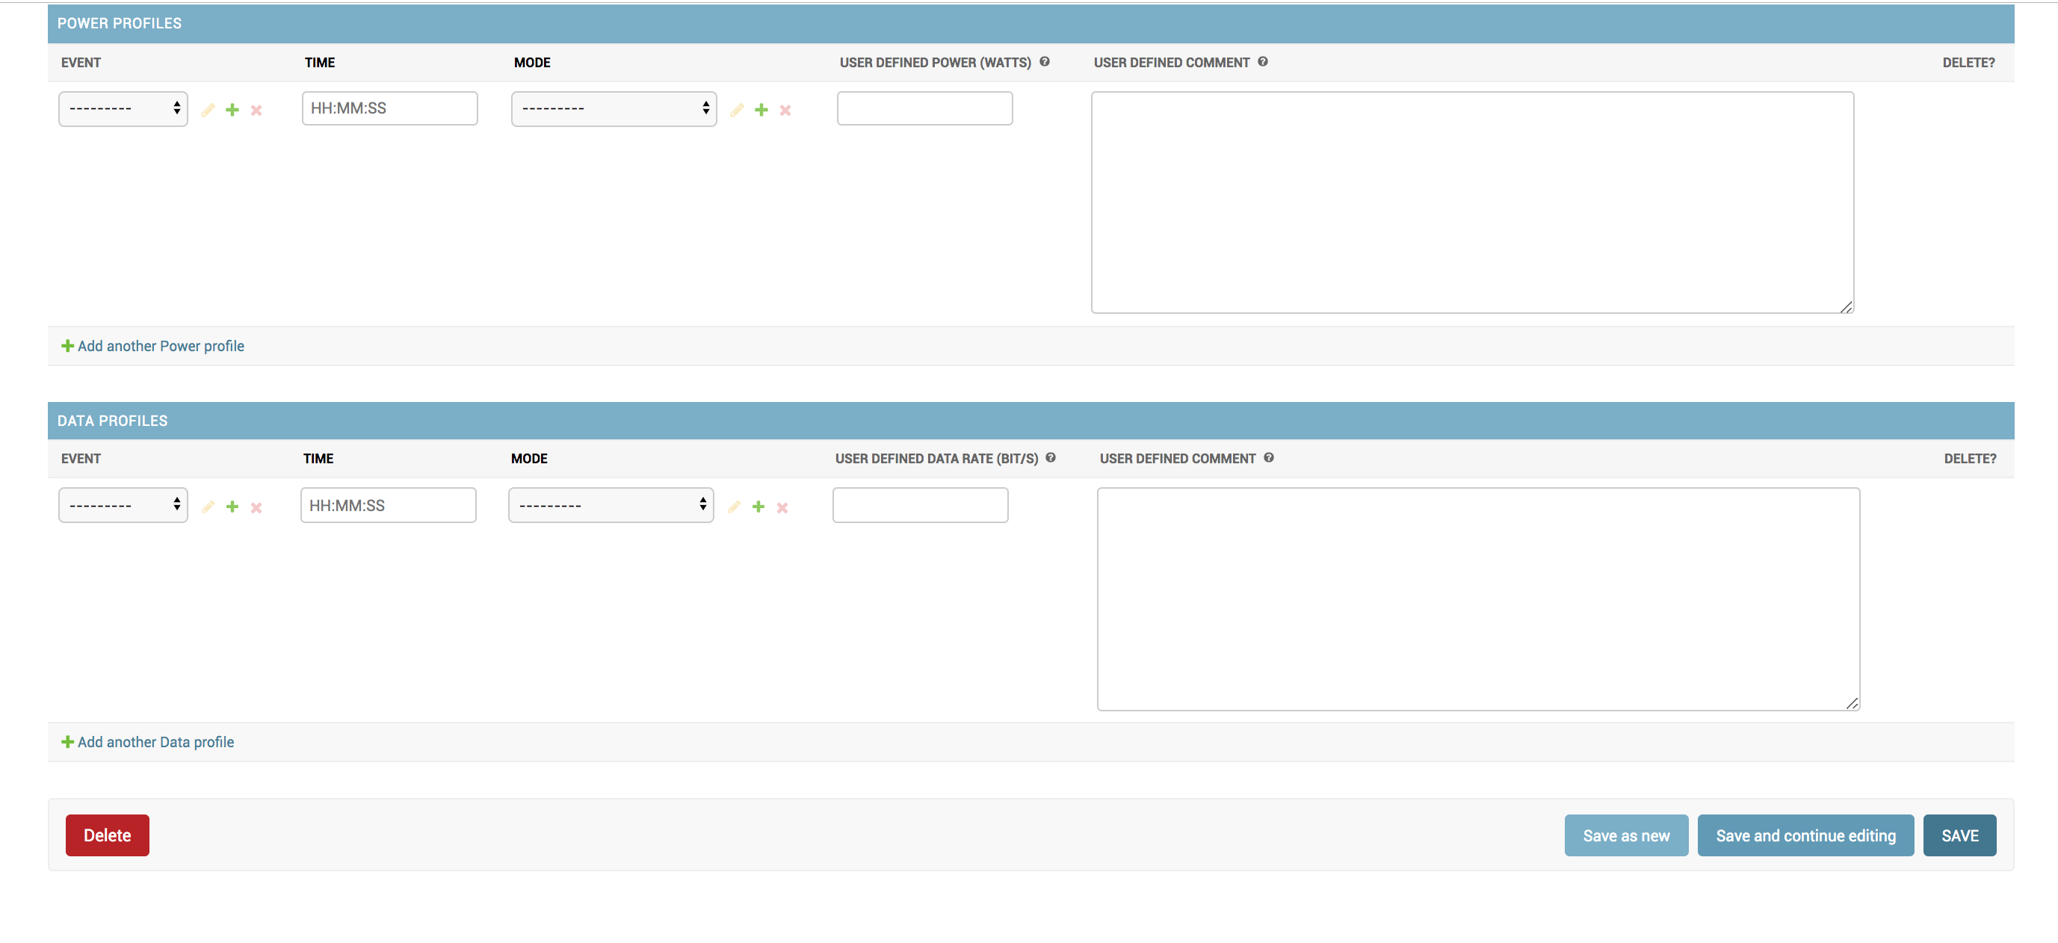
OBSERVATION DATABASE
2. DETAILED INSTRUMENT OPERATIONS PLANNING

Slide 16
1+2: FROM STRATEGIC TO DETAILED PLANNING:
LINKING AND FEEDBACK

Slide 17
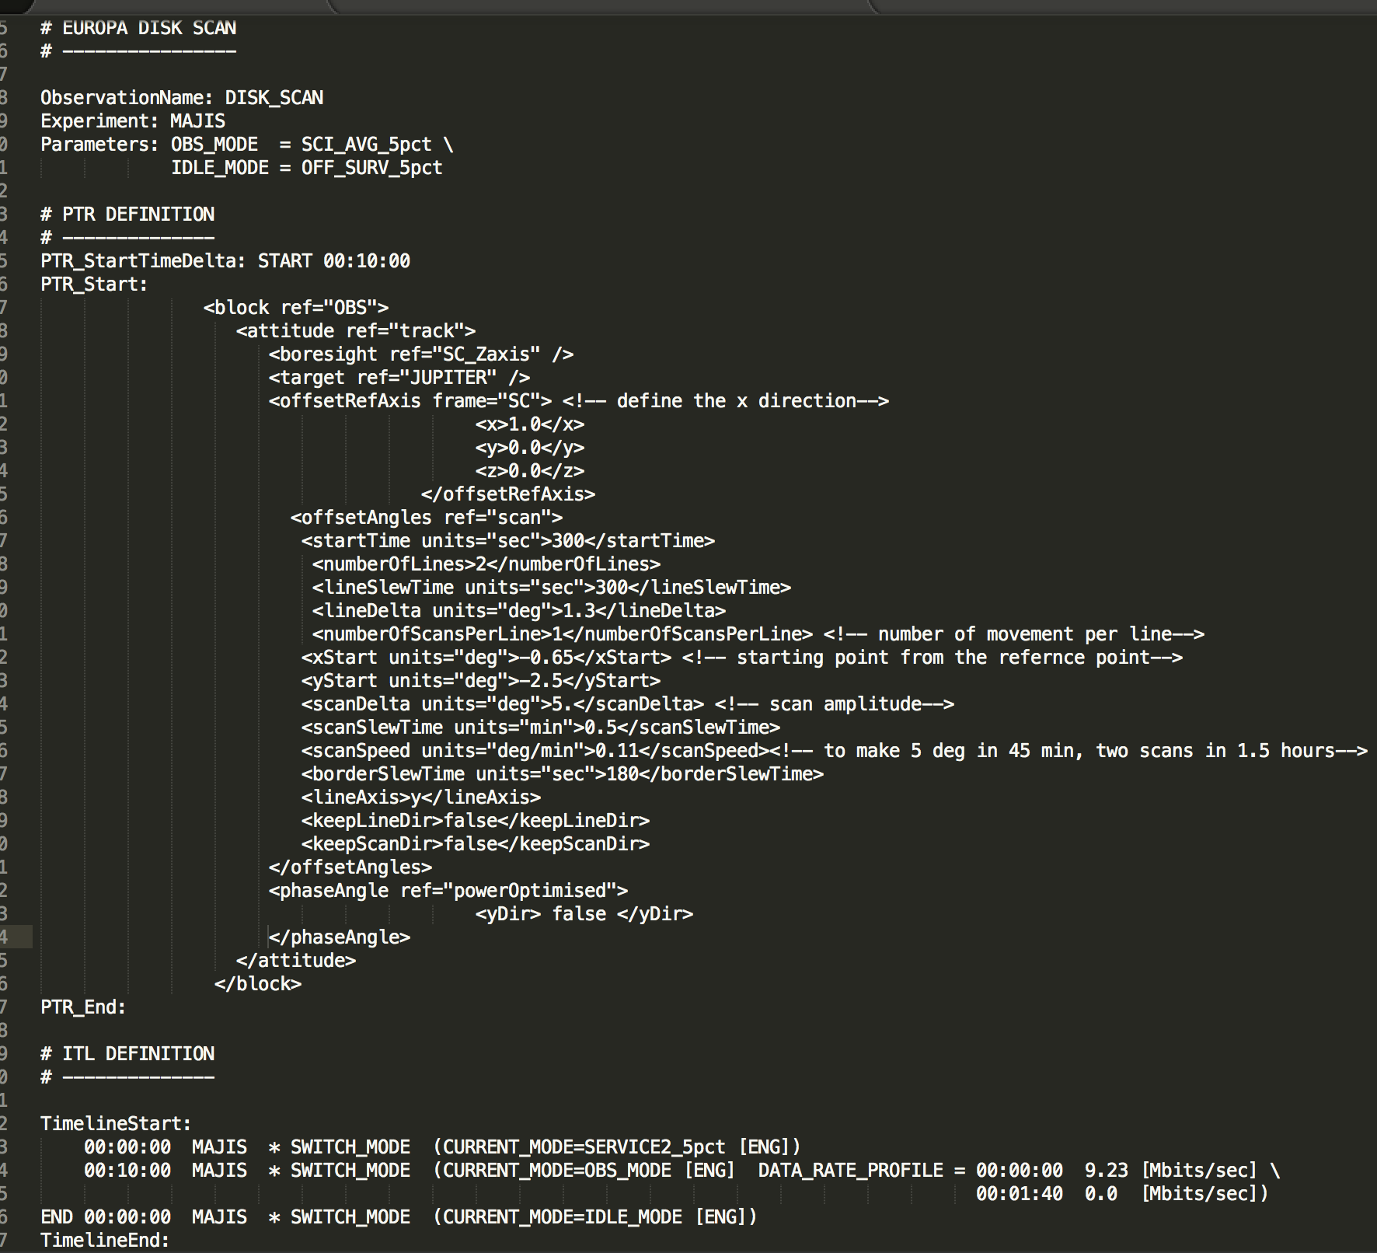
1+2: FROM STRATEGIC TO DETAILED PLANNING:
LINKING AND FEEDBACK
EXAMPLE: EUROPA FLYBY and ORBIT#7
INGREDIENTS
1. SEGMENTATION ORBIT #7
 | DOWNLINK
 | FLIGHT DYNAMICS
 | WG1
 | WG2
 | WG3
 | WG4
 | OUTREACH
3. OBSERVATIONS/BLOCKS ASSIGNED TO EACH SEGMENT TYPE
ASSIGNED
OBSERVATION
OBSERVATION DEFINITION
JA_MONITORING
2. INSTRUMENT TIMELINES WITH ASSIGNED OBSERVATIONS

Slide 18
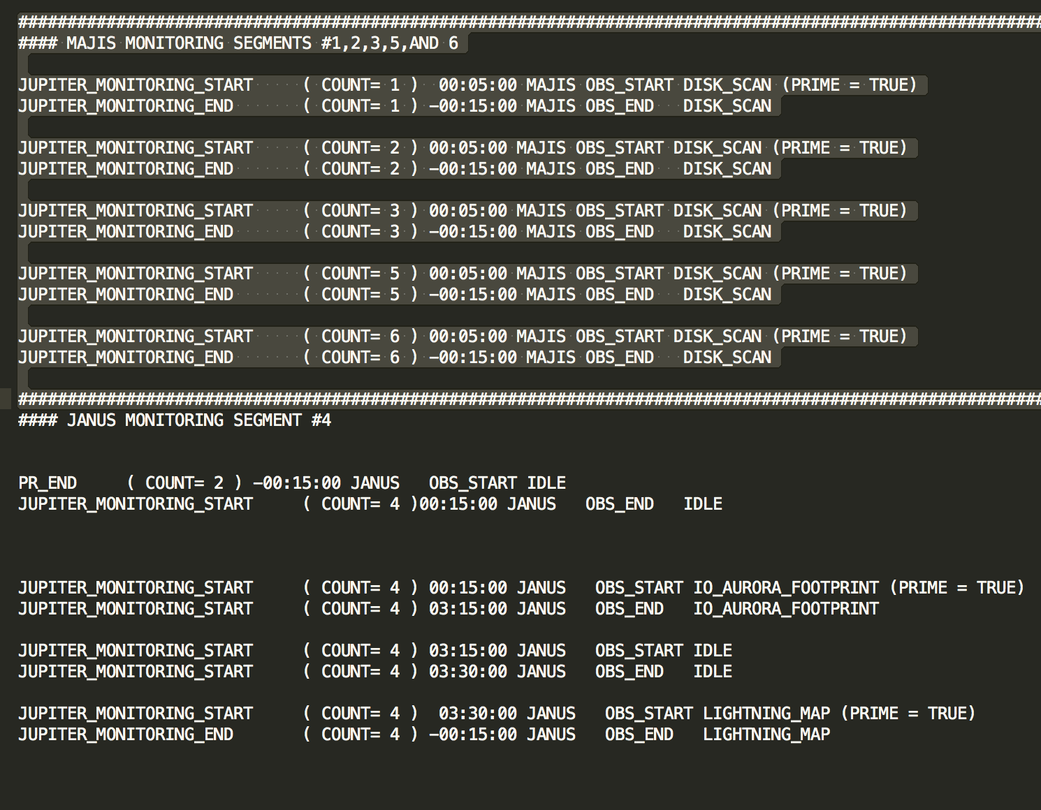
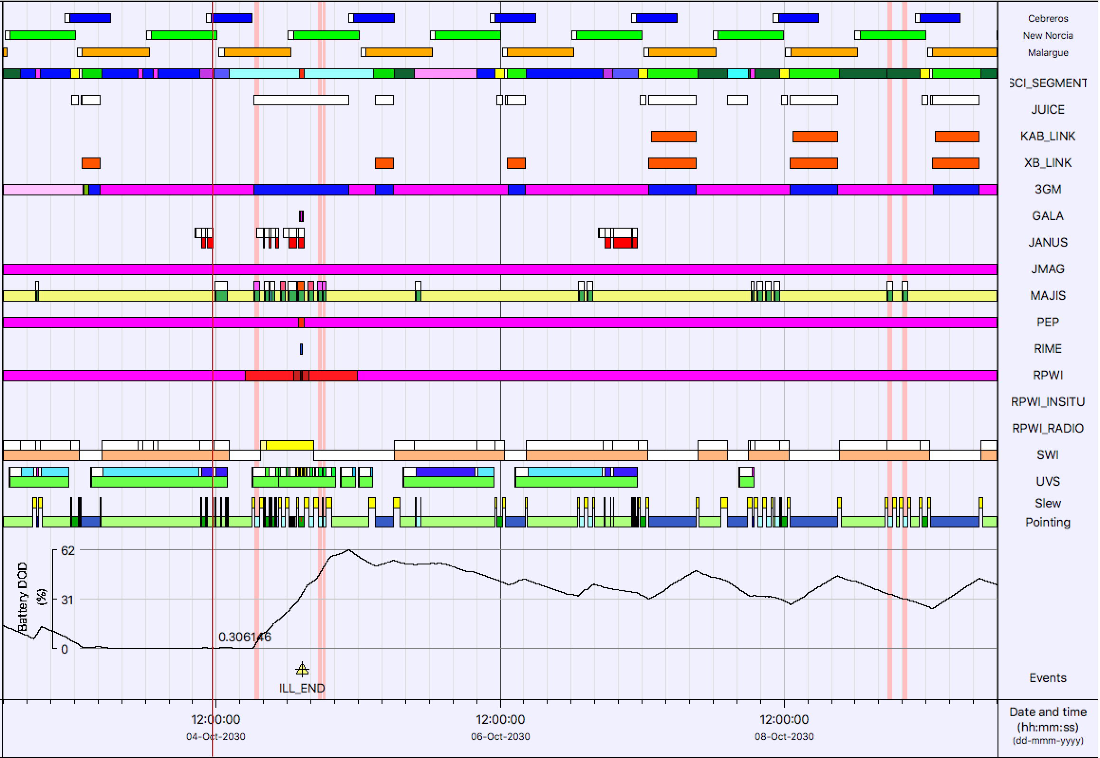
1+2: FROM STRATEGIC TO DETAILED PLANNING:
LINKING AND FEEDBACK
SEGMENTATION FLEXIBILITY
REVISED
SEGMENTATION
PROPOSED
SEGMENTATION
INSTRUMENT TIMELINES FLEXIBILITY
OBSERVATIONS FLEXIBILITY
MAJIS LIMB SCANS SPREAD OVER DIFFERENT SEGMENTS

Slide 19
1+2: FROM STRATEGIC TO DETAILED PLANNING:
LINKING AND FEEDBACK
PLANNING EVOLUTION: The STRATEGIC PLANNING provides a science plan baseline that will be refined/adapted as the nominal PLANNING CYCLES (Long/Medium/Short Term Planning) will be faced.
USABILITY
COHERENCE
BALANCE
STRATEGIC PLANNING
DETAILED INSTRUMENT OPERATIONS PLANNING
????
FLEXIBILITY
FEASIBILITY
PLANNING EVOLUTION: The aim of the strategic planning is to provide a science plan baseline that will be refined/adapted as the nominal planning cycles (Long/Medium/Short Term Planning) will be faced.
EXAMPLE: The orbit#7 segmentation, containing the first Europa flyby, has been used to develop a detailed scenario covering two weeks of operations. The exercise showed that:
the segmentation is helping as starting point for the scenario → Science Activity Plan/Medium Term Planning COHERENCE
the attempt to use pre-defined timelines for each segment type was unsuccessful → FLEXIBLE TIMELINES
the segmentation had to be revised in order to fit the results of the detailed scenario → Science Activity Plan/Medium Term Planning COHERENCE and FLEXIBILITY
FLEXIBILITY: Some flexibility is given to the strategic planning to improve the science return and to make the best usage of the resources at detailed level. This is ensured by feeding the detailed scenarios into the high level science planning.

Slide 20
STRATEGIC PLANNING
MAJIS assumptions FOR CASE 4 (JUI-ESAC-SGS-TN-024)
Purpose: get a rough estimation of data volume to be downlinked by each instrument
(= downlinked to Earth, NOT necessarily generated on board!) to get a representative data volume analysis over the whole tour and define a strategy for the SSMM.
CASE 4:
VERY FIRST ESTIMATE with what was available at that time (different sources: WGs, instrument teams, detailed scenario analysis…)
NO DISTINCTION made between individual flybys (except Europa) or individual perijove

Slide 21
STRATEGIC PLANNING
MAJIS assumptions FOR CASE 4 (JUI-ESAC-SGS-TN-024)
A- ICY MOONS FLYBYS:
Europa flybys: remote sensing (MAJIS+SWI+UVS+JANUS) averaged data volume estimated from the total data volume produced in Europa scenario JUI_ESAC_SGS_TN_007
Total remote-sensing: 72.2 Gb (44.7 Gb for MAJIS)
Callisto and Ganymede flybys: remote sensing data volume from G4-G5 analysis by the WGs in 2015 with MAJIS/JANUS/UVS and SWI numbers TN-009 (20/01/2016)
Total remote sensing: 16.231 Gb (9.5 Gb from MAJIS)

Slide 22
STRATEGIC PLANNING
MAJIS assumptions FOR CASE 4 (JUI-ESAC-SGS-TN-024)
B- JUPITER ATMOSPHERE: PERIJOVE
Description of MAJIS observations pattern from WG4 report:
(1) 1 MAJIS_JUP_DISK_SCAN centered at perijove; 3 cubes
(2) 1 MAJIS_JUP_DISK_SCAN at the start of the periove segment: 2 cubes
(3) 1 MAJIS_JUP_DISK_SCAN right at the end of the periove segment: 2 cubes
(4) 1 MAJIS_JUP_LIMB_SCAN when at ~90deg phase angle : 8 cubes
Associated data volume from MAJIS document (MAJIS_observing_types_Jupiter_01_004)
(1) 3 cubes, duration 20min at 4.3 Mbit/s (x0.33 from data compression and x0.5 from dayside spectral editing) = 2554 Mb
(2) 2 MAJIS_JUP_DISK_SCAN with 2 cubes, duration 20min at 4.3 Mbit/s (x0.33 from data compression and x0.5 from dayside spectral editing) = 2x 1702 Mb
(3)1 MAJIS_JUP_LIMB_SCAN with 8 cubes, each one of 55min with a production rate of 0.782 Mb/s (x0.33 from data compression and x0.5 from spectral editing and x0.1 from spatial editing) = 341 Mb
Total MAJIS only= 6.3 Gbits/perijove

Slide 23
STRATEGIC PLANNING
MAJIS assumptions UPDATES (CASE 5)
Jupiter Atmosphere: updated rates by individual Perijove segment and addition of monitoring and phase segments (see details in Nico’s presentation)
Numbers provided by WG4 as part of the Data Volume reduction (to fit the data volume allocation recommendation for Jupiter atmosphere science provided by the SWT)
Those numbers are not meant to be used as individual instrument allocation, but rather as a confirmation that WG4 can be compliant with its data volume allocation
Icy moons: updated rates for FLYBYS
Europa flybys: same as CASE 4
Ganymede and Callisto flybys:
Total MAJIS only= 10.8 Gbits/flyby
ALL flybys assumed to generate the same amount.
QUESTION to MAJIS: updated numbers/flyby available?
2G2, 5C1 and 21C13 (1st Ganymede, 1st Callisto and slow Callisto flyby with CA on the far side illuminated): decision from SWT to assume 50, 30 and 70Gb in total respectively (total for ALL instruments). This corresponds to respectively ~43 Gb, 24.8Gb and 62.83 Gb for the remote-sensing.

Slide 24
STRATEGIC PLANNING
MAJIS assumptions: UPDATES TO BE CONSIDERED
JUPITER SYSTEM: new target and associated segments to be considered (and associated segments): [MAJIS PI inputs]
Inner moons
Amalthea, 2 hemisphere observations
Data Volume per campaign: 0.8 Mb (2 cubes)
Rings
Low phases: 5.1 Mb per segment (2 cubes)
High phases:
Rings mosaic: 2.55 Mb/cube, 30.5 Mb per campaign (2 ansae, 3 cubes/ansa, 2 elevation ranges; total 12 cubes)
Main rings region structure: 20.3 Mb (2 cubes)
Phase curves: Nx2.55 Mb per campaign (N number of phases sampled)

Slide 25
OPEN QUESTIONS/WISHES…
NEW EVENTS TO BE DEFINED?
DUMP OF THE DATABASE TO CHECK/UPDATE THE SEGMENT DEFINITIONS (WG in the loop)?
ANY IDEAS TO ASSESS A SEGMENTATION (~coverage tool = #scheduled/#opportunities) *weight?
LIST OF OBSERVATIONS/INSTRUMENT BLOCKS WITH ASSOCIATED RESOURCES AND CONSTRAINTS?
COLLABORATION MAJIS/JANUS TO IDENTIFY AND HARMONIZE THE COMMON OPPORTUNITIES, WITH COORDINATION AT WG LEVEL
ANY UPDATES ON THE DV ASSUMPTIONS FOR THE LEVEL 0 STUDY?
ANYTHING YOU NEED FROM OUR SIDE??
JUICE web site

