Slide 1
MAJIS Thermal Condition in some science cases
Bortolino Saggin
Bortolino.saggin@polimi.it

Slide 2
Observation Cases
GEO 5000
Beta angle 30°
Beta angle 45°
Beta angle 60°
GCO 500 Beta angle 65°

Slide 3
Nodes of interest
IR detector node 5400001
IR sidecar 5400011
VIS detector 5400002
VIS sidecar 5400012

Slide 4
simulation parameters
GE0 5000 km
Inclination i=97.1°
Eccentricity : e=0
Beta angles : 30°, 45°, 60°
GCO 500 km, inclination 100.8°,
Power dissipations
Sidecar Power dissipation: Ws=0.6 W (0.25 W in the RTMM)
Detector Power dissipation: Wd=0.0006 W (0.03 or 0.042W in the RTMM)
Scan unit Wsc=0.168W

Slide 5
simulation parameters
Hot case:
Conductive interface temperature -17 °C
SWI temperature -20°C
UVS temperature 40°C
ME temperature 70°C
Cold case
Conductive interface temperature -50 °C
SWI temperature -40°C
UVS temperature -25°C
ME temperature -26°C

Slide 6
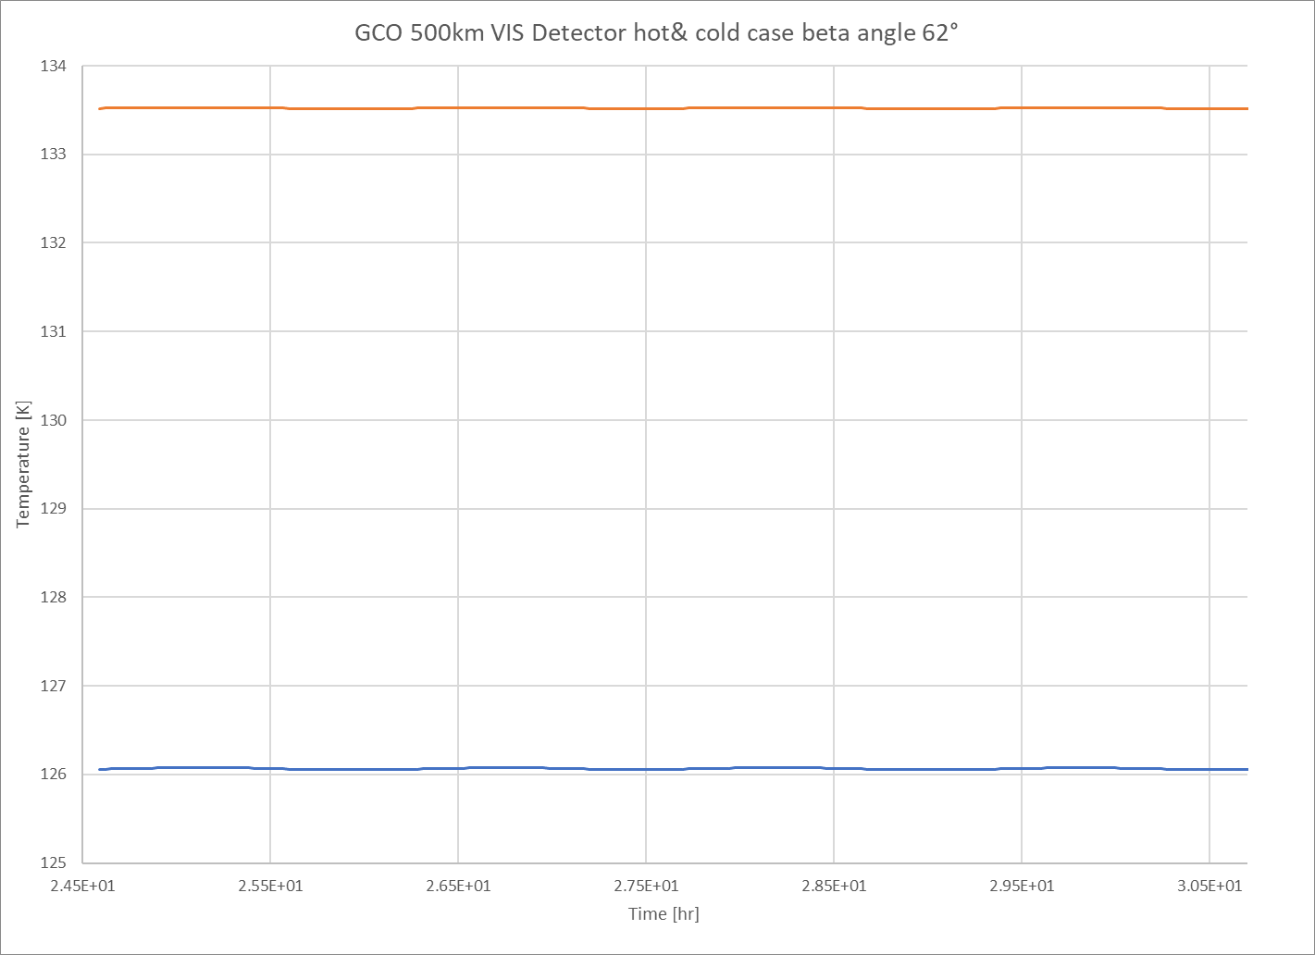
GCO 500km, beta 62°, Cold S/C, VIS detector (Reference RTM)

Slide 7
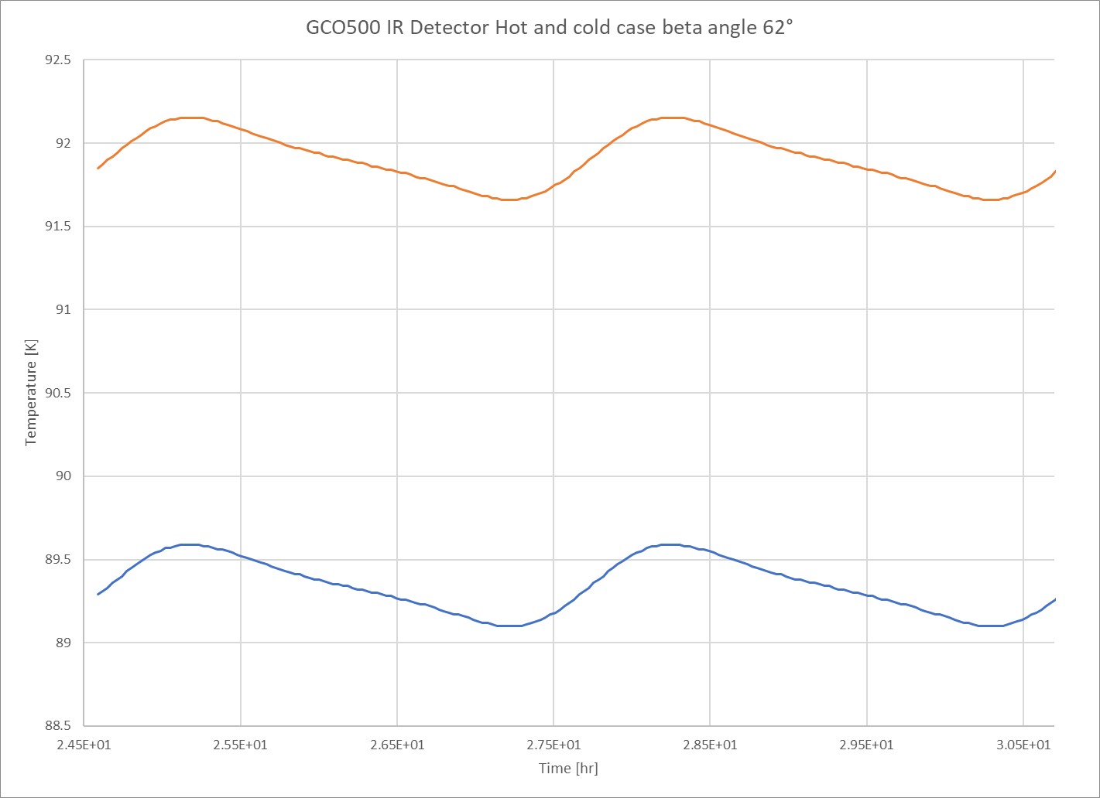
GCO 500km, beta 62°, cold &hot S/C, IR detector (Reference RTM)

Slide 8
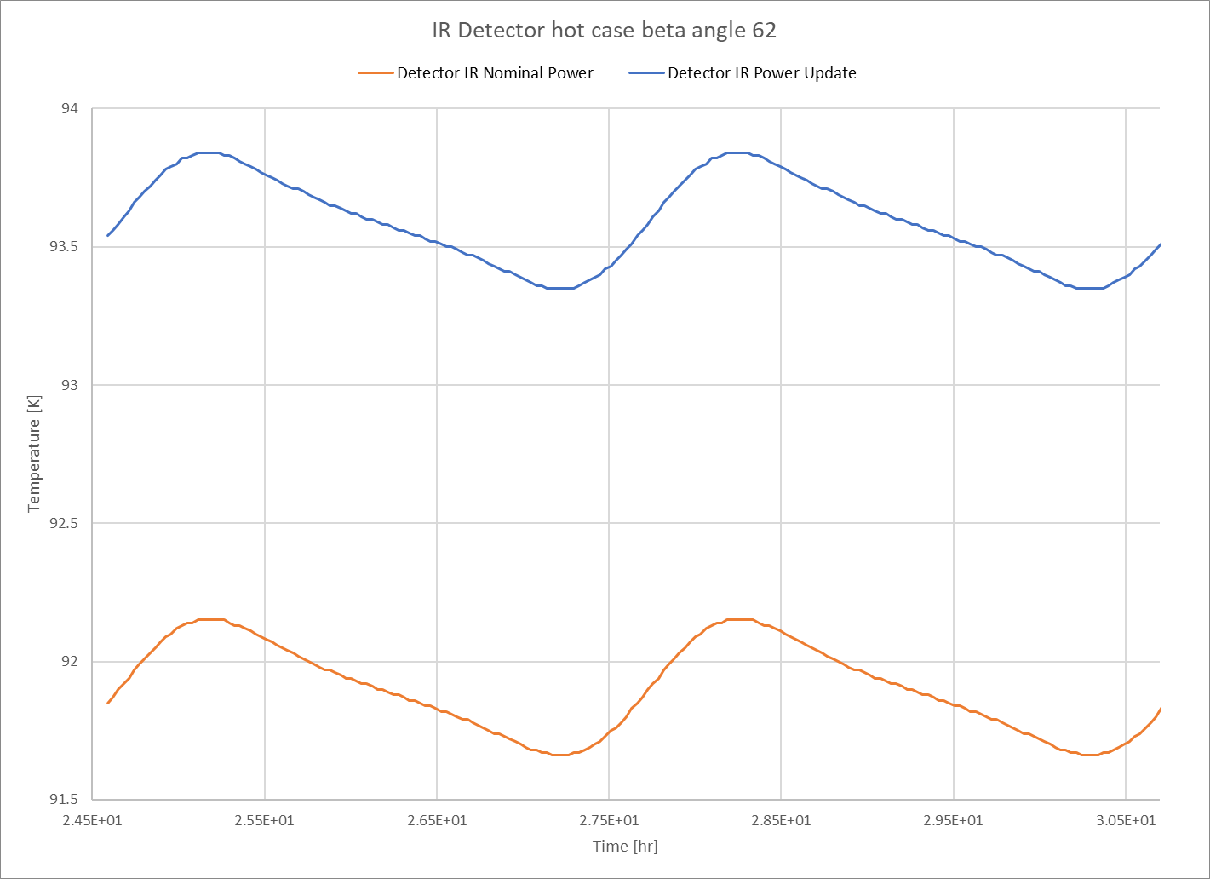
Effect of new detectors power dissipation GCO 500km, beta 62°, hot S/C, IR detector

Slide 9
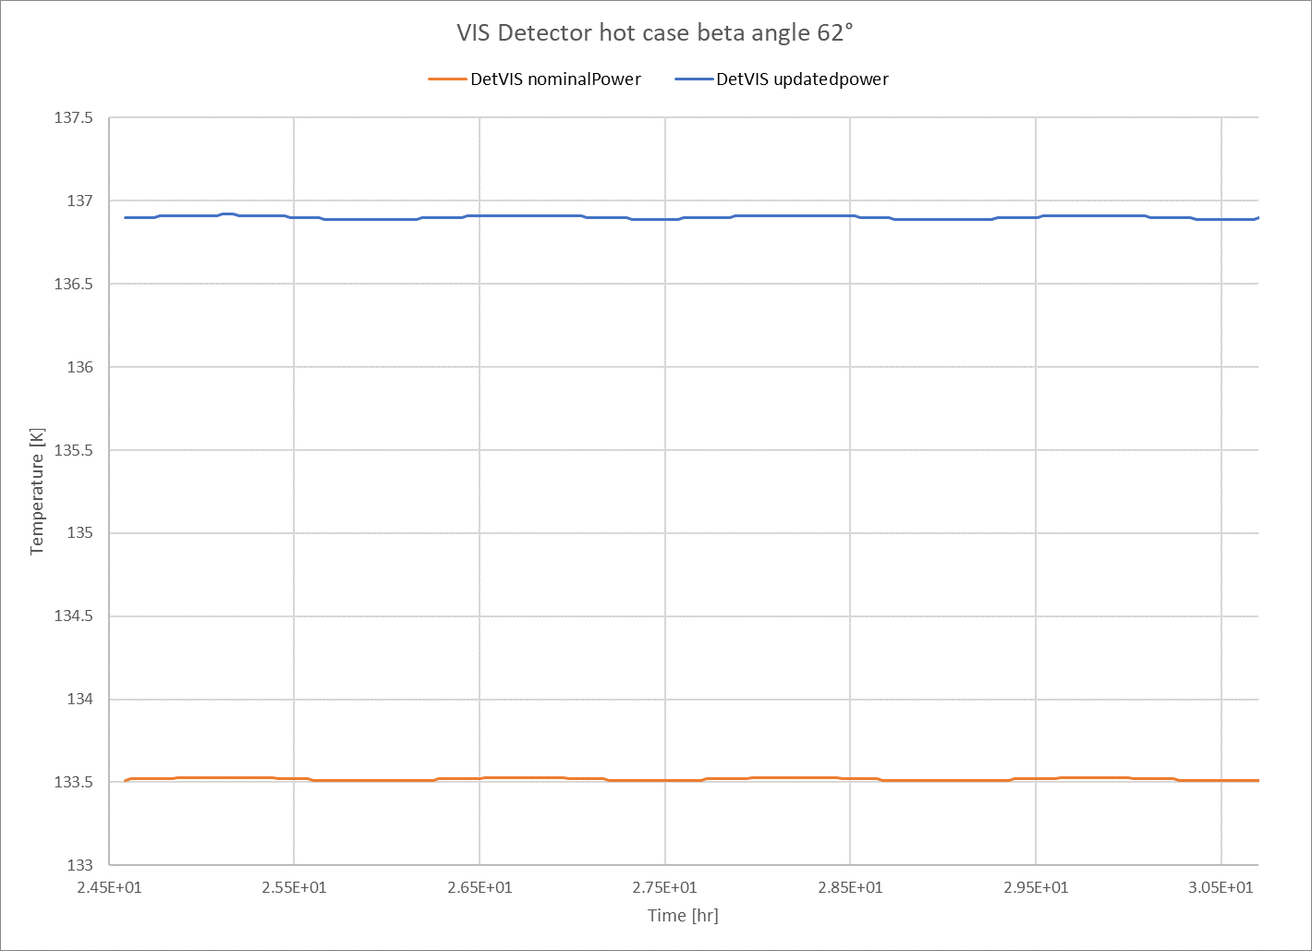
Effect of detectors power dissipation GCO 500km, beta 62°, hot S/C, VIS detector

Slide 10
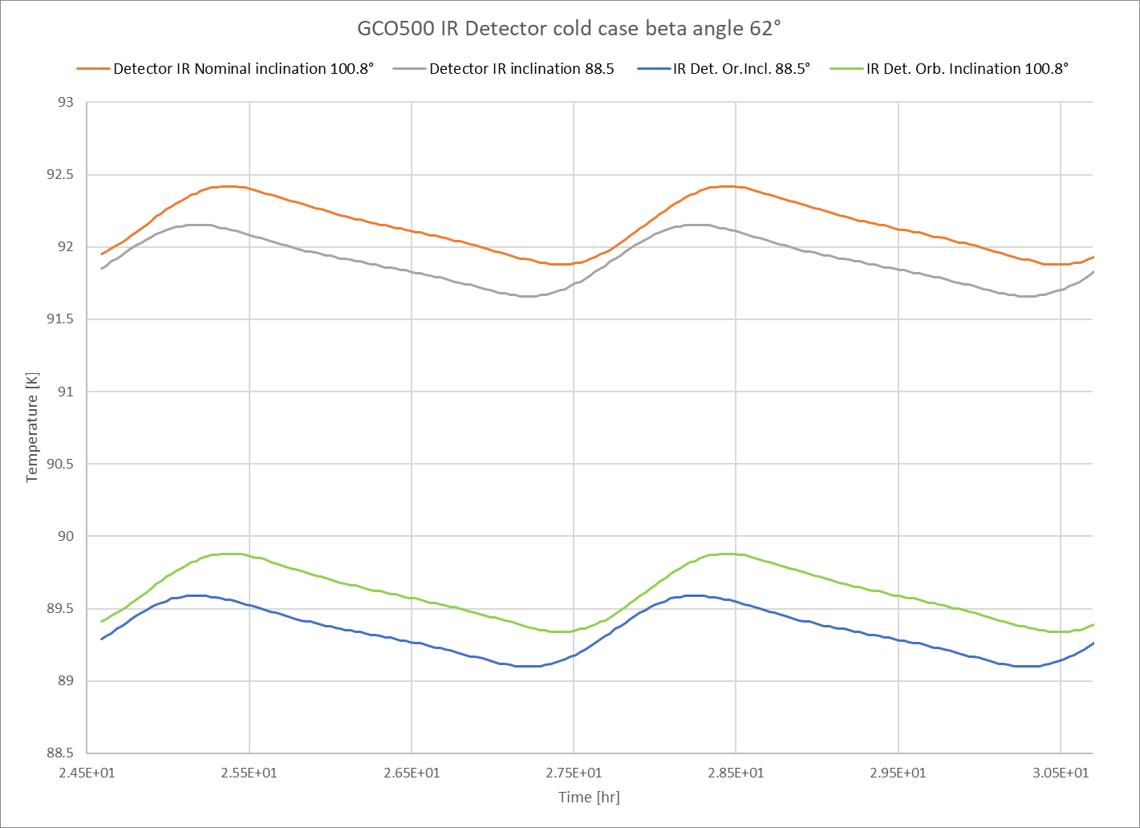
Effect of orbit inclination GCO 500km, beta 62°, hot S/C, IR detector

Slide 11
Effect of orbit inclination GCO 500km, beta 62°, hot S/C, VIS detector

Slide 12
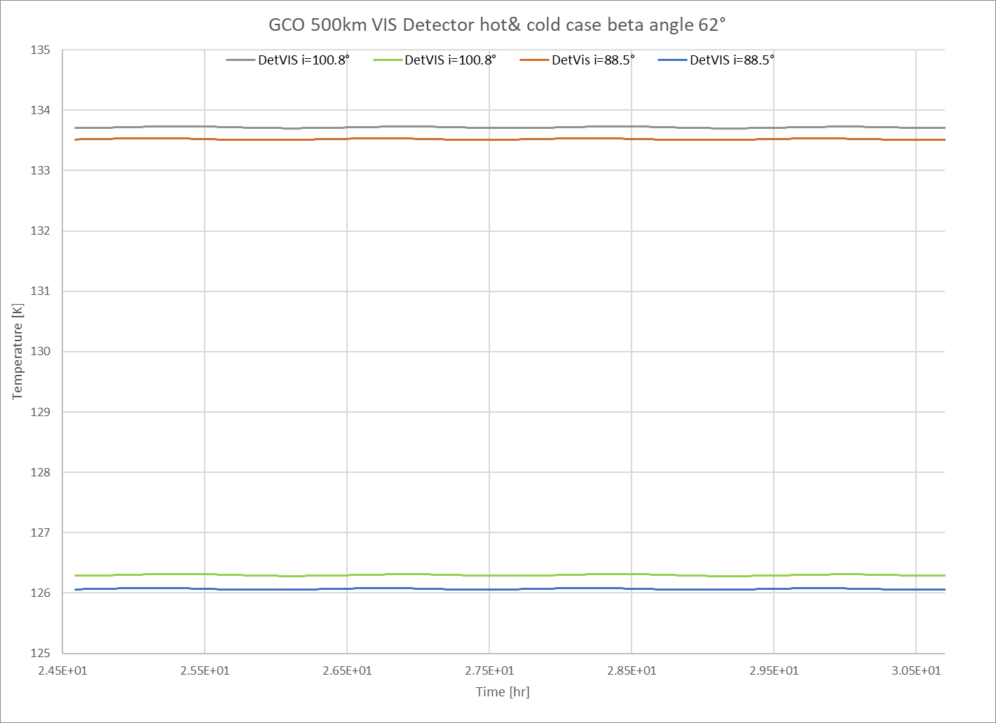
New orbit inclination GCO 500km, beta 62°, VIS detector

Slide 13
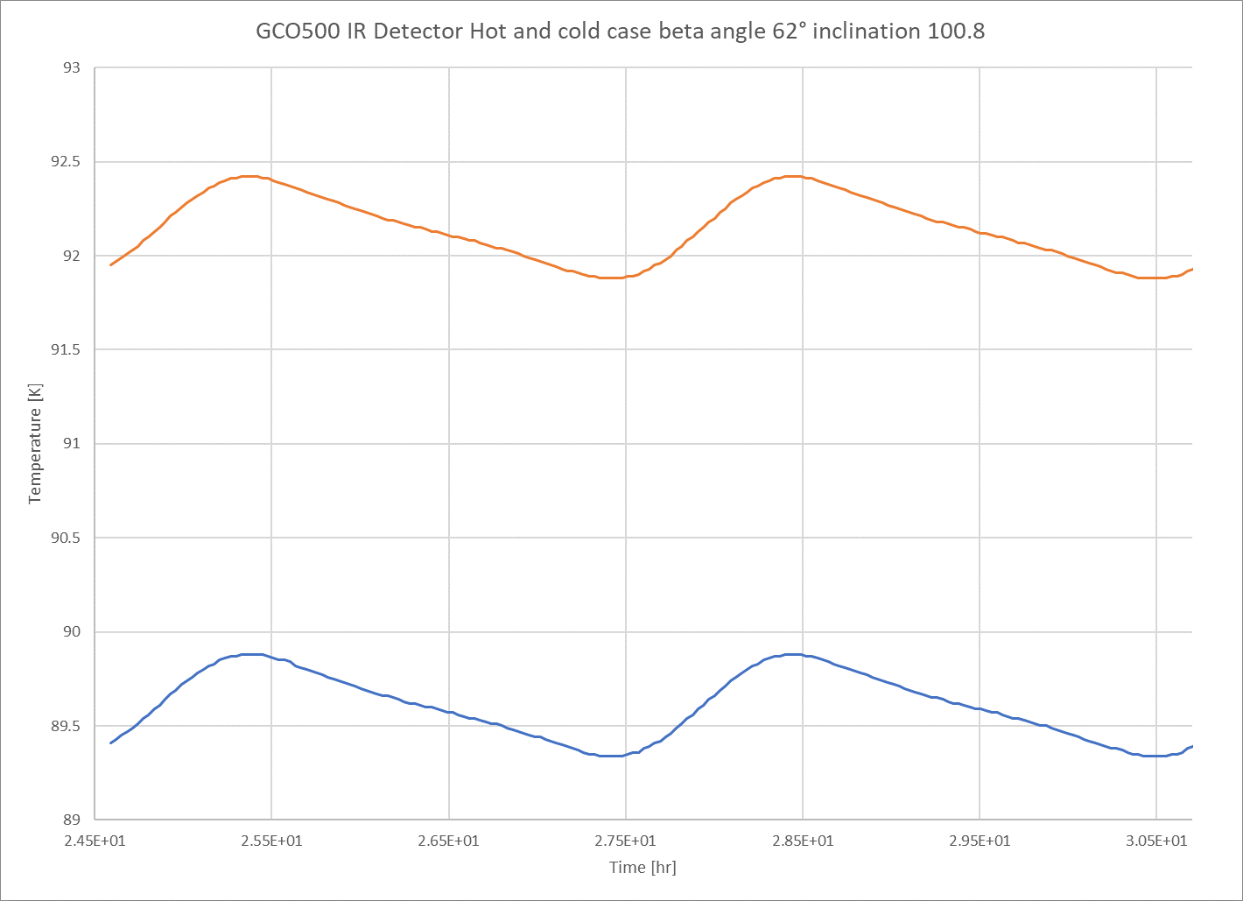
New orbit inclination GCO 500km, beta 62°, IR detector

Slide 14
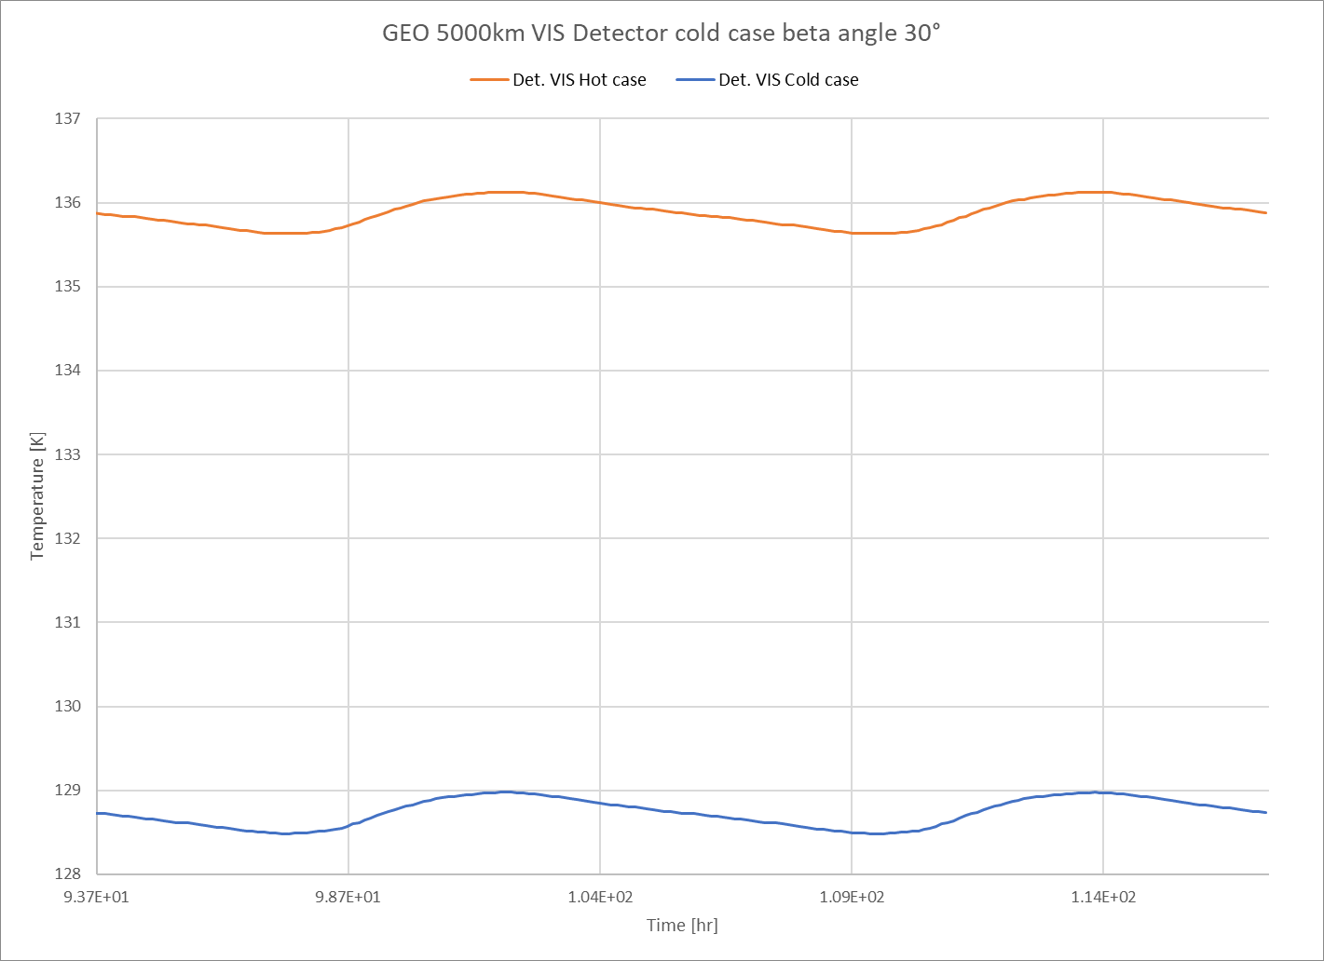
GEO 5000km, beta 30° Hot&Cold S/C VIS detector

Slide 15
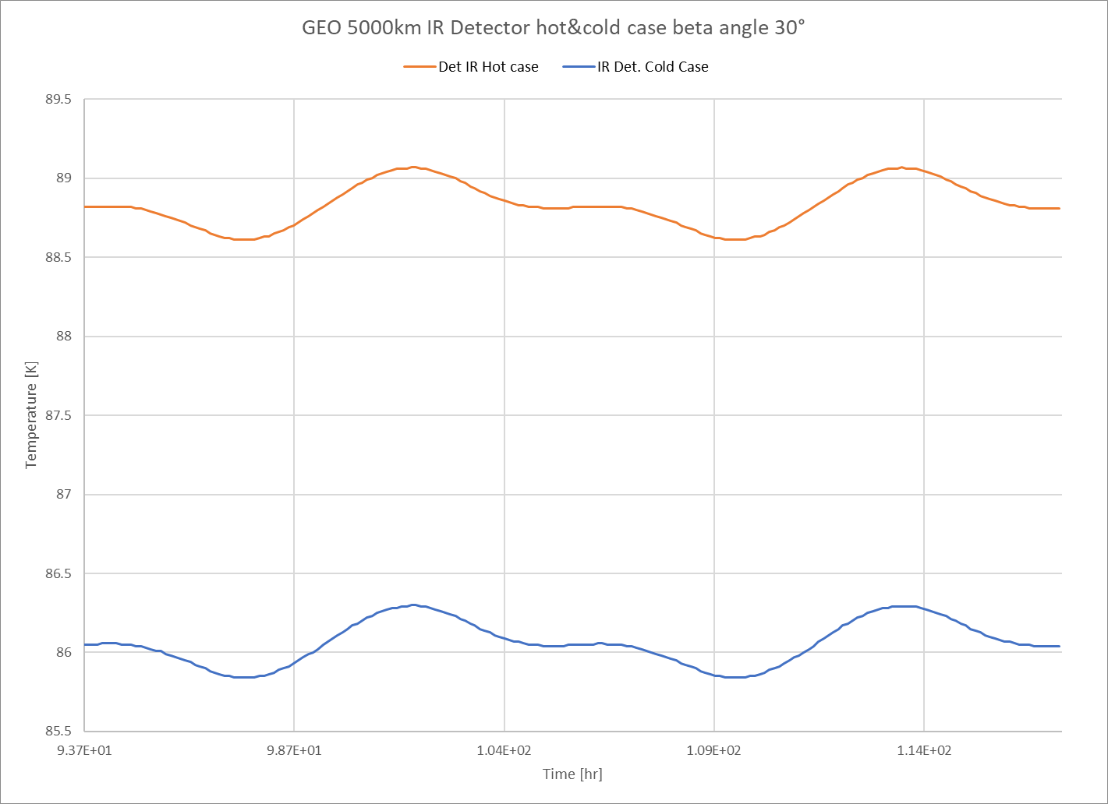
GEO 5000km, beta 30° Hot&Cold S/C, IR detector

Slide 16
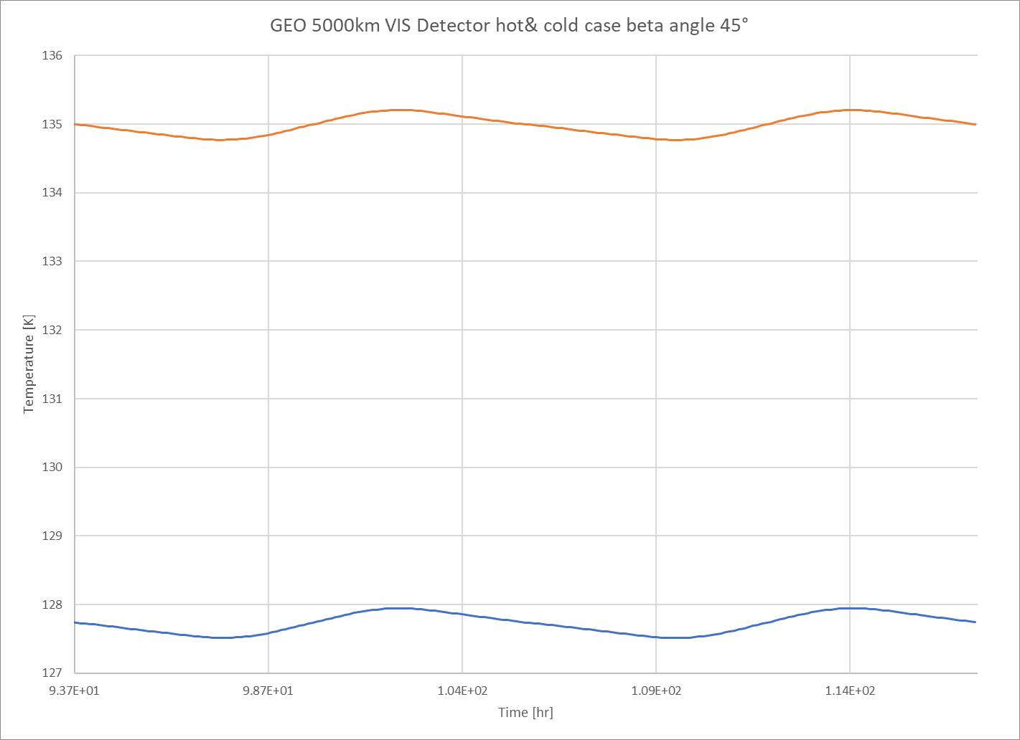
GEO 5000km, beta 45°, Hot &cold S/C VIS detetctor

Slide 17
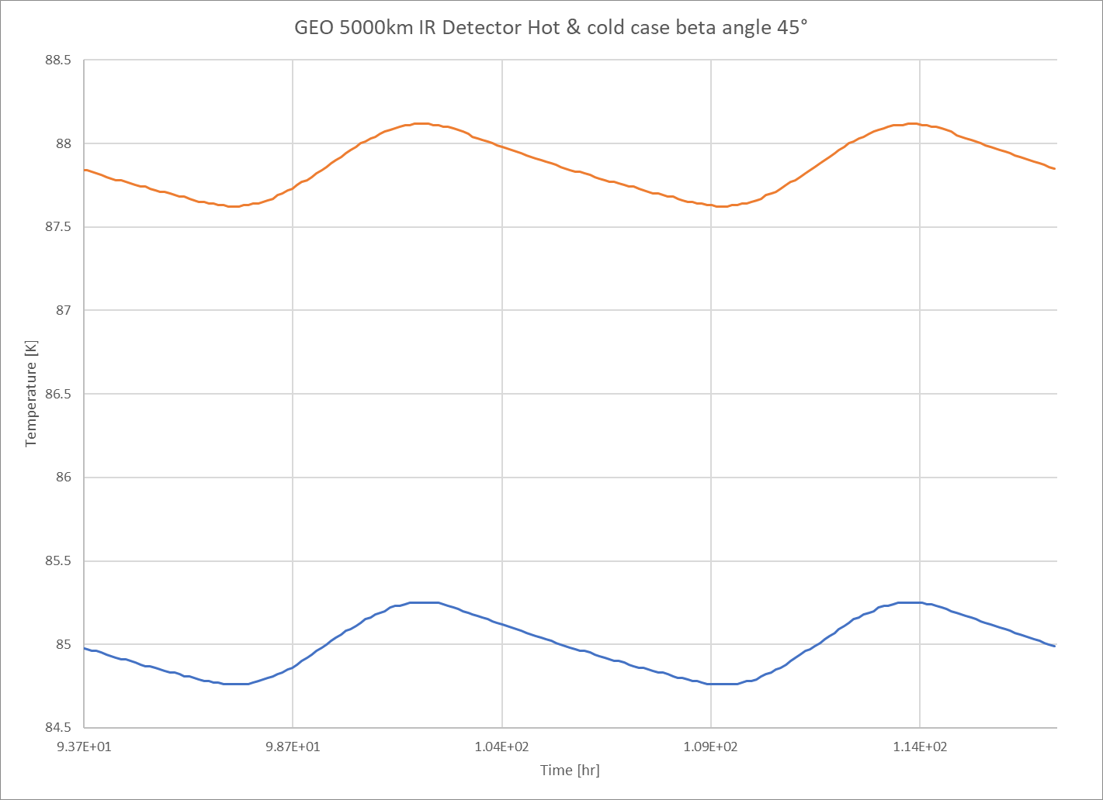
GEO 5000km, beta 45°, hot S/C IR detector

Slide 18
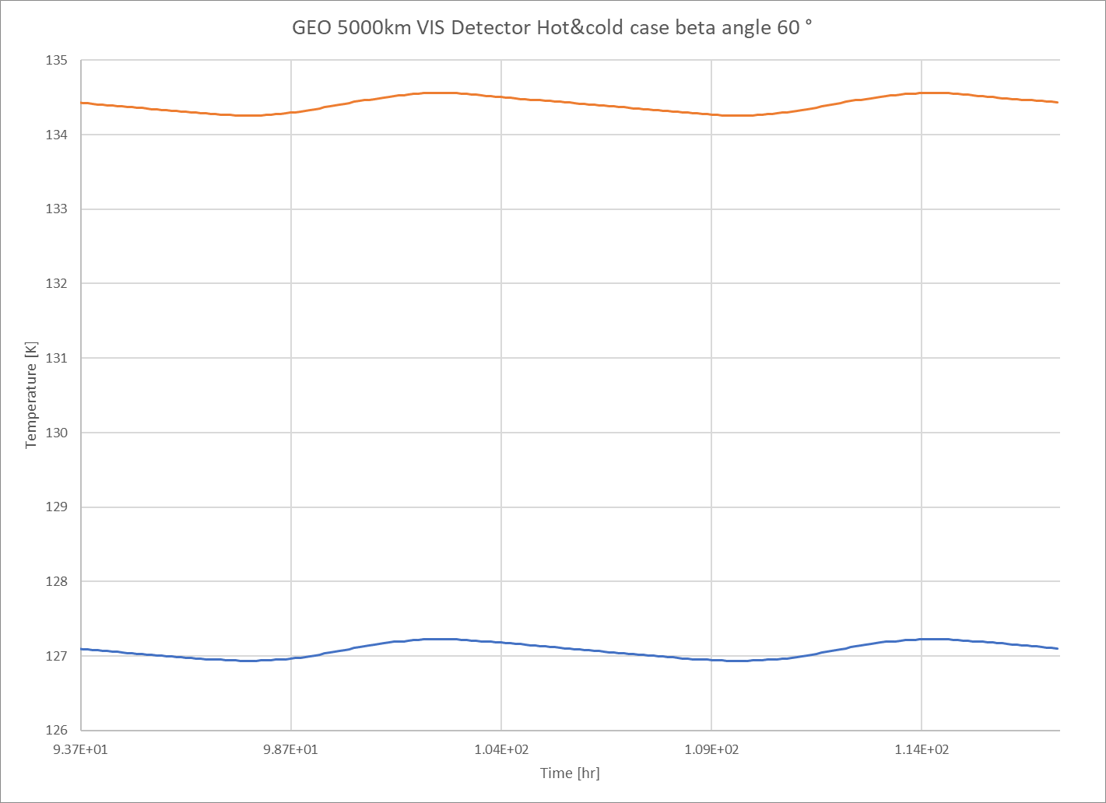
GEO 5000km, beta 60°, Hot&cold S/C VIS detetctor

Slide 19
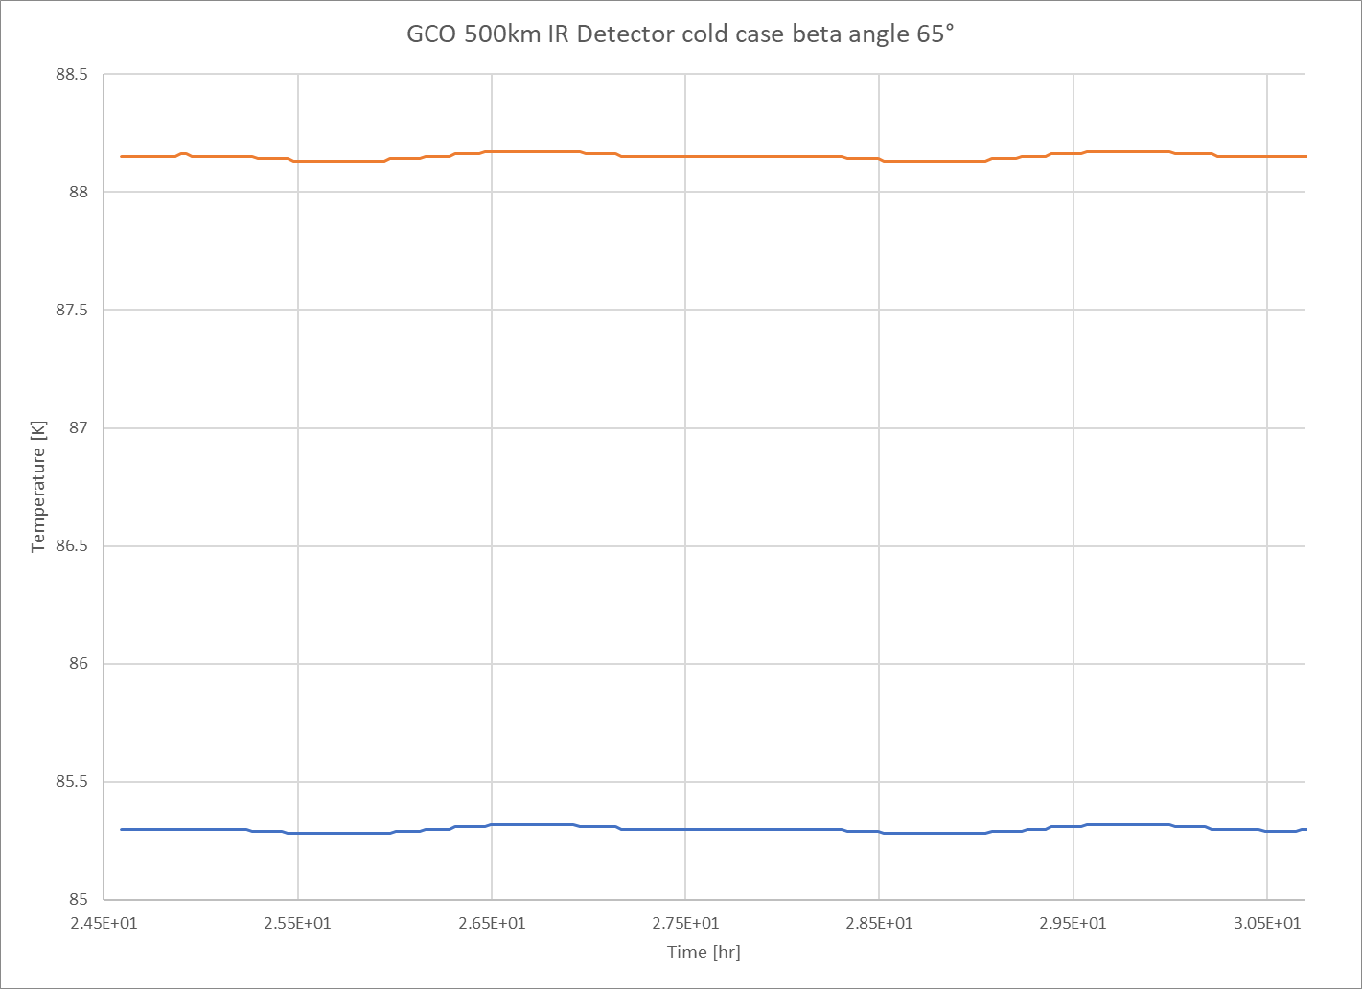
GEO 5000km, beta 60°, hot&cold S/C IR detector

Slide 20
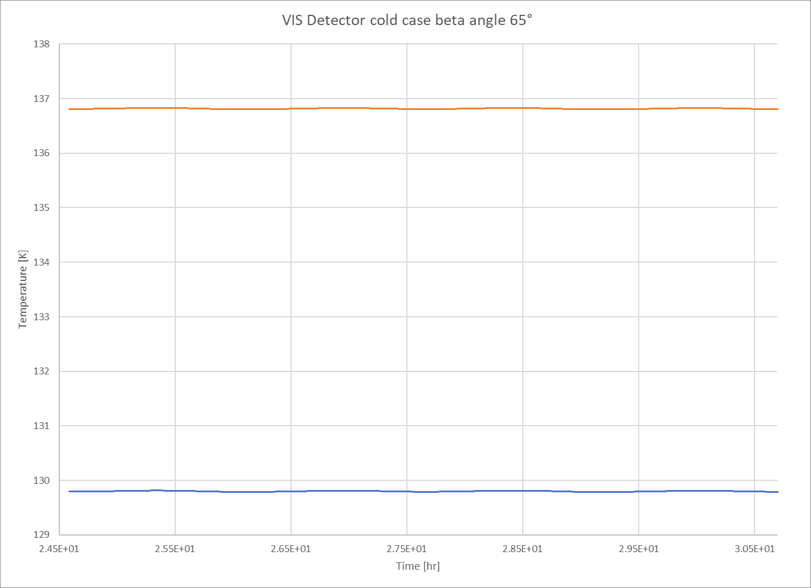
GCO 500km, beta 65°, Hot&cold S/C VIS detector

Slide 21
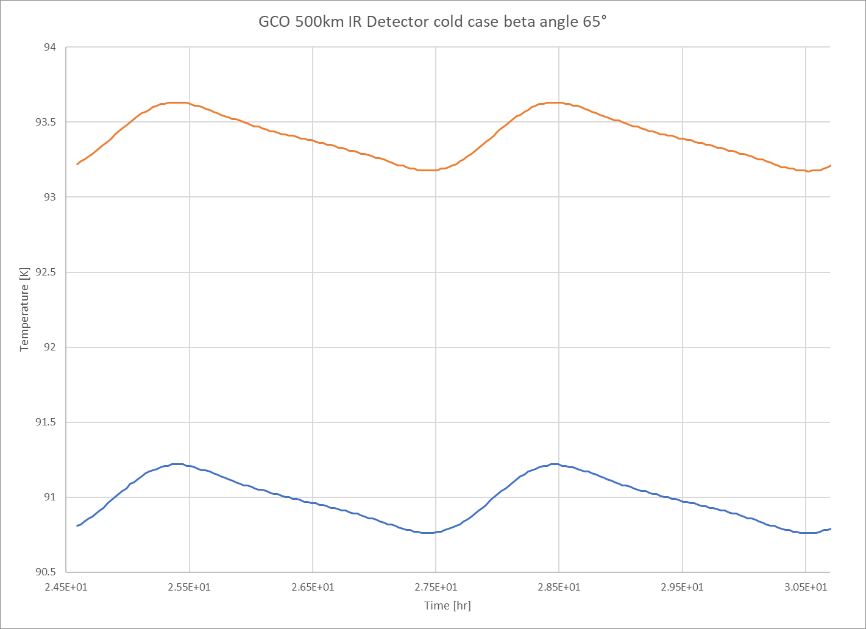
GCO 500km, beta 65°, hot&cold S/C IR detector

Slide 22
Conclusions
Detectors Power dissipation is a key factor, accurate values and profiles are needed to perform meaningful analysis
The changes in orbit inclination at GCO has a small inpact on the
During GEO the operation is always possible with some margin on the temperature requirements

