Slide 1
JUICE WG2 activities
Federico Tosi

Slide 2
After the JUICE SWT#13, held on 7 March 2019 at ESTEC, it was agreed to resume the WG activities with two main tasks:
Support the update of the Level-0 data volume ‘case 4’ (which minimizes the data volume carry over prior to Ganymede orbit insertion);
Study the Ganymede orbital phase.

Slide 3
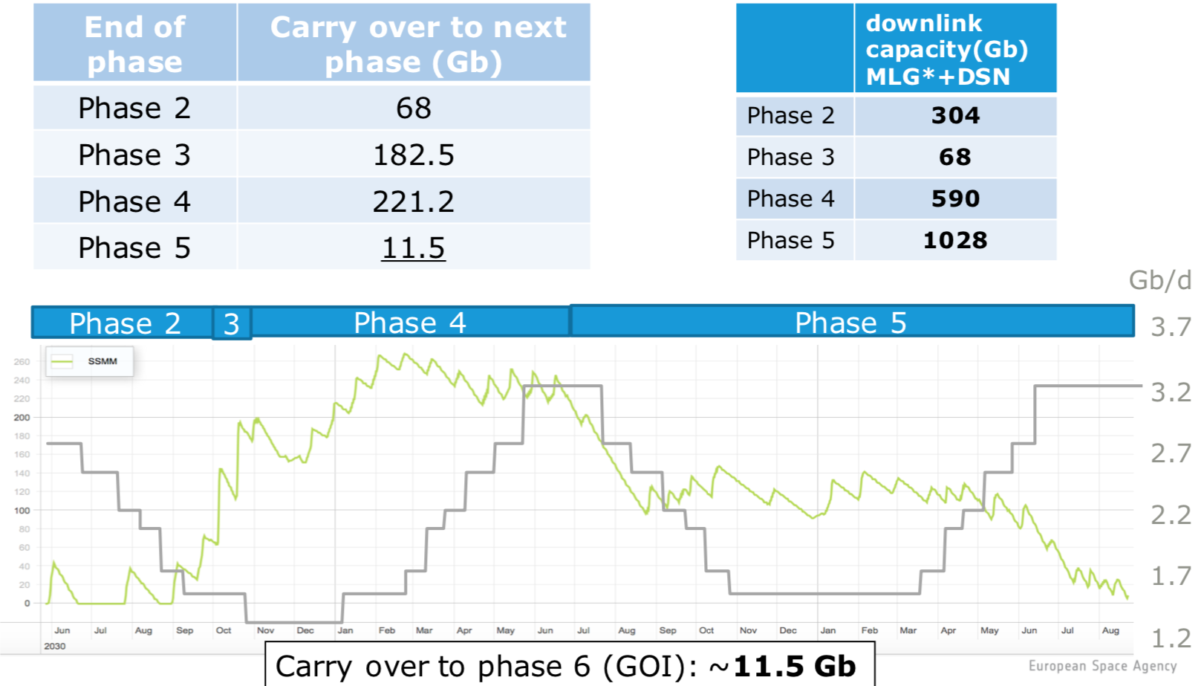

Slide 4
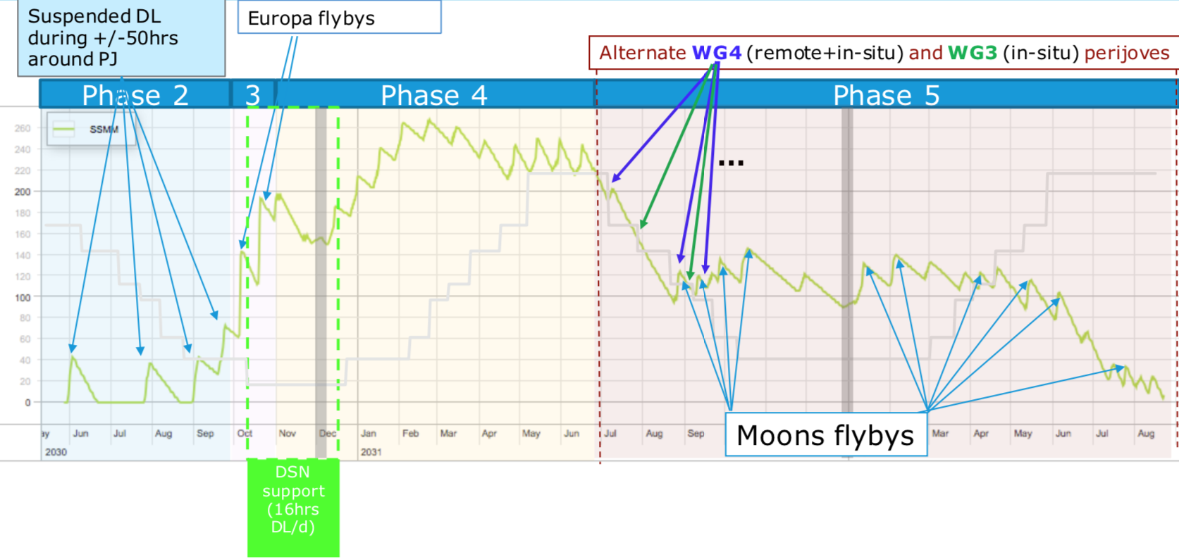

Slide 5
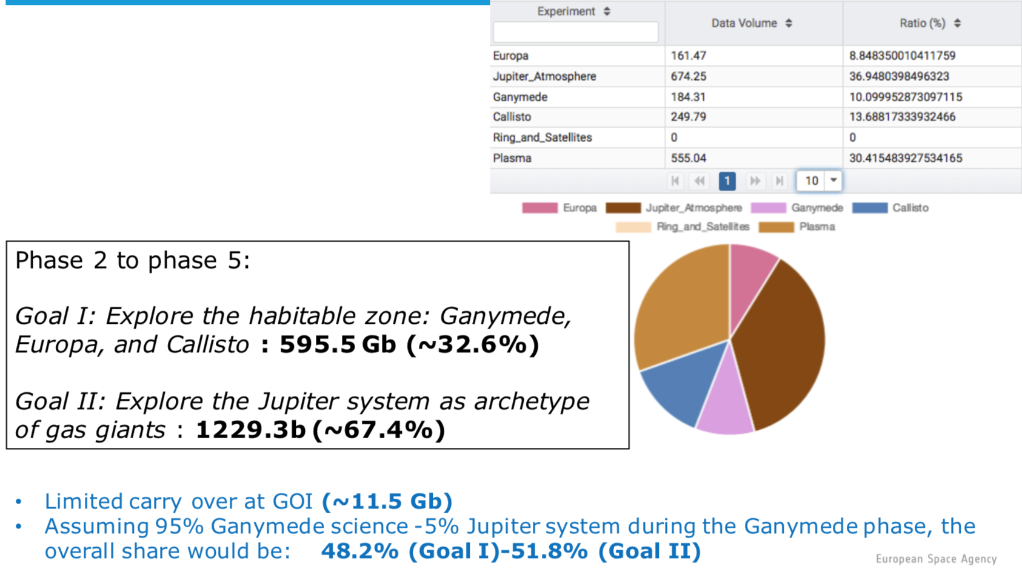

Slide 6
Regarding Task 1, the following points were agreed:
2G2 flyby (the first usable flyby of Ganymede) will be boosted as much as possible.
The Callisto data share will be increased to reach at least 267 Gb. In particular, the data volume will increase for the 5C1 and 23C12 Callisto flybys.
The Ganymede flybys allocation will be reviewed based on WG2 inputs (iteration with the JANUS team might be needed).
Io, minor satellites observations and ring science will be added for a total data volume of at least 44 Gb.
Add radio occultations opportunities by moons if applicable.
WG2 leads can at any time provide some inputs. SOC/PS will come back regularly to WG2 leads to check the updates.

Slide 7
Task 2 is actually in the process of being discussed within WG1, WG2 and WG3.
In consultation with some of the SWT members, it was decided to retain version 3.0 of the trajectory for this first analysis. This version was chosen mainly because it currently offers a better overall surface coverage during GCO500 (w.r.t 3.2/4.1). The JUICE SOC will however make sure that future updates of the trajectory.
The WGs are requested:
To check the JUICE Red Book and Science Requirement Document for the Ganymede phase.
To analyse the trajectory CREMA 3_0 to find the relevant scientific opportunities. The WG are free to organise their work as they wish, although it is recommended to start with GEO, then GCO500, GEO and GCO500.
To provide a list of requirements.

Slide 8
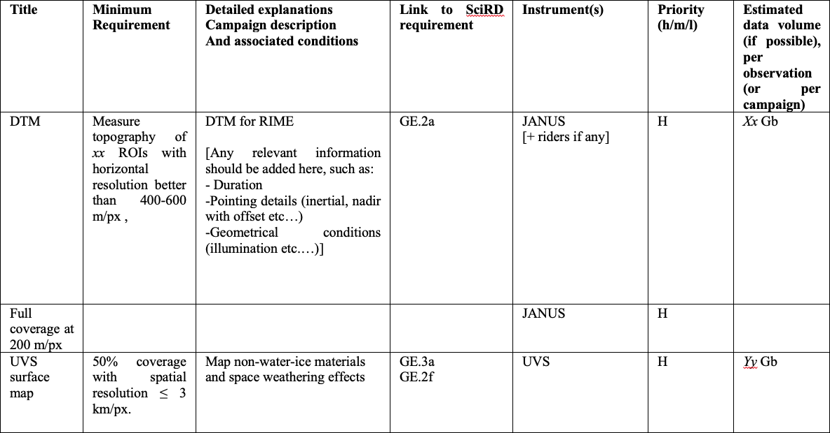
For each working group and for each subphase [GEO part 1, GCO5000, GEO part 2, GCO500 (and GCO200 if time allows)], the SOC would like to obtain a table like this one (it can be a xls file) (note that this is a starting point, to be iterated in the future):

Slide 9
A list of special campaigns with description and justification (e.g. multi-instrument auroral crossing in-situ and remote sensing observations).
Wishes, nice to have.
Recommendations for operations (like empty SSMM at the start of GCO500, calibrations).
WG2 telecon held on this subject on 27 June 2019 (six preliminary inputs received as of that date).
WG2 face-to-face meeting is scheduled at ESTEC on 29 October 2019 (last one was held on 2 March 2018, next one will probably come no earlier than 2021...).
Oral report from this WG2 meeting is due for the SWT#14 (scheduled on 31 October 2019).

